Slide 1

52 KNN Predict Movie Rating
Peter H. Chen

Slide 2
52 KNN Predict Movie Rating
https://www.udemy.com/course/data-science-and-machine-learning-with-python-hands-on/learn/lecture/4020708#overview
KNN Predict Movie Rating
We discuss the simple KNN (K-Nearest Neighbor) to predict the complicate problem, predicting the rating of a movie by genre and popularity infroamtion.

Slide 3
52 KNN (K-Nearest Neighbor)
https://www.udemy.com/course/data-science-and-machine-learning-with-python-hands-on/learn/lecture/4020708#overview
KNN (K-Nearest Neighbor)
KNN is a simple concept: define some distance metric between the items in your dataset, and find the K closest items.
You can then use those items to predict some property of a test item, by having them somehow "vote" on it.
As an example, let's look at the MovieLens data.
We'll try to guess the rating of a movie by looking at the 10 movies that are closest to it in terms of genres and popularity.

Slide 4
52.1 Read Movie Data

Slide 5
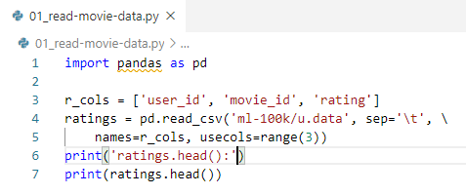
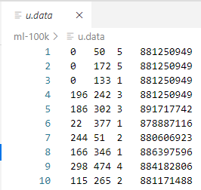
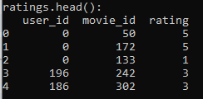
52.1 Read Movie Data
https://www.udemy.com/course/data-science-and-machine-learning-with-python-hands-on/learn/lecture/4020708#overview
Read Movie Data
KNN is a simple concept: define some distance metric between the items in your dataset, and find the K closest items.

Slide 6
52.2 Group by Movie ID

Slide 7
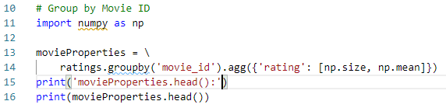
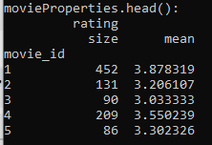
52.2 Group by Movie ID
https://www.udemy.com/course/data-science-and-machine-learning-with-python-hands-on/learn/lecture/4020708#overview
Group by Movie ID
We will group everything by movie ID, and compute the total number of ratings (each movie's popularity) and the average rating for every movie:

Slide 8
52.3 Normalize Movie Rating

Slide 9
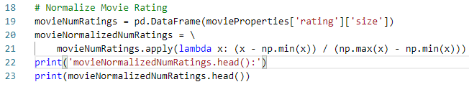
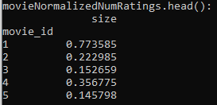
52.3 Normalize Movie Rating
https://www.udemy.com/course/data-science-and-machine-learning-with-python-hands-on/learn/lecture/4020708#overview
Normalize Movie Rating
The raw number of ratings isn't very useful for computing distances between movies.
We'll create a new DataFrame that contains the normalized number of ratings.
So, a value of 0 means nobody rated it, and a value of 1 will mean it's the most popular movie there is.

Slide 10
52.4 Normalize Movie Rating

Slide 11
52.3 Normalize Movie Rating
https://www.udemy.com/course/data-science-and-machine-learning-with-python-hands-on/learn/lecture/4020708#overview
Normalize Movie Rating
The raw number of ratings isn't very useful for computing distances between movies.
We'll create a new DataFrame that contains the normalized number of ratings.
So, a value of 0 means nobody rated it, and a value of 1 will mean it's the most popular movie there is.

Slide 12
52.4 Read Genre Data

Slide 13
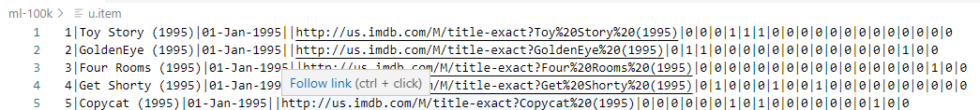
52.4 Read Genre Data
https://www.udemy.com/course/data-science-and-machine-learning-with-python-hands-on/learn/lecture/4020708#overview
Read Genre Data
Read the genre information from the u.item file.
The way this works is there are 19 fields, each corresponding to a specific genre - a value of '0' means it is not in that genre, and '1' means it is in that genre.
A movie may have more than one genre associated with it.
While we're at it, we'll put together everything into one big Python dictionary called movieDict.
Each entry will contain the movie name, list of genre values, the normalized popularity score, and the average rating for each movie:

Slide 14
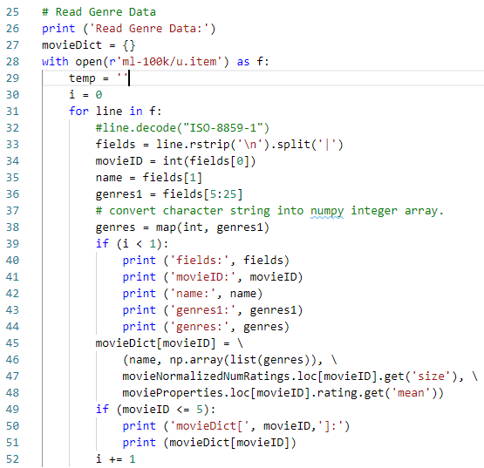
52.4 Read Genre Data
https://www.udemy.com/course/data-science-and-machine-learning-with-python-hands-on/learn/lecture/4020708#overview
Read Genre Data

Slide 15
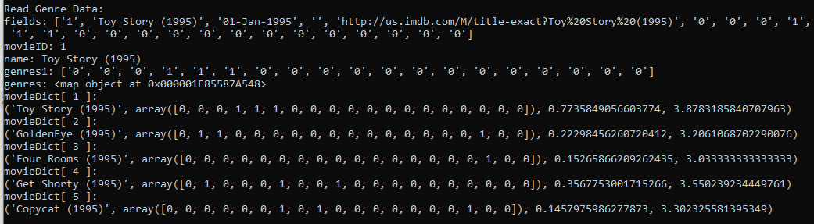
52.4 Read Genre Data
https://www.udemy.com/course/data-science-and-machine-learning-with-python-hands-on/learn/lecture/4020708#overview
Read Genre Data

Slide 16
52.5 Compute Distance

Slide 17
52.5 Compute Distance
https://www.udemy.com/course/data-science-and-machine-learning-with-python-hands-on/learn/lecture/4020708#overview
Compute Distance
Now let's define a function that computes the "distance" between two movies based on how similar their genres are, and how similar their popularity is.
We will compute the distance between movie ID's 2 and 4.
Note:
The higher the distance, the less similar the movies are.
Let's check what movies 2 and 4 actually are - and confirm they're not really all that similar:

Slide 18
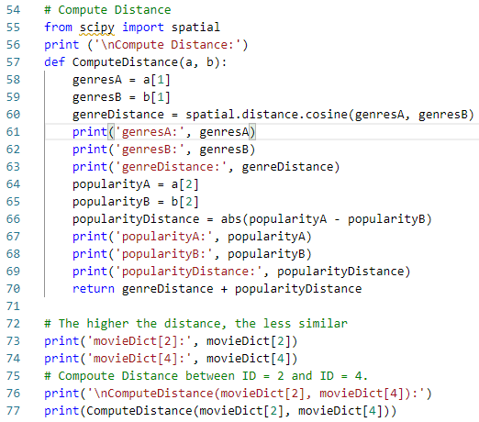
52.5 Compute Distance
https://www.udemy.com/course/data-science-and-machine-learning-with-python-hands-on/learn/lecture/4020708#overview
Compute Distance

Slide 19
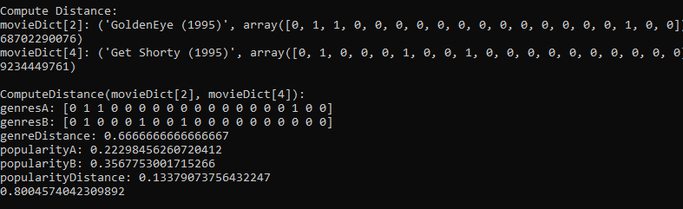
52.5 Compute Distance
https://www.udemy.com/course/data-science-and-machine-learning-with-python-hands-on/learn/lecture/4020708#overview
Compute Distance

Slide 20
52.6 Toy Story Compute Distance

Slide 21
52.6 Toy Story Compute Distance
https://www.udemy.com/course/data-science-and-machine-learning-with-python-hands-on/learn/lecture/4020708#overview
Test Compute Distance for ‘Toy Story’
Compute the distance between some given test movie (Toy Story)
All of the movies in our data set.
When the sort those by distance, and print out the K nearest neighbors:

Slide 22
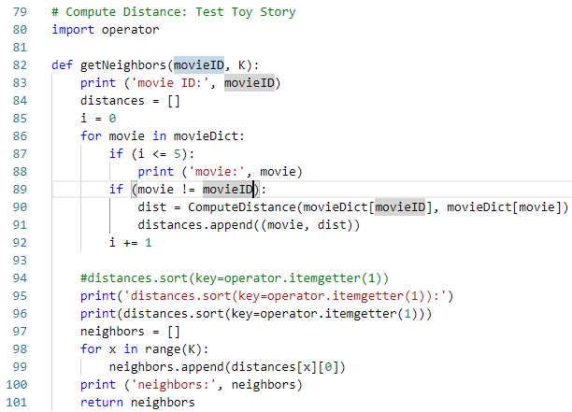
52.6 Toy Story Compute Distance
https://www.udemy.com/course/data-science-and-machine-learning-with-python-hands-on/learn/lecture/4020708#overview
Compute Distance

Slide 23
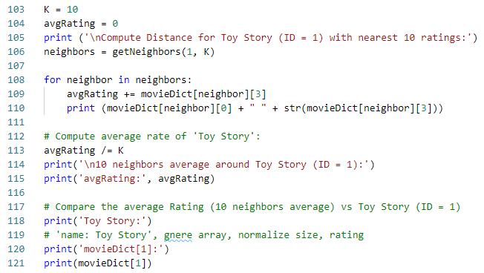
52.6 Toy Story Compute Distance
https://www.udemy.com/course/data-science-and-machine-learning-with-python-hands-on/learn/lecture/4020708#overview
Compute Distance

Slide 24
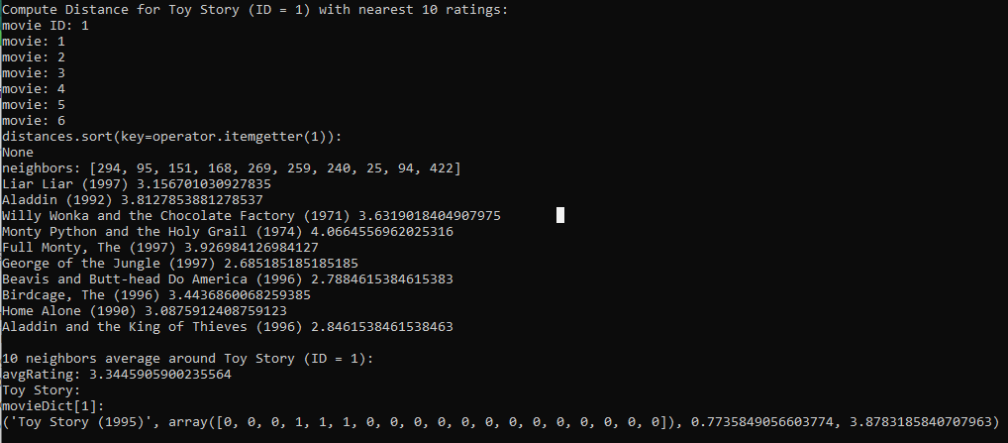
52.6 Toy Story Compute Distance
https://www.udemy.com/course/data-science-and-machine-learning-with-python-hands-on/learn/lecture/4020708#overview
Compute Distance
The average rate = 3.34 for 10 neighbors (based on similar popularity)
The Toy Story rate = 3.8 (based on normalized popularity size = 0.77)

Slide 25
52.7 Exercise

Slide 26
52.7 Exercise
https://www.udemy.com/course/data-science-and-machine-learning-with-python-hands-on/learn/lecture/4020708#overview
Exercise
1. Our choice of 10 for K was arbitrary: what effect do different K values (K = 100) have on the results?
2. Our distance metric was also somewhat arbitrary - we just took the cosine distance between the genres and added it to the difference between the normalized popularity scores. Can you improve on that?

Slide 27

52.7 Exercise
https://www.udemy.com/course/data-science-and-machine-learning-with-python-hands-on/learn/lecture/4020708#overview
Exercise
1. Our choice of 10 for K was arbitrary: what effect do different K values (K = 100) have on the results?
Ans:
10 neighbor: average rate = 3.3445
100 neighbor: average rate = 3.30
Average rate reduce with large neighbors.

Slide 28
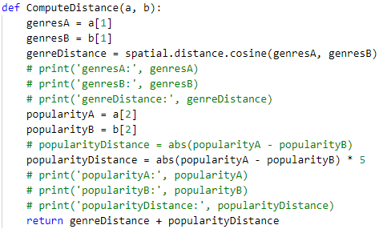


52.7 Exercise
https://www.udemy.com/course/data-science-and-machine-learning-with-python-hands-on/learn/lecture/4020708#overview
Exercise
2. Our distance metric was also somewhat arbitrary - we just took the cosine distance between the genres and added it to the difference between the normalized popularity scores. Can you improve on that?
Ans:
Increase the effect of distance by multiple 5 times for the same K neighbors.
The average rating increase from 3.3 to 3.7.

Slide 29
End of Chapter

