Slide 1

80 Spark Search
Peter H. Chen

Slide 2
80 Spark Search
https://github.com/peterhchen/900_Python_ML_DS_DL
Wikipedia Spark Search
We use the 01_spark-tf-idf.py

Slide 3
80.1 Import Package

Slide 4
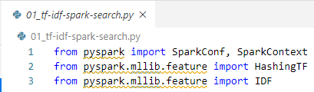
80.1 Import Package
https://github.com/peterhchen/900_Python_ML_DS_DL
Import Package
Import SparkConf and SparkContext functions from pySpark package
Import HashingTF function from PySpark MLLib package.
Import IDF function from pySpak MLLib package.

Slide 5
80.2 Create Spark Conf and Context

Slide 6

80.2 Create Spark Conf and Context
https://github.com/peterhchen/900_Python_ML_DS_DL
Create Spark Conf and Context
Create Spark configuration and Spark Context.

Slide 7
80.3 Read Small Article

Slide 8
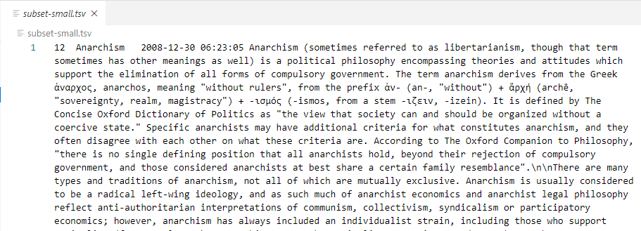
80.3 Read Small Article
https://github.com/peterhchen/900_Python_ML_DS_DL
Read Small Article
Open the file “subset-small.tsv” with VS Code.
Hard to read. It is tsv, the tab (\t) separate value.

Slide 9
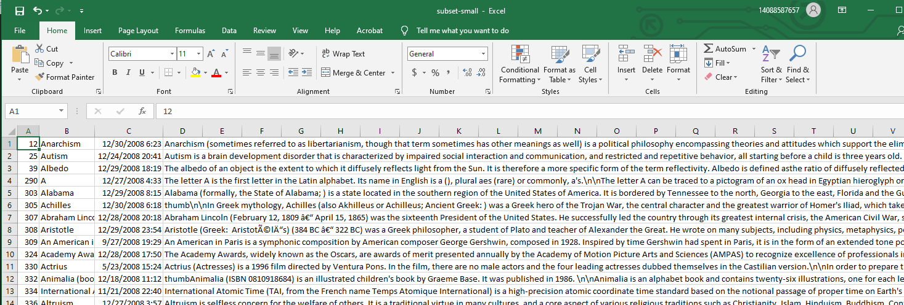
80.3 Read Small Article
https://github.com/peterhchen/900_Python_ML_DS_DL
Read Small Article
Start MS-Excel, open all files, open “subset-msall.tsv”

Slide 10
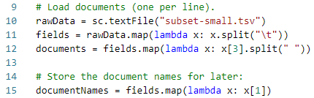
80.3 Read Small Article
https://github.com/peterhchen/900_Python_ML_DS_DL
Read Small Article
Read the text file “subset-small.tsv”.
Data split with “\t” into fields.
Fields split with x[3] is the body of text. Split with “ “ into words of documents.

Slide 11
80.4 Transform Gettysburg

Slide 12
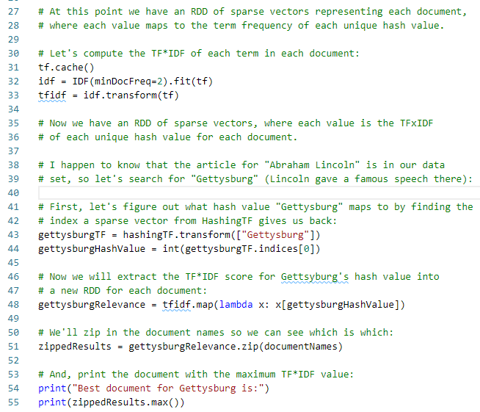
80.4 Transform Gettysburg
https://github.com/peterhchen/900_Python_ML_DS_DL
Transform Gettysburg

Slide 13
80.5 Run TF-IDF

Slide 14
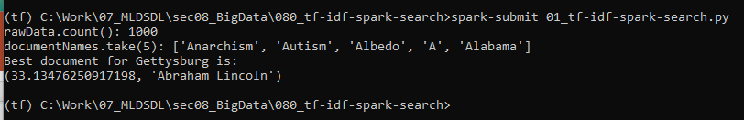
80.5 Run TF-IDF
https://github.com/peterhchen/900_Python_ML_DS_DL
Run
> spark-submit 01-idf-spark-search.py
Best document for Gettysburg is:
(33.1, “Abraham Lincoln’)

Slide 15
End of Chapter

