Slide 1

15 Standard Deviation and Variance
Peter H. Chen

Slide 2
15 Standard Deviation and Variance
https://www.udemy.com/course/data-science-and-machine-learning-with-python-hands-on/learn/lecture/4020096#overview
Variance Measure how “spread-out” the data is
Variance (σ²) is simple the average square differences form the mean.
Example: What is the variance of the data set (1, 4, 5, 4, 8)?
First, find the mean: (1+4+5+4+8)/5 = 4.4
Now, find the difference from the mean: (-3.4, -0.4, 0.6, -0.4, 4.6)
Find the squared differences: (11.56, 0.16, 0.36, 0.16, 12.96)
Find the average of the squared differences:
Variance (σ²) = (11.56+0.16+0.36+0.16+12.96)/5 = 5.04

Slide 3
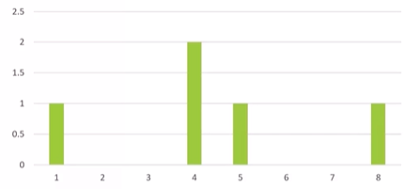
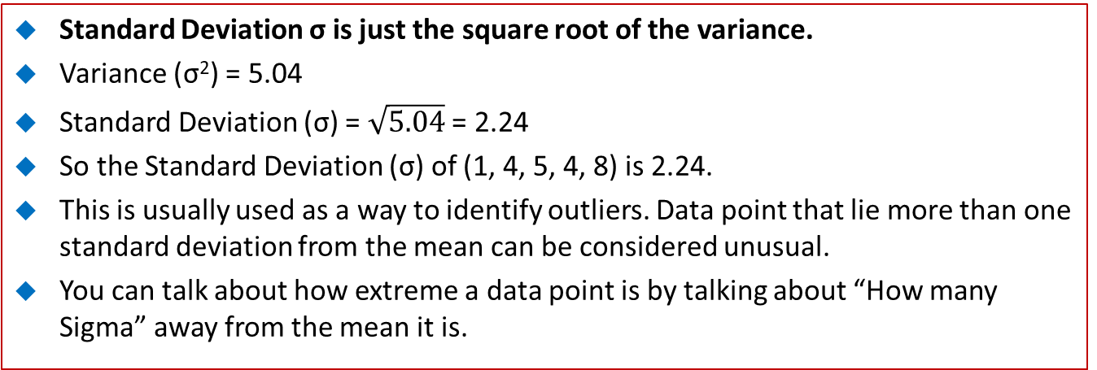
15 Standard Deviation and Variance
https://www.udemy.com/course/data-science-and-machine-learning-with-python-hands-on/learn/lecture/4020096#overview
Standard Deviation σ is just the square root of the variance.
Variance (σ²) = 5.04
Standard Deviation (σ) = $\sqrt{5.04}$ = 2.24
So the Standard Deviation (σ) of (1, 4, 5, 4, 8) is 2.24.
This is usually used as a way to identify outliers. Data point that lie more than one standard deviation from the mean can be considered unusual.
You can talk about how extreme a data point is by talking about “How many Sigma” away from the mean it is.

Slide 4
15 Standard Deviation and Variance
https://www.udemy.com/course/data-science-and-machine-learning-with-python-hands-on/learn/lecture/4020096#overview
Population vs. Sample
If you work with a sample of data instead of an entire data set (the entire population)…
Then you want use the “sample variance” instead of the “population variance”.
Sample is a large data set.
For N samples, you just divide the squared variances by N-1 instead of N.
So, in our example, we compute the population variance:
Population Variance (σ²) = (11.56+0.16+0.36+0.16+12.96)/5 = 5.04
But the sample variance would be:
Sample Variance (S²) = (11.56+0.16+0.36+0.16+12.96)/4 = 6.3

Slide 5
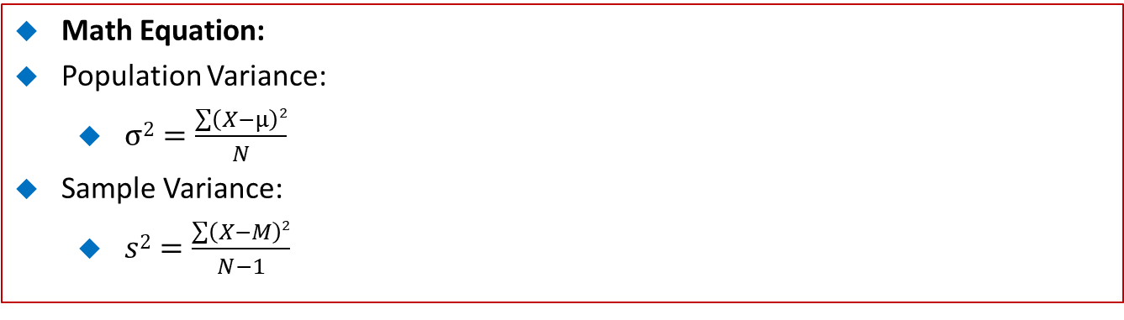
15 Standard Deviation and Variance
https://www.udemy.com/course/data-science-and-machine-learning-with-python-hands-on/learn/lecture/4020096#overview
Math Equation:
Population Variance:
$σ2=\frac{\sum{\left(X−μ\right)2}}{N}$
Sample Variance:
$s2=\frac{\sum{\left(X−M\right)2}}{N−1}$

Slide 6
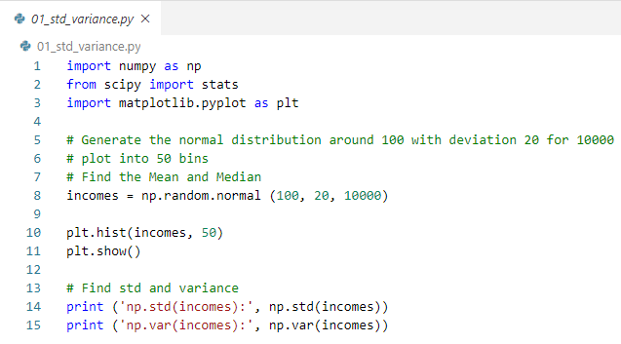
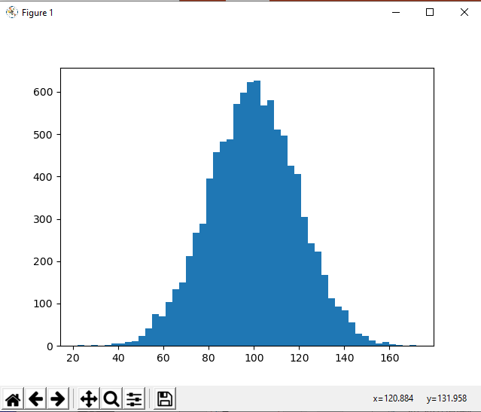

15 Standard Deviation and Variance
https://www.udemy.com/course/data-science-and-machine-learning-with-python-hands-on/learn/lecture/4020096#overview
Given Gaussian distribution with centered at 100 (mean) and scale 20 (standard deviation) for size 10000 (number of data point).
Find standard deviation and variance.

Slide 7
End of Chapter

