Slide 1

16 Probability Distribution Function
Peter H. Chen

Slide 2
16 Probability Distribution Function
https://www.udemy.com/course/data-science-and-machine-learning-with-python-hands-on/learn/lecture/4020106#overview
Example: a “normal distribution”
The Probability distribution function can be the continuous or discrete. In the continuous case, it is called PDF (probability density function). In the discrete case, it is called PMF (Probability Mass Function).

Slide 3
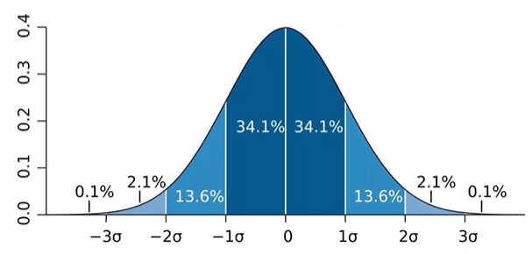
16 Probability Distribution Function
https://www.udemy.com/course/data-science-and-machine-learning-with-python-hands-on/learn/lecture/4020106#overview
Continuous PDF (Probability Density Function):
Given you the probability of data point falling within some give range of a give value: Probability density function to visualize the continuous distribution.

Slide 4
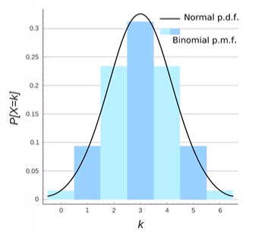
16 Probability Distribution Function
https://www.udemy.com/course/data-science-and-machine-learning-with-python-hands-on/learn/lecture/4020106#overview
Discrete PMF (Probability Mass Function):
To visualize the discrete data

Slide 5
End of Chapter

