Slide 1

17 Common Data Distribution
Peter H. Chen

Slide 2
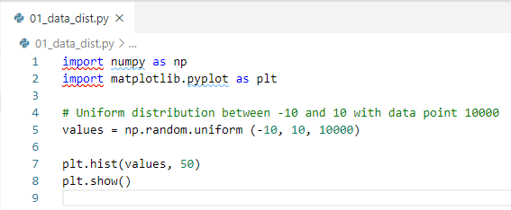
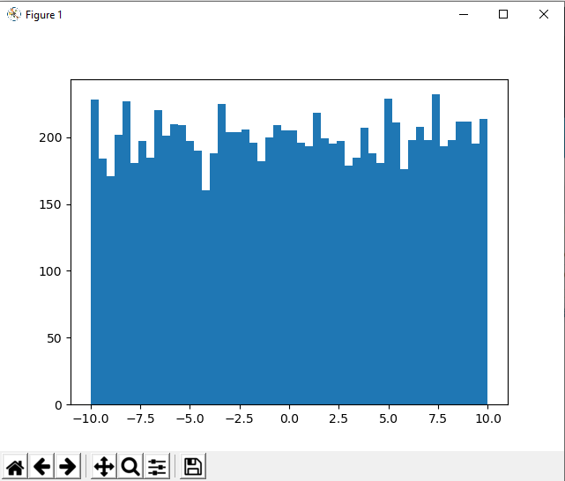
17 Common Data Distribution
https://www.udemy.com/course/data-science-and-machine-learning-with-python-hands-on/learn/lecture/4020100#overview
Data Distribution

Slide 3
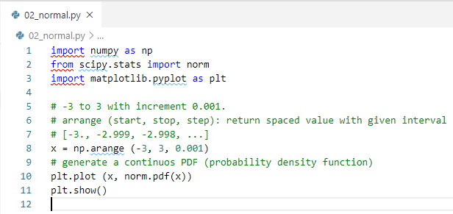
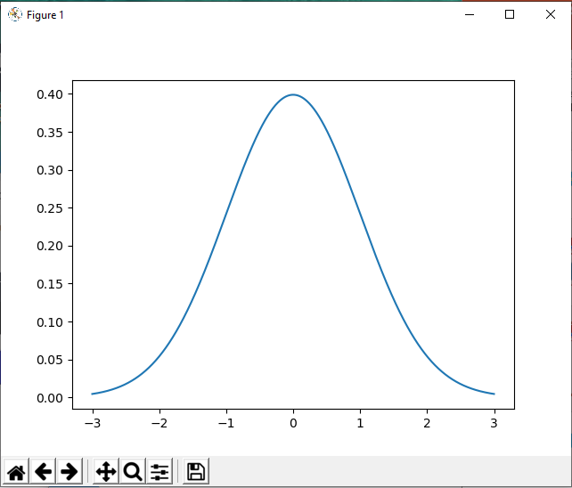
17 Common Data Distribution
https://www.udemy.com/course/data-science-and-machine-learning-with-python-hands-on/learn/lecture/4020100#overview
PDF (Probability Density Function): Continuous

Slide 4
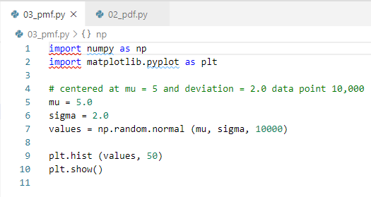
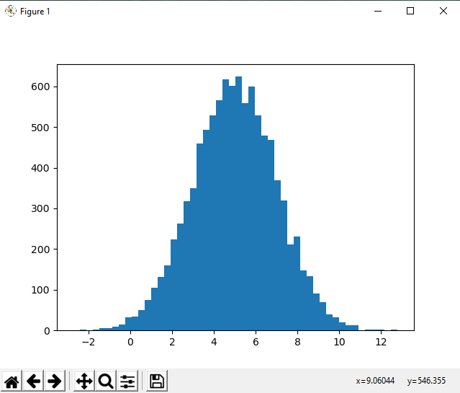
17 Common Data Distribution
https://www.udemy.com/course/data-science-and-machine-learning-with-python-hands-on/learn/lecture/4020100#overview
Normal Distribution

Slide 5
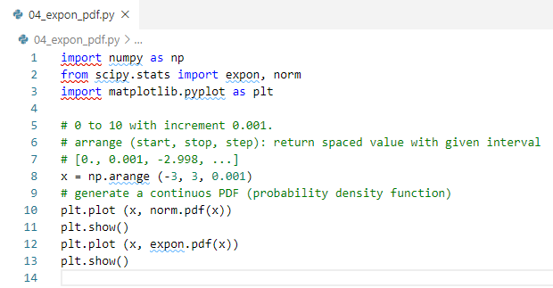
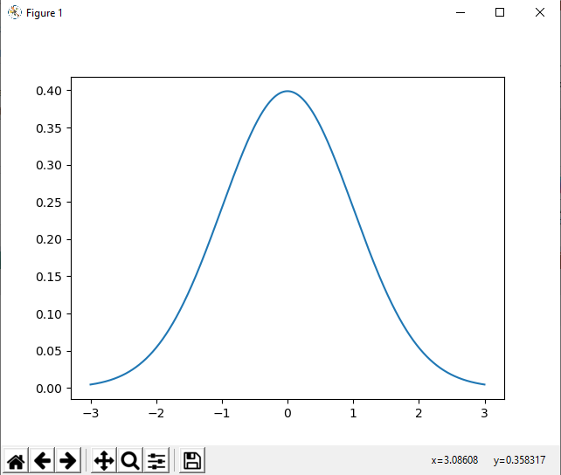
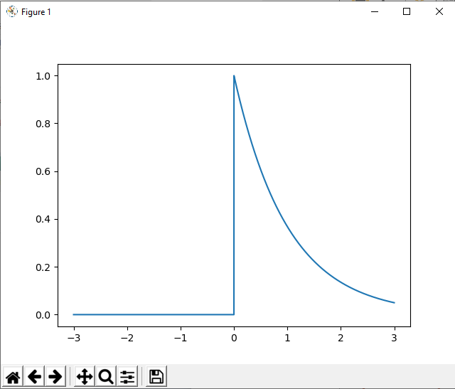
17 Common Data Distribution
https://www.udemy.com/course/data-science-and-machine-learning-with-python-hands-on/learn/lecture/4020100#overview
PDF and Exponential PDF Function

Slide 6
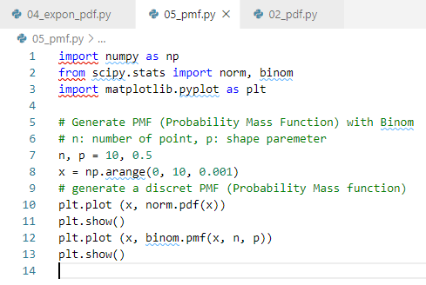
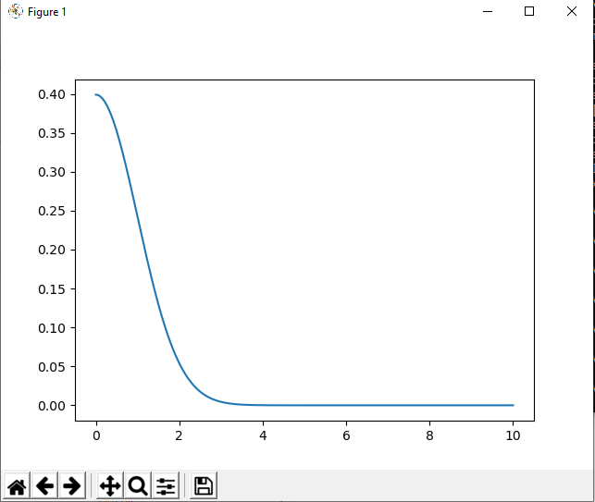
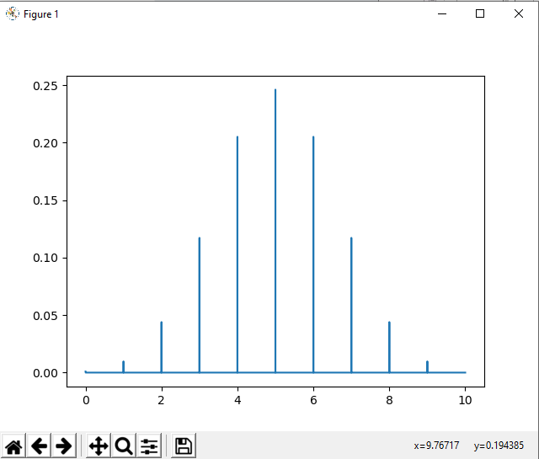
17 Common Data Distribution
https://www.udemy.com/course/data-science-and-machine-learning-with-python-hands-on/learn/lecture/4020100#overview
Binomial PMF (Probability Mass Function)

Slide 7
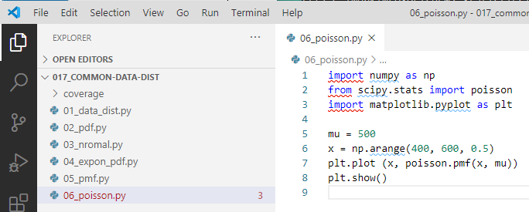
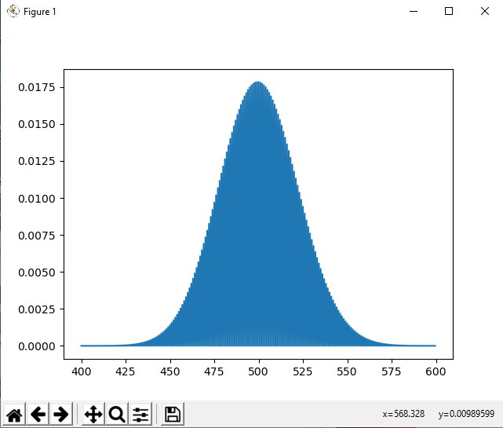
17 Common Data Distribution
https://www.udemy.com/course/data-science-and-machine-learning-with-python-hands-on/learn/lecture/4020100#overview
Binomial PMF (Probability Mass Function)

Slide 8
17 Common Data Distribution
https://www.udemy.com/course/data-science-and-machine-learning-with-python-hands-on/learn/lecture/4020100#overview
Quiz:
What is the equivalent of a probability distribution function when using discrete instead of continuous data?
Ans:
PMF (Probability Mass Function): Discrete function
There are two kinds of Probability Distribution Function,
If it is discrete, then we use PMF (Probability Mass Function): Discrete function
If continuous, we use PDF (Probability Density Function).

Slide 9
End of Chapter

