Slide 1

35 Entropy
Peter H. Chen

Slide 2
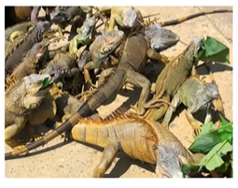
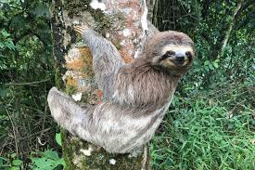
35 Entropy
https://www.udemy.com/course/data-science-and-machine-learning-with-python-hands-on/learn/lecture/4020558#overview
Entropy
Before we discuss Decision Tree algorithm, we need to understand the concept of Entropy in data science.
Entropy concept is from physics thermodynamics. It is a measure of data set’s disorder “how much of similarity or different it is.”
If we classify a data set into N different classes, for example, a data set of animal attributes and their species.
The entropy is 0 if all the classes in the data are the same animal (every animal is an Iguana).
The entropy is high if the data set are all different animal, such as, iguanas, pigs, sloths, and etc.
Note: Entropy is a fancy word for a simple concept “how much of sameness and differences throughout of the data”. Zero implies all the classes in the data are the same.
iguana
sloth

Slide 3
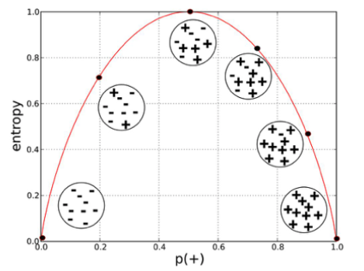
35 Entropy
https://www.udemy.com/course/data-science-and-machine-learning-with-python-hands-on/learn/lecture/4020558#overview
Computing Entropy
H(S) = -p₁ x ln (p₁) - … - p_{n} x ln (p_{n})
p_{i} represents the proportion of the data labeled for each class
Each term look like this:
https://towardsdatascience.com/entropy-how-decision-trees-make-decisions-2946b9c18c8
Flip a coin between 0 and 1. Both 0 or 1 has equal probability is 0.5 (Head or tail). The maximum probability (1) at 0.5 (either head or tail).

Slide 4
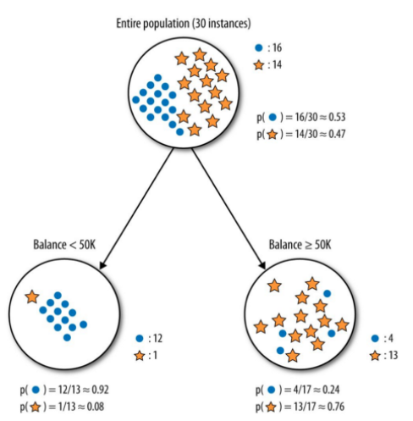
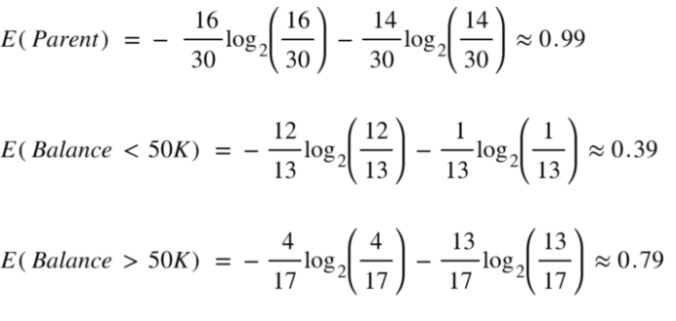
35 Entropy
https://www.udemy.com/course/data-science-and-machine-learning-with-python-hands-on/learn/lecture/4020558#overview
Computing Entropy
https://towardsdatascience.com/entropy-how-decision-trees-make-decisions-2946b9c18c8
We will minimize the entropy (randomness) at each node, i.e., the parent has greater randomness of Hire/not hire together, The child node with one Hire (1) and no-hire (0). After make decision/choice, the parent has greater randomness = 0.99 and the child has the minimum randomness 0.39 and 0.79, respectively.

Slide 5
34.1 Generate Income and Age Data

Slide 6
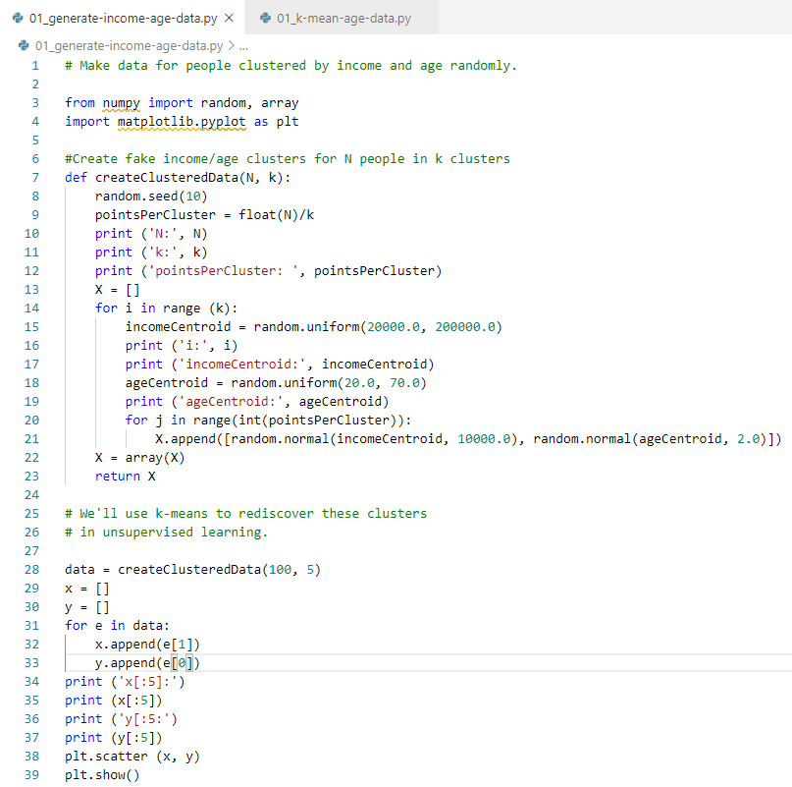
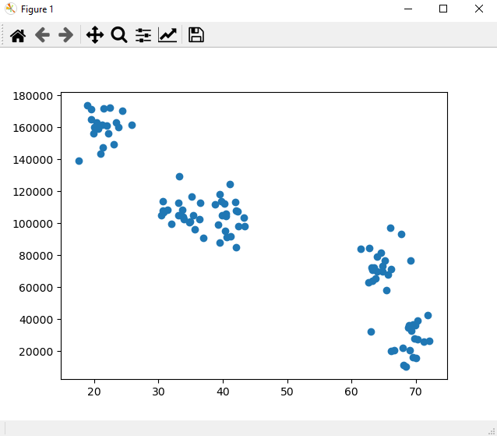
34 Generate Income and Age Data
https://www.udemy.com/course/data-science-and-machine-learning-with-python-hands-on/learn/lecture/4020558#overview
K-Mean Clustering Example
Make data for people clustered by income and age, randomly.
Plot data

Slide 7
End of Chapter

