Slide 1

85 T-Test Example
Peter H. Chen

Slide 2
85 T-Test Example
https://github.com/peterhchen/900_Python_ML_DS_DL
T-Test Example
Let’s create some experimental data, and use the T-Statistic and P-Value to determine whether or not a given experimental result is a real effect or not.
We're going to create some fake experimental data and run T-Statistics and P-Values on them and see how it works and how to compute it in Python.

Slide 3
85.1 High T-Value and Low P-Value

Slide 4
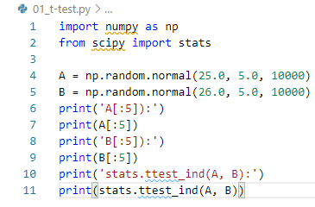
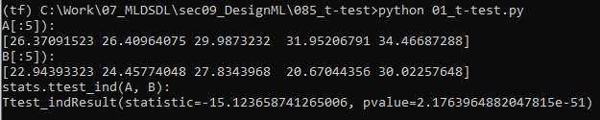
85.1 High T-Value and Low P-Value
https://github.com/peterhchen/900_Python_ML_DS_DL
High T-Value and Low P-Value
Let's say we're running an A/B test.
We'll fabricate some data that randomly assigns order amounts from customers in sets A and B, with B being a little bit higher:

Slide 5
85.1 High T-Value and Low P-Value
https://github.com/peterhchen/900_Python_ML_DS_DL
High T-Value and Low P-Value (Explanation)
Let's start by fabricating some data here.
Let's imagine that we're running and A/B Test on a website, and we have randomly assigned our users into two groups, Group A and Group B.
Group A is going to be our test subjects, our treatment group.
Group B will be our control, i.e., the old way of the website used to be.
In this example, our treatment group is going to have a randomly distributed purchase behavior, where they spend on average $25 per transaction, with a standard deviation of five and 10,000 samples.
The old way the website used to be had a mean of $26 per transaction with the same standard deviation and sample size, so we're basically looking at an experiment that had a negative result here.

Slide 6
85.1 High T-Value and Low P-Value
https://github.com/peterhchen/900_Python_ML_DS_DL
High T-Value and Low P-Value (Explanation)
And all you have to do to figure out the T-Statistic and the P-Value.
We use stats.ttest_ind(A, B) method from sciPy.
We have T-statistics = -15. There are very different distribution.
The P-Value is too small (2.1^-51), not consistent.
We have
High T-Value (Two different tests, Not random test)
Low P-Value (less than threshold 1%), not consistent.
We have good difference in T-Value but P-Value is not consistent.

Slide 7
85.2 Low T-Value and High P-Value

Slide 8
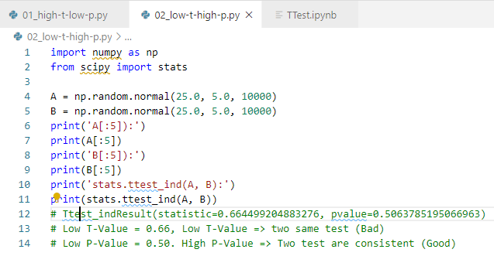
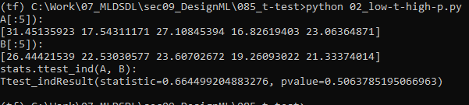
85.2 Low T-Value and High P-Value
https://github.com/peterhchen/900_Python_ML_DS_DL
Low T-Value and High P-Value
Let's change things up so both A and B are just random, generated under the same parameters. So there's no "real" difference between the two:
We create Low T-Value (Two distributions are same) and High P-Value (> threshold) for consistent test.
Because Low T-Value, two distribution are random, we cannot pick the new B Test to replace the old A-Test.

Slide 9
85.2 Low T-Value and High P-Value

Slide 10
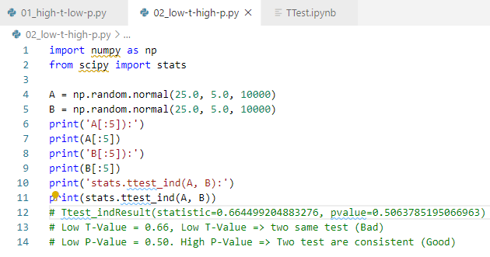
85.2 Low T-Value and High P-Value
https://github.com/peterhchen/900_Python_ML_DS_DL
Low T-Value and High P-Value
We create Low T-Value (Two distributions are same) and High P-Value (> threshold) for consistent test.
Because Low T-Value, two distribution are random, we cannot pick the new B Test to replace the old A-Test.

Slide 11
85.2 Low T-Value and High P-Value

Slide 12
85.2 Low T-Value and High P-Value
https://github.com/peterhchen/900_Python_ML_DS_DL
Low T-Value and High P-Value

Slide 13
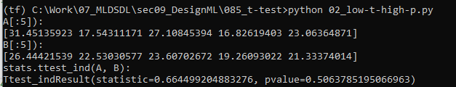
85.2 Low T-Value and High P-Value
https://github.com/peterhchen/900_Python_ML_DS_DL
Low T-Value and High P-Value
We create Low T-Value (Two distributions are same) and High P-Value (> threshold) for consistent test.
Because Low high T-Value, two distribution are same. Do we pick the new B Test to replace the old A-Test?

Slide 14
85.3 Increase Sample Size

Slide 15
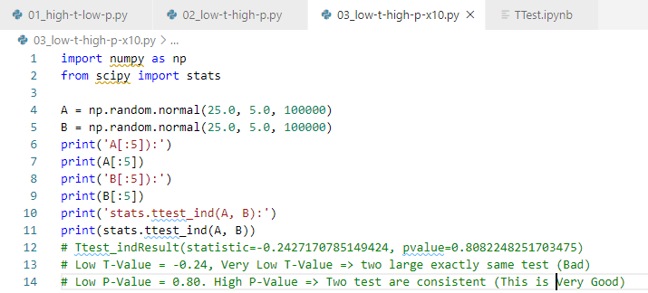
85.3 Increase Sample Size
https://github.com/peterhchen/900_Python_ML_DS_DL
Increase Sample Size 10 times
Increase the Sample Size 10 times.

Slide 16
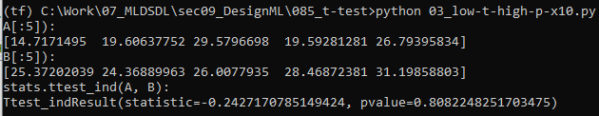
85.3 Increase Sample Size
https://github.com/peterhchen/900_Python_ML_DS_DL
Increase Sample Size 10 times
Increase the Sample Size 10 times.
Very Low T-Value: The sample are random varaible.
High P-Value: This is very consistent Data.
We cannot pick this due to two sample are random variable.

Slide 17
85.4 T-Value=0 and P-Value=1

Slide 18
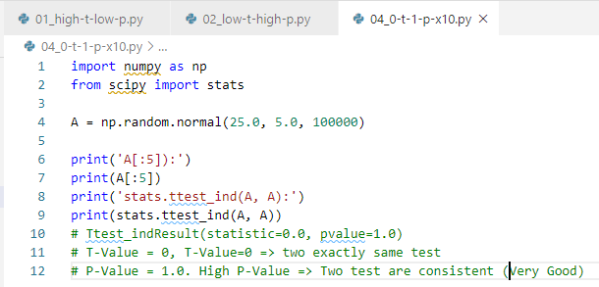
85.4 T-Value=0 and P-Value=1
https://github.com/peterhchen/900_Python_ML_DS_DL
T-Value=0 and P-Value=1
Exactly the same data

Slide 19

85.3 Increase Sample Size
https://github.com/peterhchen/900_Python_ML_DS_DL
Increase Sample Size 10 times
Increase the Sample Size 10 times.
T-Value=0 : The sample are same.
P-Value=1: This is very consistent Data.

Slide 20
85.5 Exercise

Slide 21
85.5 Exercise
https://github.com/peterhchen/900_Python_ML_DS_DL
Exercise
Experiment with more different distributions for A and B, and see the effect it has on the t-test.
1. Keep same parameter and becrease sample size to 10.

Slide 22
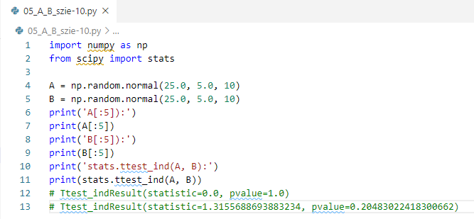
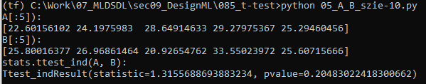
85.5 Exercise
https://github.com/peterhchen/900_Python_ML_DS_DL
Exercise
Experiment with more different distributions for A and B, and see the effect it has on the t-test.
1. Decrease sample size to 10.
Ans:
T-Test become bigger (different), not random variable
P-Value become moderate (consistent data).

Slide 23
End of Chapter

