Slide 1

78 Spark K-Means Cluster
Peter H. Chen

Slide 2
78 Spark K-Means Cluster
https://github.com/peterhchen/900_Python_ML_DS_DL
Spark K-Means Cluster
We discussed Spark MLLib for K-Means clustering using Python.
We will use Apache Spark to run Python in Cluster.
Open 01_spark-k-means.py

Slide 3
78.1 Import Spark Package

Slide 4
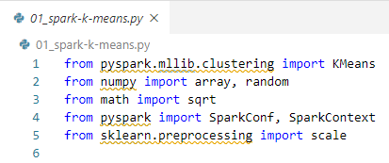
78.1 Import Spark Package
https://github.com/peterhchen/900_Python_ML_DS_DL
Import Spark Package
Import the KMeans function from K-Means clustering package.
Import array and random functions from numpy package.
Import sqrt function from math package.
Import SparkConf and SparkContext functions from pyspark package.
Import the scale function from scikit learn preprocessing package. Make sure the sklearn package are installed in all the machines in the clusters.

Slide 5
78.2 Create Spark Conf and Context

Slide 6
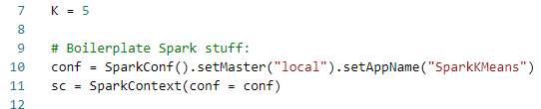
78.2 Create Spark Conf and Context
https://github.com/peterhchen/900_Python_ML_DS_DL
Create Spark Conf and Context
Setup global variable K to 5. This K is for 5 centroids in K-Means clustering.
Set up a local for local computer and our application “01_spark-k-means” for SparkConf.
Then, we create conf object by SparkConf() function.
Then we create the object sc by SparkContext() function. The Spark Context is used to create RDD for our cluster machine.

Slide 7
78.3 Create RDD

Slide 8
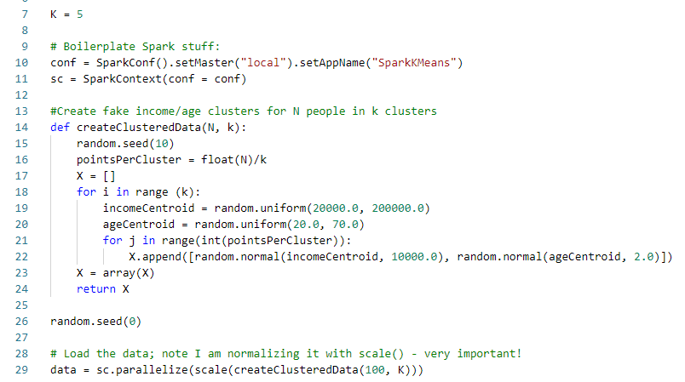
78.3 Create RDD
https://github.com/peterhchen/900_Python_ML_DS_DL
Create RDD (Resilient Distributed Dataset)
We call ramdom.seed(0) to make sure the random number keep the same pattern each time we run. We do not read ant dataset in this example.

Slide 9
78.3 Create RDD
https://github.com/peterhchen/900_Python_ML_DS_DL
Create RDD (Resilient Distributed Dataset)
Create an rdd by a parallelizing for data. The data is create by function creeatClusteredData(100, 5) for 100 data point and K = 5 centroid.
We normalize with scale the RDDs (Resilient Distributed Dataset).
Then, we parallelize the RDDs for Spark clusters.

Slide 10
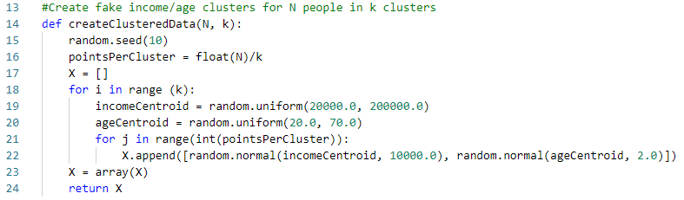
78.3 Create RDD
https://github.com/peterhchen/900_Python_ML_DS_DL
Create RDD (Resilient Distributed Dataset) by createClusteredData (100, 5).
1. We have 100 points for 5 clusters.
2. Each cluster has = 100/5 = 20 points.
https://docs.python.org/3/library/random.html
3. Generate 5 income centroid data between 20K to 200K.
4. Generate the 5 age centroid data from age 20 to 70.
5. Generate income data by income centroid (20K to 200 K) and deviation 10000.
6. Generate age data by age centroid (20 to 70) and deviation 2.
7. Returns a numpy array of data.

Slide 11
78.4 Train RDDs Data

Slide 12
78.4 Train RDDs Data
https://github.com/peterhchen/900_Python_ML_DS_DL
Train RDDs Data
Now, we have all the normalized RDD (Resilient Distributed Datasets) we need.
These RDDs data are parallelized in the Spark Context of Spark cluster.
https://spark.apache.org/docs/2.2.0/mllib-clustering.html
Note: the runs is removed after Spark MLLib 2.2.0.
Call KMeans.train(data, K, maxIterations =10, initializationMode = “random”)
Data: parallelized RDD datasets.
K: 5 centroids for our clusters

Slide 13
78.5 Print Cluster

Slide 14
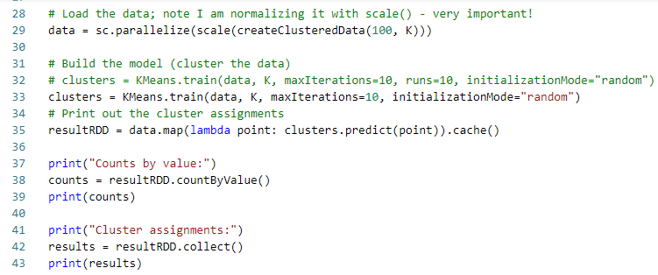
78.5 Print Cluster
https://github.com/peterhchen/900_Python_ML_DS_DL
Print Cluster: Print out the cluster assignments for each one of our points.
The map function take RDD data array into serialized individual point.
Then, call the predict(point) function in clusters model and put into cache() memory.
Then, return the result to resultRDD.

Slide 15
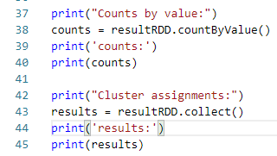
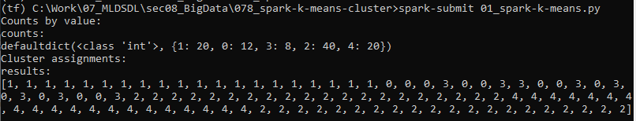
78.5 Print Cluster
https://github.com/peterhchen/900_Python_ML_DS_DL
Print Cluster: Print out the cluster assignments for each one of our points.
> counts = resultRDD.countByValue().
Get the histogram for each unique value.
Collect the finals results from distributed cluster computing.
We got 5 clusters. Each cluster has count: 0: 12, 1: 20, 2: 40, 3: 8, 4: 20

Slide 16
78.6 [sqrt(x^2), sqrt(y^2)]

Slide 17
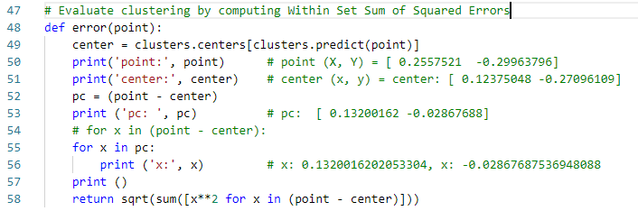

78.6 Sum of Error Square in [x, y]
https://github.com/peterhchen/900_Python_ML_DS_DL
Sum of Error Square in [x, y]
Function error(point)
For each point, find its centroid.
> center = Cluster.centers[cluster.predict(point)]
1.47
1.74
-1.28
point - center
[0.26, 0.05]
point
(1.74, -1.28)
-1.3
center
(1.47, -1.33)

Slide 18
78.7 sqrt(x^2) + sqrt(y^2)

Slide 19
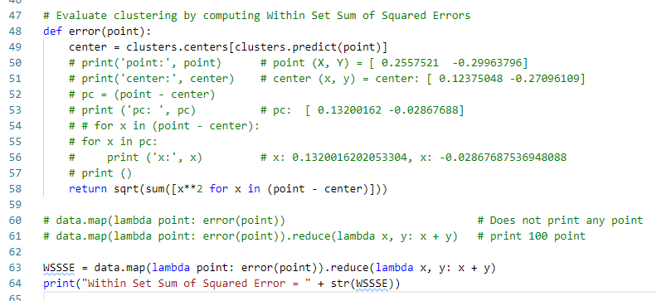
78.7 sqrt(x^2) + sqrt(y^2)
https://github.com/peterhchen/900_Python_ML_DS_DL
sqrt(x^2) + sqrt (y^2)
How do we measure how good of the K-Means Cluster?
WSSSE (Within Set Sum of Squared Error)
Map: square the errors and store in separate dimension [sqrt (x^2), sqrt(y^2)).
Reduce: sum square errors (sqrt(x^2) + sqrt(y^2)) into one number.

Slide 20
78.8 Exercise

Slide 21
78.8 Exercise
https://github.com/peterhchen/900_Python_ML_DS_DL
Exercise
1. What happens to WSSSE as you increase or decrease K? Why?
2. What happens if you don't normalize the input data before clustering?
3. What happens if you change the maxIterations or runs parameters?

Slide 22
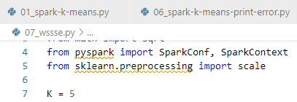
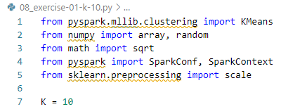

78.8 Exercise
https://github.com/peterhchen/900_Python_ML_DS_DL
Exercise
1. What happens to WSSSE as you increase or decrease K? Why?
Ans: K increase from 5 to 10, WSSSE (Within Set Sum of Squared Error) decrease from 22.49 to 19.05

Slide 23

78.8 Exercise
https://github.com/peterhchen/900_Python_ML_DS_DL
Exercise
2. What happens if you don't normalize the input data before clustering?
Ans: income become very huge number and error become very huge number (WSSSE = 597770).

Slide 24

78.8 Exercise
https://github.com/peterhchen/900_Python_ML_DS_DL
Exercise
3. What happens if you change the maxIterations or runs parameters?
Ans:
Iterations=1, WSSSE = 32.
Iteration = 10, WSSSE = 22.
Iterations=30, WSSSE = 20.
Conclusion: More iterations impreove classification, therefore, WSSSE decrease.
Iteration = 1
Iteration = 30

Slide 25
End of Chapter

