Slide 1

9 Function
Peter H. Chen

Slide 2
9.9 Function
https://github.com/peterhchen/900_Python_ML_DS_DL
Python Function
2020/9/25

Slide 3
9.1 Function

Slide 4
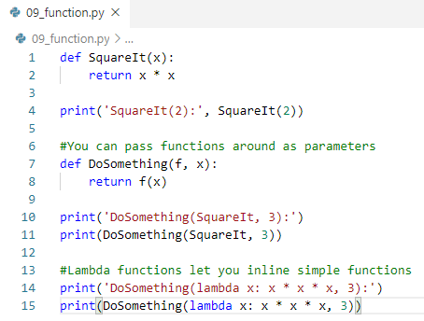

9.9 Function
https://github.com/peterhchen/900_Python_ML_DS_DL
Lists: Python Anaconda Prompt
2020/9/25

Slide 5
End of Chapter

