Slide 1

97 Keras Political Affiliation
Peter H. Chen

Slide 2
97 Keras Political Affiliation
https://github.com/peterhchen/930_Python_ML_DS_DL
Keras Political Affiliation
Keras API is much easier implementation than Tensorflow.
The MNIST data set is just one type of problem that we solve in neural network.
The MNIST is a multi class classification for fitting feature images into the 0 to 9 images. In this case, we have 10 different possible classification values.
This makes MNIST a multi class classification problem.
Now, based on Keras's documentation and examples, they have general advice on how to handle different types of problems.

Slide 3
97.1 Multi-Class Classification

Slide 4
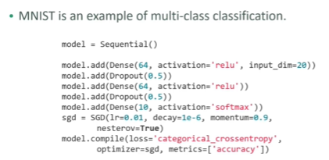
97.1 Multi-Class Classification
https://github.com/peterhchen/930_Python_ML_DS_DL
Example: Multi-Class Classification

Slide 5
97.1 Multi-Class Classification
https://github.com/peterhchen/930_Python_ML_DS_DL
Example: Multi-Class Classification (Explanation)
https://faroit.com/keras-docs/1.2.0/
Below is an example of how they suggest setting up a multi class classification issue.
In general, we have two hidden layers.
We have an input dimension of many features.
We have 20 input here, but depending on the nature of your problem there may be more.
It is setting up to “relu” activation function layers each with 64 neurons.
It is sticking in a dropout layer to discard half of the neurons in each training step. This dropout is to prevent overfitting.
It is using a soft max activation to one of in this example 10 different output values.

Slide 6
97.1 Multi-Class Classification
https://github.com/peterhchen/930_Python_ML_DS_DL
Example: Multi-Class Classification (Explanation)
This is how Keras solve the MNIST problem within their own documentation.
Then, Keras use an SGD optimizer and model compile with a categorical cross and entropy loss function.
We can refer to the Keras documentation for some general starting points to begin from when you're tackling a specific kind of problem.
The actual numbers of neurons and number of layers the number of inputs and outputs will vary depending on the problem you are trying to solve.
This is the general guidance they give you on what the right loss function is.
To start with what the right optimizer to start with might be another type of classification problem is binary classification maybe you're trying to decide if images or people are pictures of males or females.
Maybe you are trying to decide if someone's political party is Democrat or Republican.

Slide 7
97.1 Multi-Class Classification
https://github.com/peterhchen/930_Python_ML_DS_DL
Example: Multi-Class Classification (Explanation)
If you have a binary classification problem (0 or 1), Keras documentation recommend a sigmoid activation function instead of softmax because you don not really need the complexity of softmax if you just try to classify between 0 and 1.
For simple binary classification, Keras recommend: The activation function: Use sigmoid.
For complicate multi-class classification, Kera recommend: complicated softmax activation function.
Keras also recommend to use binary cross entropy for loss function and RMS prop for optimizer.

Slide 8
97.2 Integrate Keras with scikit_learn

Slide 9
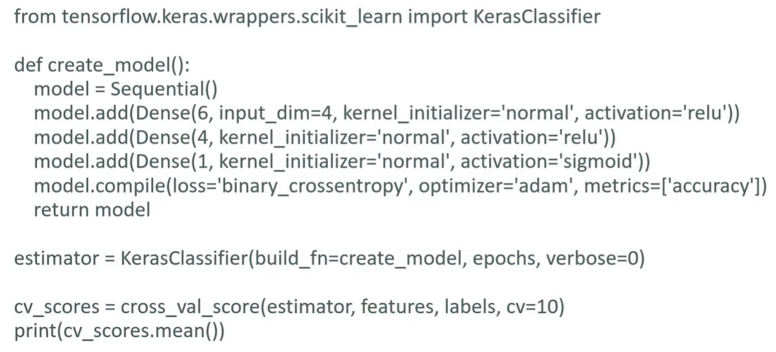
97.2 Integrate Keras with scikit_learn
https://github.com/peterhchen/930_Python_ML_DS_DL
Integrate Keras with scikit_learn

Slide 10
97.2 Integrate Keras with scikit_learn
https://github.com/peterhchen/930_Python_ML_DS_DL
Integrate Keras with scikit_learn (Explanation)
Finally, discuss how to use Keras with scikit learn.
Keras make a lot easier to do cross validation.
Below example, we creates a model and use scikit_learn.
We create model function with a sequential model, put in a dense layer with 4 inputs and six neurons.
In that layer that feeds to another hidden layer of 4 neurons.
Finally, it is a binary classifier with a sigmoid activation function.

Slide 11
97.2 Integrate Keras with scikit_learn
https://github.com/peterhchen/930_Python_ML_DS_DL
Integrate Keras with scikit_learn (Explanation)
This example set up a small binary classification neural network.
We then get estimator from scikit_learn KerasClassifier function.
We get cv_score from scikit_learn cross_val_score (estimator) function.
We get the cv_score mean from scikit_learn cv_score.mean().
The cv_score is the k-fold cross validation score: cross_val_score () evaluate our model using k-fold cross-validation and give you a very meaningful result for how accurate in its ability to correctly predict the classifications.

Slide 12
97.3 Predict Political Parties with Keras

Slide 13

97.3 Predict Political Parties with Keras
https://github.com/peterhchen/930_Python_ML_DS_DL
Predict Political Party with Keras based on votes
We use a public data set of how US congressmen voted on 17 different issues in the year 1984.
We can figure out their political party based on their votes alone, using a deep neural network.
Our two main political parties are "Democrat" and "Republican." In modern times they represent progressive and conservative ideologies, respectively.
Politics in 1984 were not quite as polarized as they are today, but you should still be able to get over 90% accuracy without much trouble.
Let's start by importing the raw CSV file using Pandas, and make a DataFrame out of it with nice column labels.

Slide 14
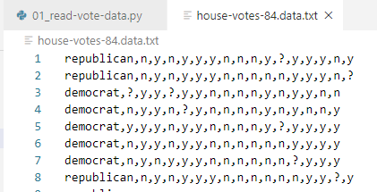
97.3 Predict Political Parties with Keras
https://github.com/peterhchen/930_Python_ML_DS_DL
Predict Political Parties with Keras (Explanation)
In this discussion, we predict the political parties of congressmen based on their votes in Congress using the Keras library.
Open jupyter notebook file: “PoliticsExercse.ipynb”
The data is in “house-votes-84.data.txt”.

Slide 15
97.4 Read Data

Slide 16
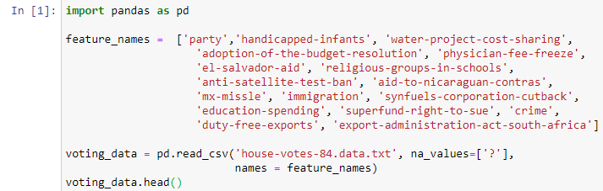
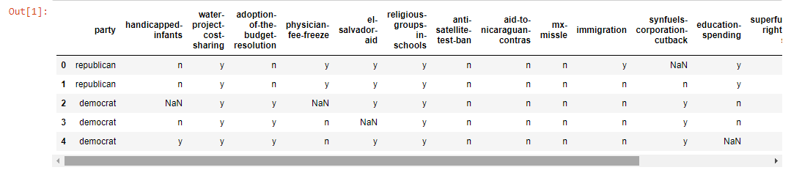
97.4 Read Data
https://github.com/peterhchen/930_Python_ML_DS_DL
Read Data
We importing the raw CSV file using Pandas, and make a DataFrame out of it with nice column labels.
There are 17 issues (as below) for vote. The republican is more conservative and democratic is more progressive.

Slide 17
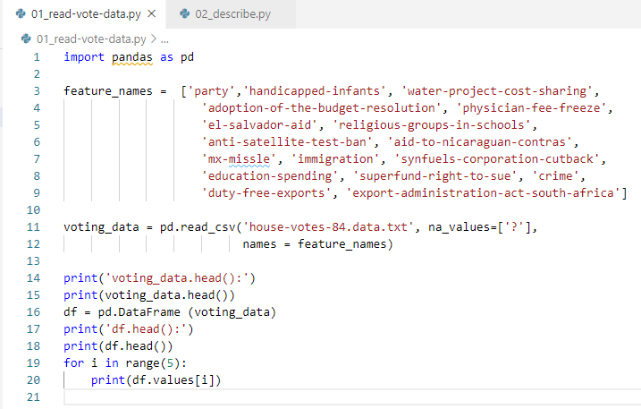
97.4 Read Data
https://github.com/peterhchen/930_Python_ML_DS_DL
Predict Political Parties with Keras (Explanation)
Read “house-votes-84.data.txt”.
We use panda library to load the csv data which is a comma separated value file.
The column is not part of csv file.
The party is either democratic or republican.
The na_values is used to replace “?” into “NaN”.

Slide 18
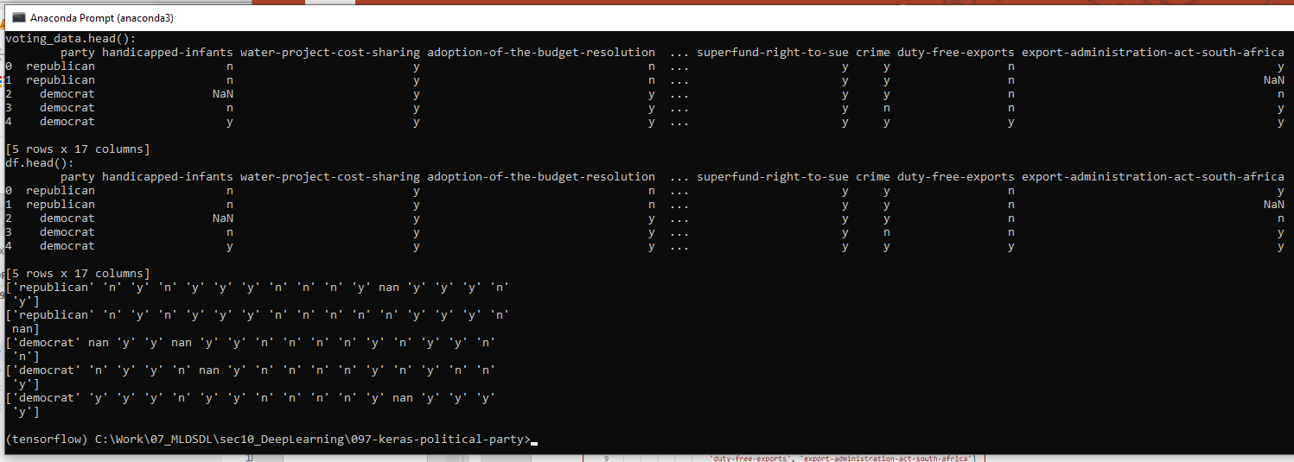
97.4 Read Data
https://github.com/peterhchen/930_Python_ML_DS_DL
Predict Political Parties with Keras (Explanation)
The vote is either N, Y, or NaN for different subjects.

Slide 19
97.5 Check Missing Data

Slide 20
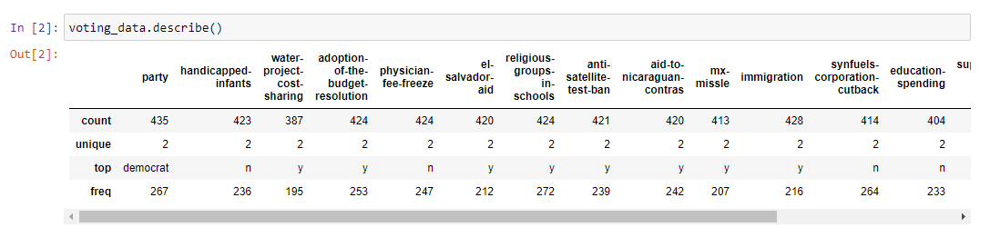
97.5 Check Missing Data
https://github.com/peterhchen/930_Python_ML_DS_DL
Print Describe
We can use describe() to get a feel of how the data looks in aggregate.
We can see there's some missing data to deal with here.
Some politicians abstained on some votes, or just weren't present when the vote was taken.
We will just drop the rows with missing data to keep it simple, but in practice you'd want to first make sure that doing so didn't introduce any sort of bias into your analysis (if one party abstains more than another, that could be problematic for example.)

Slide 21
97.5 Check Missing Data
https://github.com/peterhchen/930_Python_ML_DS_DL
Print Describe (Explanation)
For example, you can see this lot of missing data for example even though that there's 435 people in the party associated.
Only 387 of them actually had a vote on the “water-project-cost-sharing” project, for example, so we have to deal with missing data here.
The easiest thing to do is to just throw away rows that have missing data.
Now, in the real world you'd want to make sure that you're not introducing some sort of unintentional bias by doing that.

Slide 22
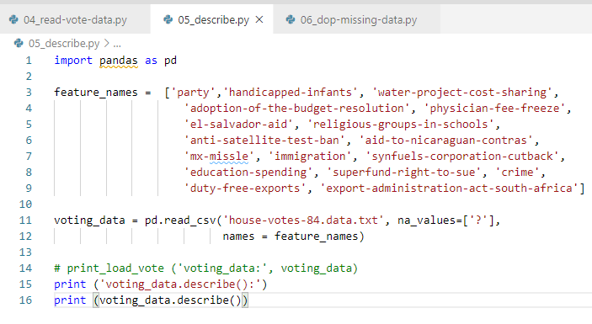
97.5 Check Missing Data
https://github.com/peterhchen/930_Python_ML_DS_DL
Print Describe (Explanation)
You know maybe there is more of a tendency for Republicans to not vote than Democrats or vice versa.
If that were the case and you might be biasing your analysis by throwing out politicians that didn’t vote on every actual issue here.

Slide 23
97.6 Drop Missing Data

Slide 24
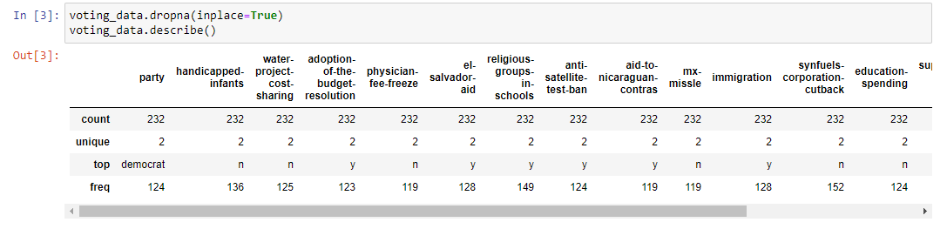
97.6 Drop Missing Data
https://github.com/peterhchen/930_Python_ML_DS_DL
Drop Missing Data
We drop the missing data.

Slide 25
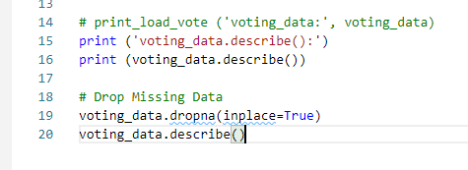
97.3 Print Describe
https://github.com/peterhchen/930_Python_ML_DS_DL
Print Describe (Explanation)
Assume that there is no such bias and we can just go ahead and drop those missing values.
We drop the NaN (Missing Data) and display again. Now every columns have the same count = 232.

Slide 26
97.7 Convert String into 1/0

Slide 27
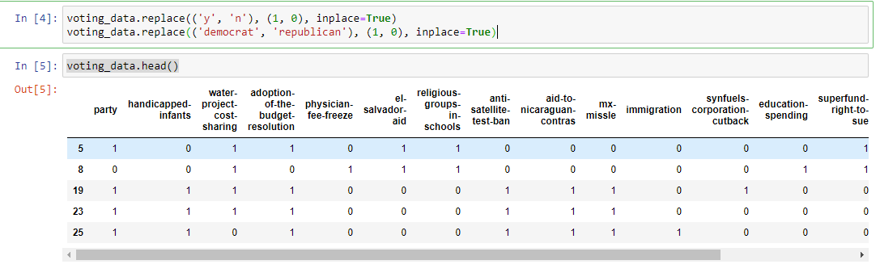
97.7 Convert String into 1/0
https://github.com/peterhchen/930_Python_ML_DS_DL
Convert String into 1/0
Next say we need to do is actually massage this data into a form that Keras can consume.
Keras does not know with Y/N, it only know numbers (1/0).
We replace all the Y/N and Democrat/Republican into numbers 1 and 0.

Slide 28
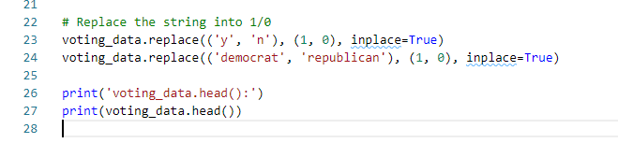
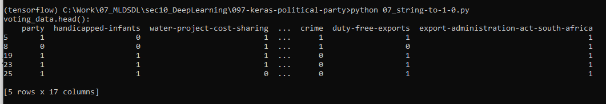
97.7 Convert String into 1/0
https://github.com/peterhchen/930_Python_ML_DS_DL
Convert String into 1/0 (Explanation)
We replace all the Y/N and Democrat/Republican into numbers 1 and 0.
Print. We only see all 1/0 only.

Slide 29
97.8 Feature and Label

Slide 30
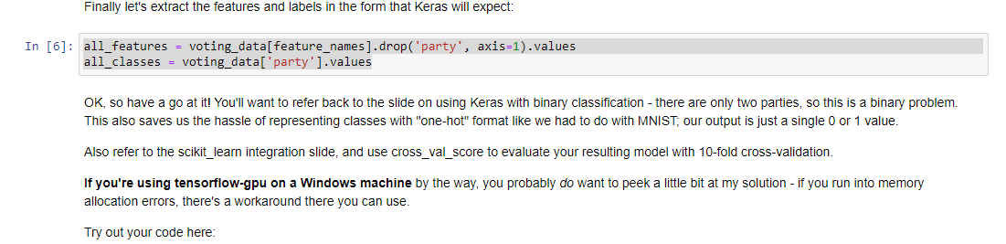
97.8 Feature and Label
https://github.com/peterhchen/930_Python_ML_DS_DL
Extract Feature and Label

Slide 31

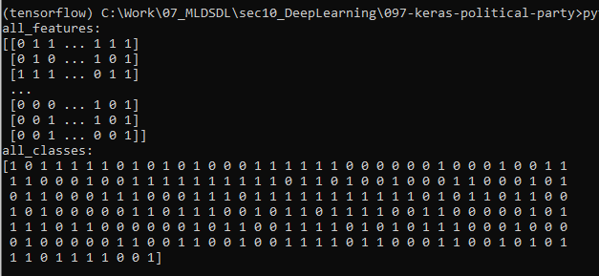
97.8 Feature and Label
https://github.com/peterhchen/930_Python_ML_DS_DL
Extract Feature and Label (Explanation)
1. We extract all features (except the party name in party column).
2. We take out party name and make party name into label.

Slide 32
97.9 Classify and Validation

Slide 33
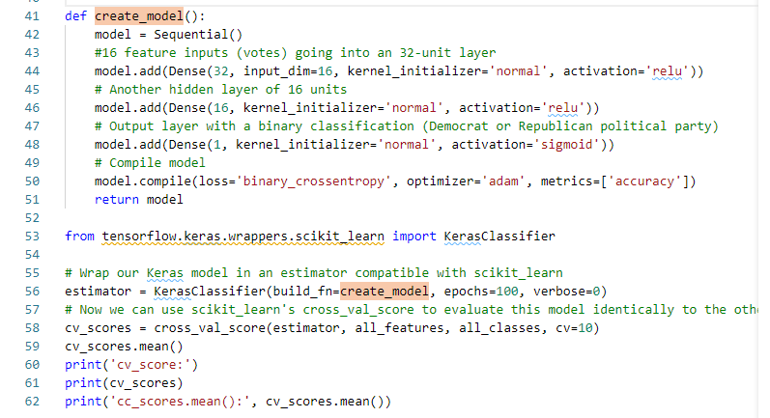
97.9 Classify and Validation
https://github.com/peterhchen/930_Python_ML_DS_DL
Classify and Validation
This is turning this into a binary classification problem. We use Keras and scikit-learn cross-validation to create model, classification, prediction, and cross validation.

Slide 34
97.9 Classify and Validation
https://github.com/peterhchen/930_Python_ML_DS_DL
Classify and Validation (Explanation)
We use Keras to build the model.
We integrate Keras with scikit_learn with cross_val_score() function.
In this case, we have 16 different issues that people voted on.
We use a “relu” activation function with a layer of 32 neurons.
We add hidden layer of 16 neurons.
We have the output layer with 1 neuron to predict 1/0 (democratic/republican).

Slide 35
97.9 Classify and Validation
https://github.com/peterhchen/930_Python_ML_DS_DL
Classify and Validation (Explanation)
We use Keras to build the model.
We integrate Keras with scikit_learn with cross_val_score() function.
In this case, we have 16 different issues that people voted on.
We use a “relu” activation function with a layer of 32 neurons.
We add hidden layer of 16 neurons.
We have the output layer with 1 neuron to predict 1/0 (democratic/republican).

Slide 36

97.9 Classify and Validation
https://github.com/peterhchen/930_Python_ML_DS_DL
Classify and Validation (Explanation)
The we do the cross validation from scikit_learn.
The accuracy is 94%.

Slide 37
97.9 Classify and Validation
https://github.com/peterhchen/930_Python_ML_DS_DL
Classify and Validation (Explanation)
In 1984 politicians were not as polarized as they are today. It was harder.
Today, it is polarized and will be easier to predict party from the based on vote.

Slide 38
End of Chapter

