Slide 1

40 Predict Hire Decision
Peter H. Chen

Slide 2
40 Predict Hire Decision
https://www.udemy.com/course/data-science-and-machine-learning-with-python-hands-on/learn/lecture/15090192#overview
Decision Trees
We discuss the decision tree implement with Hire/No Hire example.

Slide 3
40.1 Create/Read Past Hire Data

Slide 4
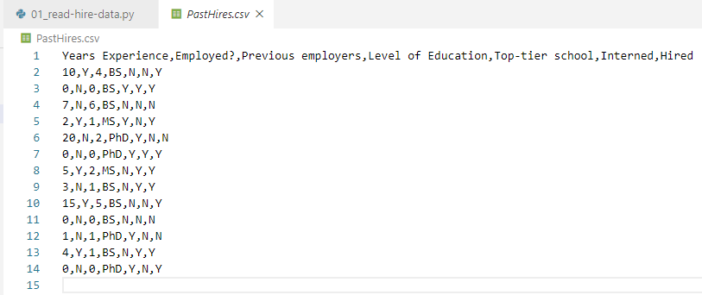
40.1 Create/Read Past Hire Data
https://www.udemy.com/course/data-science-and-machine-learning-with-python-hands-on/learn/lecture/15090192#overview
Create Past Hire Data
First, create past hire in csv format.

Slide 5
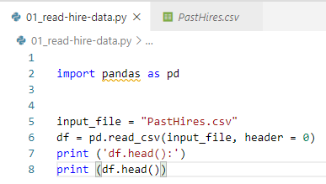
40.1 Create/Read Past Hire Data
https://www.udemy.com/course/data-science-and-machine-learning-with-python-hands-on/learn/lecture/15090192#overview
Read Past Hire Data
Note how we use pandas to convert a csv file into a DataFrame:

Slide 6
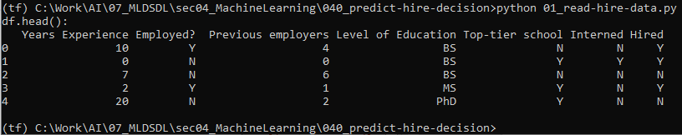
40.1 Create/Read Past Hire Data
https://www.udemy.com/course/data-science-and-machine-learning-with-python-hands-on/learn/lecture/15090192#overview
Read Past Hire Data
Note how we use pandas to convert a csv file into a DataFrame:

Slide 7
40.2 Translate Text into Values

Slide 8
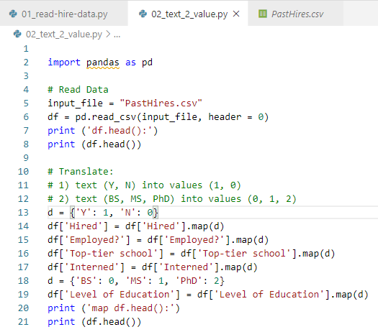
40.2 Translate Text into Values
https://www.udemy.com/course/data-science-and-machine-learning-with-python-hands-on/learn/lecture/15090192#overview
Translate the Text into Values
scikit-learn needs everything to be numerical for decision trees to work.
We map Y, N to 1, 0.
We map BS, MS, PhD, into 0, 1, 2.
In the real world, you'd need to think about how to deal with unexpected or missing data.
By using map(), we know we'll get NaN for unexpected values.

Slide 9
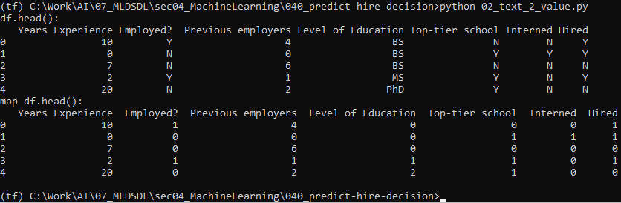
40.2 Translate Text into Values
https://www.udemy.com/course/data-science-and-machine-learning-with-python-hands-on/learn/lecture/15090192#overview
Read Past Hire Data
Note how we use pandas to convert a csv file into a DataFrame:

Slide 10
40.3 Get Feature

Slide 11

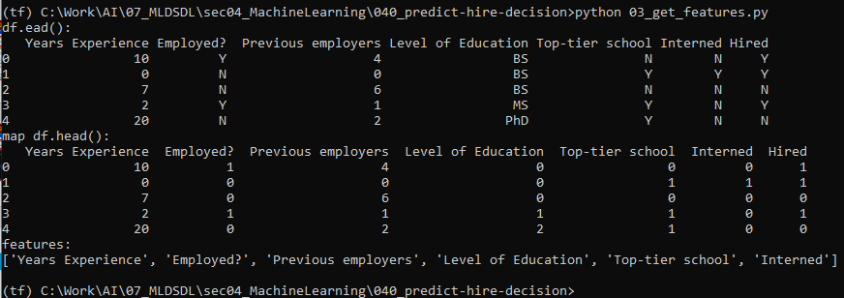
40.3 Get Feature
https://www.udemy.com/course/data-science-and-machine-learning-with-python-hands-on/learn/lecture/15090192#overview
Get Feature
Next we need to separate the features from the target column.
We are trying to build a decision tree.

Slide 12
40.4 Construct Decision Tree

Slide 13
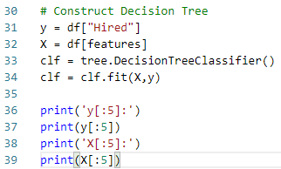
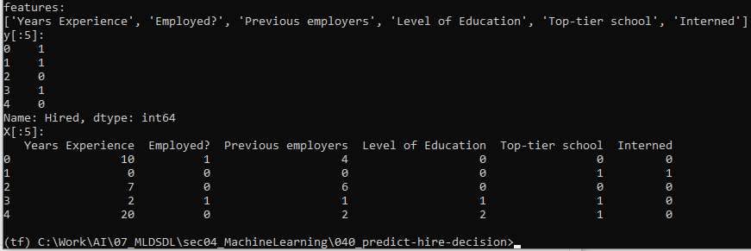
40.4 Construct Decision Tree
https://www.udemy.com/course/data-science-and-machine-learning-with-python-hands-on/learn/lecture/15090192#overview
Construct Decision Tree
Now actually construct the decision tree:

Slide 14
40.5 Display Prediction by Graphviz

Slide 15
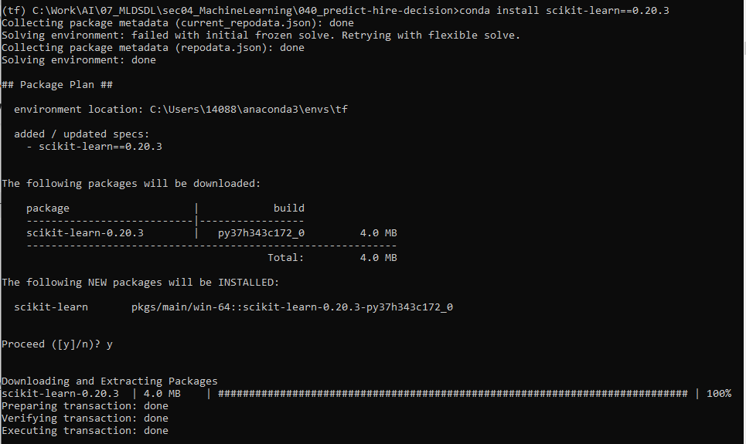
40.5 Display Prediction by Graphviz
https://www.udemy.com/course/data-science-and-machine-learning-with-python-hands-on/learn/lecture/15090192#overview
Display prediction
https://stackoverflow.com/questions/61901365/modulenotfounderror-no-module-named-sklearn-externals-six
We need to have scklearn 0.20.3 for sklearn.externals.six.
> conda install scklearn==0.20.3

Slide 16
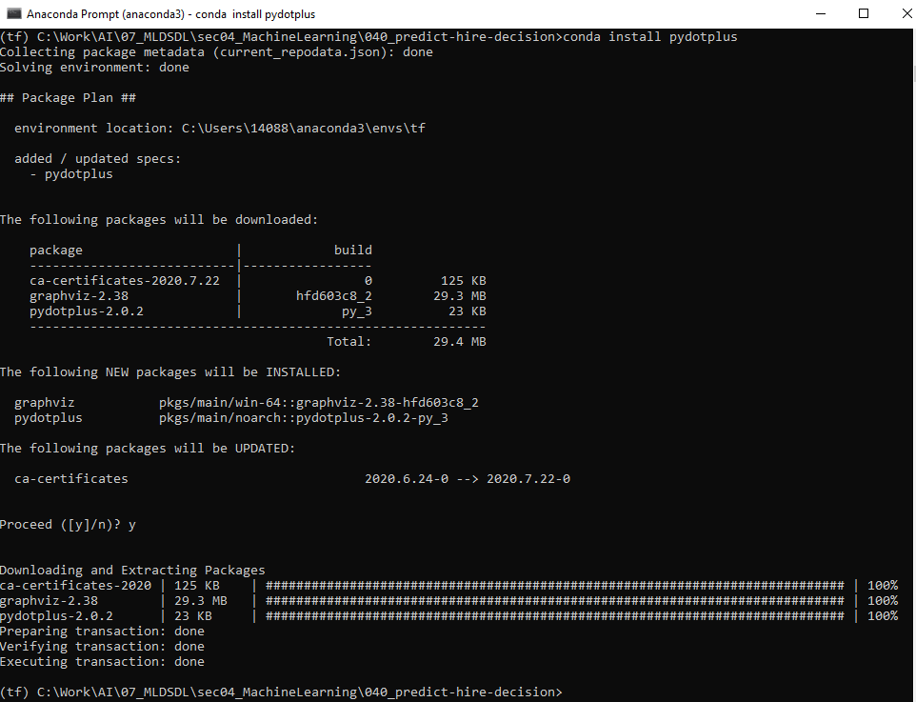
40.5 Display Prediction by Graphviz
https://www.udemy.com/course/data-science-and-machine-learning-with-python-hands-on/learn/lecture/15090192#overview
Display prediction
We need to have pydotplus installed for this to work.
> conda install pydotplus

Slide 17
40.5 Display Prediction by Graphviz
https://www.udemy.com/course/data-science-and-machine-learning-with-python-hands-on/learn/lecture/15090192#overview
Display prediction
To read this decision tree, each condition branches left for "true" and right for "false".
When you end up at a value, the value array represents how many samples exist in each target value.
So value = [0. 5.] mean there are 0 "no hires" and 5 "hires“
By the time we get to that point.
value = [3. 0.] means 3 no-hires and 0 hires.

Slide 18
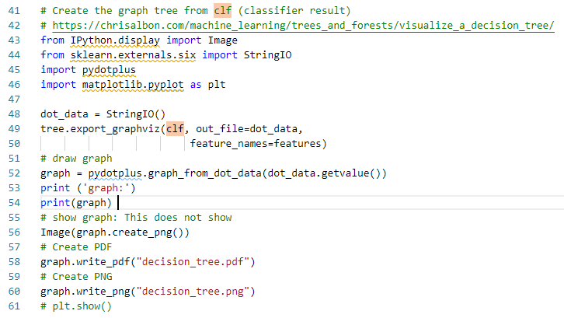
40.5 Display Prediction by Graphviz
https://www.udemy.com/course/data-science-and-machine-learning-with-python-hands-on/learn/lecture/15090192#overview
Display prediction
We write into the pdf and png file and view from graphic tool.

Slide 19
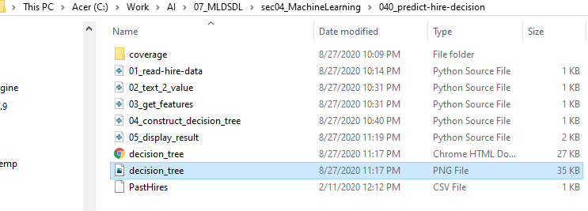
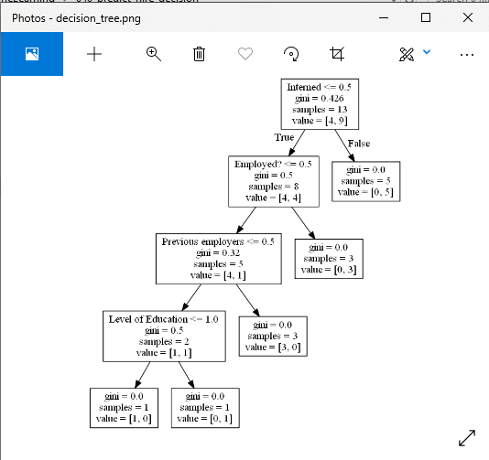
40.5 Display Prediction by Graphviz
https://www.udemy.com/course/data-science-and-machine-learning-with-python-hands-on/learn/lecture/15090192#overview
Display prediction: Browse the PNG file
Double Click “decision_tree.png” to browse.

Slide 20
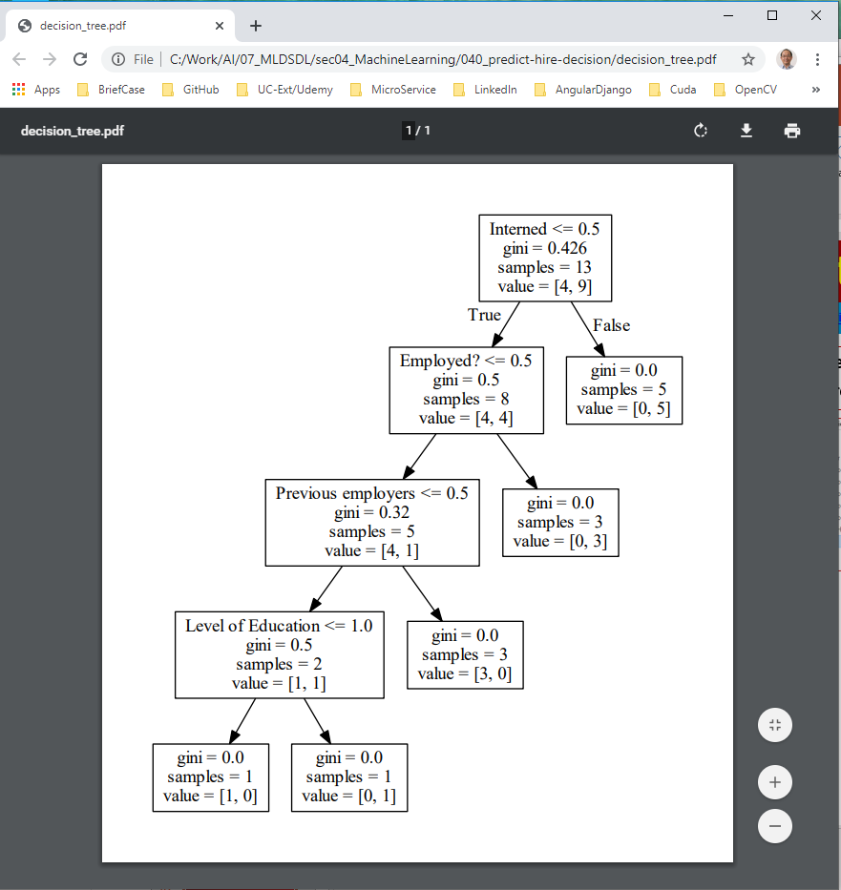
40.5 Display Prediction by Graphviz
https://www.udemy.com/course/data-science-and-machine-learning-with-python-hands-on/learn/lecture/15090192#overview
Display prediction: Browse the PDF file
Double Click “decision_tree.pdf”. The chrome browse automatically open to browse it.

Slide 21
40.6 Random Forest

Slide 22
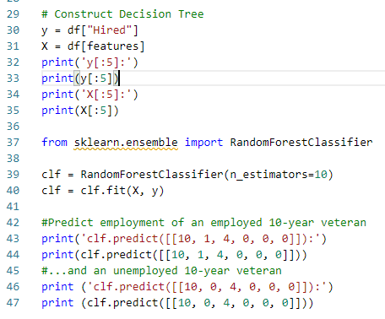
40.6 Random Forest
https://www.udemy.com/course/data-science-and-machine-learning-with-python-hands-on/learn/lecture/15090192#overview
Random Forest
We'll use a random forest of 10 decision trees to predict employment of specific candidate profiles:

Slide 23
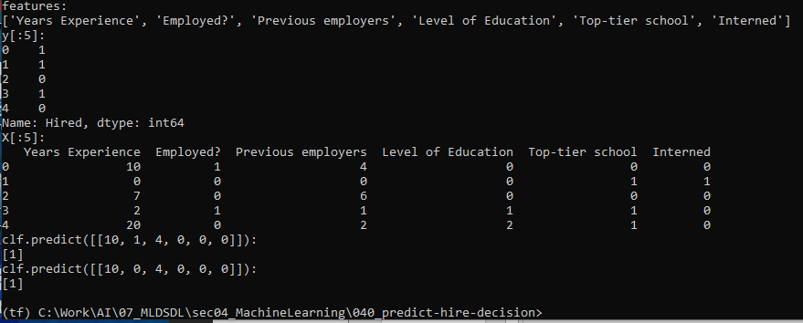
40.6 Random Forest
https://www.udemy.com/course/data-science-and-machine-learning-with-python-hands-on/learn/lecture/15090192#overview
Random Forest
We'll use a random forest of 10 decision trees to predict employment of specific candidate profiles:

Slide 24
40.7 Exercise

Slide 25
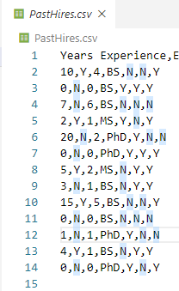
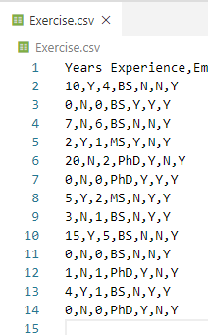
40.7 Exercise
https://www.udemy.com/course/data-science-and-machine-learning-with-python-hands-on/learn/lecture/15090192#overview
Exercise
Modify the test data: Change Hire to Yes to all rows.
Compare the resulting decision tree to the one from the original data.
Some Hired, Some not Hired
All Hired: Only Root remained

Slide 26
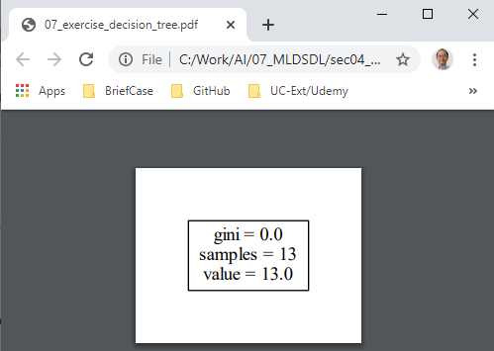
40.7 Exercise
https://www.udemy.com/course/data-science-and-machine-learning-with-python-hands-on/learn/lecture/15090192#overview
Exercise
Result.
Some Hired, Some not Hired
All Hired: Only Root remained

Slide 27
End of Chapter

