Slide 1

25 Linear Regression
Peter H. Chen

Slide 2
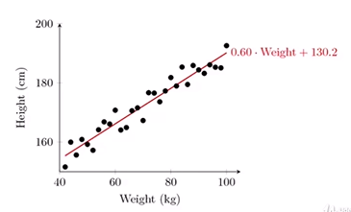
25 Linear Regression
https://www.udemy.com/course/data-science-and-machine-learning-with-python-hands-on/learn/lecture/5591552#overview
Linear Regression
Fit a Line to a data set of observation
Use this line to predict unobserved values
The regression means reverse or backward. Regression model the data and use this model (backward or reverse) to predict the data.
You can use regression line to predict points in the future, the past, and etc. Time usually has nothing to do with regression.
For example, you have a bunch of people with weight and height. X-axis is weight and y-axis is height. We can plot all these data points. We can see they are linear relationship. We have straight line with slope = 0.6 and y-intercept is 130.2.

Slide 3
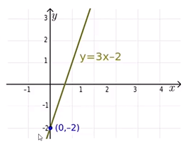
25 Linear Regression
https://www.udemy.com/course/data-science-and-machine-learning-with-python-hands-on/learn/lecture/5591552#overview
Linear Regression: How does it work?
Usually using “least squares”. Error is similar to a deviation and square is a variance. Minimizes the squared-error between each point and the line.
Linear regression becomes the correlation of data points between x and y.
Remember the slop-intercept equation or line? y = mx + b
The slope is the correlation between two variables: The standard deviation of y divided by the standard deviation of x, i.e., m = std (y)/std(x)
What is the meaning of standard deviation?
The intercept is the mean of y minus the slope times the mean of x, i.e., b = y – mx.
Python will do all the math calculation for us.

Slide 4
25 Linear Regression
https://www.udemy.com/course/data-science-and-machine-learning-with-python-hands-on/learn/lecture/5591552#overview
Linear Regression: How does it work?
Least square minimizes the sum of squared errors.
There is another way to think of least squared error. You are given a line there and have the data around the line with probability.
This is the same as maximizing the likelihood of the observed data if you start thinking of the problem in terms of the probabilities and probability distribution functions.
This is sometimes called “maximum likelihood estimation.” This is really talking about the regression.

Slide 5
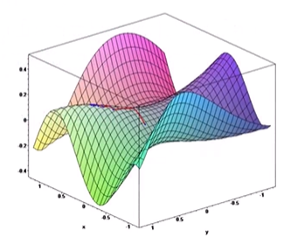
25 Linear Regression
https://www.udemy.com/course/data-science-and-machine-learning-with-python-hands-on/learn/lecture/5591552#overview
More than one way to do it
Gradient Descent is an alternative method to least squared. Gradient Descent is used in high dimensional data, for exmaple, 3D.
Basically iterates to find the line that best follows the contours defined by the data.
Can make sense when dealing with 3D data
Easy to try Python and just compare the results to least squares
But usually least squares is a perfectly good choice.

Slide 6
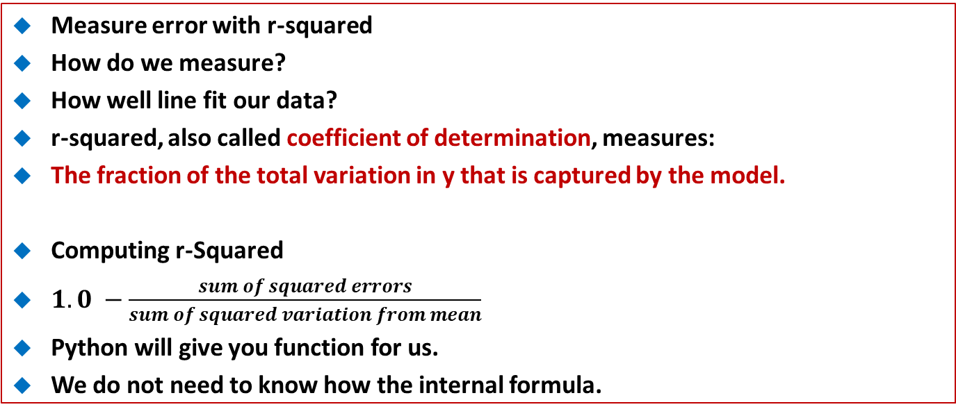
25 Linear Regression
https://www.udemy.com/course/data-science-and-machine-learning-with-python-hands-on/learn/lecture/5591552#overview
Measure error with r-squared
How do we measure?
How well line fit our data?
r-squared, also called coefficient of determination, measures:
The fraction of the total variation in y that is captured by the model.
Computing r-Squared
$1.0 −\frac{sum of squared errors}{sum of squared variation from mean}$
Python will give you function for us.
We do not need to know how the internal formula.

Slide 7
25 Linear Regression
https://www.udemy.com/course/data-science-and-machine-learning-with-python-hands-on/learn/lecture/5591552#overview
Interpreting r-Squared
Ranges from 0 to 1
0 is bad (none of the variance is captured), 1 is good (all of the variance is captured).
You can use the r-squared to measure how good of the regression is by the data point.

Slide 8
25.1 Linear Regression Example

Slide 9
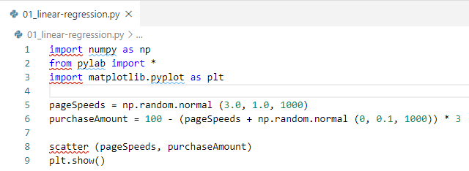
25.1 Linear Regression Example
https://www.udemy.com/course/data-science-and-machine-learning-with-python-hands-on/learn/lecture/5591552#overview
Linear Regression Example
Open “LinearRegression.ipynb”.
Let's fabricate some data that shows a roughly linear relationship between page speed and amount purchased:

Slide 10
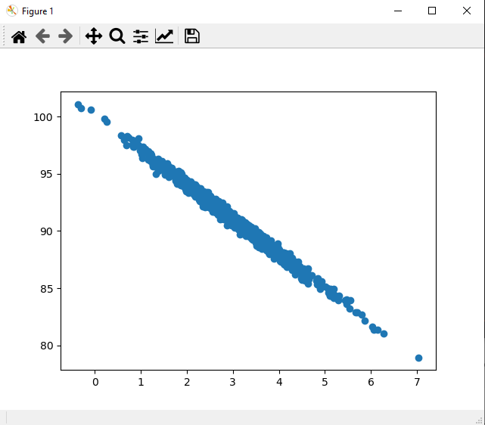
25.1 Linear Regression Example
https://www.udemy.com/course/data-science-and-machine-learning-with-python-hands-on/learn/lecture/5591552#overview
Linear Regression Example
Result

Slide 11
25.2 stats.linregress

Slide 12
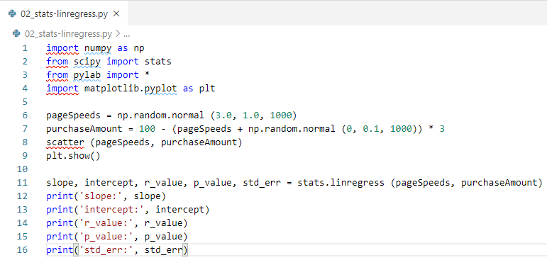
25.2 stats.linregress
https://www.udemy.com/course/data-science-and-machine-learning-with-python-hands-on/learn/lecture/5591552#overview
Linear Regression Example
As we only have two features, we can keep it simple and just use scipy.stats.linregress:

Slide 13
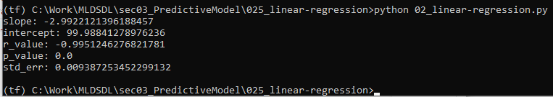
25.2 stats.linregress
https://www.udemy.com/course/data-science-and-machine-learning-with-python-hands-on/learn/lecture/5591552#overview
Linear Regression Example
scipy.stats.linregress:
Result

Slide 14
25.3 r-square

Slide 15
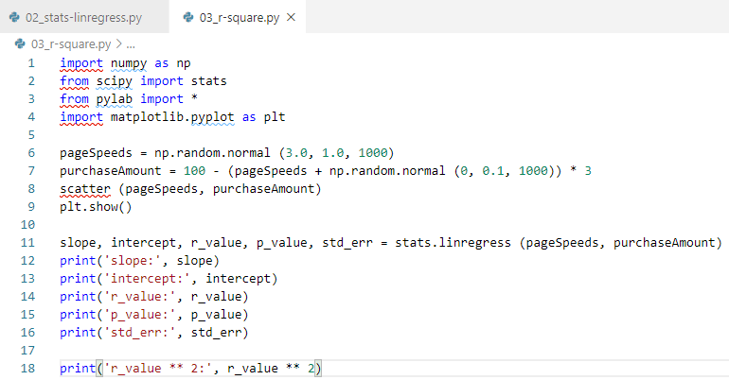
25.3 r-square
https://www.udemy.com/course/data-science-and-machine-learning-with-python-hands-on/learn/lecture/5591552#overview
Linear Regression Example
Not surprisingly, our R-squared value shows a really good fit:

Slide 16
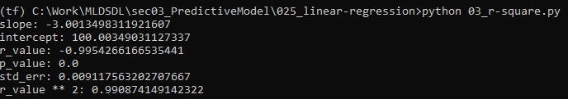
25.3 r-square
https://www.udemy.com/course/data-science-and-machine-learning-with-python-hands-on/learn/lecture/5591552#overview
Linear Regression Example
R-square: r** 2 close to 0.

Slide 17
25.4 Slope and intercept

Slide 18
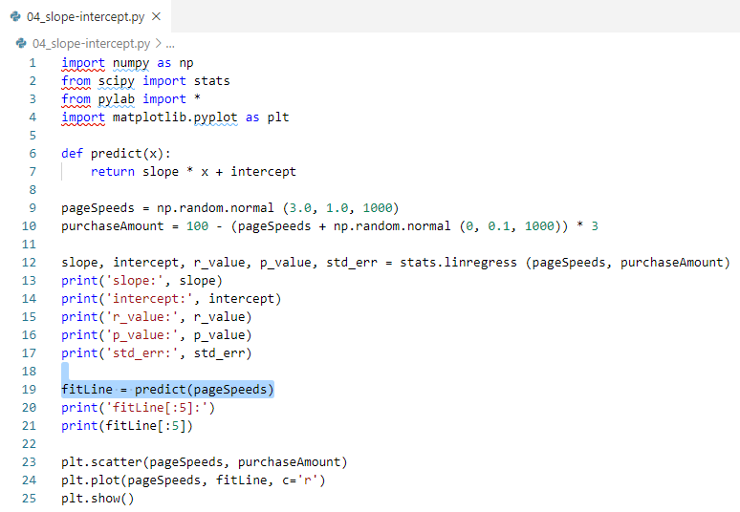
25.4 Slope and intercept
https://www.udemy.com/course/data-science-and-machine-learning-with-python-hands-on/learn/lecture/5591552#overview
Slope and Intercept
Let's use the slope and intercept we got from the regression to plot predicted values vs. observed:
Note:
plot (…, c=‘r”). Plot Color = ‘red’

Slide 19
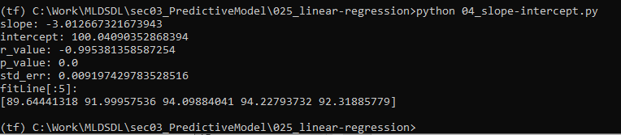
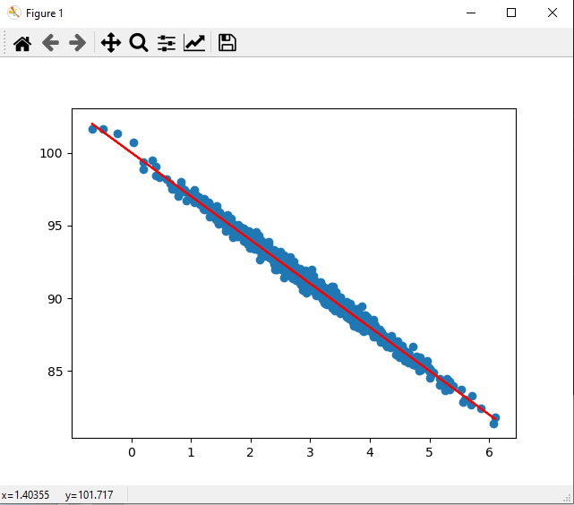
25.4 Slope and intercept
https://www.udemy.com/course/data-science-and-machine-learning-with-python-hands-on/learn/lecture/5591552#overview
Slope and Intercept
Let's use the slope and intercept we got from the regression to plot predicted values vs. observed:

Slide 20
25.5 Exercise

Slide 21
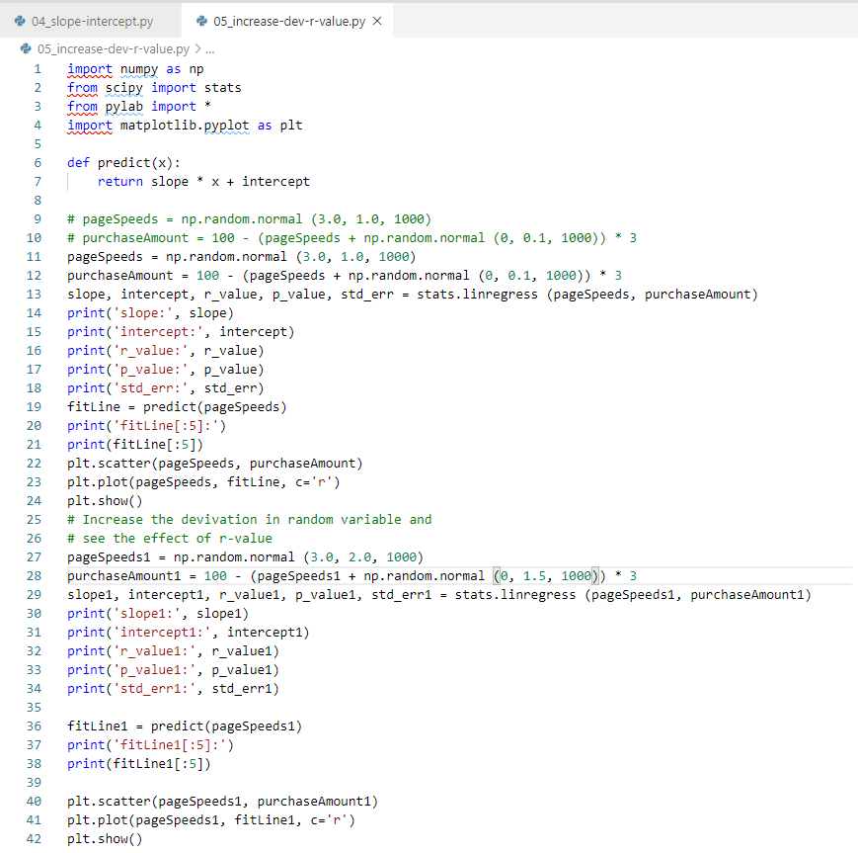
25.5 Exercise
https://www.udemy.com/course/data-science-and-machine-learning-with-python-hands-on/learn/lecture/5591552#overview
Exercise
Increase the random variation in the test data
See what effect it has on the r-squared error value.

Slide 22
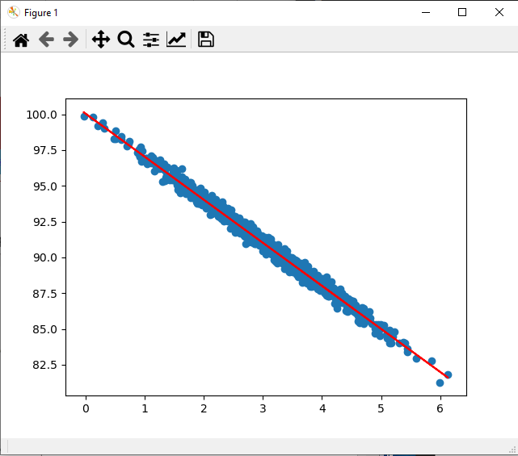
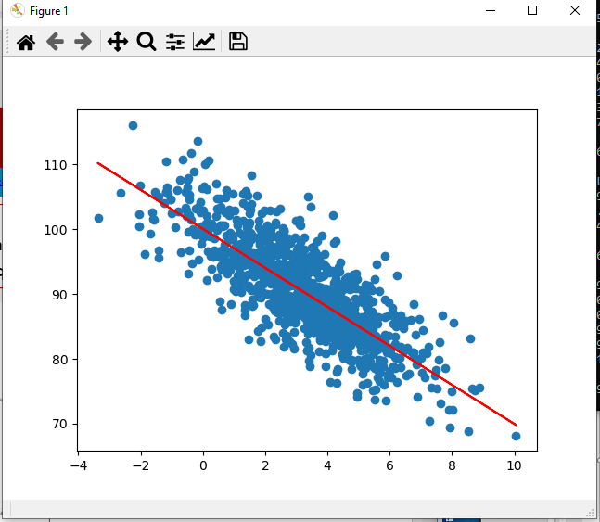
25.5 Exercise
https://www.udemy.com/course/data-science-and-machine-learning-with-python-hands-on/learn/lecture/5591552#overview
Exercise
Increase the random variation in the test data
See what effect it has on the r-squared error value.

Slide 23
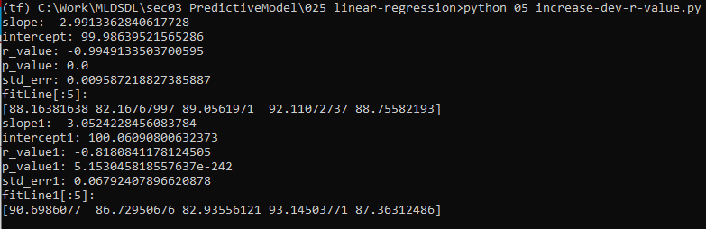
25.5 Exercise
https://www.udemy.com/course/data-science-and-machine-learning-with-python-hands-on/learn/lecture/5591552#overview
Exercise
Increase the random variation in the test data
See what effect it has on the r-squared error value.
R-value from -0.99 to -0.81. (absolute value from 0.99 to 0.81)

Slide 24
End of Chapter

