Slide 1

31 Bayesian Method: Concept
Peter H. Chen

Slide 2
31 Bayesian Method: Concept
https://www.udemy.com/course/data-science-and-machine-learning-with-python-hands-on/learn/lecture/4020548#overview
Bayesian Method: Concept
Do you have a Spam classifier for your e-mail?
How do they know the email is spam or not?
A popular technology called Naïve Bayes, and that is an example of a Bayesian method.

Slide 3
31.1 Bayesian Method

Slide 4
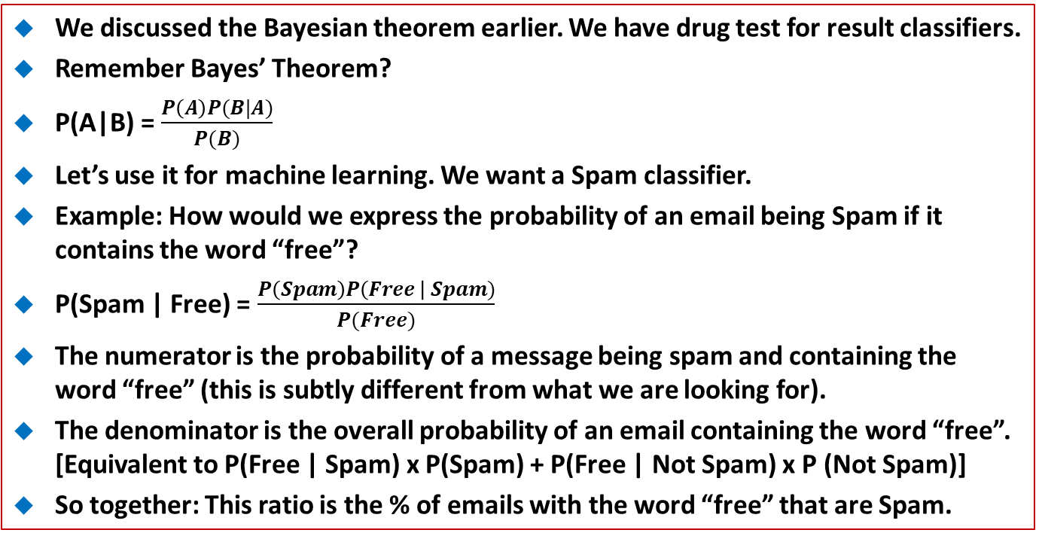
31.1 Bayesian Method
https://www.udemy.com/course/data-science-and-machine-learning-with-python-hands-on/learn/lecture/4020548#overview
We discussed the Bayesian theorem earlier. We have drug test for result classifiers.
Remember Bayes’ Theorem?
P(A|B) = $\frac{P\left(A\right)P(B|A)}{P(B)}$
Let’s use it for machine learning. We want a Spam classifier.
Example: How would we express the probability of an email being Spam if it contains the word “free”?
P(Spam | Free) = $\frac{P\left(Spam\right)P\left(Free \right| Spam)}{P(Free)}$
The numerator is the probability of a message being spam and containing the word “free” (this is subtly different from what we are looking for).
The denominator is the overall probability of an email containing the word “free”. [Equivalent to P(Free | Spam) x P(Spam) + P(Free | Not Spam) x P (Not Spam)]
So together: This ratio is the % of emails with the word “free” that are Spam.

Slide 5
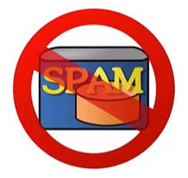
31.1 Bayesian Method
https://www.udemy.com/course/data-science-and-machine-learning-with-python-hands-on/learn/lecture/4020548#overview
How to we classifier the email is Spam?
We can construct P (Spam | Word) for every (meaningful) word we encounter during training.
Then multiple these words and P (Spam | Word) together when analyzing a new email to get the probability of it being Spam.
Assumes the presence of different words are independent of each other. We are not looking at the relationship between the words.
We call this is called “Naïve Bayes” (Naïve means “no experience”) because it has no relationship between the words themselves.
Note:
The words “SPAM” come from a brand of canned cooked pork made by Hormel Food Corporation.
The “Month Python Sketch” keep on using name “Spam” for so many times and leading this name being borrowed for “unsolicited email”.

Slide 6
31.1 Bayesian Method
https://www.udemy.com/course/data-science-and-machine-learning-with-python-hands-on/learn/lecture/4020548#overview
Sound like at lot of work
Scikit-learn is easy to Spam classifier.
Scikit-learn offers the CountVectorizer. The CountVectorizer help us operate on lot of words at once, and MultinomiaNB does all the heavy lifting on Naïve Bayes.
We will train it on know sets of Spam and “ham” (no-Spam) emails without a lot of code.
So Spam classifier is a supervised learning

Slide 7
End of Chapter

