Slide 1
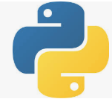
6 Install TensorFlow
Peter H. Chen

Slide 2
6 Install TensorFlow
https://github.com/peterhchen/930_Python_ML_DS_DL
Install Tensorflow
Under the Windows 10 (Linux or MacOS), Tensorflow 6.0 has dependencies for Anaconda 3, Python 3, and numpy, scikit-learn (formal name is SciKits or SciPy Toolkit), and associated frameworks.
After environment update for many years, it is very difficult to fix with tons of error messages.
It is easier to install a clean system with Python and associated Tensorflow dependencies.
Jeff Heaton provides the video and yaml file tensorflow.yml.
YouTube video:
https://www.youtube.com/watch?v=RgO8BBNGB8w&t=376s
Jeff Heaton GitHub:
https://github.com/jeffheaton/t81_558_deep_learning

Slide 3
6.1 Install Anaconda

Slide 4

6.1 Install Anaconda
https://github.com/peterhchen/930_Python_ML_DS_DL
Install Anaconda
Google search for “Anaconda download” and select “Individual Edition”.

Slide 5
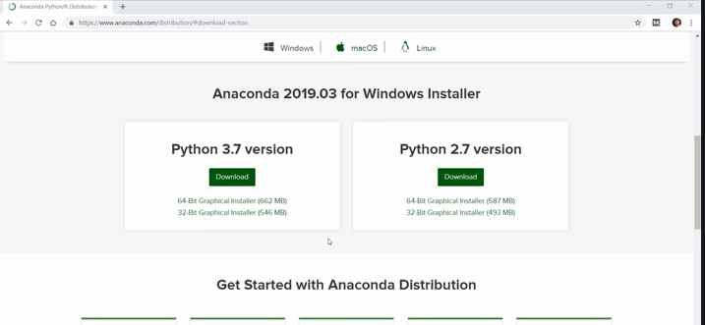
6.1 Install Anaconda
https://github.com/peterhchen/930_Python_ML_DS_DL
Install Anaconda
Select Python 3.7. Anaconda container come with Python 3.7.

Slide 6
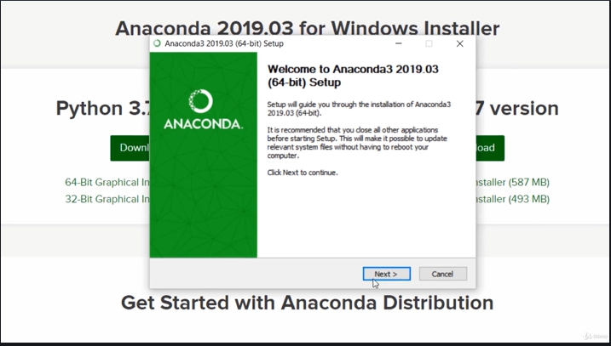
6.1 Install Anaconda
https://github.com/peterhchen/930_Python_ML_DS_DL
Install Anaconda
Click Next.

Slide 7
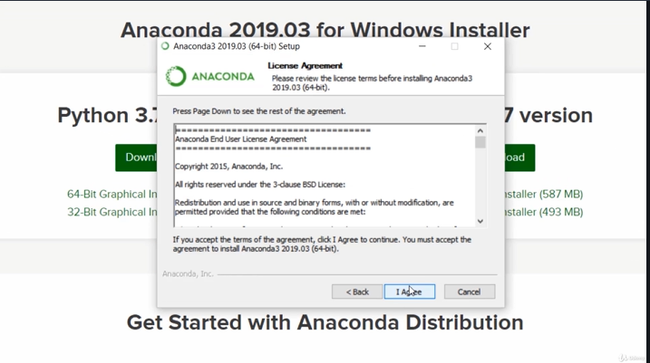
6.1 Install Anaconda
https://github.com/peterhchen/930_Python_ML_DS_DL
Install Anaconda
Click “I Agree”, and click default to install.

Slide 8
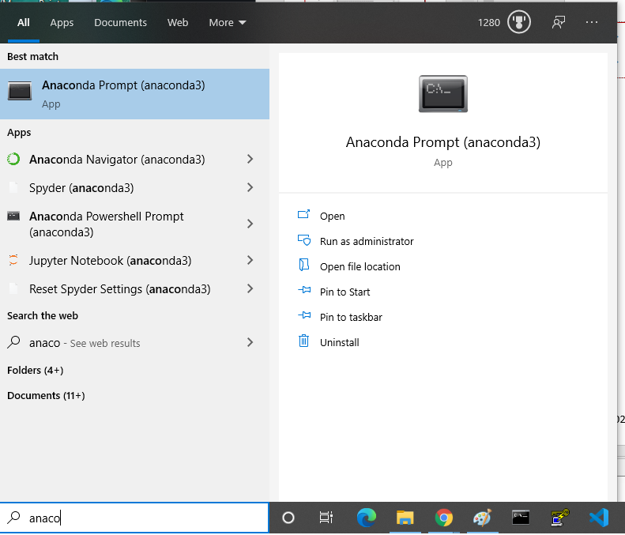
6.1 Install Anaconda
https://github.com/peterhchen/930_Python_ML_DS_DL
Install Anaconda
After finished installation, we can bring “Anaconda prompt”

Slide 9
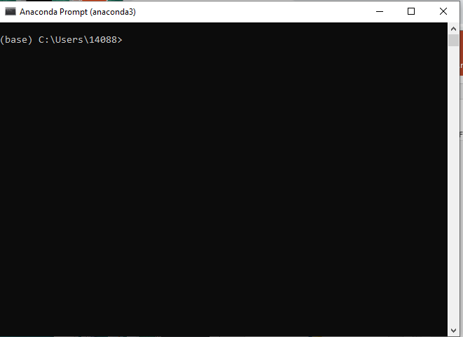
6.1 Install Anaconda
https://github.com/peterhchen/930_Python_ML_DS_DL
Install Anaconda
We have the default Anaconda prompt.

Slide 10
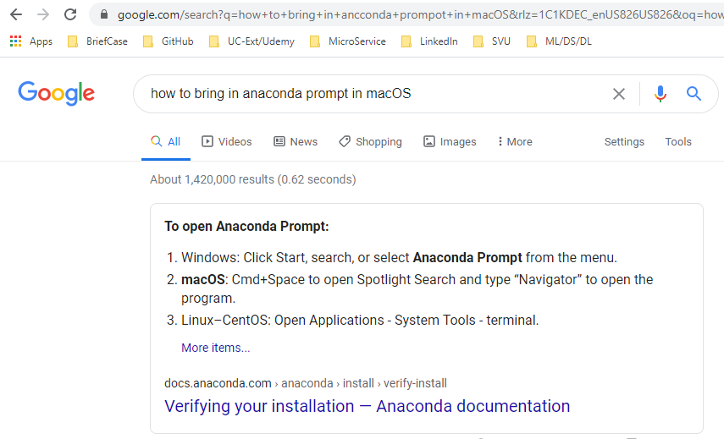
6.1 Install Anaconda
https://github.com/peterhchen/930_Python_ML_DS_DL
Install Anaconda
For MacOS and Linux, we can open Anconda prompt as follow:

Slide 11
6.6 Create Tensorflow Environment

Slide 12
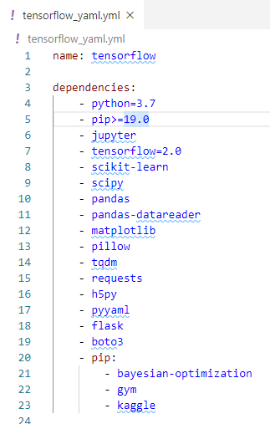
6.6 Create Tensorflow Environment
https://github.com/peterhchen/930_Python_ML_DS_DL
Create Tensorflow Environment
2020, Installing TensorFlow 6.0, Keras, and Python 3.7 in Windows 10
Download the tensroflow.yml
This file contains the environment setup for us.

Slide 13
6.3 Install Jupyter

Slide 14

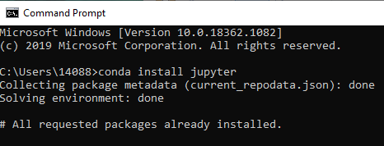
6.3 Install Jupyter
https://github.com/peterhchen/930_Python_ML_DS_DL
Install Jupyter
Under window 10 (MacOS/Linux) prompt or Anaconda prompt:
> conda install jupyter

Slide 15
6.6 Install Tensorflow Environments

Slide 16
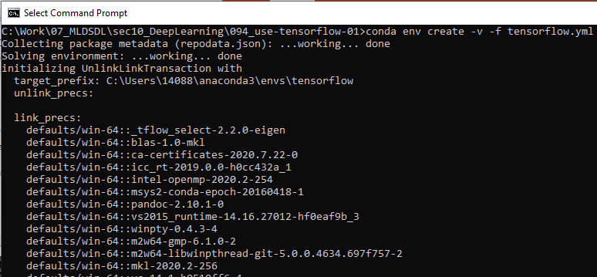
6.6 Install Tensorflow Environments
https://github.com/peterhchen/930_Python_ML_DS_DL
Install Tensorflow and Associated Environments
This is very important:
Download tensorflow.yml includes the verified dependencies and frameworks.
This prevent us to use incompatible dependencies and very difficult to fix.
C:\[work-folder] > conda env create -v -f tensorflow.yml

Slide 17
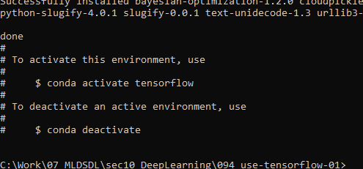
6.6 Install Tensorflow Environments
https://github.com/peterhchen/930_Python_ML_DS_DL
Install Tensorflow and Associated Environments
After tensroflow.yml installed, we have the following message:
Start anaconda prompt
(base) > conda activate tensroflow
(tensorflow) > conda deactivate

Slide 18
6.5 Start Tensorflow Environments

Slide 19
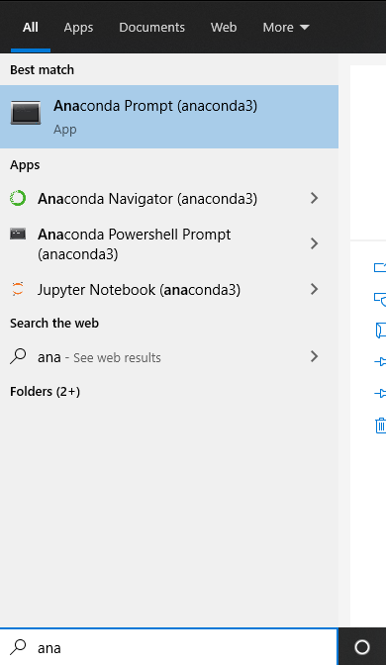
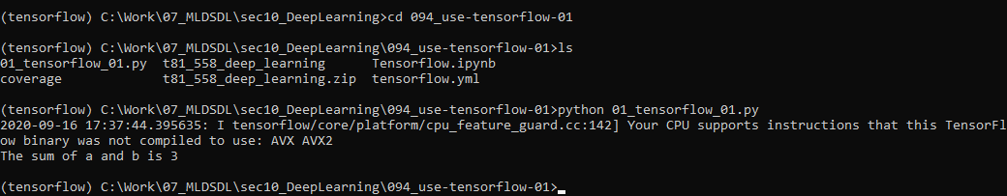
6.5 Start Tensorflow Environments
https://github.com/peterhchen/930_Python_ML_DS_DL
Start Tensorflow Environments
start anaconda prompt
> conda activate tensorflow
> cd [work-folder]

Slide 20
6.6 Run Jupyter Tensorflow

Slide 21
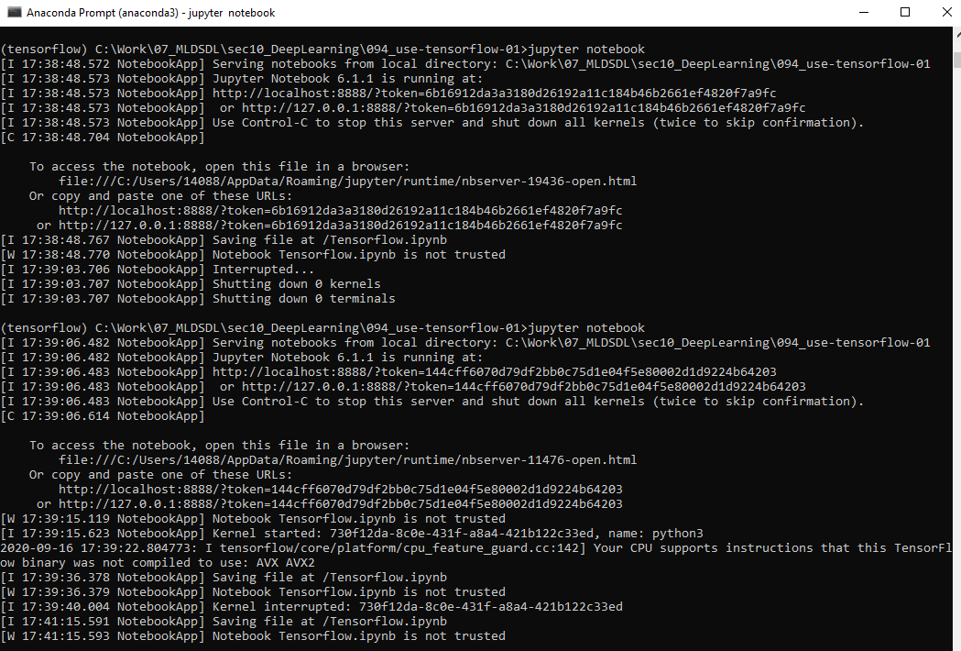
6.6 Run Jupyter Tensorflow
https://github.com/peterhchen/930_Python_ML_DS_DL
Start Jupyter Notebook
> ls
> jupyter notebook

Slide 22
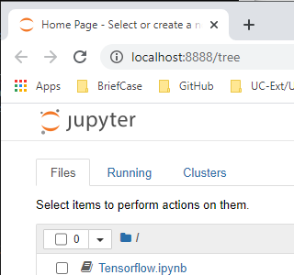
6.6 Run Jupyter Tensorflow
https://github.com/peterhchen/930_Python_ML_DS_DL
Use Tensorflow 01
We can see “Tensorflw.ipynb”
Double click to open

Slide 23
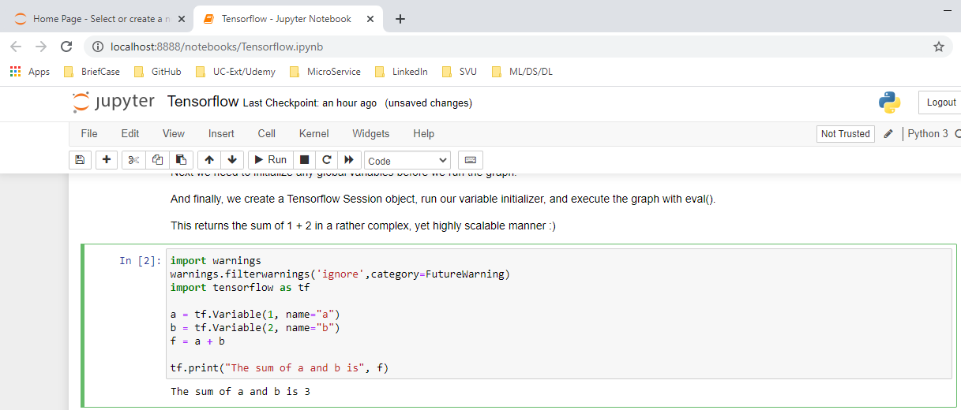
6.6 Run Jupyter Tensorflow
https://github.com/peterhchen/930_Python_ML_DS_DL
Use Tensorflow 01
We can see “Tensorflw.ipynb”
Double click to open

Slide 24
6.7 Run Python Tensorflow
Peter H. Chen

Slide 25
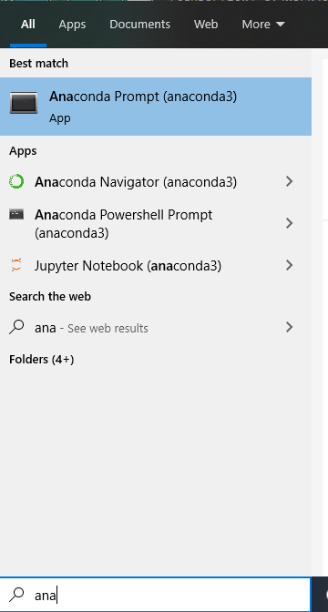
6.7 Run Python Tensorflow
https://github.com/peterhchen/930_Python_ML_DS_DL
Run Python Tensorflow
Under window 10
Search “anaconda”

Slide 26
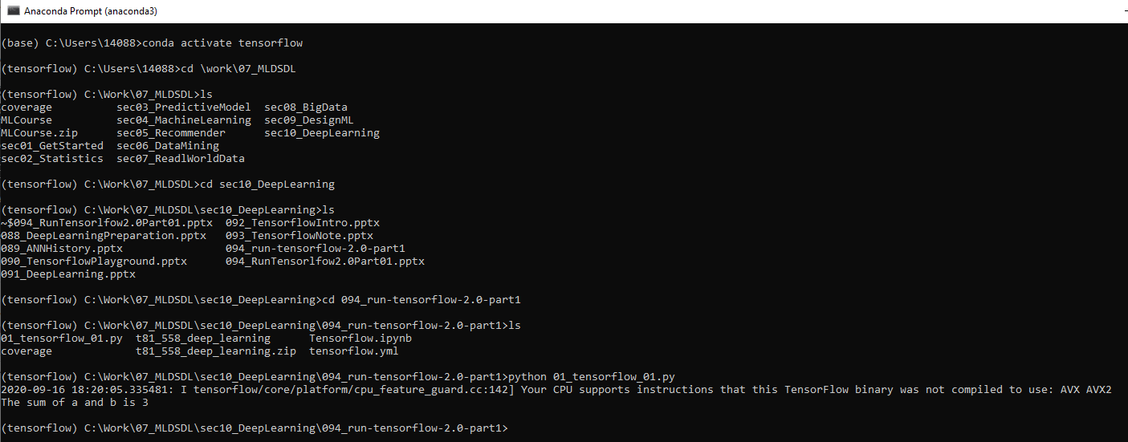
6.7 Run Python Tensorflow
https://github.com/peterhchen/930_Python_ML_DS_DL
Run Python Tensorflow
Activate TensorFlow environment
(base) > conda activate tensorflow
(tensorflow) > cd [work folder]
(tensorflow) > [work folder] > python 01_tnesorflow_01.py

Slide 27
End of Chapter

