Slide 1

69 Binning and etc
Peter H. Chen

Slide 2
69 Binning and etc
https://www.udemy.com/course/data-science-and-machine-learning-with-python-hands-on/learn/lecture/16656268#overview
Binning, Transforming, Encoding, Scaling, and Shuffling
We discussed Binning, Transforming, Encoding, Scaling, and Shuffling.

Slide 3
69.1 Binning

Slide 4
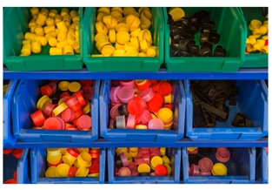
69.1 Binning
https://www.udemy.com/course/data-science-and-machine-learning-with-python-hands-on/learn/lecture/16656268#overview
Binning
Bucket observations together based on ranges of values
Example: Estimated ages of people
Put all 20-somethings in one classification, 30-somethinfs in another, etc.
Quantile binning categorizes data by their place in the data distribution
Ensure even sizes of bins
Transforms numeric data to ordinal data
Especially useful when there is uncertainty in the measurement

Slide 5
69.1 Binning
https://www.udemy.com/course/data-science-and-machine-learning-with-python-hands-on/learn/lecture/16656268#overview
Binning Explanation
Let's quickly go through some other techniques you might use in the process of feature engineering.
One is called "binning".
The idea here is just to take your numerical data, and transform it into categorical data by binning these values together based on ranges of values.
For example, maybe I have the ages of people in my data set.
I might put every one of their 20s into one bucket, if they're their 30s into another bucket, and so on and so forth.
That would be an example of binning where I'm just putting everyone in a given a range into a certain category.
Instead of saying I'm going to train based on the fact that you're 22 and 3 months old, I'm just going to bucket you into the bin of 20 year old.
I have changed that number of 22 point whatever it is into a category of 20 somethings.

Slide 6
69.1 Binning
https://www.udemy.com/course/data-science-and-machine-learning-with-python-hands-on/learn/lecture/16656268#overview
Binning Explanation
So that's all binning is.
Why would you want to do that?
Well there's a few reasons.
One is that sometimes you have some uncertainty in your measurements.
Maybe your measurements aren't exactly precise, and you're not actually adding any information of person is 22.37 years old versus 22.38 years old.
Maybe some people will remember the wrong birthday or something, or you know you ask someone different days and you got different values as a result.
So binning is a way of covering up imprecision in your measurements.
That's one way. That's one reason.
Another reason might be that you just really want to use a model that works on categorical data instead of numerical data.
You know that's kind of a questionable thing to be doing, because you're basically throwing some information away by binning right.

Slide 7
69.1 Binning
https://www.udemy.com/course/data-science-and-machine-learning-with-python-hands-on/learn/lecture/16656268#overview
Binning Explanation
If you're doing that you should think hard about why you're doing that.
The only really legitimate reason to do this is if there is uncertainty or errors in your actual underlying measurements that you're trying to get rid of.
There's also something called quantile binning that you should understand.
The nice thing about quantile binning is that it categorizes your data by their place in the data distribution.
It ensures that every one of your bins has an equal number of samples within them.
With quantile burning, you know make sure that I have my data distributed in such a way that I have the same number of samples in each resulting bin.
Sometimes that's a useful thing to do.
Remember quantile binning will have even sizes in each bin.

Slide 8
69.2 Transforming

Slide 9
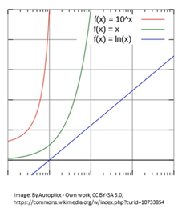
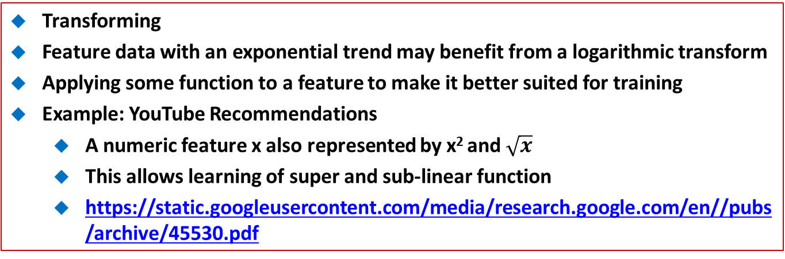
69.2 Transforming
https://www.udemy.com/course/data-science-and-machine-learning-with-python-hands-on/learn/lecture/16656268#overview
Transforming
Feature data with an exponential trend may benefit from a logarithmic transform
Applying some function to a feature to make it better suited for training
Example: YouTube Recommendations
A numeric feature x also represented by x² and $\sqrt{x}$
This allows learning of super and sub-linear function
https://static.googleusercontent.com/media/research.google.com/en//pubs/archive/45530.pdf

Slide 10
69.2 Transforming
https://www.udemy.com/course/data-science-and-machine-learning-with-python-hands-on/learn/lecture/16656268#overview
Transforming Explanation
Another thing we might do is transforming our data, applying some sort of a function to our features to make it better suited for our algorithms.
For example, if you have feature data that has an exponential trend within it, that might benefit from doing a logarithmic transform on it to make that data look more linear.
That might help out your model in actually finding real trends in it.
Sometimes models have difficulty with nonlinear data coming into it.
A real world example is YouTube, they publish a paper on how their recommendations work, which is great reading by the way, there's a reference to that in the slide here.
https://static.googleusercontent.com/media/research.google.com/en//pubs/archive/45530.pdf
They have a whole section on feature engineering there that you might find useful.

Slide 11
69.2 Transforming
https://www.udemy.com/course/data-science-and-machine-learning-with-python-hands-on/learn/lecture/16656268#overview
Transforming Explanation
And one thing they do is for any numeric feature X that they have, you know for example, how long has it been since you watched the video, they also feed in the square of that and the square root of it.
The idea there is that they can learn super and sub linear functions in the underlying data that way.
They're not just throwing in raw values, they're also throwing in the square and the square root just to be careful and see if there actually are nonlinear trends there that they should be picking up on.
They found that that actually improves their results.
That is an example of transforming data.
It's not necessarily replacing data with a transformation, sometimes you're actually creating a new feature from transforming an existing one.
That's what's going on here.

Slide 12
69.2 Transforming
https://www.udemy.com/course/data-science-and-machine-learning-with-python-hands-on/learn/lecture/16656268#overview
Transforming Explanation
They are feeding in both the original feature X and X squared and the square root of X.
You can see in this graph here why you might want to do that.
If I'm starting off with a function of X here on the green line, you can see that by taking the Ln, the logarithm, of that I end up with a linear relationship instead which might be easier for models to pick up on.
I could also raise that to a higher power which would actually make things worse in this case.
But sometimes more data is better.
Again you know we're talking about the curse of dimensionality, so there is a limit to that, but that’s what future engineering is all about, trying to find that balance between having just enough information and too much information.

Slide 13
69.3 Encoding

Slide 14
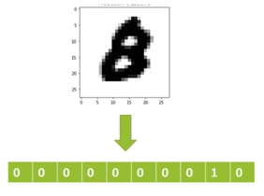
69.3 Encoding
https://www.udemy.com/course/data-science-and-machine-learning-with-python-hands-on/learn/lecture/16656268#overview
Encoding
Transforming data into some new representation required by the model
One-hot encoding
Create “buckets” for every category
The bucket for your category has a , all others have a 0.
Very common in deep learning, where categories are represented by individual output “neurons”

Slide 15
69.3 Encoding
https://www.udemy.com/course/data-science-and-machine-learning-with-python-hands-on/learn/lecture/16656268#overview
Encoding Explanation
Another very common thing you'll do while preparing your data is encoding and you see this a lot in the world of deep learning.
A lot of times your model will require a very specific kind of input and you have to transform your data and encode it into the format that your model requires. A very common example is called One-hot encoding.
Make sure you understand how this works.
The idea is how to create a bucket for every category that I have.
Basically, I have a one that represents that.
That category exists.
And a zero that represents that it's not that category.
Let's look at this picture as an example, let's say that I'm building a deep learning model that tries to do handwriting recognition on people drawing the numbers 0 through 9.

Slide 16
69.3 Encoding
https://www.udemy.com/course/data-science-and-machine-learning-with-python-hands-on/learn/lecture/16656268#overview
Encoding Explanation
This is a very common example that will look at more later.
To one-hot encode this information, I know that this thing represents the number eight, and to represent that in a one-hot encoded manner.
Basically I have ten different buckets for every possible digit that that might represent 0 1 2 3 4 5 6 7 8 or 9.
Now, I usually start counting at zero here, so you can see here that in the ninth slot there, there’s a one that represents the number eight, and every other slot there has a zero representing that it is not that category.
That's all one-hot encoding is.
Again if I had a one in that first slot, I would represent the number zero.
If I had a one in the second slot that'd represent the number one, and so on and so forth.

Slide 17
69.3 Encoding
https://www.udemy.com/course/data-science-and-machine-learning-with-python-hands-on/learn/lecture/16656268#overview
Encoding Explanation
We do this because in deep learning, neurons generally are either on or off, or activated or they're not activated, so I can’t just feed in the number eight or the number one into an input neuron and expect it to work.
That's that's not how these things operate.
Instead I need to have this one-hot encoding scheme, where every single training value, that label is actually going to be fed into 10 different input neurons, where only one of them represents the actual category I have.

Slide 18
69.4 Scaling/Normalization

Slide 19
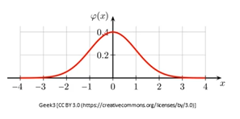
69.4 Scaling/Normalization
https://www.udemy.com/course/data-science-and-machine-learning-with-python-hands-on/learn/lecture/16656268#overview
Scaling/Normalization
Some models prefer feature data to be normally distributed around 0 (most neural networks).
Most models require feature data to at least be scaled to comparable values
Otherwise, features with larger magnitudes will have more weight than they should
Example: modeling age and income as features – incomes will be much higher values than ages
Scikit-learn has a preprocessor module that helps (MinMaxScaler, and etc.)
Remember to scale your result back.

Slide 20
69.4 Scaling/Normalization
https://www.udemy.com/course/data-science-and-machine-learning-with-python-hands-on/learn/lecture/16656268#overview
Scaling/Normalization Explanation
We can also talk about scaling and normalizing your data, again pretty much every model requires this as well.
A lot of models prefer their feature data to be normally distributed around zero.
This is also true of most deep learning and neural networks, and at a minimum most models will require that your feature data is at least scaled to comparable values.
There are models out there that don't care so much, such as decision trees, but most of them will be sensitive to the scale of your input data.
Otherwise, if you have features that have larger magnitudes, they will end up having more weight on your model than they should.
Going back to the example of people, if I'm trying to train a system based on their income, which might be some very large number, like you know 50000, and also their age, which is a relatively small number, like you know 30 or 40.
If I weren't normalizing that data down to comparable ranges before training on it, that income would have a much higher impact on the model than their ages.

Slide 21
69.4 Scaling/Normalization
https://www.udemy.com/course/data-science-and-machine-learning-with-python-hands-on/learn/lecture/16656268#overview
Scaling/Normalization Explanation
That is going to result in a model that doesn't do a very good job.
Now it's very easy to do this, especially with Scikit_learn in Python. It has a pre processor module that helps you out with this sort of thing.
It has something called MinMaxScaler that will do it for you very easily.
The only thing is you have to remember to scale your results back up if what you're predicting is not just categories and actual numeric data.
So sometimes if you're predicting something, you have to make sure to reapply that scaling in reverse to actually get a meaningful result out of your model at the end of the day.

Slide 22
69.5 Shuffling

Slide 23

69.5 Shuffling
https://www.udemy.com/course/data-science-and-machine-learning-with-python-hands-on/learn/lecture/16656268#overview
Shuffling
Many algorithms benefit from shuffling their training data
Otherwise, they may learn from residual signals in the training data resulting from the order in which they were collected.

Slide 24
69.5 Shuffling
https://www.udemy.com/course/data-science-and-machine-learning-with-python-hands-on/learn/lecture/16656268#overview
Shuffling Explanation
Finally we will talk about "shuffling".
A lot of algorithms benefit from shuffling your training data.
Otherwise, sometimes there is sort of a residual signal in your training data, resulting from the order in which that data was collected.
You want to make sure you're eliminating any byproducts of like how the data was actually collected by shuffling it, and just randomize the order that its fed into your model.
Often that makes a difference in the quality as well.
There are a lot of stories I've seen where someone got a really bad result out of their machine learning model, but by just shuffling the input, things got a lot better.
Do not forget to do shuffling as well. That is the world of feature engineering in a nutshell (simply in one word).

Slide 25
End of Chapter

