Slide 1
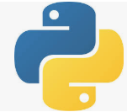
36-38 Graphviz
Peter H. Chen

Slide 2
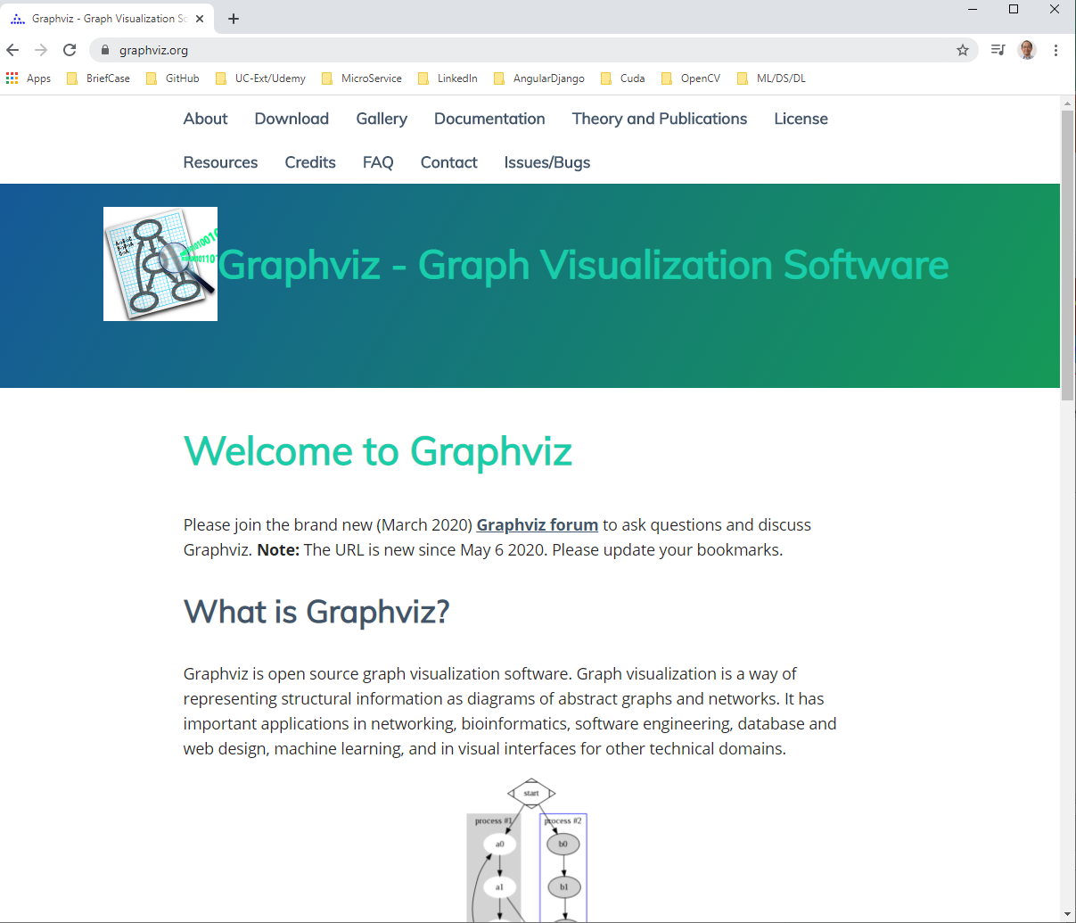
36-38 Graphviz
https://www.udemy.com/course/data-science-and-machine-learning-with-python-hands-on/learn/lecture/15090192#overview
Graphviz
On windows with Anaconda environment, we do not have to do anything for Decision Tree.
https://graphviz.org/

Slide 3
36-38 Graphviz
https://www.udemy.com/course/data-science-and-machine-learning-with-python-hands-on/learn/lecture/15090192#overview
Graphviz
If you have anaconda, the Graphviz is automatically installed for you.
For Mac and Linux user, you need extra step to install Graphviz.
For Mac:
You need to install Homebrew first by “curl command”
> brew install graphviz
For Linux:
> sudo apt-get install graphviz

Slide 4
End of Chapter

