Slide 1

39 Decision Tree
Peter H. Chen

Slide 2
39 Decision Tree
https://www.udemy.com/course/data-science-and-machine-learning-with-python-hands-on/learn/lecture/15090192#overview
Decision Trees
If you have something that you try to predict one, you can use a decision tree.
The decision tree actually look at multiple attributes.
The decision tree decide upon at each level in a flow chart.
You can actually print out the flow chart and see the flow chart of the decision tree based on the actual machine learning.

Slide 3
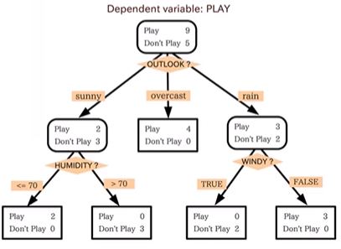
39 Decision Tree
https://www.udemy.com/course/data-science-and-machine-learning-with-python-hands-on/learn/lecture/15090192#overview
Decision Trees
Decision Tree is one of most interesting applications in machine learning.
You can actually construct a flowchart to help you decide a classification for something with machine learning.
You have some dependent variable, whether or not we will go outside or not, based on the weather.
And you have a decision depends on multiple attributes, multiple variables, a decision tree can be a good choice. This is called a Decision Tree. So, there can be many different aspects of the weather that may influence our decision of going out to play.

Slide 4
39 Decision Tree
https://www.udemy.com/course/data-science-and-machine-learning-with-python-hands-on/learn/lecture/15090192#overview
Decision Trees
Our decision may have to do with the humidity, the temperature, whether it is sunny or not, and etc.
A decision tree can look at all these different attributes of the weather or anything else, and decide what is the threshold, what are the decisions we need to make on each one of those attributes before we arrive at a decision or whether or not I should go and play outside.
This is all a Decision Tree is.
So a decision tree is a form of supervised learning
Give it some sample data and the resulting classifications
Outcome is a tree.

Slide 5
39 Decision Tree
https://www.udemy.com/course/data-science-and-machine-learning-with-python-hands-on/learn/lecture/15090192#overview
Decision Trees
We would have some data set of historical weather and whether or not people went outside to play that day.
For example, we would feed data to the model. The data of whether it was a sunny or not on each day and what is the humidity was, it was windy or not, and whether or not it was a good day to go play outside.
Given that training data, a decision tree algorithm can actually arrive at a tree that gives you this flowchart that you can print out.
The flowchart looks like the right diagram.
You can walk through and figure out it is a good day to play outside based on the current attributes.
So, you can use that to predict a decision for a new set of values.

Slide 6
39 Decision Tree
https://www.udemy.com/course/data-science-and-machine-learning-with-python-hands-on/learn/lecture/15090192#overview
Decision Trees
We have an algorithm that will make a flowchart for you automatically just based on observation data.

Slide 7
39.1 Decision Tree Example

Slide 8
39.1 Decision Tree Example
https://www.udemy.com/course/data-science-and-machine-learning-with-python-hands-on/learn/lecture/15090192#overview
Decision Trees Example
The technological companies have tons of tons resumes. We have to decide who we are actually bring in for an interview because it can be expensive to filter somebody out. It takes time to conduct an interview.
What if there is a way to actually to take historical data on who actually got hired and map that to things in the resume that are found on their resume.
We can construct a decision tree that will go through an individual resume and based on the historical data and filter the resume will get hired or not.
So, we can train the decision tree based on that historical data, and walk through that for future candidates.

Slide 9
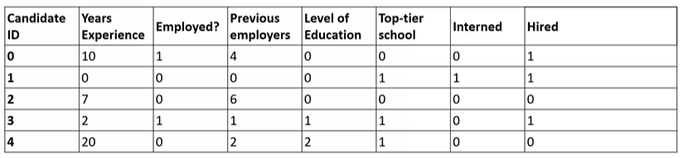
39.1 Decision Tree Example
https://www.udemy.com/course/data-science-and-machine-learning-with-python-hands-on/learn/lecture/15090192#overview
Totally Fabricated Hiring Data
We have several attributes, how may years of experience do they have? Are they currently employed? How many employers do have previously? What is the level of education? What degree do they have? Did they go to what we classify as top-tier school? Did they do an internship while they were in college?
We can take a look of the historical data and the dependent variable here is “Hired”, the person actually get a job offer or not based on that information.
Obviously, there is a lot of information. The decision tree that we train from this data might actually be useful in doing an initial pass and filter out some candidates.

Slide 10
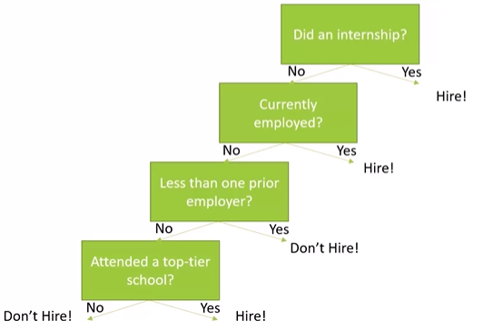
39.1 Decision Tree Example
https://www.udemy.com/course/data-science-and-machine-learning-with-python-hands-on/learn/lecture/15090192#overview
Totally Fabricated Tree: Should I hire this person?
Internship can be a good predict for how good a person is.
Currently employed, then hire.
If not, then check for previous employer, if none do not hire.
If yes, more than one previous employers, then check the degree he have. Is he from top tier school? If yes, then get hire.

Slide 11
39.2 What is Entropy?

Slide 12

39.2 What is Entropy?
https://www.udemy.com/course/data-science-and-machine-learning-with-python-hands-on/learn/lecture/15090192#overview
What is entropy?
https://www.britannica.com/science/entropy-physics
Entropy is the measure of system thermal energy per unit temperature that is unavailable for useful work. The work is obtained from ordered molecule work.
The entropy is the measure of molecular disorder or randomness of a system.
https://towardsdatascience.com/entropy-how-decision-trees-make-decisions-2946b9c18c8
In decision tree, the entropy is used to measure of disorder.

Slide 13
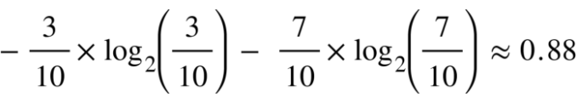
39.2 What is Entropy?
https://www.udemy.com/course/data-science-and-machine-learning-with-python-hands-on/learn/lecture/15090192#overview
What is entropy?
https://towardsdatascience.com/entropy-how-decision-trees-make-decisions-2946b9c18c8
The Pi is the probability of an element/class i in our data.
For example, we have two classes, a positive class and a negative class. Therefore i here could be either + or (-).
If we had a total of 100 data points in our dataset with 30 belonging to the positive class and 70 belonging to the negative class then ‘P+’ would be 3/10 and ‘P-’ would be 7/10.
The entropy here is approximately 0.88. It is a high entropy, a high level of disorder (meaning low level of purity).
Entropy is measured between 0 and 1.(Depending on the number of classes in your dataset, entropy can be greater than 1 but it means the same thing , a very high level of disorder. For the sake of simplicity, the examples in this blog will have entropy between 0 and 1).

Slide 14
39.2 What is Entropy?
https://www.udemy.com/course/data-science-and-machine-learning-with-python-hands-on/learn/lecture/15090192#overview
What is entropy?
https://towardsdatascience.com/entropy-how-decision-trees-make-decisions-2946b9c18c8
The Pi is the probability of an element/class i in our data.
For example, we have two classes, a positive class and a negative class. Therefore i here could be either + or (-).
If we had a total of 100 data points in our dataset with 30 belonging to the positive class and 70 belonging to the negative class then ‘P+’ would be 3/10 and ‘P-’ would be 7/10.
The entropy here is approximately 0.88. It is a high entropy, a high level of disorder (meaning low level of purity).

Slide 15
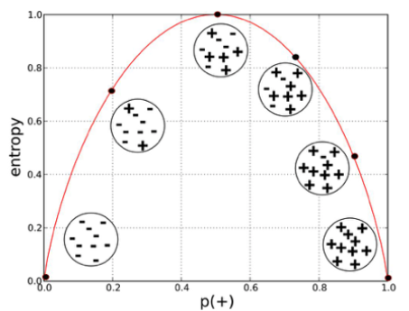
39.2 What is Entropy?
https://www.udemy.com/course/data-science-and-machine-learning-with-python-hands-on/learn/lecture/15090192#overview
What is entropy?
https://towardsdatascience.com/entropy-how-decision-trees-make-decisions-2946b9c18c8
Entropy is measured between 0 and 1 depending on the number of classes in your dataset, entropy can be greater than 1 but it means the same thing , a very high level of disorder.
We will separate 0 and 1 class at the minimize the entropy.

Slide 16
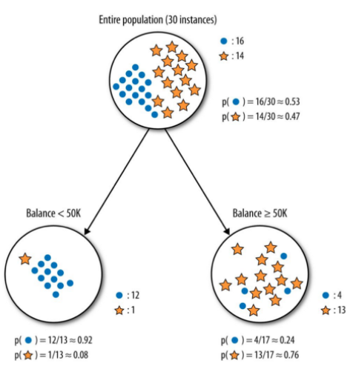
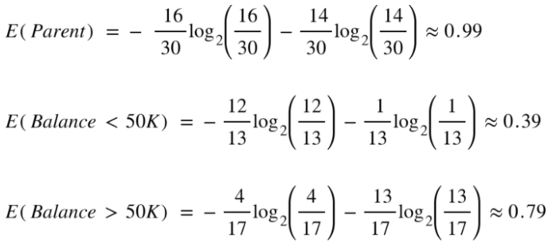
39.2 What is Entropy?
https://www.udemy.com/course/data-science-and-machine-learning-with-python-hands-on/learn/lecture/15090192#overview
What is entropy?
https://towardsdatascience.com/entropy-how-decision-trees-make-decisions-2946b9c18c8
We minimize the entry in the decision tree.
Here parent is 0.99.
The child is 0.39 and 0.79, respectively.

Slide 17
39.3 How Decision Tree Work?

Slide 18
39.3 How Decision Tree Work?
https://www.udemy.com/course/data-science-and-machine-learning-with-python-hands-on/learn/lecture/15090192#overview
How Decision Tree Work?
The Fancy name for this simple algorithm is called ID3 (Iterative Dichotomizer 3).
https://en.wikipedia.org/wiki/ID3_algorithm
It is a greedy algorithm: as it goes down the tree, it just picks the decision that will minimize the entropy at that point.
That might not actually result in an optimal tree that minimize the number of choices that you have to make
But it will result in a tree that works given the data that you gave it. It is a very simple idea.

Slide 19
39.3 How Decision Tree Work?
https://www.udemy.com/course/data-science-and-machine-learning-with-python-hands-on/learn/lecture/15090192#overview
How Decision Tree Work?
The algorithm is simple but it works:
At each step, find the attribute we can use to partition the data set to minimize the entropy of the data at the next step.
We have a result of classification. In this case, it is “hire” or “don’t hire”.
We want to choose the attribute decision. At each step, that will minimize the entropy at the next step.
Basically, at each step, we want to make all the remaining choices, result in either as many no-hires or as many hire decision as possible.
We want to make that data more and more uniform.
So, as we work our way down the flow chart, we ultimately end up with a set of candidates that ae either all “hires” or all “no-hires”.
So we can classify into yes or no decision on a decision tree.
So, we just walk down the tree, minimize entropy at each step by choosing the right attribute to decision on and keep on going until we run out.

Slide 20
39.4 Random Forest

Slide 21
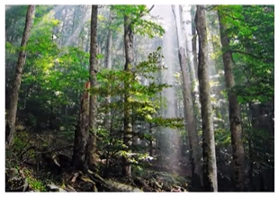
39.4 Random Forest
https://www.udemy.com/course/data-science-and-machine-learning-with-python-hands-on/learn/lecture/15090192#overview
Random Forest
One problem with Decision trees is they are very susceptible to overfitting.
We saw it work beautifully for the data it trained on but might not be great for actually predicting for correct classification for new people that have not seen before.
The decision trees are all about arriving at the right decision for the existed training data.
It did not consider for the new people. This decision tree method causes the real problem to predict for the new people.

Slide 22
39.4 Random Forest
https://www.udemy.com/course/data-science-and-machine-learning-with-python-hands-on/learn/lecture/15090192#overview
Random Forest
To fight this, we use a technique called Random Forest.
The idea of Random Forest here is we actually sample our data that we train on different ways for multiple decision trees.

Slide 23
39.4 Random Forest
https://www.udemy.com/course/data-science-and-machine-learning-with-python-hands-on/learn/lecture/15090192#overview
Random Forest
We can construct several alternate decision trees and let them “vote” on the final classification.
Randomly re-sample the input data for each tree. The term for this is called Bootstrap aggregating or bagging. This is a form of what we called ensemble learning. We will discuss more detail next. The basic idea here, we have multiple trees, a forest of trees. Each tree uses a random sub-sample of data that we have to train on. And then each of trees can vote on the final result. That will help us to result overfitting for a given set of training data..
The other thing random forest can do is actually restrict the number of attributes that can choose between, at each stage, it try to minimize the entropy as it goes. And it can randomly pick what attributes it can choose from at each level. It also give the variation from tree to tree, and therefore, we get more of variety of algorithms that we can compete each others. And they can all vote on the final result using different approach at arriving at the same answer. Randomize a subset of the attributes. Each step is allowed to choose form.

Slide 24
39.4 Random Forest
https://www.udemy.com/course/data-science-and-machine-learning-with-python-hands-on/learn/lecture/15090192#overview
Random Forest
That is how random forest work. Basically, it is a forest of decision tree where they are drawing from different samples and also different sets of attributes at each stage that is can choose between.

Slide 25
39.5 Summary

Slide 26
39.5 Summary
https://www.udemy.com/course/data-science-and-machine-learning-with-python-hands-on/learn/lecture/15090192#overview
Summary
In this discussion, we discuss the concept of entropy, decision tree, and random forest.
Next:
We will use scikit-learn to implement decision tree and random forest.

Slide 27
End of Chapter

