Slide 1

48 Improve Movie Similarities
Peter H. Chen

Slide 2
48 Improve Movie Similarities
https://www.udemy.com/course/data-science-and-machine-learning-with-python-hands-on/learn/lecture/4020682#overview
Improve Movie Similarities
We discuss how to improve Movie Similarities.

Slide 3
48.1 Initial Sort Data

Slide 4
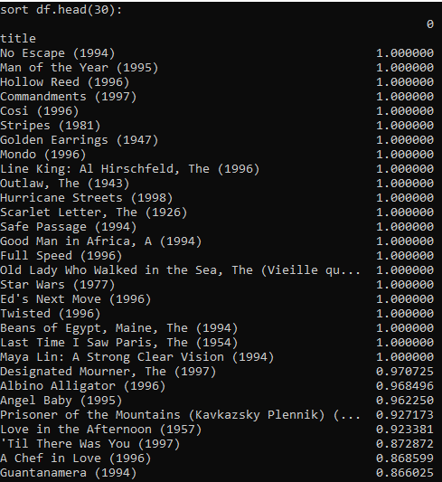

48.1 Initial Sort Data
https://www.udemy.com/course/data-science-and-machine-learning-with-python-hands-on/learn/lecture/4020682#overview
Improve Movie Similarities
We have the initial result for movie similarities.
We see the a lot of recommendation of movie with all 1.0 scores.
Is it make sense?
We have a lot of people who watch Star Wars and some other obscure (unclear) film.
We have goo correlation between these movies because they are tied together by Star Wars.

Slide 5
48.1 Initial Sort Data
https://www.udemy.com/course/data-science-and-machine-learning-with-python-hands-on/learn/lecture/4020682#overview
Improve Movie Similarities
Do we want to recommend these same obscure movie to our customer? The answer is “No”.
Do we recommend “No Escape”, “Full Speed”, and etc.? Probably not to make good recommendation to other users.
We need some confidence level in our similarities by enforcing some minimum bound of how many people watched that movie. We cannot make a judgement that a given movie is good just based on the score of one of two people.

Slide 6
48.2 Reviewer Count and Average Score

Slide 7
48.2 Reviewer Count and Average Score

Slide 8
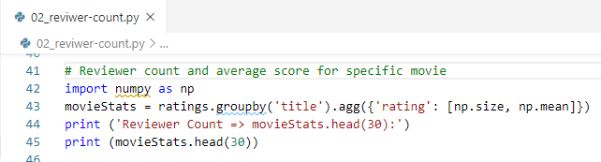
48.2 Reviewer Count and Average Score
https://www.udemy.com/course/data-science-and-machine-learning-with-python-hands-on/learn/lecture/4020682#overview
Reviewer Count and Average Score
Since the movie score based on one or two people is not confident enough, we need to set the requirement with minimum number of reviewer, such as, 500 people write the score 1.0 is more confident than one people write score 1.0.
We aggregate the title with size, we can see how many people review the movie.
We aggregate all of the rows of the same title into one row.
We aggregate the ratings (size and average score/mean) for specific title.

Slide 9
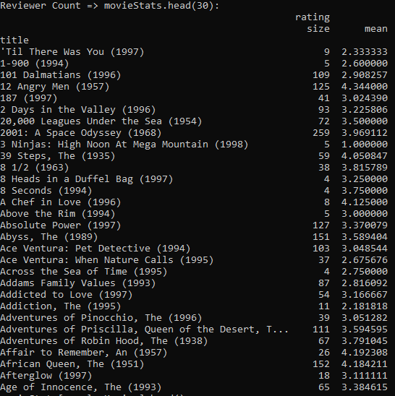
48.2 Reviewer Count and Average Score
https://www.udemy.com/course/data-science-and-machine-learning-with-python-hands-on/learn/lecture/4020682#overview
Reviewer Count and Average Score
Result.
This tell us 109 people watched the “101 Dalmatian (1996)” and give the averaged rate 2.90 star.
I never heard of “’Till There Was You (1997)”, only 9 people reviewed and rate 2.33.

Slide 10
48.3 Set Threshold for Reviewer Count

Slide 11
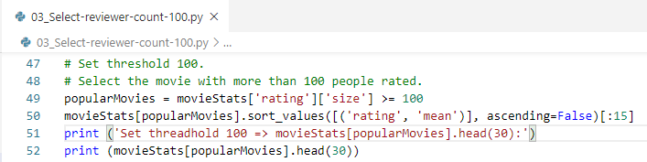
48.3 Set Threshold for Reviewer Count
https://www.udemy.com/course/data-science-and-machine-learning-with-python-hands-on/learn/lecture/4020682#overview
Set Threshold for Reviewer Count
Select rating and size with Threshold = 100
Sort the rating with score (mean).

Slide 12
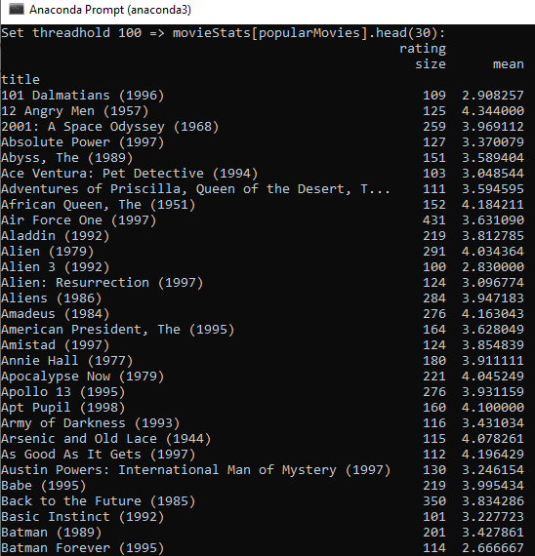
48.1 Reviewer Count and Average Score
https://www.udemy.com/course/data-science-and-machine-learning-with-python-hands-on/learn/lecture/4020682#overview
Reviewer Count and Average Score
Result.

Slide 13
48.4 Join Similarity Data to Popular Movie

Slide 14
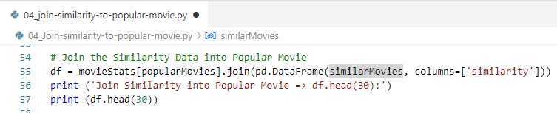
48.4 Join Similarity Data to Popular Movie
https://www.udemy.com/course/data-science-and-machine-learning-with-python-hands-on/learn/lecture/4020682#overview
Join Similarity Data to Popular Movie
Join similarity columns to popular movie Data Frame.

Slide 15
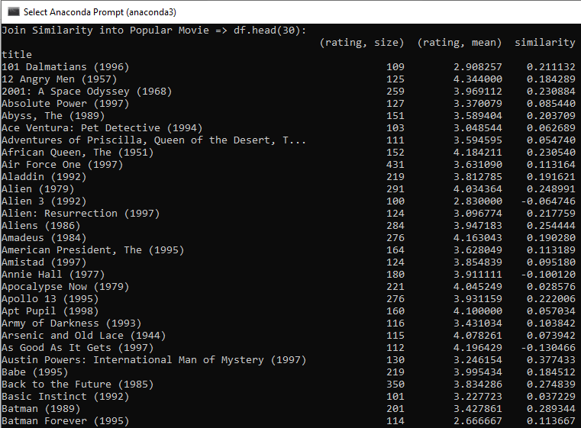
48.4 Join Similarity Data to Popular Movie
https://www.udemy.com/course/data-science-and-machine-learning-with-python-hands-on/learn/lecture/4020682#overview
Join Similarity Data to Popular Movie
Result.

Slide 16
48.5 Sort Similarity of Popular Movie

Slide 17
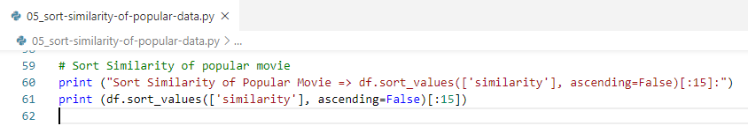
48.5 Sort Similarity of Popular Movie
https://www.udemy.com/course/data-science-and-machine-learning-with-python-hands-on/learn/lecture/4020682#overview
Sort Similarity of Popular Movie

Slide 18
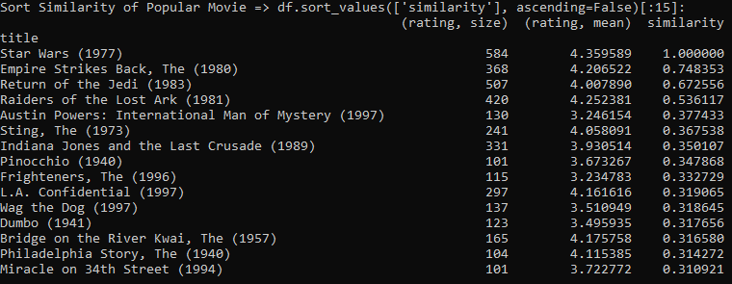
48.5 Sort Similarity of Popular Movie
https://www.udemy.com/course/data-science-and-machine-learning-with-python-hands-on/learn/lecture/4020682#overview
Sort Similarity of Popular Movie
Finally, we got expected “Star Wars (1977)”, “Empire Strikes Back (1980)”, and “Return of the Jedi (1983)”.
“Raiders of the Lost Ark (1981)” also very similar in style.
We can increase the number of rating people from 100 to 500 to see another result.

Slide 19
48.6 Exercise

Slide 20
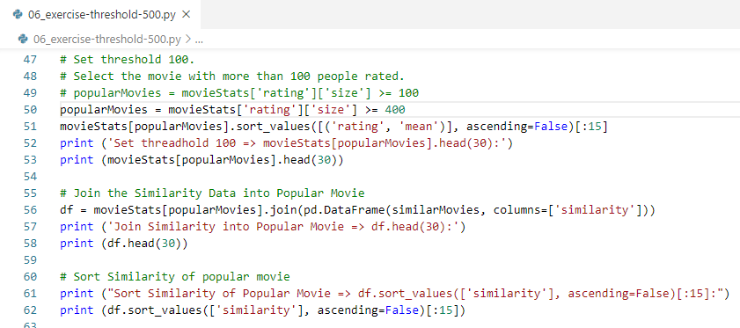
48.6 Exercise
https://www.udemy.com/course/data-science-and-machine-learning-with-python-hands-on/learn/lecture/4020682#overview
Exercise
“Empire Strike Back” has 368 reviewers.
If we set threshold set over 368, the “Empire Strike Back” will be removed.
Below example, we set threshold to 400.

Slide 21
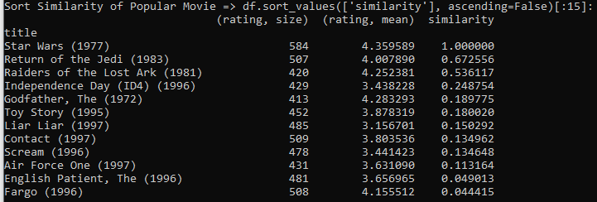
48.6 Exercise
https://www.udemy.com/course/data-science-and-machine-learning-with-python-hands-on/learn/lecture/4020682#overview
Exercise
“Empire Strike Back” has 368 reviewers.
We set threshold set over 400, the “Empire Strike Back” is removed.

Slide 22
End of Chapter

