Slide 1

101 RNN Sentiment
Peter H. Chen

Slide 2
101 RNN Sentiment
https://github.com/peterhchen/930_Python_ML_DS_DL
RNNs (Recurrent Neural Networks) with Keras
Sentiment analysis from movie reviews
IMb dataset location:
https://keras.io/api/datasets/imdb/
We will do RNN to do sentiment analysis on full-text movie reviews.
We train an artificial neural network how to "read" movie reviews and guess whether the author liked the movie or not from them.
Since understanding written language requires keeping track of all the words in a sentence, we need a RNN (Recurrent Neural Network) to keep a "memory" of the words that have come before as it "reads" sentences over time.
We use LSTM (Long Short-Term Memory) cells because we don't want to "forget" words early on in a sentence.
The “forget” can affect the meaning of that sentence significantly.

Slide 3
101.1 Import RNN Packages

Slide 4
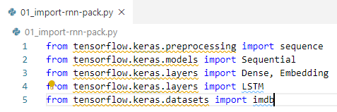
101.1 Import RNN Packages
https://github.com/peterhchen/930_Python_ML_DS_DL
Import RNN Packages

Slide 5
101.2 Read IMDb Data

Slide 6
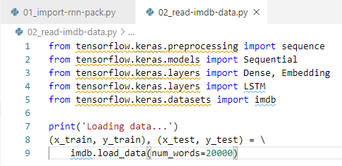
101.2 Read IMDb Data
https://github.com/peterhchen/930_Python_ML_DS_DL
Read IMDb Data
Now import our training and testing data.
We specify that we only care about the 20,000 most popular words in the dataset in order to keep things somewhat managable.
The dataset includes 5,000 training reviews and 25,000 testing reviews for some reason.

Slide 7
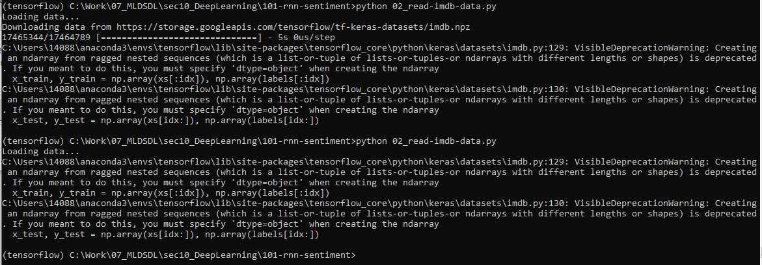
101.2 Read IMDb Data
https://github.com/peterhchen/930_Python_ML_DS_DL
Read IMDb Data
Downloading data from https://storage.googleapis.com/tensorflow/tf-keras-datasets/imdb.npz

Slide 8
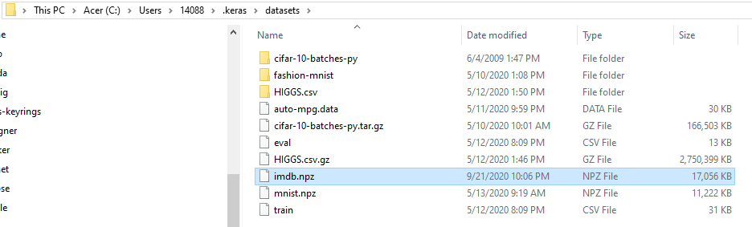
101.2 Read IMDb Data
https://github.com/peterhchen/930_Python_ML_DS_DL
Read IMDb Data
Downloading data from https://storage.googleapis.com/tensorflow/tf-keras-datasets/imdb.npz
To
C:\Users\14088\.keras\datasets\imdb.npz

Slide 9
101.3 Check Training Data

Slide 10
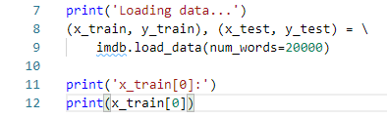
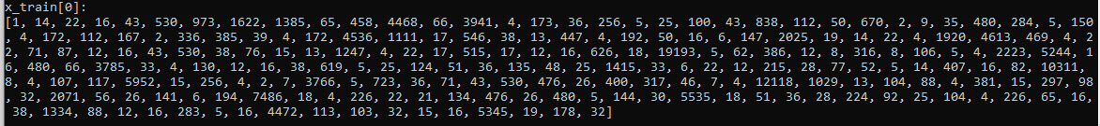
101.3 Check Training Data
https://github.com/peterhchen/930_Python_ML_DS_DL
Check Training Data
Get a feel for what this data looks like.
Look at the first training feature, which should represent a written movie review:

Slide 11
101.3 Check Training Data
https://github.com/peterhchen/930_Python_ML_DS_DL
Check Training Data
That x_train[0] does not look like a movie review.
This data set already converted words to integer-based indices.
We only see a sequence of integer. Each integer represents a word.
The model only recognize the numbers (integer), not the words.
Each number in the training features represent some specific word.

Slide 12
101.4 Check Label Data

Slide 13
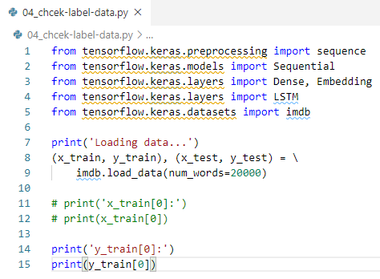

101.4 Check Label Data
https://github.com/peterhchen/930_Python_ML_DS_DL
Check Label Data

Slide 14
101.4 Check Label Data
https://github.com/peterhchen/930_Python_ML_DS_DL
Check Label Data
The label y_train[0] are just 0 or 1, which indicates whether the reviewer said they liked the movie or not.
We have a bunch of movie reviews that have been converted into vectors of words represented by integers, and a binary sentiment classification to learn from.

Slide 15
101.5 Pad/Limit Train Data Length

Slide 16
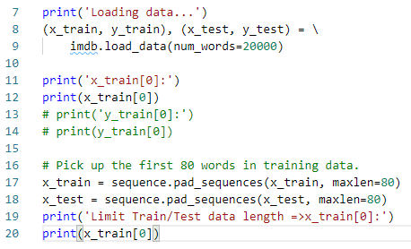
101.5 Pad/Limit Train Data Length
https://github.com/peterhchen/930_Python_ML_DS_DL
Pac/Limit Train Data Length
RNN’s Data can blow up quickly.
Keep train/test data manageable on our computer.
For each sentence, we pick up the first 90 words form the reviews:

Slide 17
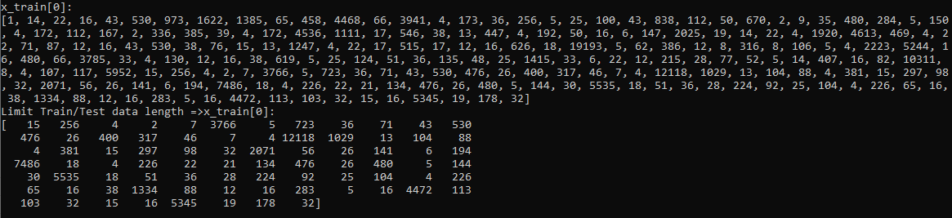
101.5 Pad/Limit Train Data Length
https://github.com/peterhchen/930_Python_ML_DS_DL
Pac/Limit Train Data Length
RNN’s Data can blow up quickly.
Keep train/test data manageable on our computer.
For each sentence, we pick up the first 90 words form the reviews:

Slide 18
101.6 Setup RNN Model

Slide 19
101.6 Setup RNN Model
https://github.com/peterhchen/930_Python_ML_DS_DL
Setup RNN Model
We set up our RNN (Recurrent Neural Network) model.
We use Keras to setup LSTM (Long Short-Term Memory) for RNN (Recurrent Neural Network) Model
Start with an Embedding layer:
https://machinelearningmastery.com/use-word-embedding-layers-deep-learning-keras/#:~:text=Keras%20offers%20an%20Embedding%20layer,represented%20by%20a%20unique%20integer.&text=The%20Embedding%20layer%20is%20initialized,words%20in%20the%20training%20dataset.
Keras offers an Embedding layer that can be used for neural networks on text data. It requires that the input data be integer encoded, so that each word is represented by a unique integer. The Embedding layer is initialized with random weights and will learn an embedding for all of the words in the training dataset.
This layer converts the input data into dense vectors of fixed size that's better suited for a neural network.

Slide 20
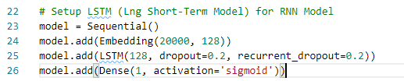
101.6 Setup RNN Model
https://github.com/peterhchen/930_Python_ML_DS_DL
Setup RNN Model
Keras provides Embedding layer to encode the 20,000 words into 128 codes.
You generally see this in conjunction with index-based text data like we have here. The 20,000 indicates the vocabulary size (remember we said we only wanted the top 20,000 words) and 128 is the output dimension of 128 units.
Next, we have to set up a LSTM layer for the RNN. We specify 128 to match the output size of the Embedding layer, and dropout terms to avoid overfitting, which RNN's are particularly prone to.
Finally, we need to make a single neuron with a sigmoid activation function to choose our binary sentiment classification of 0 or 1.

Slide 21
101.7 Compile RNN Model

Slide 22
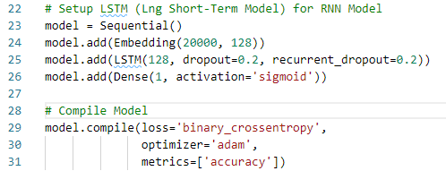
101.7 Compile RNN Model
https://github.com/peterhchen/930_Python_ML_DS_DL
Compile RNN Model
As this is a binary classification problem, we'll use the binary_crossentropy loss function.
And the Adam optimizer is usually a good choice (feel free to try others.)

Slide 23
101.7 Compile RNN Model
https://github.com/peterhchen/930_Python_ML_DS_DL
Compile RNN Model
Now we will actually train our model.
RNN's, like CNN's, are very resource heavy.
Keeping the batch size relatively small is the key to enabling this to run on your Computer at all.
In the real word of course, you'd be taking advantage of GPU's installed across many computers on a cluster to make this scale a lot better.

Slide 24
101.8 Train/Score RNN Model

Slide 25
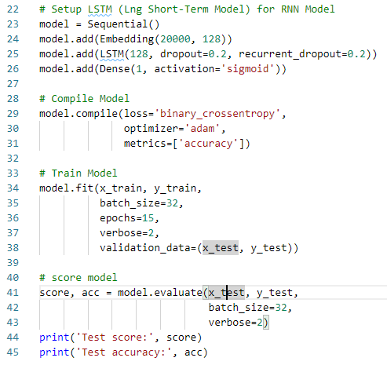
101.8 Train/Score RNN Model
https://github.com/peterhchen/930_Python_ML_DS_DL
Train/Score RNN Model
The moel.fit for RNN will take a very long time (more than one hour) to run, even on a fast computer.
Evaluate our model's accuracy.

Slide 26
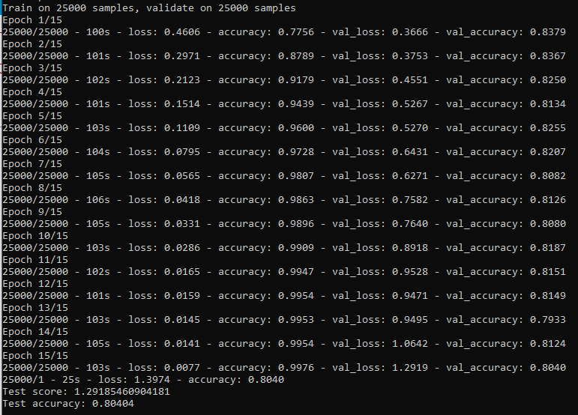
101.8 Train/Score RNN Model
https://github.com/peterhchen/930_Python_ML_DS_DL
Train/Score RNN Model
1. Train RNN Model
2. Score RNN Model

Slide 27
101.9 Summary

Slide 28
101.9 Summary
https://github.com/peterhchen/930_Python_ML_DS_DL
Summary
Score is only 80%?
Not too bad, we limited to the first 80 words of each review.
Note:
The validation accuracy while we were training never really improved after the first epoch. The model is overfitting. We can do early stop after first epoch.
RNN that can "read" reviews and deduce whether the author liked the movie or not based on that text.
RNN takes the context of each word and its position in the review into account - and setting up the model itself was just a few lines of code.
RNN can be implemented easily with Keras.

Slide 29
101.10 Exercise

Slide 30
101.10 Exercise
https://github.com/peterhchen/930_Python_ML_DS_DL
Exercise
Change Epoch = 2 and re-run.

Slide 31
End of Chapter

