Slide 1

96 Keras
Peter H. Chen

Slide 2
96 Keras
https://github.com/peterhchen/930_Python_ML_DS_DL
Keras
We discussed tensorflow for deep learning. Tensorflow is a lower level API.
Tensorflow dived into low level tensors and matrices and multiplying more than higher level neuron network hierarchy.
Tensorflow run very fast but not easy from high level implementation.

Slide 3
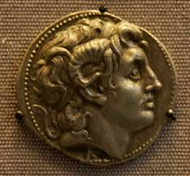
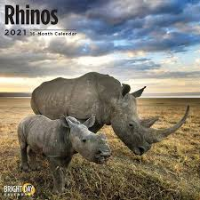
96 Keras
https://github.com/peterhchen/930_Python_ML_DS_DL
What is meaning of Keras?
https://www.quora.com/What-is-the-meaning-of-Keras-word-of-Keras-machine-learning-library
The name Keras come from Greek.
Keras means Horn (or Rhino) in Greek.
Keras is a literary image from ancient Greek and Latin literature, first found in the Odyssey.

Slide 4
96.1 Why Keras?

Slide 5
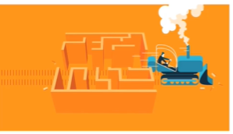
96.1 Why Keras?
https://github.com/peterhchen/930_Python_ML_DS_DL
Why Keras?
Easy and fast prototyping
Available as a higher-level API in Tensorflow 1.9+
Scikit-learn integration
Less to think about: which often yield better results without even trying
This is really important: The faster you can experiment, the better your results.

Slide 6
96.1 Why Keras?
https://github.com/peterhchen/930_Python_ML_DS_DL
Why Keras? (Explanation)
Fortunately, we have higher level Keras API on top of Tensorflow (after Tensorflow 1.9).
Keras is really nice for deep learning implementation.
Keras is very easy to construct the layers of neural network, different optimization functions, and scikit-learn library integration.
We do machine learning by Python and scikit-learn library a lot.
Using Keras, we can integrate deep neural networks with scikit-learn.
We use train, test, or cross-validation a lot and very difficult to do in Tensorflow. These are very easy to do cross validation, analysis, and evaluation in scikit-learn library.
Keras is easier integrate scikit-learn, models, or chain a neural network with other deep learning or machine learning techniques.

Slide 7
96.1 Why Keras?
https://github.com/peterhchen/930_Python_ML_DS_DL
Why Keras? (Explanation)
There is also a lot less to think.
You can often get better results without even trying.
With tensorflow, you have to think every detail at a linear algebra level.
The Tensorflow constructed neural network in low level. It never help out of the box.
In Tensorflow, we have to figure out how to multiply input with weights, multiply internal layers with weights, how to add in the biased terms, how do to create an optimizer, how to create a loss function, and etc.
The Keras API can take care of a lot of those details for us.
Why is that important?
The faster you can experiment and prototyping, the better your results will be.
It is that much easier for us to try different layers, different topologies, different optimizers, different variations, much easier, and quicker to converge on the optimal neural network problem we try to solve.

Slide 8
96.2 MNIST with Keras

Slide 9

96.2 MNIST with Keras
https://github.com/peterhchen/930_Python_ML_DS_DL
MNINST with Keras
We Dive in MNINST with Keras.

Slide 10
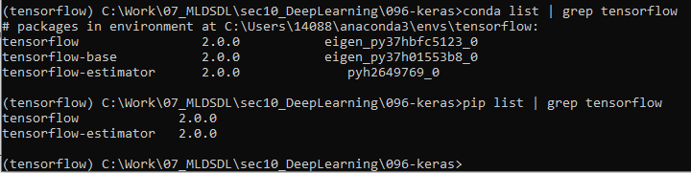
96.2 MNIST with Keras
https://github.com/peterhchen/930_Python_ML_DS_DL
MNINST with Keras
Be sure to be using tensorflow 1.9 or newer.
> conda list | grep tensorflow
Or
> pip list | grep tensorflow

Slide 11
96.2 MNIST with Keras
https://github.com/peterhchen/930_Python_ML_DS_DL
MNINST with Keras
Keras is a higher-level API within TensorFlow that makes things a lot easier. Not only is it easier to use, it's easier to tune.
Let's set up the same deep neural network we set up with TensorFlow to learn from the MNIST data set.
First we'll import all the stuff we need, which will initialize Keras as a side effect:

Slide 12
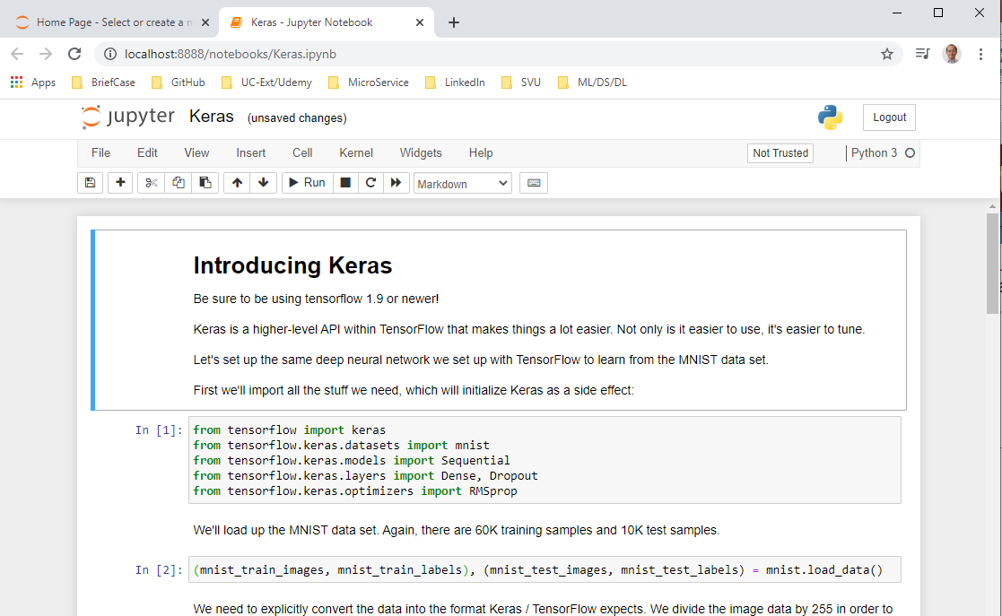
96.2 MNIST with Keras
https://github.com/peterhchen/930_Python_ML_DS_DL
MNINST with Keras (Explanation)
> conda activate tensorflow
> cd [Work-folder]
> Open Chrome
> jupyter notebook
> Open “Keras.ipynb”

Slide 13
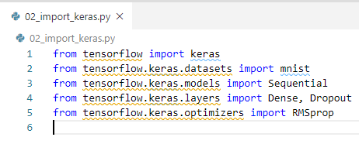
96.2 MNIST with Keras
https://github.com/peterhchen/930_Python_ML_DS_DL
MNINST with Keras (Explanation)
Import keras API libraries.

Slide 14
96.3 Read MNIST by Keras

Slide 15
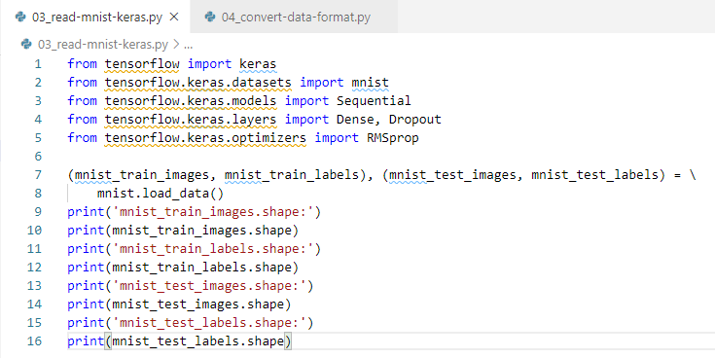
96.3 Read MNIST by Keras
https://github.com/peterhchen/930_Python_ML_DS_DL
Read MNIST by Keras
We'll load up the MNIST data set. Again, there are 60K training samples and 10K test samples.
Check the dimension of the array image.

Slide 16
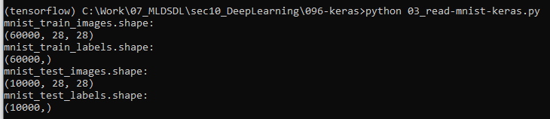
96.3 Read MNIST by Keras
https://github.com/peterhchen/930_Python_ML_DS_DL
Read MNIST by Keras (Explanation)
We read 60,000 training samples and 10,000 test sample

Slide 17
96.4 Convert Data Format

Slide 18
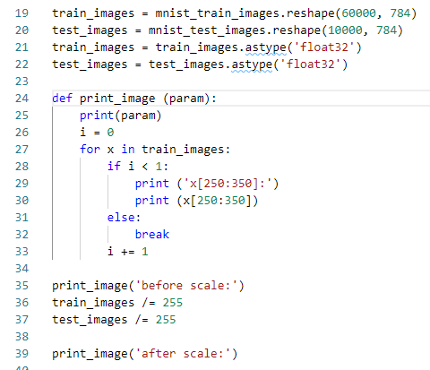
96.4 Convert Data Format
https://github.com/peterhchen/930_Python_ML_DS_DL
Convert Data Format
We need to explicitly convert the data into the format Keras / TensorFlow expects.
We divide the image data by 255 in order to normalize it into 0-1 range, after converting it into floating point values.

Slide 19
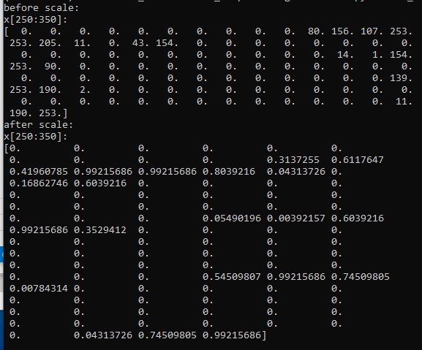
96.4 Convert Data Format
https://github.com/peterhchen/930_Python_ML_DS_DL
Convert Data Format (Explanation)
We print the first image before scale (0 to 255) and after scale (0 to 1).
The first image dimension is 784.
We only print the from index = 250 to index < 350.

Slide 20
96.5 Convert One-Hot Label

Slide 21
96.5 Convert One-Hot Label
https://github.com/peterhchen/930_Python_ML_DS_DL
Convert One-Hot Label
We convert the 0-9 labels into "one-hot" format.
The one_hot as a binary representation of the label data, i.e., which number each handwriting sample was intended to represent.
Mathematically one_hot represents a dimension for every possible label value.
Every dimension is set to the value 0, except for the "correct" one which is set to 1.
For example, the label vector representing the:
number 0 would be [1, 0, 0, 0, 0, 0, 0, 0, 0, 0],
number 1 would be [0, 1, 0, 0, 0, 0, 0, 0, 0, 0], and etc.
It is a format that is optimized for how the labels are applied during training.
The training label data is a tensor of shape [60,000, 10]: 60,000 test images each associated with 10 binary values that indicate whether or not the image represents a given number from 0-9.

Slide 22
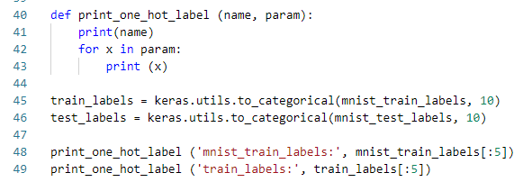
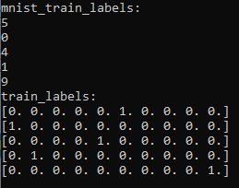
96.5 Convert One-Hot Label
https://github.com/peterhchen/930_Python_ML_DS_DL
Convert One-Hot Label (Explanation)
It just converts the label data on both the training and the test data set to one hot 0 to 9 values.
Below example, we transform:
From ‘5’ to [0, 0, 0, 0, 0, 1, 0, 0, 0, 0, 0]
From ‘0’ to [1, 0, 0, 0, 0, 0, 0, 0, 0, 0, 0]
From ‘4’ to [0, 0, 0, 0, 1, 0, 0, 0, 0, 0, 0]
From ‘1’ to [0, 1, 0, 0, 0, 0, 0, 0, 0, 0, 0]
From ‘9’ to [0, 0, 0, 0, 0, 0, 0, 0, 0, 0, 1]

Slide 23
96.6 Visualize Training Image

Slide 24
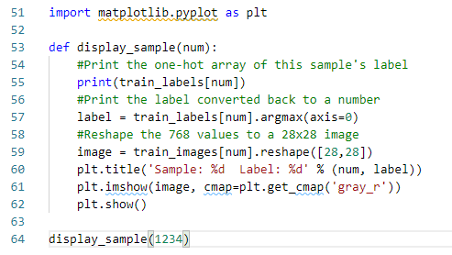
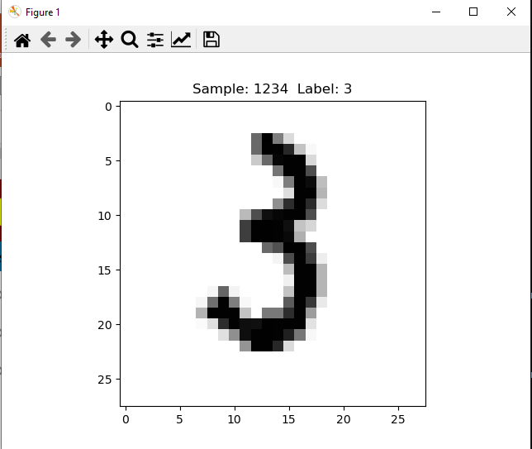

96.6 Visualize Training Image
https://github.com/peterhchen/930_Python_ML_DS_DL
Visualize Training Image
Display training image and train label number 1234.

Slide 25
96.7 Setup Neural Network

Slide 26

96.7 Setup Neural Network
https://github.com/peterhchen/930_Python_ML_DS_DL
Setup Neural Network
In Tensorflow, we create placeholders, variables, and define a bunch of linear algebra for each layer in our neural network.
In Keras, we can set up very easily:
The input layer of 784 features feeds into a ReLU layer of 512 nodes.
Then, we have 10 output nodes with softmax applied.

Slide 27
96.7 Setup Neural Network
https://github.com/peterhchen/930_Python_ML_DS_DL
Setup Neural Network(Explanation)
We set up our neural network.
Well look at how much easier it is with Keras.
All we need to do is say that we're setting up a model a sequential model and that means that we can add individual layers to our neural network one layer at a time sequentially if you will.
We start off by adding a dense layer of 512 neurons with an input shape of 784 neurons.
This is our first layer that takes our 784 input signals from each image one for each pixel and feeds it into a hidden layer of five hundred and twelve neurons.
Those neurons will have the relu activation function associated with them.
With one line of code we've done a whole lot of work that we had to do in tensorflow before.
We put a softmax activation function to a final layer of 10.
The final layer will map to our final classification of what number this represents from 0 to 9.
So wasn't that easy.
We can even ask Keras to give us back a summary of what we set up just to make sure that things look
the way that we expected and sure enough we have two layers here.
You know one that has 512 and then going to a 10 neuron layer for the final classification.
And this does sort of omit the input layer but we do have that input shape of 784 features going into
that first layer.
All right.
Now you also might remember that it was kind of a pain in the butt to get the optimisation and loss
function set up and tensorflow again.
That's a one liner in Keras.
All we have to do is say that our loss function is categorical cross entropy and it will know what
to do there.
We're going to use the RMS prop optimizer just for fun.
We could use any other one that we wanted too we could just use Atom if we wanted to or there are other
choices like Adagrad SGD you can read up on those at this link here if you want to and we will
measure the accuracy as we go along.
So that's all that's saying let's go ahead and hit that and that will build the underlying graph that
we want to run in tensorflow.
All right.
Now we actually have to run it.
And again that's just one line of code with Keras.
All we need to do is say that we're going to fit this model using this training dataset.
These are the input features the input layers that we're going to train with.
We want to use batch sizes of 100.
We're going to run that 10 times.
I'm going to set a verbosity level of two because that's what works best with an iPython
notebook.
And for validation we will provide the test data set as well.
So instead of writing this big function that does this iteration of learning by hand like we did in
tensorflow Keras does it all for us.
So let's go ahead and hit shift enter and kick that off as well.
Now Keras is slower than tensorflow and you know it's doing a little bit more work under the hood.
So this will take more time but you'll see that the results are really good.
I mean even on that first iteration we've already matched the accuracy that we got after 2000 iterations
in our hand coded tensorflow implementation we're already up to epoch 6 and we're approaching 99 percent
accuracy in our training data.
Keep in mind this is measuring the accuracy in the training dataset
and we're almost there.
But yeah I mean even with just 10 epochs we've done a lot better than using tensorflow and again you
know Keras is kind of doing a lot of the right things for you automatically without making you even
think about it.
That's the power of Keras even though it's slower it might give you better results in less time at the
end of the day.
Now here's something that we couldn't really do easily with tensorflow it's possible I just didn't
get into it because that lecture was long enough as it was.
But remember that we can actually integrate Keras with scikit learn so we can say model.evaluate
and that's just like a scikit learn model as far as python's concerned and actually measure based on
our test dataset what the accuracy is and using the test data set as a benchmark.
It had a 98 percent success rate in correctly classifying those images.
So that's not bad.
Now mind you you know a lot of research goes into optimizing this and this dataset problem and 98 percent
is not really considered a good result.
Like I said later in the course we'll talk about some better approaches that we can use.
But hey that's a lot better than we got in the previous lecture isn't it.
As before let's go ahead and take a look at some of the ones that it got wrong just to get a feel of
where it has trouble.
Things that our neural network has challenges the code here is similar we're just gonna go through the
first 1000 test images here and since it does have a much higher accuracy rate we have to go deeper
into that test data to find examples of things that went wrong.
We'll reshape each data.
Each image and do a flat 784 pixel array which is what our neural network expects as input.
Call ARG max on the resulting classification and one hot format and see if that predicted classification
matches the actual label for that data.
If not print it out.
All right so you can see here that this model really is doing better.
The ones that it's getting wrong are pretty wonky.
OK so in this case we predicted that this was a number nine.
And if I were to look at that myself I might guess that was a nine as well.
Turns out this person was trying to draw the number four.
But you know this is a case where even a human brain is trying to run into trouble as to what this person
was actually trying to write.
I don't know what that's supposed to be.
Apparently they were trying to draw the number four our best guess was the number six not unreasonable
given the shape of things.
Here's somebody who is trying to draw a 2 but it looks a whole lot more like a 7.
Again I wouldn't be too sure about that myself.
So you know even though we flatten this data to one dimension this neural network that we've constructed
is already rivaling the human brain in terms of doing handwriting recognition on these these numbers.
I mean that's kind of amazing that one I probably would guessed a three on that one.
But again you can see that the quality of the stuff that it has trouble with is really sketchy.
What is that.
A scorpion.
Apparently that was supposed to be an eight and our best guess was a two.
But that's much less.
Wow OK.
Yeah.
Some people really can't write that's a seven.
Yeah.
I mean you get the point here.
So just by using Keras alone we've gotten better accuracy.
We've got a better result because there's less for us to think about.
All right.
You can probably improve on this even more so again as before a tensorflow I want you to go back and
see if you actually improve on these results try using a different optimizer than RMS prop. Try
you know different typologies and the beauty with Keras is that it's a lot easier to try those different
typologies now.
Right.
Keras actually comes in it's documentation with an example of using MNIST and this is the actual
topology that they use in their examples so go back and give that a try.
See if it's actually any better or not.
See if you can improve upon things.
One thing you can see here is that they're actually adding dropout layers to prevent overfitting.
So you can it's very easy to add those sorts of features here.
Basically what we've done here is add a that same dense layer of 512 hidden neurons taking the 784 features
and then we're gonna drop out 20 percent of the neurons at the next layer to force learning to be spread
out more and prevent overfitting so might be interesting to see if that actually improves your results
on the test data set by adding those dropout layers.
All right.
So go play with that.
When we come back we'll do some even more interesting stuff using Keras.

Slide 28
96.8 Model Summary

Slide 29
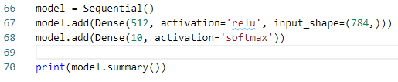
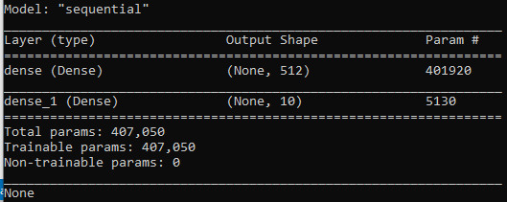
96.8 Model Summary
https://github.com/peterhchen/930_Python_ML_DS_DL
Model Summary
We can get the model summary.

Slide 30
96.8 Model Summary
https://github.com/peterhchen/930_Python_ML_DS_DL
Model Summary (Explanation)
We can ask Keras for model summary
We have two layers here. One layer have 512 and one layer have 10 neurons for the final classification.
We do not have input layer. We only can see the shape of 784 features go into the first layer.

Slide 31
96.9 Optimization and Loss Function

Slide 32

96.9 Optimization and Loss Function
https://github.com/peterhchen/930_Python_ML_DS_DL
Optimization and Loss Function
Set up our optimizer and loss function is very simple.
We will use the RMSProp optimizer here. Other choices include Adagrad, SGD, Adam, Adamax, and Nadam.
See https://keras.io/optimizers/

Slide 33
96.9 Optimization and Loss Function
https://github.com/peterhchen/930_Python_ML_DS_DL
Optimization and Loss Function (Explanation)
Now, we setup the optimization and loss function.
That is a one line of code in Keras.
We setup our loss function is “categorical_cross_entropy”.
We setup use the optimizer = RMSprop().
There are other choices of optimizer, such as, Adam, Adagrad, SGD, and etc. You can read this link (https://keras.io/optimizers/) for more options.

Slide 34
96.10 Train Model

Slide 35
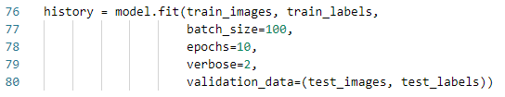
96.10 Train Model
https://github.com/peterhchen/930_Python_ML_DS_DL
Train Model
Training our model is just one line of code with Keras.
We have 10 epochs with a batch size of 100.
Keras is slower.
If we are not running on top of a GPU-accelerated Tensorflow, it will be very slow (we limit the run with 10 epochs.)

Slide 36
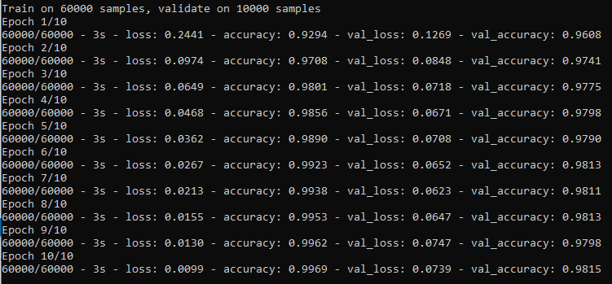
96.10 Train Model
https://github.com/peterhchen/930_Python_ML_DS_DL
Train Model

Slide 37
96.10 Train Model
https://github.com/peterhchen/930_Python_ML_DS_DL
Train Model (Explanation)
Now, we train the model. That is just one line of code with Keras.
We are going to fit this model using this training dataset.
These are the input features the input layers that we're going to train with.
We want to use batch sizes of 100. We are going to run that 10 times.
We set a verbosity level of two for printing the details message.
We provide the test data set for validation.

Slide 38
96.11 Evaluate Model

Slide 39

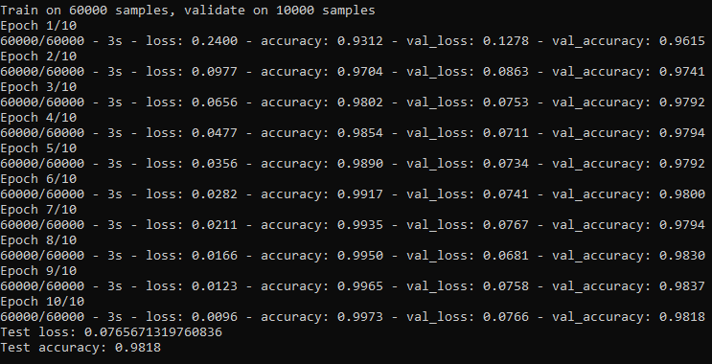
96.11 Evaluate Model
https://github.com/peterhchen/930_Python_ML_DS_DL
Evaluate Model
With just 10 epochs, we have 98% accuracy which is better than Tensorflow 93%. We have outperformed our Tensorflow version considerably!

Slide 40
96.11 Evaluate Model
https://github.com/peterhchen/930_Python_ML_DS_DL
Evaluate Model (Explanation)
We integrate Keras with scikit-learn. We can use model.evaluate from scikit-learn model for benchmark.
The result have a 98 percent success rate in correctly classifying those images.
Now, we know a lot of research in optimizing this and 98 percent is not really considered a good result.
We will discuss some better approaches later.
But this result 98% is a lot better than we got in previous tensorflow 93%.

Slide 41
96.12 Review Misclassification

Slide 42
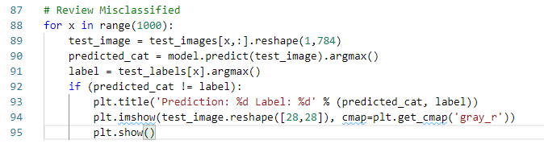
96.12 Review Misclassification
https://github.com/peterhchen/930_Python_ML_DS_DL
Review Misclassification
We visualize the ones it got wrong.
To improve this model, we will have to search deeper to find mistakes to look at.

Slide 43
96.12 Review Misclassification
https://github.com/peterhchen/930_Python_ML_DS_DL
Review Misclassification (Explanation)
We review misclassification image.
First, we loop through the 1,000 test images to find what went wrong.
We reshape each data.
Each image and do a flat 784 pixel array which is what our neural network expects as input.
Call argmax on the resulting classification and one hot format and see if that predicted classification matches the actual label for that data.
If not print it out.

Slide 44
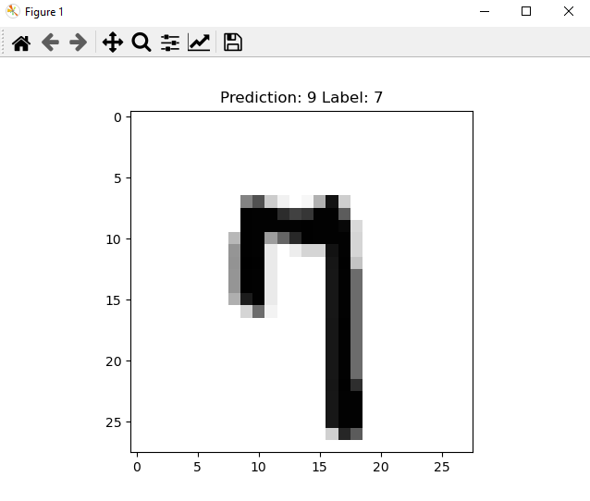
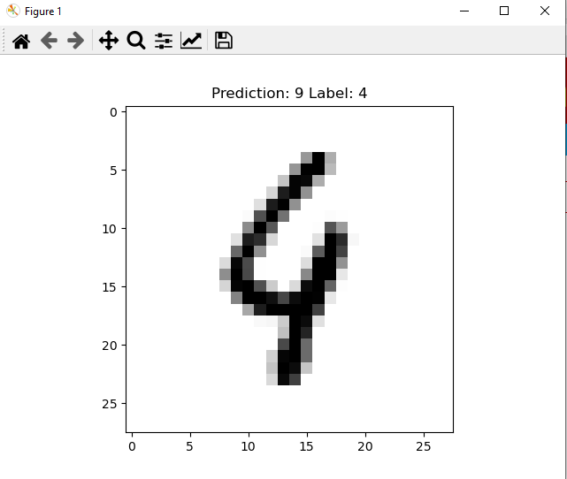
96.12 Review Misclassification
https://github.com/peterhchen/930_Python_ML_DS_DL
Review Misclassification (Explanation)

Slide 45
96.12 Review Misclassification
https://github.com/peterhchen/930_Python_ML_DS_DL
Evaluate Model (Explanation)
There is some misclassified. We can think how we can improve some of them.

Slide 46
96.13 Exercise

Slide 47
96.13 Exercise
https://github.com/peterhchen/930_Python_ML_DS_DL
Exercise
Can we improve on the results?
Does running more epochs help considerably?
How about trying different optimizers?
We can also take advantage of Keras's ease of use to try different topologies quickly.
Keras includes a MNIST example, where they add an additional layer, and use Dropout at each step to prevent overfitting, like this:
model = Sequential() model.add(Dense(512, activation='relu’, input_shape=(784,))) model.add(Dropout(0.2)) model.add(Dense(512, activation='relu')) model.add(Dropout(0.2)) model.add(Dense(10, activation='softmax’))
Try adapting that to our code above and see if it makes a difference or not
Hint:
Try different dropout, different node, additional hidden layers, activation function, and etc.

Slide 48
End of Chapter

