Slide 1

46 Item-Based Collaborative Filtering
Peter H. Chen

Slide 2
46 Item-Based Collaborative Filtering
https://www.udemy.com/course/data-science-and-machine-learning-with-python-hands-on/learn/lecture/4020670#overview
Item-Based Collaborative Filtering
In order to overcome the shortcoming problem in User-Based Collaborative Filtering, there is a technique called Item-Based Collaborative Filtering.
We will see how Item-Based Collaborative Filtering can more powerful.
The Amazon use Item-Based Collaborative Filtering under the hood.
The Amazon talk about his in public. We can discuss why is a great idea.

Slide 3
46.1 Item-Base Recommender System

Slide 4
46.1 Item-Base Recommender System
https://www.udemy.com/course/data-science-and-machine-learning-with-python-hands-on/learn/lecture/4020670#overview
Item-Based Recommender Systems
What if we based recommendations on relationships between things instead of people?
A movie will always be the same movie - It does not change
There are usually fewer things than people (less computation to do)
Harder to game the system

Slide 5
46.1 Item-Base Recommender System
https://www.udemy.com/course/data-science-and-machine-learning-with-python-hands-on/learn/lecture/4020670#overview
Item-Based Recommender Systems Explanation
We talked about user-based recommendation system that based on what people similar to you liked that you have not seen yet or experienced yet.
The people taste change all the time on their past behavior becomes pretty complicated.
But item will always be the same, it has never change. Star Wars will always the Star Wars. Items do not change like people do. So, we know the relationships are more permanent.
Some permanent relationship we can make between the items. This relationship will not change over the time.
The items size will not as much as 7.6 billions of people. This will save a lot of computational resources because we have fewer items than users.
We can run item-based recommendation more frequently than user-based.
We can develop more complicated algorithm for item-based recommendation system because we have less relationship to compute. That is good.

Slide 6
46.1 Item-Base Recommender System
https://www.udemy.com/course/data-science-and-machine-learning-with-python-hands-on/learn/lecture/4020670#overview
Item-Based Recommender Systems Explanation
Item-based recommendation is also harder to game the system.
We talked in user-based recommendation system is easy to fickle (cheat) the system with some popular product to shilling (fake) attack the recommender system.
It is harder to cheat recommendation system in the item based system. The item based in based on the actual money spend on each item. So, you always gets better and more reliable results when you based recommendation on what people actually bought as opposed to what they viewed or what they clicked on.

Slide 7
46.2 Item-Base Collaborative Filtering

Slide 8
46.2 Item-Base Collaborative Filtering
https://www.udemy.com/course/data-science-and-machine-learning-with-python-hands-on/learn/lecture/4020670#overview
Item-Based Collaborative Filtering
Find every pair of movies hat were watched by the same person.
Measure the similarity of their rating across all users who watched both.
Sort by time, then by similarity strength
This is just one way to do it.

Slide 9
46.2 Item-Base Collaborative Filtering
https://www.udemy.com/course/data-science-and-machine-learning-with-python-hands-on/learn/lecture/4020670#overview
Item-Based Collaborative Filtering Explanation
Item-based collaborative Filtering is similar to User-Based collaborative Filtering.
Instead of User, we find the item.
For example, the movie recommendation, the first thing we do is find every pair of movies, every movie pair that is watched by the same person.
So, we go through and find every movie that is watched by identical people. And then, we measure the similarity of all those people who viewed that movie to each other.
So, by this means, we can compute similarities between two different movies based on ratings of the people who watched both of those movies.
So, we have movie pairs, “Star Wars” and “Empire Strike Back”.
We have a list of everyone who watched both of hose movies.
We compare their ratings to each other. If they are similar, then we can say these two movies are similar because they were rated similarly by people who watched both of them.

Slide 10
46.2 Item-Base Collaborative Filtering
https://www.udemy.com/course/data-science-and-machine-learning-with-python-hands-on/learn/lecture/4020670#overview
Item-Based Collaborative Filtering Explanation
That is the general idea.
That is the way to do it.
There is more than one way to do it.
We select the pair of movie and then the similarity strength of all the similar movie to it.
And list the result for people who liked or people who rated this highly also rated this highly, and etc.
This is just one way of doing it.
First, find the relationship between movies based on the relationships of the people who watched every give pair of movies.

Slide 11
46.3 Item-Base Collaborative Filtering Example

Slide 12
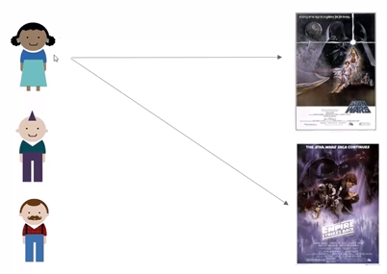
46.3 Item-Base Collaborative Filtering Example
https://www.udemy.com/course/data-science-and-machine-learning-with-python-hands-on/learn/lecture/4020670#overview
Item-Based Collaborative Filtering Example
We have lady watch two movies “Sta Wars” and “Empire Strikes Back” and like both of them.

Slide 13
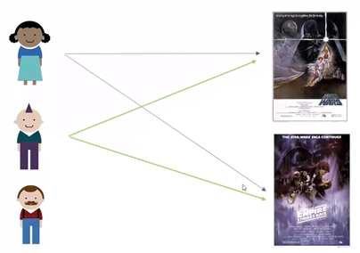
46.3 Item-Base Collaborative Filtering Example
https://www.udemy.com/course/data-science-and-machine-learning-with-python-hands-on/learn/lecture/4020670#overview
Item-Based Collaborative Filtering Example Explanation
And the Mr. Edgy Mohawk also watched “Sta Wars” and “Empire Strikes Back” and also liked both of them.
At this point, we can say there is a relationship. There is a similarity between the “Sta Wars” and “Empire Strikes Back” based on these two users who like these pairs of movies. We are going to look at each pair of movies.
We look at both users both liked them. We can say they are similar to each other.
If they both disliked them, we also can say they are similar to each other.
We put a similarity score of both lady and Mr. Edgy Mohawk.

Slide 14
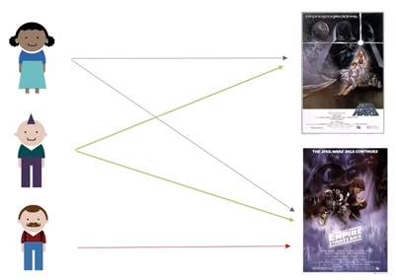
46.3 Item-Base Collaborative Filtering Example
https://www.udemy.com/course/data-science-and-machine-learning-with-python-hands-on/learn/lecture/4020670#overview
Item-Based Collaborative Filtering Example Explanation
Then, we welcome Mr. Mustache Lumberjack Hipster man (stylish Lumber worker with Mustache). He watched the “Empire Strikes Back”. He lives in some strange world and have no idea of “Star Wars”, the first existed movie.
We computed a relationship between the “Empire Strikes Back” and “Star Wars” based on the behavior of these Lay and Mr. Edgy Mohawk and we know these two movies are similar tow each other.

Slide 15
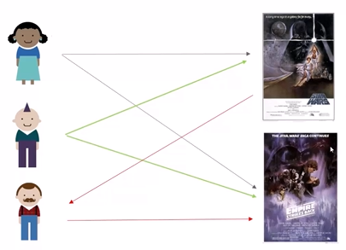
46.3 Item-Base Collaborative Filtering Example
https://www.udemy.com/course/data-science-and-machine-learning-with-python-hands-on/learn/lecture/4020670#overview
Item-Based Collaborative Filtering Example Explanation
So, we think Mr. Hipster man liked the “Empire Strikes Back” will also like “Star Wars”.
We can recommend that as the top movie recommendation.
This relationship is based on aggregation of people who watched the items.
Fundamentally, we based on items and not relationships between people.

Slide 16
46.4 Python Movie Similarities

Slide 17
46.4 Python Movie Similarities
https://www.udemy.com/course/data-science-and-machine-learning-with-python-hands-on/learn/lecture/4020670#overview
Python Movie Similarities
Next, we will use Python to create real “movie similarities” using real MovieLens Data set.
In addition to being important for the item-based collaborative filtering, these results are valuable in themselves. Think “People who liked X also liked Y”
It is a real world data and we will encounter real world problems
Then we will use these results to create movie recommendations for individuals

Slide 18
46.4 Python Movie Similarities
https://www.udemy.com/course/data-science-and-machine-learning-with-python-hands-on/learn/lecture/4020670#overview
Python Movie Similarities Explanation
We have some Python code that use Pandas and all the various other tools at our disposal to create movie recommendations with a surprisingly amount of code..
First, we use item-based collaborative filtering in practice.
Building these movie to movie relationships.
We will based on real data from MovieLens Project.
Go to MovieLens.org. There is actually an open movie recommender system there where people can rate movies and get recommendations for new movies.
MovieLens.org make all the underlying data publicly available for researchers like us.
We will use real movie rating data. It is 10 years old data.
We will use that to compute between movies.
We use real world data to solve the real world problem.

Slide 19
46.5 Summary

Slide 20
46.5 Summary
https://www.udemy.com/course/data-science-and-machine-learning-with-python-hands-on/learn/lecture/4020670#overview
Summary
We use Item-Based Collaborative Filtering instead of user-based collaborative Filtering.
We discussed what is item-based collaborative filtering.

Slide 21
End of Chapter

