Slide 1

47 Find Movie Similarities
Peter H. Chen

Slide 2
47 Find Movie Similarities
https://www.udemy.com/course/data-science-and-machine-learning-with-python-hands-on/learn/lecture/4020676#overview
Find Movie Similarities
We apply the concept of Item-Based Collaborative Filtering.
We start with Movie Similarities.
Figure out what movies are similar to other movies.
In particular, what movies are similar to Star Wars, based on user rating data.
We will see what we get out of it.

Slide 3
47.1 Read ml-100k Data

Slide 4
47.1 Read ml-100k Data
https://www.udemy.com/course/data-science-and-machine-learning-with-python-hands-on/learn/lecture/4020676#overview
Read Ml-100k Data
Load the MovieLens dataset.
Using Pandas, we can very quickly load the rows of the u.data and u.item files that we care about, and merge them together so we can work with movie names instead of ID’s.
In a real production job, you'd stick with ID's and worry about the names at the display layer to make things more efficient.
But this lets us understand what's going on better for now.

Slide 5
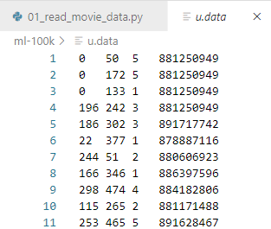
47.1 Read ml-100k Data
https://www.udemy.com/course/data-science-and-machine-learning-with-python-hands-on/learn/lecture/4020676#overview
Load m1-100K/u.data Data from Kaggle.com
https://www.kaggle.com/prajitdatta/movielens-100k-dataset
“ml-100k/u.data”

Slide 6
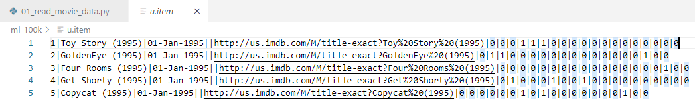
47.1 Read ml-100k Data
https://www.udemy.com/course/data-science-and-machine-learning-with-python-hands-on/learn/lecture/4020676#overview
Load m1-100K/u.item Data from Kaggle.com
https://www.kaggle.com/prajitdatta/movielens-100k-dataset
“ml-100k/u.item”

Slide 7
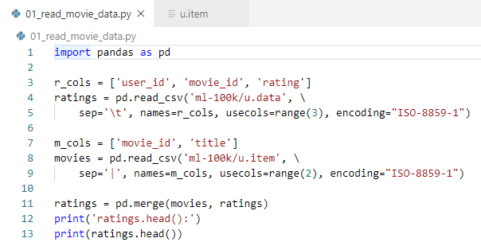
47.1 Read ml-100k Data
https://www.udemy.com/course/data-science-and-machine-learning-with-python-hands-on/learn/lecture/4020676#overview
Load m1-100K/u.data and u.item Data from Kaggle.com
https://www.kaggle.com/prajitdatta/movielens-100k-dataset
Read data into Data Frame:
1. u.data: Read first three columns (range(3)) with separator (\t), user ID, movie ID, and rating.
2. u.item: Rad first two columns (range(2)) with separator (|): Movie ID and Title.

Slide 8
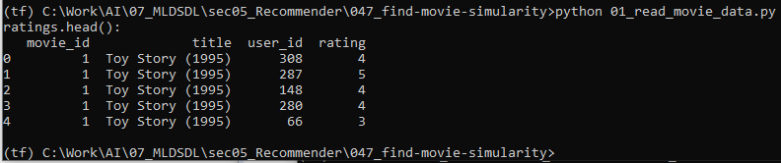
47.1 Read ml-100k/u.item Data
https://www.udemy.com/course/data-science-and-machine-learning-with-python-hands-on/learn/lecture/4020676#overview
Load m1-100K/u.item Data from Kaggle.com
https://www.kaggle.com/prajitdatta/movielens-100k-dataset
Read Data result:

Slide 9
47.2 Construct Matrix

Slide 10
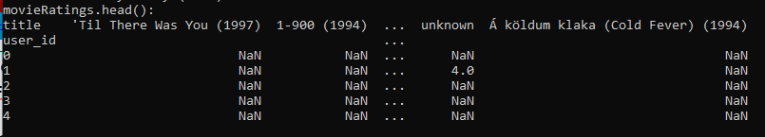
47.2 Construct Matrix
https://www.udemy.com/course/data-science-and-machine-learning-with-python-hands-on/learn/lecture/4020676#overview
Construct Matrix
The amazing pivot_table function on a DataFrame will construct a user / movie rating matrix.
Note:
The NaN indicates missing data - movies that specific users didn't rate.

Slide 11
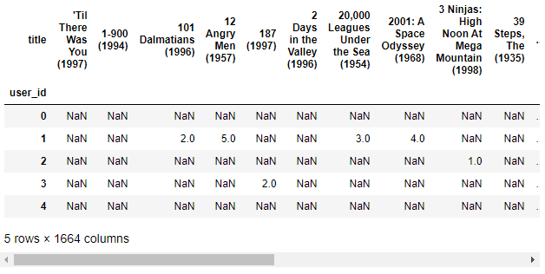
47.2 Construct Matrix
https://www.udemy.com/course/data-science-and-machine-learning-with-python-hands-on/learn/lecture/4020676#overview
Construct Matrix
Window-10 Layout property can set to 9999.
Use Jupyter to scroll more data in horizontally and get better idea.

Slide 12
47.3 Extract Data

Slide 13
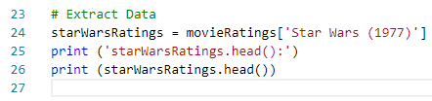
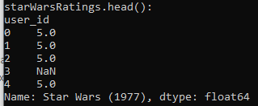
47.3 Extract Data
https://www.udemy.com/course/data-science-and-machine-learning-with-python-hands-on/learn/lecture/4020676#overview
Extract Data
Let's extract a Series of users who rated Star Wars:

Slide 14
47.4 Correlate Data

Slide 15
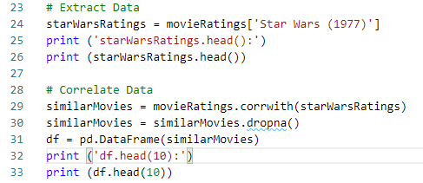
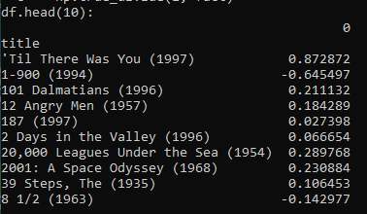
47.4 Correlate Data
https://www.udemy.com/course/data-science-and-machine-learning-with-python-hands-on/learn/lecture/4020676#overview
Correlate Data
Pandas' corrwith function makes it really easy to compute the pairwise correlation of “Star Wars (1977)” vector of user rating with every other movie!
After that, we drop any results that have no data with dropna().
We construct a new DataFrame of movies and their correlation score (similarity) to “Star Wars (1997)”.
Note: There are warning messages. The warning messages are safe to ignore.

Slide 16
47.5 Sort Data

Slide 17
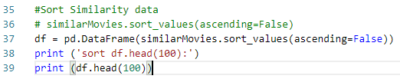
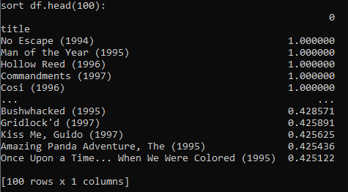
47.5 Sort Data
https://www.udemy.com/course/data-science-and-machine-learning-with-python-hands-on/learn/lecture/4020676#overview
Sort Data
We sort the results by similarity score, and we should have the movies most similar to Star Wars! Except... we don't. These results make no sense at all!
This is why it's important to know your data - clearly we missed something important.

Slide 18
47.6 Rearrange Data

Slide 19

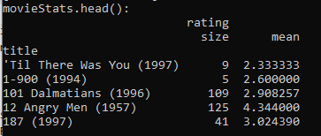
47.6 Rearrange Data
https://www.udemy.com/course/data-science-and-machine-learning-with-python-hands-on/learn/lecture/4020676#overview
Rearrange Data
Our results are probably getting messed up by movies that have only been viewed by a handful of people who also happened to like Star Wars.
So we need to get rid of movies that were only watched by a few people that are producing spurious results.
Let's construct a new DataFrame that counts up how many ratings exist for each movie, and also the average rating while we're at it - that could also come in handy later.

Slide 20
47.7 Sort Cleanup Data

Slide 21
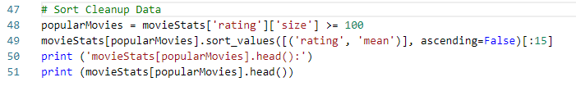
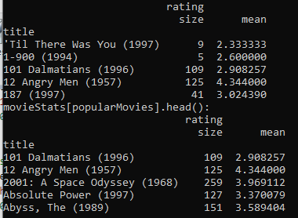
47.7 Sort Cleanup Data
https://www.udemy.com/course/data-science-and-machine-learning-with-python-hands-on/learn/lecture/4020676#overview
Sort Cleanup Data
Get rid of any movies rated by fewer than 100 people
Check the top-rated ones that are left.

Slide 22
47.8 Join Similarity Data

Slide 23

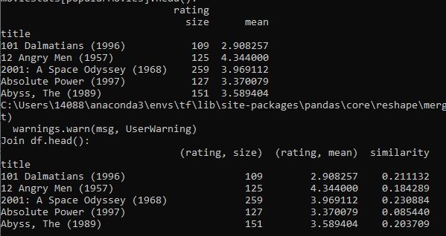
47.8 Join Similarity Data
https://www.udemy.com/course/data-science-and-machine-learning-with-python-hands-on/learn/lecture/4020676#overview
Join Similarity Data
Get rid of 100 or fewer people might still be too low, but these results look pretty good as far as "well rated movies that people have heard of."
Join this data with our original set of similar movies to Star Wars:

Slide 24
47.9 Sort Similarity Data

Slide 25

47.9 Sort Similarity Data
https://www.udemy.com/course/data-science-and-machine-learning-with-python-hands-on/learn/lecture/4020676#overview
Sort Similarity Data
100 might still be too low, but these results look pretty good as far as "well rated movies that people have heard of."
Join this data with our original set of similar movies to Star Wars:

Slide 26
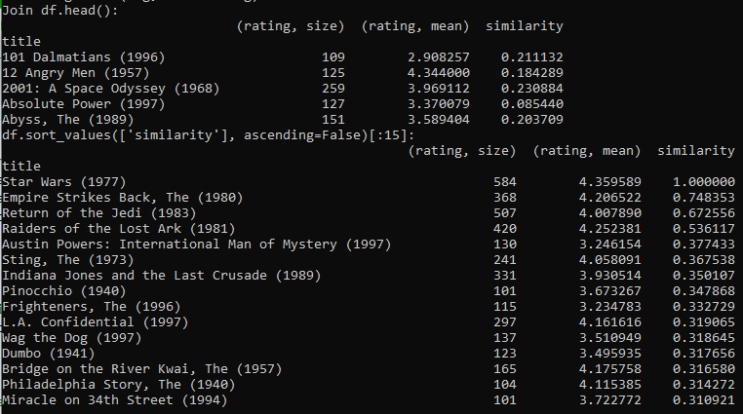
47.9 Sort Similarity Data
https://www.udemy.com/course/data-science-and-machine-learning-with-python-hands-on/learn/lecture/4020676#overview
Sort Similarity Data
Result:

Slide 27
47.10 Exercise

Slide 28
47.10 Exercise
https://www.udemy.com/course/data-science-and-machine-learning-with-python-hands-on/learn/lecture/4020676#overview
Exercise
100 was an arbitrarily chosen cutoff.
Try different values - what effect does it have on the end results?

Slide 29
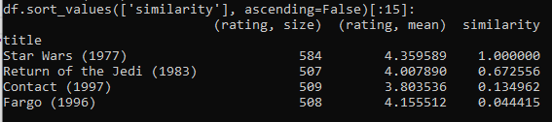
47.10 Exercise
https://www.udemy.com/course/data-science-and-machine-learning-with-python-hands-on/learn/lecture/4020676#overview
Exercise
Get rid of viewer under 500. The result shows less and good.

Slide 30
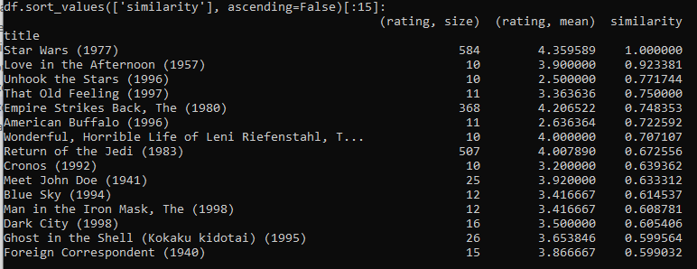
47.10 Exercise
https://www.udemy.com/course/data-science-and-machine-learning-with-python-hands-on/learn/lecture/4020676#overview
Exercise
Get rid of viewer under 10. The result is too many which is no good.

Slide 31
47.10 Exercise
https://www.udemy.com/course/data-science-and-machine-learning-with-python-hands-on/learn/lecture/4020676#overview
Conclusion:
Try to get rid of viewer more than 500 and get better results.
More viewers with more opinions are better than fewer viewers when we do the recommendation for the new users.

Slide 32
End of Chapter

