Slide 1

91 Deep Learning
Peter H. Chen

Slide 2
91 Deep Learning
https://github.com/peterhchen/910_Python_ML_DS_DL
Constructing, Training, and Tuning Multi-Layer Perceptrons
We have hands-on experience with TensorFlow playground.

Slide 3
91.1 Backpropagation

Slide 4
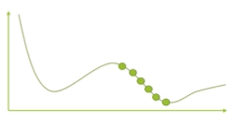
91.1 Backpropagation
https://github.com/peterhchen/910_Python_ML_DS_DL
Backpropagation
How do you train a MLP’s (Multi-Layer Perceptron) weight? How does it learn?
Backpropagation … or more specifically, Gradient Descent using reverse-mode autodiff.
For each training step:
Computer the output error
Compute how much each neuron in the previous hidden layer contributed
Backpropagate the error in reverse pass
Tweak weights to reduce the error using gradient descent

Slide 5
91.1 Backpropagation
https://github.com/peterhchen/910_Python_ML_DS_DL
Backpropagation (Explanation)
How do you train a multilayer perceptron? It uses a technique called "backpropagation.“
Backpropagation uses gradient descent which uses reverse-mode autodiff efficiently.
For each training step, we compute the output error for the weights that we have currently in place for each connection between each artificial neuron.
Then, the backpropagation happens.
Since there are multiple layers to deal with, we have to take that error that is computed at the end of our neural network and backpropagate it down in the other direction. Push it back through the neural network backwards.
That way, we distribute the error back through each connection all the way back to the inputs using the weights that we are currently using at this training step.

Slide 6
91.1 Backpropagation
https://github.com/peterhchen/910_Python_ML_DS_DL
Backpropagation (Explanation)
Pretty simple concept, we just take the errors, we use the weights that we are currently using in our neural network to propagate that error to individual connections, and then we can use that information to tweak the weights through gradient descent to actually try and arrive at a better value on the next pass.
At the next epoch if you will have better results of our training passes.
So, that is all backpropagation is: we run a set of weights, we measure the error, we backpropagate the error using that weight, tune things using gradient descent and try again.
And we keep on doing this over and over again until our system converges.

Slide 7
91.1 Backpropagation
https://github.com/peterhchen/910_Python_ML_DS_DL
Backpropagation (Explanation)
It is very hard to understand the quadratic system with multi-variables.
However, we can simplify the quadratic system into one single variable x and one dependent variable y.
Y = f(x) = a₁ x² + a₂ x + a₃ = a₁ (x - c)², where c is the final converge point.
At x = c, it is our final answer of x (weight)
The gradient of each step will reach the final point c.
y
x
c

Slide 8
91.2 Activation Functions (Rectifier)

Slide 9
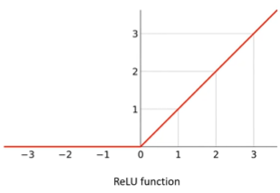
91.2 Activation Functions (Rectifier)
https://github.com/peterhchen/910_Python_ML_DS_DL
Activation Function, also called, Rectifier
Step function do not work with gradient descent
There is no gradient
Mathematically, they have no useful derivative
Alternatives:
Logistic function
Hyperbolic Tangent function
Exponential Linear Unit (ELU)
ReLU function (Rectified Linear Unit)
ReLU is common. Fast to compute and works well.
Also: “Leaky ReLU”, “Noisy ReLU”
ELU can sometimes lead to faster learning though.

Slide 10
91.2 Activation Functions (Rectifier)
https://github.com/peterhchen/910_Python_ML_DS_DL
Activation Function, also called, Rectifier (Explanation)
We saw the activation functions in the exercise of TensorFlow playground.
We use the hyperbolic tangent activation function by default and then we switched to ReLU and we saw the results were better. What is ReLU?
The activation function is just the function that determines the output of a neuron given the sum of its inputs.
You take the sum of all the weights of the inputs coming into neuron, the activation function is what takes that sum and turns it into an output signal.
The step function is what people did originally, but that doesn't really work with gradient descent because there is no gradient at step (no slope).
It is either ON or OFF, there's no useful derivative there at all.
There are some other ones called the "logistic function;" "the hyperbolic tangent function," that produces more of a curvy curve, if you think about what a hyperbolic tangent looks like.
It doesn't have that sharp cut off there at zero at the origin, so that can work out pretty well.

Slide 11
91.2 Activation Functions (Rectifier)
https://github.com/peterhchen/910_Python_ML_DS_DL
Activation Function, also called, Rectifier (Explanation)
There's also something called the "exponential linear unit," which is also a bit more curvy.
What we ended up using though, was ReLU, that stands for "Rectified Linear Unit," and that's what this graph here is showing.
Basically it's zero if it's less than zero, and if it's greater than zero, it climbs up at a 45 degree angle.
It gives you the actual sum of the input weights as its output IF that output is greater than zero.
So the advantage that ReLU has is that it's very simple, very easy, and very fast to compute.
If you're worried about converging quickly and you're computing resources, ReLU is a really good choice.

Slide 12
91.2 Activation Functions (Rectifier)
https://github.com/peterhchen/910_Python_ML_DS_DL
Activation Function, also called, Rectifier (Explanation)
Now there are variants of ReLU that work even better, if you don't care so much about efficiency.
One is called "Leaky ReLU," and all that is, is instead of being flat left of zero, it actually has a little bit of a slope there as well, a very small slope, and again, that's for mathematical purposes to have an actual meaningful derivative there to work with, so that can provide even better convergence.
It's also something called "Noisy ReLU," which can also help with convergence.
But these days ELU, the exponential linear unit, will often produce faster learning, that's kind of the, it's gaining popularity now that computing resources are becoming less and less of a concern now that you can actually do Deep Learning over a cluster of PCs on network in the cloud.
So that's what activation functions are all about.

Slide 13
91.3 Optimization Functions

Slide 14

91.3 Optimization Functions
https://github.com/peterhchen/910_Python_ML_DS_DL
Optimization Functions
There are faster (as in faster learning) optimizes than gradient descent
Momentum Optimization
Introduce a momentum term to the descent: When the surface start to flatten, the slop is small and x step is big. When the surface slope is steep, the slope is big but x step is very small.
Nesterov Accelerated Gradient
A small tweak on momentum optimization: computes momentum based on the gradient slightly ahead of you, not based where you are.
RMSProp
Adaptive learning rate to help point toward the minimum
Adam
Adaptive momentum estimation: Momentum + RMSProp combined
Popular choice today, easy to use

Slide 15
91.3 Optimization Functions
https://github.com/peterhchen/910_Python_ML_DS_DL
Optimization Functions (Explanation)
You can also choose different optimization functions, you know, we've talked in very general terms about gradient descent, but there are various variations of gradient descent that you can use as well.
We discussed about momentum optimization, basically the idea there is to speed objects up as you're going down a hill and slow objects down as you start to approach that minima.
It is a way making the grading descent happen faster by kind of skipping over those steeper parts of your learning curve.
y
c
x
Δx₁
Δx₂

Slide 16
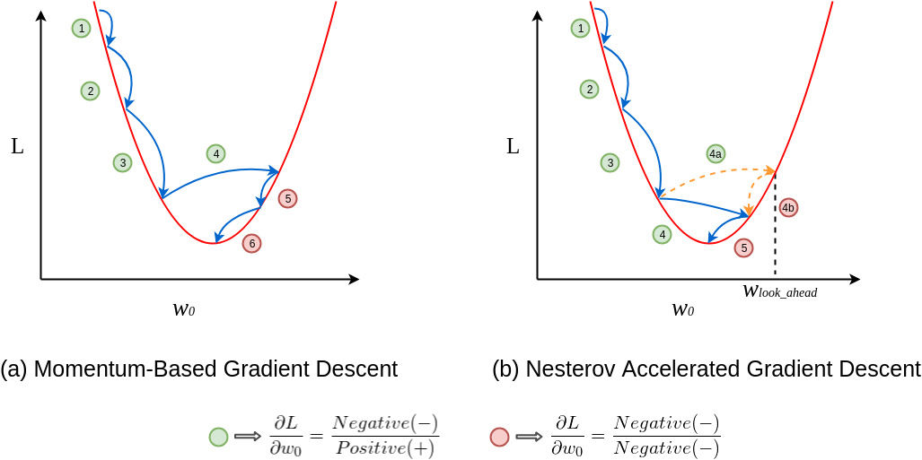
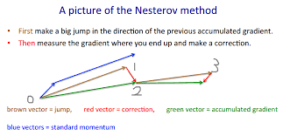
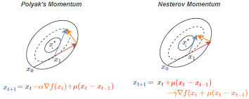
91.3 Optimization Functions
https://github.com/peterhchen/910_Python_ML_DS_DL
Optimization Functions (Explanation)
There is also something called the "Nesterov accelerated gradient," which is just a tweak on top of momentum optimization, basically it's looking ahead a little bit to the gradient in front of you to take that information into account, so that works even better.

Slide 17
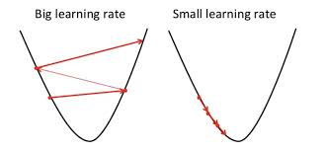
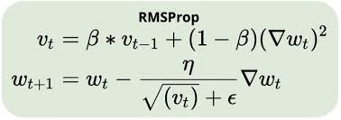
91.3 Optimization Functions
https://github.com/peterhchen/910_Python_ML_DS_DL
Optimization Functions (Explanation)
There's also something called "RMSProp," which uses an adaptive learning rate, that again, helps point you in the right direction toward the minimum.
Remember back to how greeting descent works, it's not always obvious which direction you're going to be heading in given the change in parameters, so RMSProp is just a more sophisticated way of trying to figure out the right direction.

Slide 18
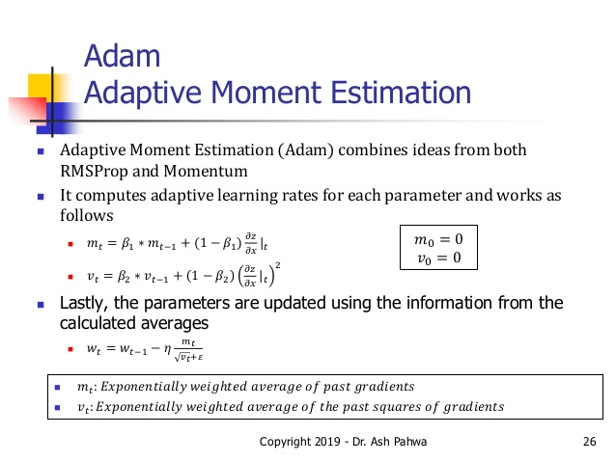
91.3 Optimization Functions
https://github.com/peterhchen/910_Python_ML_DS_DL
Optimization Functions (Explanation)
Finally, there's something called "Adam," stands for “Adaptive Moment estimation,“ basically it's the momentum optimizer and RMSProp combined.
It gives you the best of both worlds, and that is a popular choice today because it works really well and it's very easy to use.

Slide 19
91.3 Optimization Functions
https://github.com/peterhchen/910_Python_ML_DS_DL
Optimization Functions (Explanation)
The libraries that you are going to use are very high level and very easy to use.
We will not implement Nesterov accelerated gradient.
We just set optimizer =“Adam” and make sure Adm is best choice for us.
We need to be aware of the tradeoffs between speed of convergence and computational resources and time required to actually do that convergence.

Slide 20
91.4 Avoid Overfitting

Slide 21
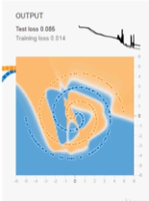
91.4 Avoid Overfitting
https://github.com/peterhchen/910_Python_ML_DS_DL
Avoid Overfitting
With thousands of weights to tune, overfitting is a problem.
Early stopping when performance starts dropping,
Regularization terms added to cost function during training
Dropout: Ignore, for example, 50% of all neurons randomly at each training step
Work surprisingly well
Forces your model to spread out its learning.

Slide 22
91.4 Avoid Overfitting
https://github.com/peterhchen/910_Python_ML_DS_DL
Avoid Overfitting (Explanation)
Let’s discussed overfitting.
You can see you'll often end up with patterns like this where you are not really getting a clean solution.
You are going to end up with these weird spikes sometimes. Sometimes if you get run time too long. It ends up reinforcing those spikes.
Those overfitted areas where you are not really fitting to the pattern you're looking for.
You just fitting to the training data that you were given, not the testing data.

Slide 23
91.4 Avoid Overfitting
https://github.com/peterhchen/910_Python_ML_DS_DL
Avoid Overfitting (Explanation)
There are ways to combat that and obviously if you have thousands of weights to tune.
Those connections between each neuron and each layer of your neurons can add up really quickly.
It is very easy for overfitting to happen.
There are ways to deal with it, one is called "early stopping.“
As soon as you see performance start to drop.

Slide 24
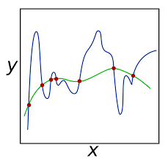

91.4 Avoid Overfitting
https://github.com/peterhchen/910_Python_ML_DS_DL
Avoid Overfitting (Explanation)
It may be natural way of telling you that it might be time for you to stop learning, you know.
At this point maybe you're just overfitting.
There are also "regularization terms" you can add to the cost function during training, you know, that can, basically like the bias term that we talked about earlier, like can help too.
https://en.wikipedia.org/wiki/Regularization_(mathematics)

Slide 25
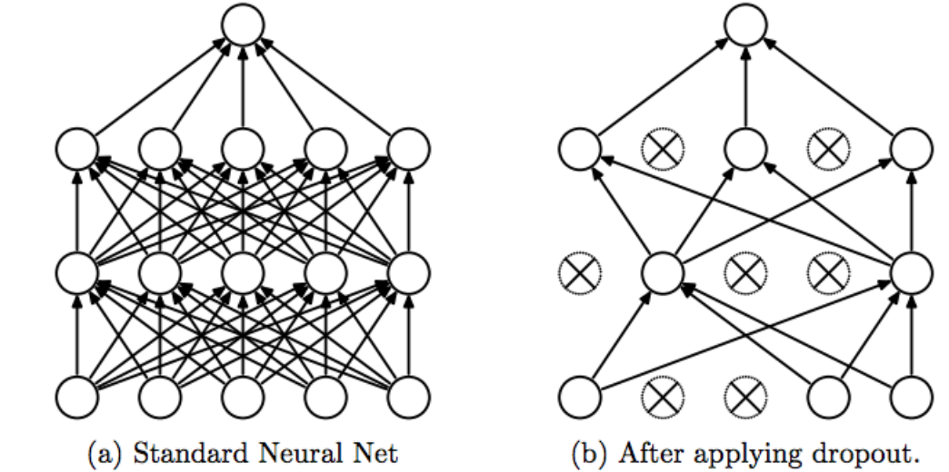
91.4 Avoid Overfitting
https://github.com/peterhchen/910_Python_ML_DS_DL
Avoid Overfitting (Explanation)
A surprisingly effective technique is called "dropout," and it kind of is an example of a very simple idea that is very effective.
The idea is just to ignore, for example, half of the neurons (weight are very small, close to zero) randomly at each training step, pretend that they don't exist at all.
And the reason this works is because it forces your model to spread out its learning.

Slide 26
91.4 Avoid Overfitting
https://github.com/peterhchen/910_Python_ML_DS_DL
Avoid Overfitting (Explanation)
If basically you're taking away half of its brain, if you will, at each training step, you're going to force the remaining half of those neurons to do as much work as possible, so this prevents things where you have individual neurons taking on more of the work than they should.
You know, you even saw some of the examples that we ran in the TensorFlow playground that sometimes we'd end up with neurons that were barely used at all, and by using dropout, that would have forced that neuron to have been used more effectively.
Very simple concept and very effective in making sure that you're making full use of your neural network.

Slide 27
91.5 Tune Your Topology

Slide 28
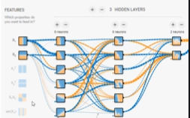
91.5 Tune Your Topology
https://github.com/peterhchen/910_Python_ML_DS_DL
Tune Your Topology
Trial and Error is one way
Evaluate a smaller network with less neurons in the hidden layers
Evaluate a larger network with more layers
Try reducing the size of each layer as you progress: form a funnel
More layers can yield faster learning
Or just use more layers and neurons than you need. Do not care because you can use early stopping
Use “model zoos”

Slide 29
91.5 Tune Your Topology
https://github.com/peterhchen/910_Python_ML_DS_DL
Tune Your Topology (Explanation)
Let’s discuss about tuning your typology.
Another way to improve the results of your Deep Learning network is to just play games with how many neurons you have and how many layers of neurons you have.
One way of dealing with it is just trial and error.
It is just we did in TensorFlow playground, but, there can be a methodology to that and, even you can start off by it with the strategy of evaluating a smaller network with less neurons in the hidden layers, or you can evaluate a larger network with more layers.
You want to see: can I get away with a smaller network and still get good results?
Can I keep on making it smaller and smaller until you find the smallest it can be safely?
You can try to make your network larger and larger and see, you know, at what point it stops providing more benefits to you.

Slide 30
91.5 Tune Your Topology
https://github.com/peterhchen/910_Python_ML_DS_DL
Tune Your Topology (Explanation)
Just start sizing things differently and see what works and what doesn’t.
There's sort of a spooky (ghostly) aspect to how this stuff all works together.
it's very hard to understand intuitively what's going on inside of a neural network, a Deep Learning network in particular.
Sometimes you just have to use your intuition to try to tune the thing and get at the right number of resources you need.
In today's modern computing environment, sometimes you don't really care so much.
It is OK that you have a deep neural network that has more neurons that it really needs.
What is the real expense involved in that these days? Probably not much.
More layers will often yield faster learning than have more neurons and less layers.

Slide 31
91.5 Tune Your Topology
https://github.com/peterhchen/910_Python_ML_DS_DL
Tune Your Topology (Explanation)
If you care about speed of convergence, adding more layers is often the right thing to do, or you can also use something called "models zoos.“
There are actually libraries out there of neural network topology for specific problems.
You are not the first person in the world to solve a specific classification problem.
You should always check out one of the model zoos out there to see if someone already figured out the optimal topology.
Try to achieve instead of trying to reinvent the wheel.
People share knowledge and it can save you a lot of time.
We will see Python and Tensorflow code next.

Slide 32
End of Chapter

