Slide 1

107 Final Project
Peter H. Chen

Slide 2
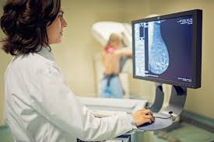
107 Final Project
https://github.com/peterhchen/930_Python_ML_DS_DL
Final Project
Predict if a mass detected in a mammogram (X-ray picture of the breast) is benign or malignant using the best supervised machine learning model you can find.

Slide 3
107.1 Mammogram Data

Slide 4
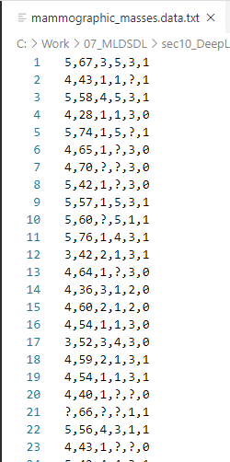
107.1 Mammogram Data
https://github.com/peterhchen/930_Python_ML_DS_DL
Mammogram Data
“mammographic_masses.data.txt”
This data file has six columns of information and you can see that missing data is represented by question marks (?).
We have to get rid of that missing data at some point.

Slide 5
107.2 Data Explanation

Slide 6
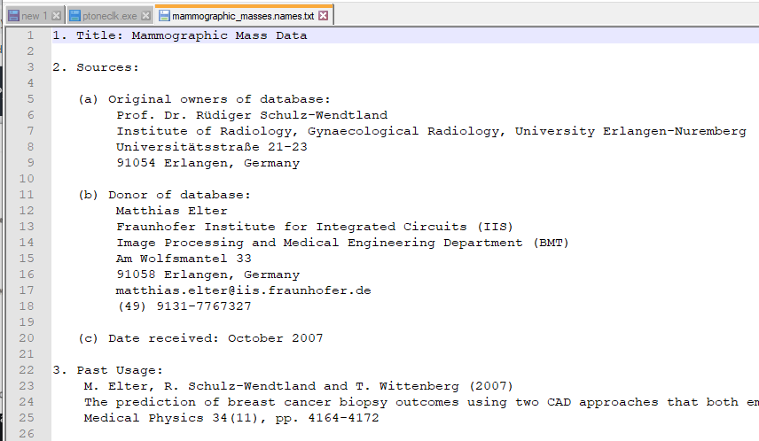
107.2 Data Explanation
https://github.com/peterhchen/930_Python_ML_DS_DL
Mammogram Mass Data Explanation: “mammographic_masses.names.txt”
If you see what those columns mean and more information about the data set itself. You can get that in the “*names.txt” file here associated with the dataset.
This data came from the UCI repository. It is a great resource for finding other data sets.
We go over this files line-by-line:

Slide 7
107.1 Mammogram Data
https://github.com/peterhchen/930_Python_ML_DS_DL
Mammogram Data: “mammographic_masses.names.txt”
1. Title: Mammographic Mass Data
2. Sources:
(a) Original owners of database:
Prof. Dr. Rüdiger Schulz-Wendtland
Institute of Radiology, Gynaecological Radiology, University Erlangen-Nuremberg
Universitätsstraße 21-23
91054 Erlangen, Germany
(b) Donor of database:
Matthias Elter
Fraunhofer Institute for Integrated Circuits (IIS)
Image Processing and Medical Engineering Department (BMT)
Am Wolfsmantel 33
91058 Erlangen, Germany
matthias.elter@iis.fraunhofer.de
(49) 9131-7767327
(c) Date received: October 2007

Slide 8
107.1 Mammogram Data
https://github.com/peterhchen/930_Python_ML_DS_DL
Mammogram Data: “mammographic_masses.names.txt”
3. Past Usage:
M. Elter, R. Schulz-Wendtland and T. Wittenberg (2007)
The prediction of breast cancer biopsy outcomes using two CAD approaches.
Both emphasize an intelligible decision process.
Medical Physics 34(11), pp. 4164-4172
4. Relevant Information:
Mammography is the most effective method for breast cancer screening available today.
However, the low positive predictive value of breast biopsy resulting from mammogram interpretation leads to approximately 70% unnecessary biopsies with benign outcomes.
To reduce the high number of unnecessary breast biopsies, several computer-aided diagnosis (CAD) systems have been proposed in the last years.

Slide 9
107.1 Mammogram Data
https://github.com/peterhchen/930_Python_ML_DS_DL
Mammogram Data: “mammographic_masses.names.txt”
These systems help physicians in their decision to perform a breast biopsy on a suspicious lesion (a region in organ) seen in a mammogram or to perform a short term follow-up examination instead.
This data set can be used to predict the severity (benign or malignant) of a mammographic mass (coherent body of no definite shape) lesion from BI-RADS attributes and the patient's age.
It contains a BI-RADS assessment, the patient's age and three BI-RADS attributes together with the ground truth (the severity field) for 516 benign and 445 malignant masses that have been identified on full field digital mammograms collected at the Institute of Radiology of the University Erlangen-Nuremberg between 2003 and 2006.
Each instance has an associated BI-RADS assessment ranging from 1 (definitely benign) to 5 (highly suggestive of malignancy) assigned in a double-review process by physicians.

Slide 10
107.1 Mammogram Data
https://github.com/peterhchen/930_Python_ML_DS_DL
Mammogram Data: “mammographic_masses.names.txt”
Assuming that all cases with BI-RADS assessments greater or equal a given value (varying from 1 to 5), are malignant and the other cases benign, sensitivities and associated specificities can be calculated.
These can be an indication of how well a CAD system performs compared to the radiologists.
5. Number of Instances: 961 (516 benign and 445 malignant)
6. Number of Attributes: 6 (1 goal field, 1 non-predictive, 4 predictive attributes)

Slide 11
107.1 Mammogram Data
https://github.com/peterhchen/930_Python_ML_DS_DL
Mammogram Data: “mammographic_masses.names.txt”
7. Attribute Information:
1. BI-RADS assessment: 1 to 5 (ordinal)
2. Age: patient's age in years (integer)
3. Shape: mass shape:
round=1, oval=2, Lobular (scallop-shape) =3, irregular=4 (nominal)
4. Margin:
mass margin: circumscribed=1, micro-lobulated (scallop-shape)=2
obscured=3, ill-defined=4, spiculated (spike shape)=5 (nominal),
5. Density: mass density high=1 iso=2 low=3 fat-containing=4 (ordinal),
6. Severity: benign=0 or malignant=1 (binominal)

Slide 12
107.1 Mammogram Data
https://github.com/peterhchen/930_Python_ML_DS_DL
Mammogram Data: “mammographic_masses.names.txt”
8. Missing Attribute Values: Yes (Some of the data is missed)
- BI-RADS assessment: 2
- Age: 5
- Shape: 31
- Margin: 48
- Density: 76
- Severity: 0
9. Class Distribution: benign: 516; malignant: 445 (total patients = 961)

Slide 13
107.2 Predict Benign or Malignant

Slide 14
107.2 Predict Benign or Malignant
https://github.com/peterhchen/930_Python_ML_DS_DL
Project Goal: Predict Benign or Malignant Based on 6 Attributes
We will be using the "mammographic masses" public dataset from the UCI repository (source: https://archive.ics.uci.edu/ml/datasets/Mammographic+Mass)
This data contains 961 instances of masses detected in mammograms, and contains the following attributes:
1. BI-RADS assessment: 1 to 5 (ordinal)
2. Age: patient's age in years (integer)
3. Shape: mass shape: round=1 oval=2 lobular=3 irregular=4 (nominal)
4. Margin: mass margin: circumscribed=1 microlobulated=2 obscured=3 ill-defined=4 spiculated=5 (nominal)
5. Density: mass density high=1 iso=2 low=3 fat-containing=4 (ordinal)
6. Severity: benign=0 or malignant=1 (binominal)
BI-RADS is an assessment of how confident the severity classification is; it is not a "predictive" attribute and so we will discard it. The age, shape, margin, and density attributes are the features that we will build our model with, and "severity" is the classification we will attempt to predict based on those attributes.

Slide 15
107.2 Predict Benign or Malignant
https://github.com/peterhchen/930_Python_ML_DS_DL
Predict Benign or Malignant
BI-RADS is an assesment of how confident the severity classification is; it is not a "predictive" attribute and so we will discard it. The age, shape, margin, and density attributes are the features that we will build our model with, and "severity" is the classification we will attempt to predict based on those attributes.
Although "shape" and "margin" are nominal data types, which sklearn typically doesn't deal with well, they are close enough to ordinal that we shouldn't just discard them. The "shape" for example is ordered increasingly from round to irregular.
A lot of unnecessary anguish and surgery arises from false positives arising from mammogram results. If we can build a better way to interpret them through supervised machine learning, it could improve a lot of lives.

Slide 16
107.3 Assignment

Slide 17
107.3 Assignment
https://github.com/peterhchen/930_Python_ML_DS_DL
Assignment
Apply several different supervised machine learning techniques to this data set, and see which one yields the highest accuracy as measured with K-Fold cross validation (K=10). Apply:
Decision tree
Random forest
KNN
Naive Bayes
SVM
Logistic Regression
And, as a bonus challenge, a neural network using Keras.
The data needs to be cleaned; many rows contain missing data, and there may be erroneous data identifiable as outliers as well.

Slide 18
107.3 Assignment
https://github.com/peterhchen/930_Python_ML_DS_DL
Assignment
Remember some techniques such as SVM also require the input data to be normalized first.
Many techniques also have "hyperparameters" that need to be tuned. Once you identify a promising approach, see if you can make it even better by tuning its hyperparameters.
We want achieve over 80% accuracy.

Slide 19
107.4 Read Data

Slide 20
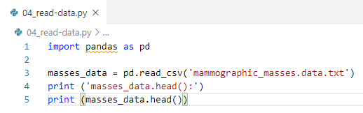
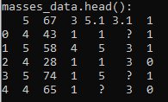
107.4 Read Data
https://github.com/peterhchen/930_Python_ML_DS_DL
Read Data
Import panda (Panel Data) data analysis library
Read “mammographic_masses.data.txt” into a Pandas df (dataframe masses_data).
Hint: Use read_csv()
Print first five lines by masses_data.head()

Slide 21
107.5 Missing Data and Column Name

Slide 22
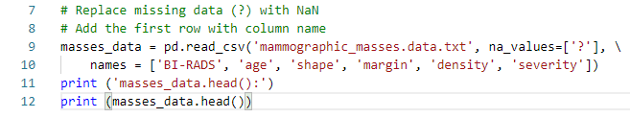
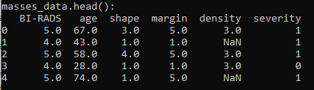
107.5 Missing Data and Column Name
https://github.com/peterhchen/930_Python_ML_DS_DL
Replace Missing Data and Add Column Name
We see some data missing field (?). We have to convert missing data (?) into NaN.
The first row is missing column name. We need to add the column names (BI_RADS, age, shape, margin, density, and severity):

Slide 23
107.6 Evaluate Data

Slide 24

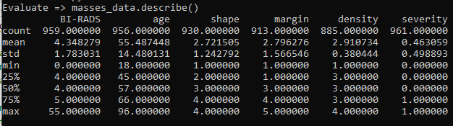
107.6 Evaluate Data
https://github.com/peterhchen/930_Python_ML_DS_DL
Evaluate Data
Evaluate whether the data needs cleaning.
Your model is only as good as the data it's given.
Hint: use describe() on the dataframe.

Slide 25
107.6 Evaluate Data
https://github.com/peterhchen/930_Python_ML_DS_DL
Evaluate Data
There are quite a few missing values in the data set.
Total data count is 961. BI-RADS = 959 (miss 2 data), age = 956 (miss 5 data), and etc.
Before, we drop every row that's missing data.
Let's make sure we don't bias our data in doing so.
Does there appear to be any sort of correlation to what sort of data has missing fields?
If there were, we'd have to try and go back and fill that data in.

Slide 26
107.7 Print Missing Data Row

Slide 27
107.7 Print Missing Data Row
https://github.com/peterhchen/930_Python_ML_DS_DL
Print Missing Data Row
There are quite a few missing values in the data set.
Total data count is 961. BI-RADS = 959 (miss 2 data), age = 956 (miss 5 data), and etc.
Before, we drop every row that's missing data.
Let's make sure we don't bias our data in doing so.
Does there appear to be any sort of correlation to what sort of data has missing fields?
If there were, we'd have to try and go back and fill that data in.

Slide 28
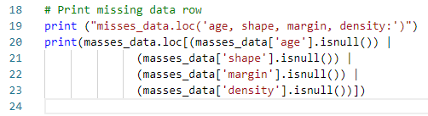
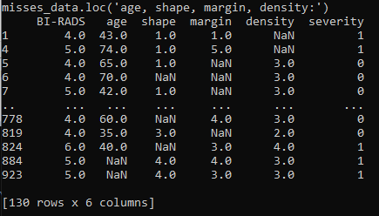
107.7 Print Missing Data Row
https://github.com/peterhchen/930_Python_ML_DS_DL
Print Missing Data Row
There are 130 rows missing data.

Slide 29
107.8 Remove Missing Data Rows

Slide 30

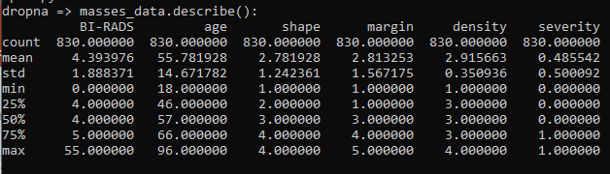
107.8 Remove Missing Data Rows
https://github.com/peterhchen/930_Python_ML_DS_DL
Remove Missing Data Rows
If the missing data seems randomly distributed, go ahead and drop rows with missing data.
Hint: use dropna().

Slide 31
107.9 Convert Panda to Numpy

Slide 32
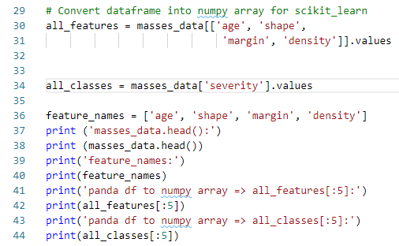
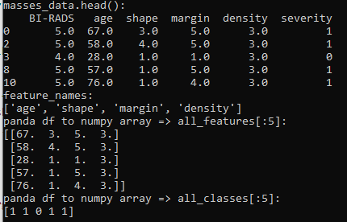
107.9 Convert Panda to Numpy
https://github.com/peterhchen/930_Python_ML_DS_DL
Convert Pandas DataFrame to Numpy Array for scikit_learn
Next you will need to convert the Pandas dataframes into numpy arrays that can be used by scikit_learn.
Create an array that extracts only the feature data we want to work with (age, shape, margin, and density) and another array that contains the classes (severity).
You'll also need an array of the feature name labels.

Slide 33
107.10 Normalize/Fit/Transform

Slide 34
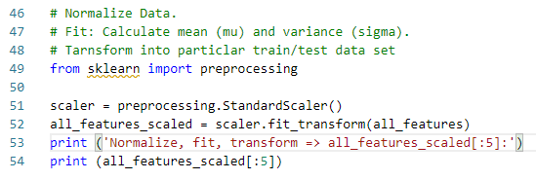
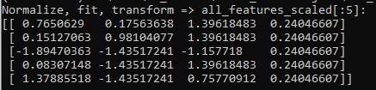
107.10 Normalize/Fit/Transform
https://github.com/peterhchen/930_Python_ML_DS_DL
Normalize/Fit/Transform
Some of our models require the input data to be normalized.
Normalize the attribute data.
Hint: use preprocessing.StandardScaler().

Slide 35
107.11 Split Data Set

Slide 36
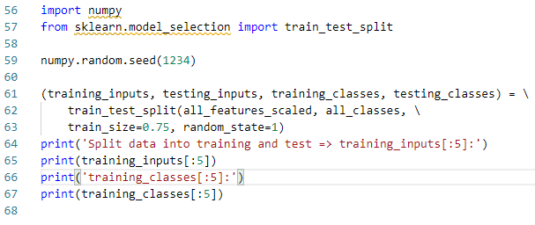
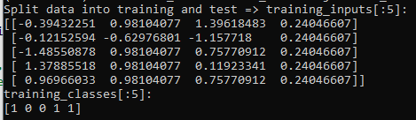
107.11 Split Data Set
https://github.com/peterhchen/930_Python_ML_DS_DL
Split Data Set
Before moving to K-Fold cross validation and random forests, start by creating a single train/test split of our data.
Set 75% for training and 25% for testing.

Slide 37
107.12 Create Classifier and Train Data

Slide 38
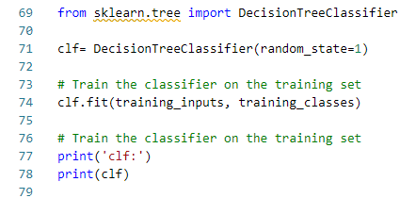
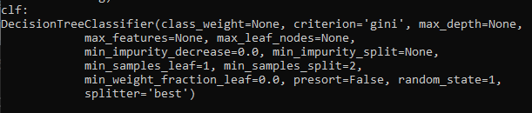
107.12 Create Classifier and Train Data
https://github.com/peterhchen/930_Python_ML_DS_DL
Create Decision Tree Classifier and Fit Train Data
Create a DecisionTreeClassifier.
Fit it to your training data.

Slide 39
107.13 Save/Display Decision Tree

Slide 40
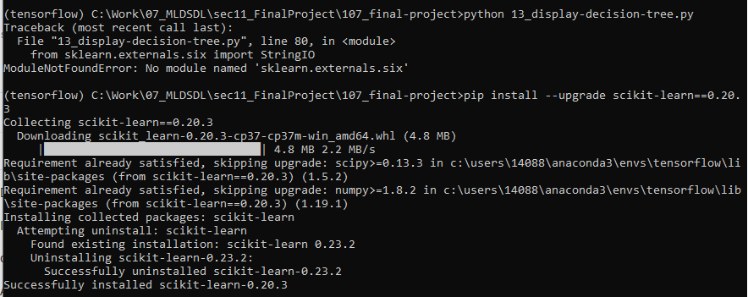
107.13 Save/Display Decision Tree
https://github.com/peterhchen/930_Python_ML_DS_DL
Display Decision Tree
> pip install --upgrade scikit-learn==0.20.3

Slide 41
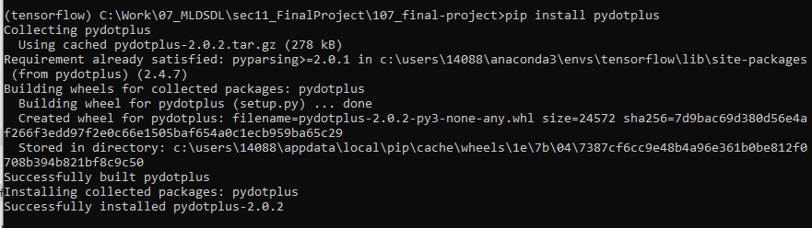
107.13 Save/Display Decision Tree
https://github.com/peterhchen/930_Python_ML_DS_DL
Display Decision Tree
> pip install pydotplus

Slide 42
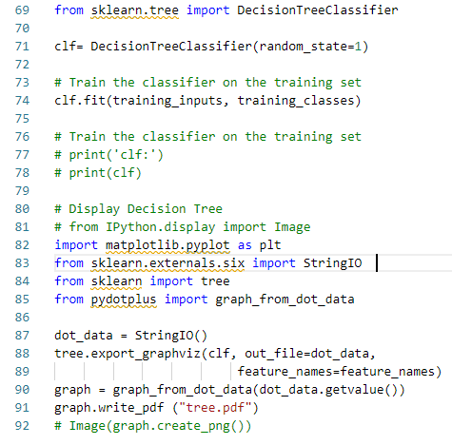
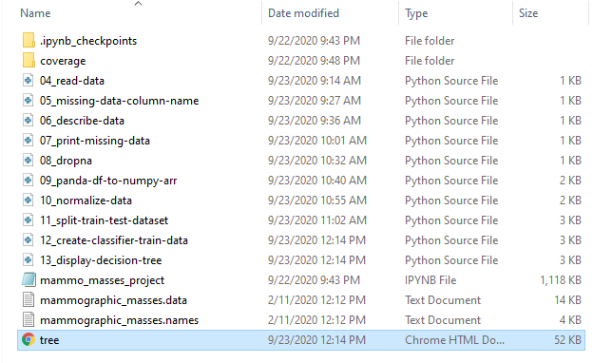
107.13 Save/Display Decision Tree
https://github.com/peterhchen/930_Python_ML_DS_DL
Display Decision Tree

Slide 43
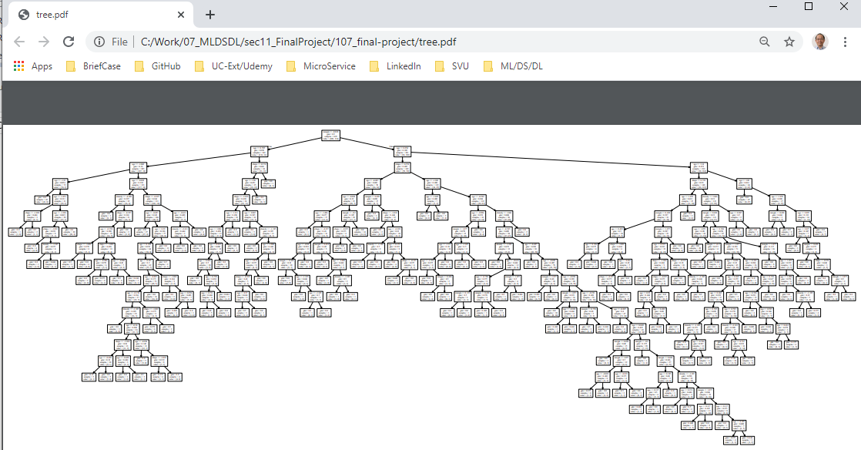
107.13 Save/Display Decision Tree
https://github.com/peterhchen/930_Python_ML_DS_DL
Display Decision Tree

Slide 44
107.14 Measure Accuracy

Slide 45

107.14 Measure Accuracy
https://github.com/peterhchen/930_Python_ML_DS_DL
Measure Accuracy
Measure the accuracy of the resulting decision tree model using your test data.

Slide 46
107.15 K-Fold Cross-Validation

Slide 47
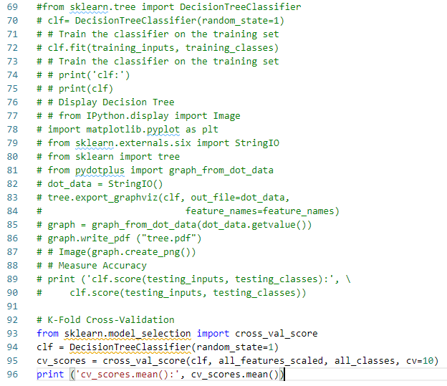
107.15 K-Fold Cross-Validation
https://github.com/peterhchen/930_Python_ML_DS_DL
K-Fold Cross-Validation
Now instead of a single train/test split, use K-Fold cross validation to get a better measure of your model's accuracy (K=10).
Hint: use model_selection.cross_val_score

Slide 48
107.16 SVM (Support Vector Machine)

Slide 49
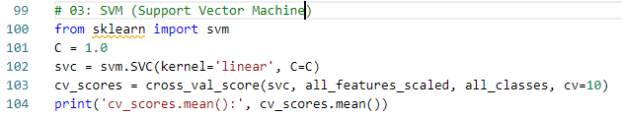
107.16 SVM (Support Vector Machine)
https://github.com/peterhchen/930_Python_ML_DS_DL
SVM (Support Vector Machine)

Slide 50
107.17 KNN (K-Nearest Neighbor)

Slide 51
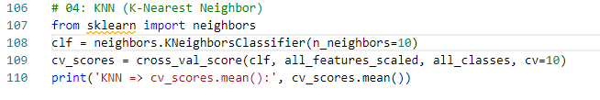

107.17 KNN (K-Nearest Neighbor)
https://github.com/peterhchen/930_Python_ML_DS_DL
KNN (K-Nearest Neighbor)
How about K-Nearest-Neighbors?
Hint: use neighbors.KNeighborsClassifier
It's a lot easier than implementing KNN from scratch like we did earlier.
Start with a K of 10.
K is an example of a hyperparameter - a parameter on the model itself which may need to be tuned for best results on your particular data set.

Slide 52
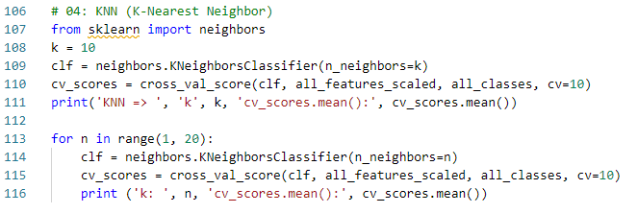
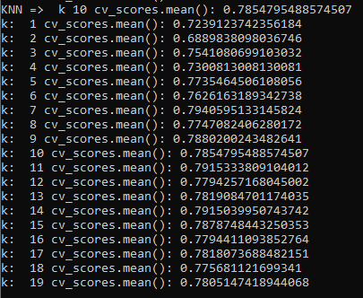
107.17 KNN (K-Nearest Neighbor)
https://github.com/peterhchen/930_Python_ML_DS_DL
KNN (K-Nearest Neighbor)
Choosing K is tricky, so we can't discard KNN until we've tried different values of K.
Write a for loop to run KNN with K values ranging from 1 to 20 and see if K makes a substantial difference.
Make a note of the best performance you could get out of KNN.

Slide 53
108.18 Naïve Bayes

Slide 54
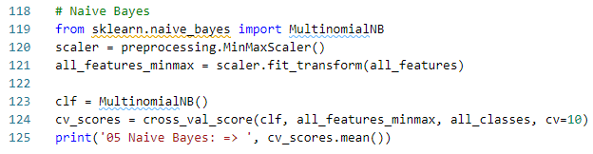
108.18 Naïve Bayes
https://github.com/peterhchen/930_Python_ML_DS_DL
Naïve Bayes
Now try naive_bayes.MultinomialNB. How does its accuracy stack up?

Slide 55
108.19 SVM-rbf

Slide 56
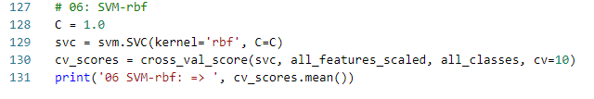
108.19 SVM-rbf
https://github.com/peterhchen/930_Python_ML_DS_DL
SVM-rbf (radial Basis Function)
svm.SVC may perform differently with different kernels.
The choice of kernel is an example of a "hyperparamter."
Try the rbf (Radial Basis Function, is a popular kernel function) kernels and see what the best-performing kernel is. Do we have a new winner?

Slide 57
108.20 SVM-sigmoid

Slide 58
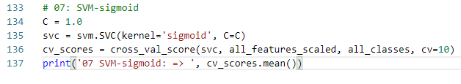

108.20 SVM-sigmoid
https://github.com/peterhchen/930_Python_ML_DS_DL
SVM-sigmoid
svm.SVC may perform differently with different kernels.
The choice of kernel is an example of a "hyperparamter."
Try sigmoid kernels and see what the best-performing kernel is. Do we have a new winner?

Slide 59
108.21 SVM-poly

Slide 60

108.21 SVM-poly
https://github.com/peterhchen/930_Python_ML_DS_DL
SVM-sigmoid
svm.SVC may perform differently with different kernels.
The choice of kernel is an example of a "hyperparamter."
Try sigmoid kernels and see what the best-performing kernel is. Do we have a new winner?

Slide 61
108.22 Logistic Regression

Slide 62
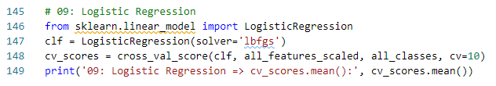
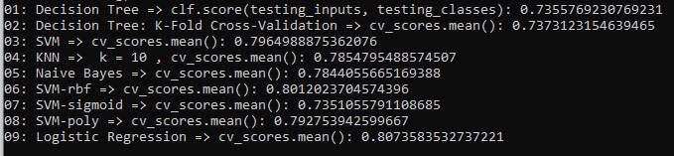
108.22 Logistic Regression
https://github.com/peterhchen/930_Python_ML_DS_DL
Logistic Regression
We've tried all these fancy techniques, but fundamentally this is just a binary classification problem.
Try Logistic Regression, which is a simple way to tackling this sort of thing.

Slide 63
108.23 Neural Network

Slide 64
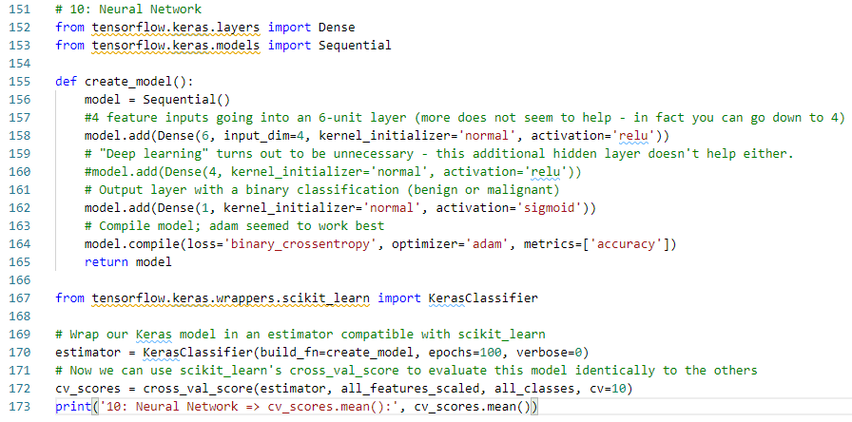
108.23 Neural Network
https://github.com/peterhchen/930_Python_ML_DS_DL
Neural Network
Let’s see if an artificial neural network can do even better.
You can use Keras to set up a neural network with 1 binary output neuron and see how it performs.
Don't be afraid to run a large number of epochs to train the model if necessary.

Slide 65
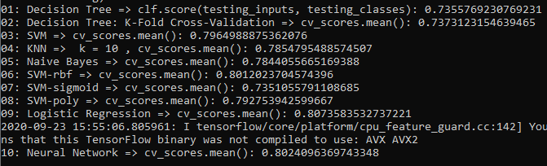
108.23 Neural Network
https://github.com/peterhchen/930_Python_ML_DS_DL
Neural Network

Slide 66
108.24 Winner

Slide 67
108.24 Winner
https://github.com/peterhchen/930_Python_ML_DS_DL
Winner
Do we have a winner?
Which model, and which choice of hyperparameters, performed the best? Feel free to share your results!
The only clear loser is decision trees. They are 73%.
Every other algorithm could be tuned to produce comparable results with 79-80% accuracy.
Additional hyperparameter tuning, or different topologies of the multi-level perceptron might make a difference.

Slide 68
108.25 Summary

Slide 69
108.25 Summary
https://github.com/peterhchen/930_Python_ML_DS_DL
Summary
We have done the following assignments of Machine Learning and Neural Network:
Decision tree
K-Fold Random forest
KNN
Naive Bayes
SVM
Logistic Regression
Neural Network

Slide 70
End of Chapter

