Slide 1

62 Data Cleaning and Normalization
Peter H. Chen

Slide 2
62 Data Cleaning and Normalization
https://www.udemy.com/course/data-science-and-machine-learning-with-python-hands-on/learn/lecture/4020718#overview
Data Cleaning and Normalization
We are discuss clean your input data. How well you clean your input data and understand your raw input data is going to have a huge impact on the quality of your results, maybe even more so than what model you choose or how well you tune your models.
So pay attention. This is important stuff.

Slide 3
62.1 Data Cleaning

Slide 4
62.1 Data Cleaning
https://www.udemy.com/course/data-science-and-machine-learning-with-python-hands-on/learn/lecture/4020718#overview
Data Cleaning
In data science, you spend most of your time actually just cleaning and preparing your data and actually relatively little of it analyzing it and trying out new algorithms.
So, cleaning data is an extremely important thing to pay attention to.
There's a lot of different things that you might find in raw data.
Data that comes into you, just raw data is going to be very dirty, it's going to be polluted in many different ways and if you don't deal with it, it's going to skew your results, it will ultimately end up in your business making the wrong decisions, and if it comes back that you made a mistake where you ingested a bunch of bad data and didn't account for it, didn't clean that data up, and what you told your business was to do something based on those results that later out turns to be completely wrong, you are going to be in a lot of trouble.

Slide 5

62.1 Data Cleaning
https://www.udemy.com/course/data-science-and-machine-learning-with-python-hands-on/learn/lecture/4020718#overview
Data Cleaning
There's a lot of different kinds of problems in data that you need to watch out for.
One is outliers:
Missing data
Malicious data
Erroneous data
Irrelevant
Inconsistent data
Formatting

Slide 6
62.1 Data Cleaning
https://www.udemy.com/course/data-science-and-machine-learning-with-python-hands-on/learn/lecture/4020718#overview
Data Cleaning Explanation
The reality is , much of your time as a data scientist will be spent preparing and “cleaning” your data: (1)
One is outliers (Outsider): A good example would be if you're looking at weblog data and you see one session ID that keeps coming back over and over and over again and it keeps doing something at a ridiculous rate that a human could never do, what you're probably seeing there is a robot, a script that's being run somewhere to actually scrape your website or it might even be some sort of malicious attack, but at any rate, you don't want that behavior of data informing your models that's meant to predict the behavior of real human beings using your website. Watching for outliers is one way to identify types of data that you might want to strip out of your model when you're building it.
Missing data: what do you do when data is just not there? Do you create a new classification for missing or not specified or do you throw that line out entirely? You have to think about what the right thing do it is there.

Slide 7
62.1 Data Cleaning
https://www.udemy.com/course/data-science-and-machine-learning-with-python-hands-on/learn/lecture/4020718#overview
Data Cleaning Explanation
The reality is , much of your time as a data scientist will be spent preparing and “cleaning” your data: (2)
Malicious data, like we talked about, there might be people trying to game your system, there might be people trying to cheat the system, and you don't want those people getting away with it. Let's say you're making a recommender system, there could be people out there trying to fabricate behavior data in order just to promote their new item. You need to be on the lookout for that sort of a thing and make sure that you're identifying these shelling attacks or other types of attacks on your input data and filtering them out from the results and don't let them win.

Slide 8
62.1 Data Cleaning
https://www.udemy.com/course/data-science-and-machine-learning-with-python-hands-on/learn/lecture/4020718#overview
Data Cleaning Explanation
The reality is , much of your time as a data scientist will be spent preparing and “cleaning” your data: (3)
Erroneous data - what if there's a software bug somewhere in some system that's just writing out the wrong values in some set of situations. It can happen. Unfortunately there's no good way for you to know about that but if you see data that just looks fishy or the results don't make sense to you, digging in deeply enough can sometimes uncover an underlying bug that's causing the wrong data to be written in the first place. Maybe things aren't being combined properly at some point, maybe sessions aren't being held throughout the entire session, people might be dropping their session ID and getting new session IDs as they go through a website for example.
Irrelevant data - a very simple one here. Maybe you're only interested in data from New York City people or something for some reason. In that case, all the data from people from the rest of the world is irrelevant to what you're trying to find out. The first thing you want to do is just throw all that data away and restrict your data, just whittle it down to the data that you actually care about.

Slide 9
62.1 Data Cleaning
https://www.udemy.com/course/data-science-and-machine-learning-with-python-hands-on/learn/lecture/4020718#overview
Data Cleaning Explanation
The reality is , much of your time as a data scientist will be spent preparing and “cleaning” your data: (3)
Inconsistent data - this is a huge problem. For example in addresses, people can write the same address in many different ways, they might abbreviate street or they might not abbreviate street. They might not put street at the end of the street name at all, they might combine lines together in different ways, they might spell things differently, they might use a zip code in the US or a zip plus four code in the US, they might have a country on it, they might not have a country on it, you need to somehow figure out what are the variations that you see and how can I normalize them all together. Maybe I'm looking at data about movies and a movie might have different names in different countries or a book might have different names in different countries, but they mean the same thing so you need to find, you need to look out for these things where you need to normalize your data, where the same data can be represented in many different ways and you need to combine them together in order to get the correct results.

Slide 10
62.1 Data Cleaning
https://www.udemy.com/course/data-science-and-machine-learning-with-python-hands-on/learn/lecture/4020718#overview
Data Cleaning Explanation
The reality is , much of your time as a data scientist will be spent preparing and “cleaning” your data: (3)
Formatting - that can also be an issue. Things can be inconsistently formatted. Take the example of dates. In the US, we always do month, day, year, but in other countries, they might do day, month, year, who knows, but you need to be aware of these formatting differences. Maybe phone numbers have parentheses around the area code, maybe they don’t. Maybe they have dashes between each section of the numbers, maybe they don’t. Maybe social security numbers have dashes, maybe they don’t. These are all things that you need to watch out for and you need to make sure that variations in formatting don't get treated as different entities or different classifications during your processing. Lots of things to watch out for and that's just the main ones to be aware of.

Slide 11
62.2 Garbage In, Garbage Out

Slide 12
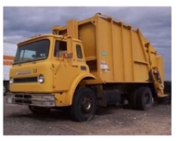
62.2 Garbage In, Garbage Out
https://www.udemy.com/course/data-science-and-machine-learning-with-python-hands-on/learn/lecture/4020718#overview
Garbage in, Garbage out
Your model's only as good as the data that you give to it and this is extremely, extremely true.
You can have a very simple model that performs very well if you give it a large amount of clean data and it could actually outperform a complex model on a more dirty data set.
Making sure that you have enough data and high quality data is often most of the battle.
You'd be surprised how simple some of the most successful algorithms used in real world are and they're only successful by virtue of the quality of the data going into it and the amount of data going into it.
You don't always need fancy techniques to get good results. Often, the quality and quantity of your data counts just as much as anything else and always question your results.

Slide 13
62.2 Garbage In, Garbage Out
https://www.udemy.com/course/data-science-and-machine-learning-with-python-hands-on/learn/lecture/4020718#overview
Garbage in, Garbage out
You don't want to go back and look for anomalies in your input data just when you get a result that you don't like.
That will introduce an unintentional bias into your results where you're letting results that you like or expect go through unquestioned right?
You want to question things all the time to make sure that you're always looking out for these things because even if you find a result you like, if it turns out to be wrong, it's still wrong.
It's still going to be informing your company in the wrong direction and that can come back to bite you later on.

Slide 14
62.3 Analyze Web Log Data

Slide 15
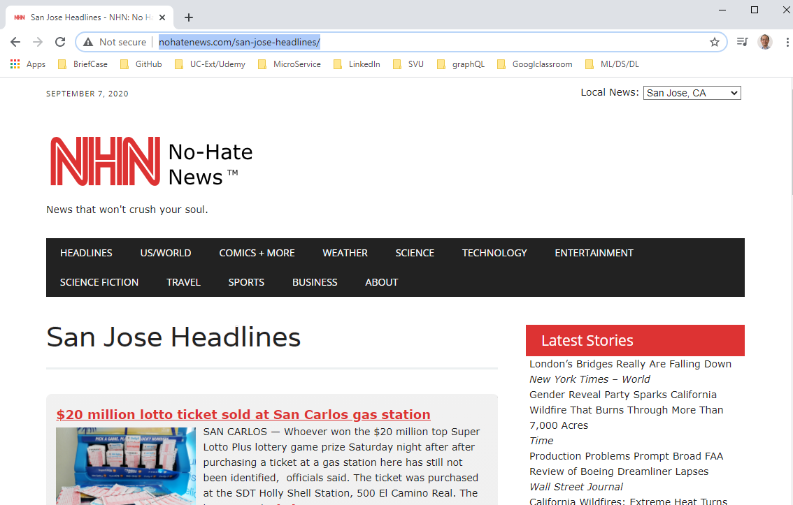
62.3 Analyze Web Log Data
https://www.udemy.com/course/data-science-and-machine-learning-with-python-hands-on/learn/lecture/4020718#overview
Analyze Web Log Data
As an example, I have a website called No-Hate News (http://nohatenews.com/).
It's a non-profit web site. I just want to find the most popular pages on this website.
That sounds like a pretty simple problem, doesn't it?
I should just be able to go through my weblogs and count up how many hits each page has and sort them, right?
How hard can it be?
Well, turns out it's really hard, so let's dive into this example and see why and see some examples of real world data clean up that has to happen.
Let's see just how important data cleaning can be.
We have a very simple task ahead of us:
Find the top few pages on a very small website.
How hard can it be? We will see next discussion.

Slide 16
End of Chapter

