Slide 1

63 Clean Web Blog Data
Peter H. Chen

Slide 2
63 Clean Web Blog Data
https://www.udemy.com/course/data-science-and-machine-learning-with-python-hands-on/learn/lecture/4020720#overview
Clean Web Blog Data
So we're going to show the importance of cleaning your data.
I have some web log data from a little website that I own and we're just going to try find the top viewed pages on that website.
Sounds pretty simple, but as you'll see it's actually quite challenging.

Slide 3
63 Clean Web Blog Data
https://www.udemy.com/course/data-science-and-machine-learning-with-python-hands-on/learn/lecture/4020720#overview
Clean Data
Let's take a web access log, and figure out the most-viewed pages on a website from it!
Copy the text file “web.log.txt” to your local working directory.
Note:
1. The web.log.txt is generated by Apache Server.
2. There are some github location which store the some web.log for test.
https://github.com/ocatak/apache-http-logs/
http://www.herongyang.com/Windows/Web-Log-File-IIS-Apache-Sample.html
3. How to find Apache Server log file?
https://blog.codeasite.com/how-do-i-find-apache-http-server-log-files/#:~:text=Access%20Logs&text=The%20location%20and%20content%20of,%2Flog%2Fapache2%2Faccess.

Slide 4
63.1 Error Parse Web.log.txt

Slide 5
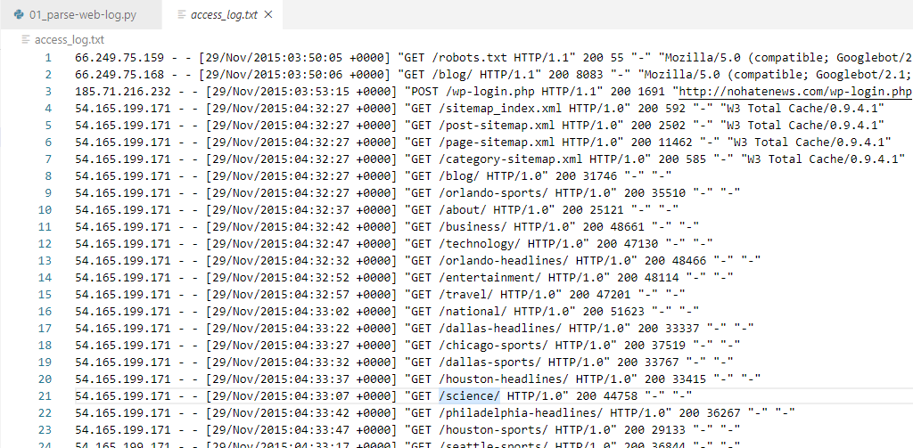
63.1 Error Parse Web.log.txt
https://www.udemy.com/course/data-science-and-machine-learning-with-python-hands-on/learn/lecture/4020720#overview
Error Parsing
The context of web.log.txt
The file contains: “GET/POST /path HTTP/1.1”
Syntax is “Action URL Protocol”

Slide 6
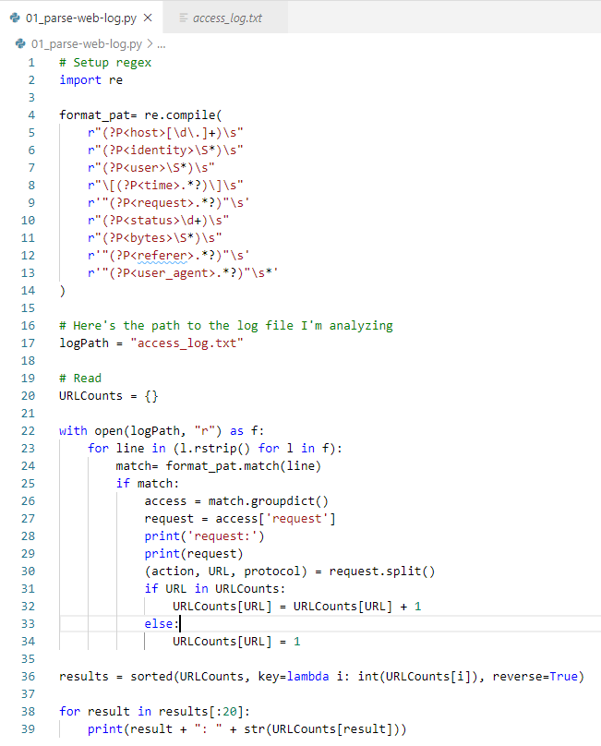
63.1 Error Parse Web.log.txt
https://www.udemy.com/course/data-science-and-machine-learning-with-python-hands-on/learn/lecture/4020720#overview
Error Parsing
https://docs.python.org/2.6/library/re.html
This is the apache access log regular expression.
?p<host> is the pattern for host name and etc. defined by Apache regular expression.
Only matched line is picked up by Python regular expression.

Slide 7
63.1 Error Parse Web.log.txt
https://www.udemy.com/course/data-science-and-machine-learning-with-python-hands-on/learn/lecture/4020720#overview
Error Parsing

Slide 8
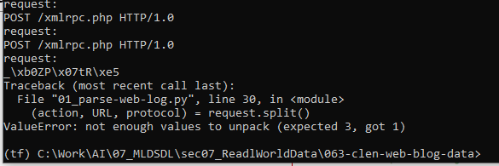
63.1 Read Web.log.txt
https://www.udemy.com/course/data-science-and-machine-learning-with-python-hands-on/learn/lecture/4020720#overview
Error Parsing
Some error in parsing web.log.txt.
One of the log message:
The 'request' part of the line is supposed to look something like this:
GET /blog/ HTTP/1.1
There should be an HTTP action, the URL, and the protocol.
But it seems that's not always happening.
Let's print out requests that don't contain three items:

Slide 9
63.2 Fix Error Read Web.log

Slide 10
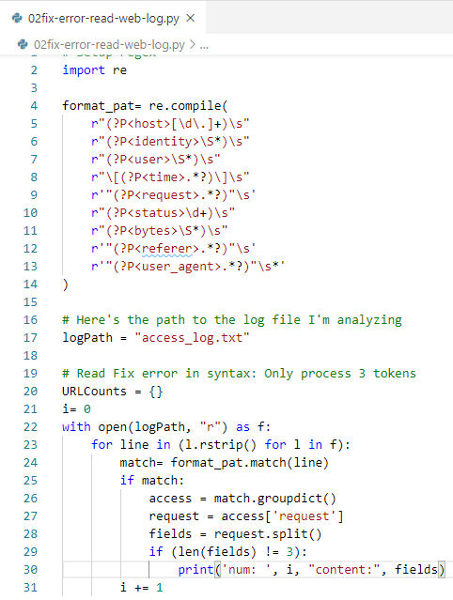
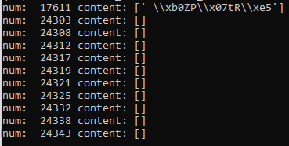
63.2 Fix Error Read Web.log
https://www.udemy.com/course/data-science-and-machine-learning-with-python-hands-on/learn/lecture/4020720#overview
Fix Error in Read Web.log.

Slide 11
63.2 Fix Error Read Web.log
https://www.udemy.com/course/data-science-and-machine-learning-with-python-hands-on/learn/lecture/4020720#overview
Fix Error in Read Web.log.
In addition to empty fields, there's one that just contains garbage.
Well, let's modify our script to check for that case:

Slide 12
63.3 Read Web.log.txt

Slide 13
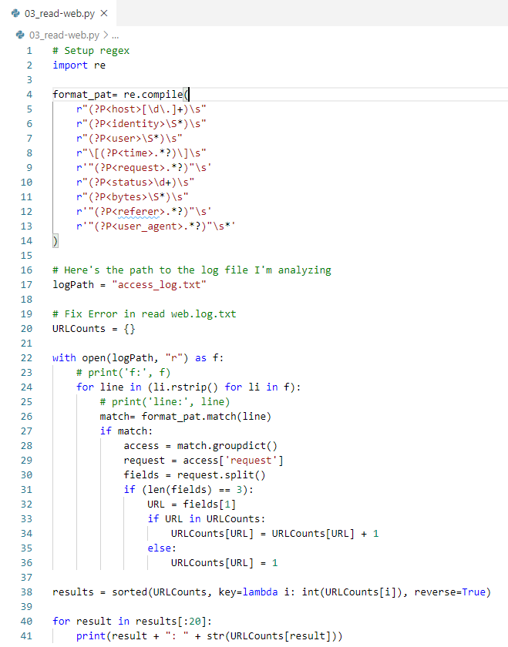
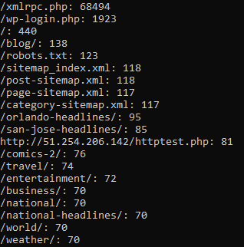
63.3 Read Web.log.txt
https://www.udemy.com/course/data-science-and-machine-learning-with-python-hands-on/learn/lecture/4020720#overview
Read Web.log.txt

Slide 14
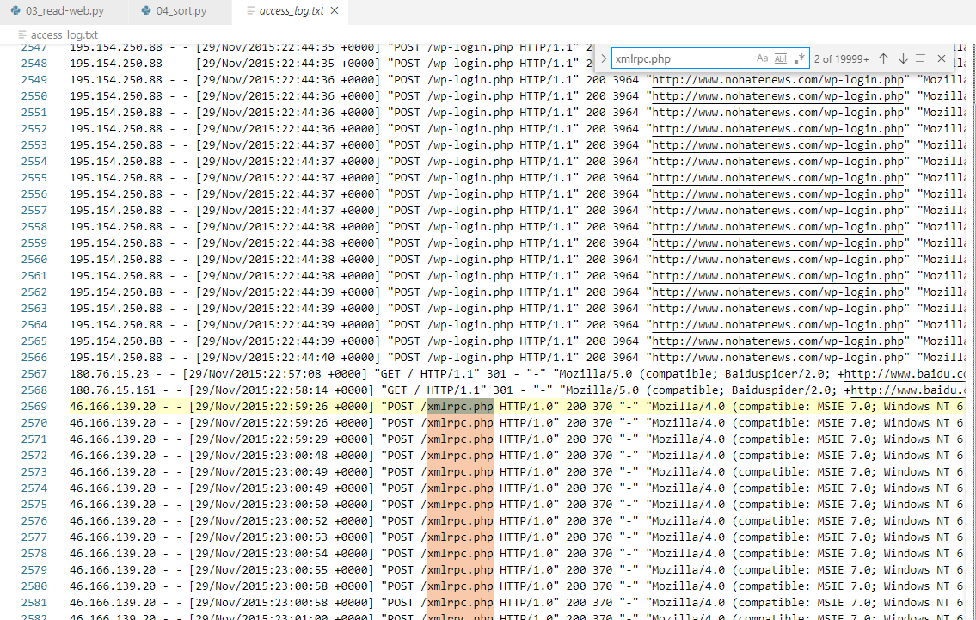
63.3 Read Web.log.txt
https://www.udemy.com/course/data-science-and-machine-learning-with-python-hands-on/learn/lecture/4020720#overview
Read Web.log.txt
It worked! But, the results don't really make sense.
What we really want is pages accessed by real humans looking for news from our little news site.
What is xmlrpc.php? A look at the log itself turns up a lot of entries like this:
46.166.139.20 - - [05/Dec/2015:05:19:35 +0000] "POST /xmlrpc.php HTTP/1.0" 200 370 "-" "Mozilla/4.0 (compatible: MSIE 7.0; Windows NT 6.0)“
I am not entirely sure what the script does, but it points out that we're not just processing GET actions.
We don't want POSTS, so let's filter those out.

Slide 15
63.4 Filter Read

Slide 16
63.4 Filter Read
https://www.udemy.com/course/data-science-and-machine-learning-with-python-hands-on/learn/lecture/4020720#overview
Filter Read
We filter out xmlrpc.php?
46.166.139.20 - - [05/Dec/2015:05:19:35 +0000] "POST /xmlrpc.php HTTP/1.0" 200 370 "-" "Mozilla/4.0 (compatible: MSIE 7.0; Windows NT 6.0)“

Slide 17
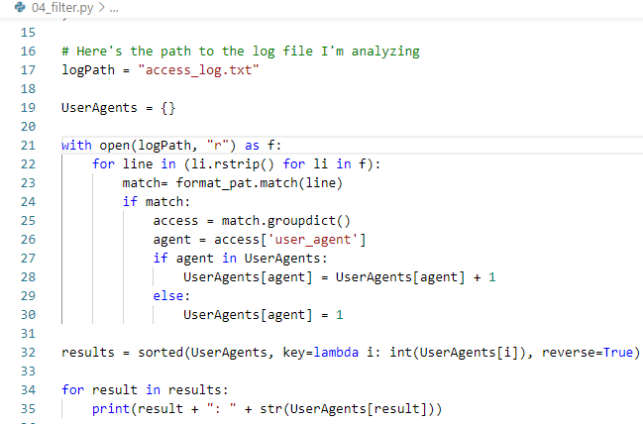
63.4 Filter Read
https://www.udemy.com/course/data-science-and-machine-learning-with-python-hands-on/learn/lecture/4020720#overview
Use “user_agent” instead of “request”

Slide 18
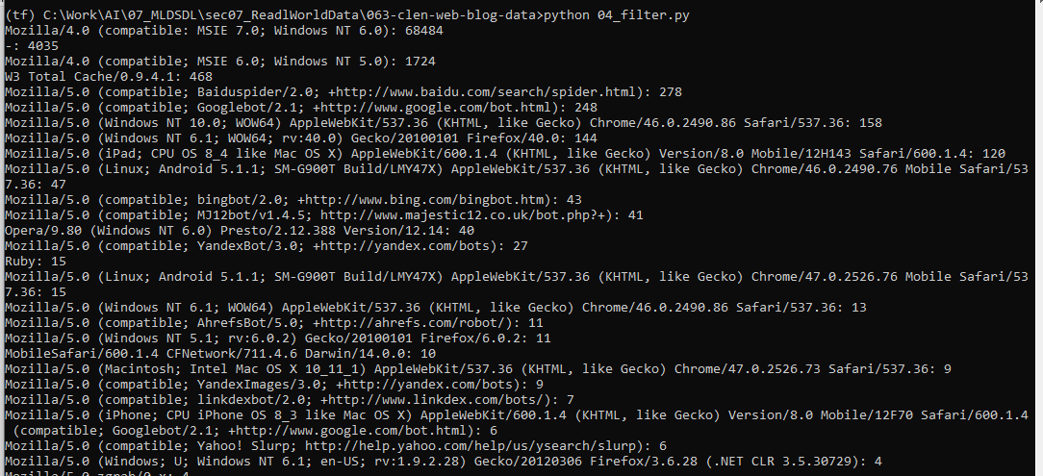
63.4 Filter Read
https://www.udemy.com/course/data-science-and-machine-learning-with-python-hands-on/learn/lecture/4020720#overview
Use “user_agent” instead of “request”

Slide 19
63.5 Filter Out Robot and Spider

Slide 20
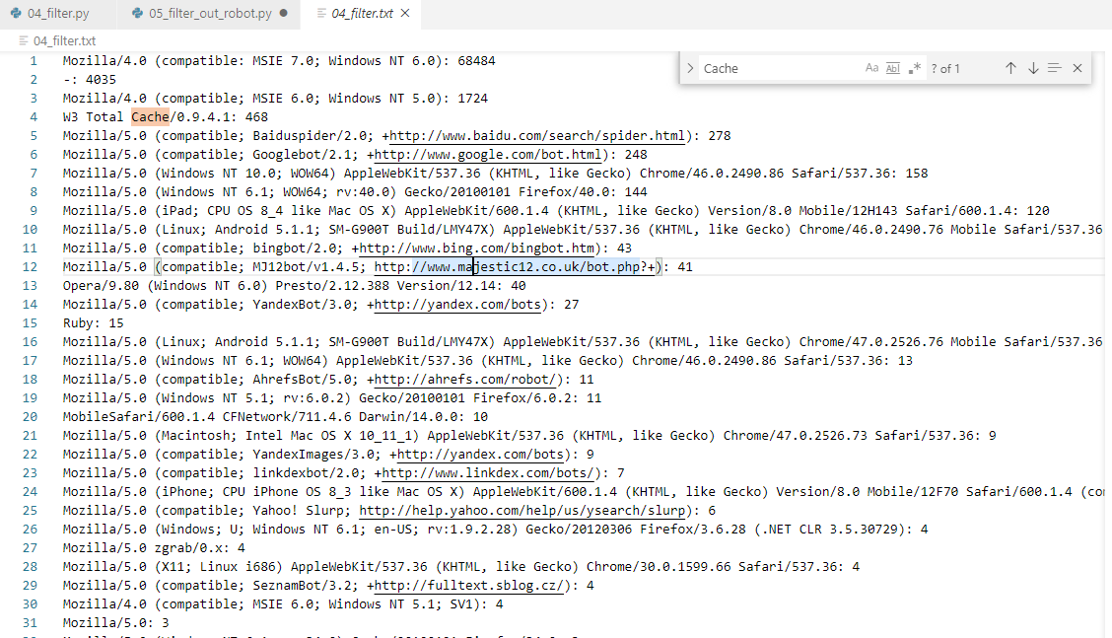
63.5 Filter Out Robot and Spider
https://www.udemy.com/course/data-science-and-machine-learning-with-python-hands-on/learn/lecture/4020720#overview
Check 04_filter.txt:
Robot, spider, “w3 Total Cache” are unwanted agent.

Slide 21
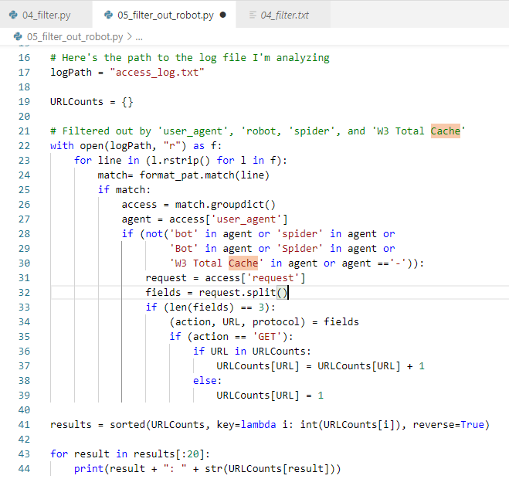
63.5 Filter Out Robot and Spider
https://www.udemy.com/course/data-science-and-machine-learning-with-python-hands-on/learn/lecture/4020720#overview
Filter Robot and Spider
In addition to '-', there are also a million different web robots accessing the site and polluting my data.
Filtering out all of them is really hard, but getting rid of the ones significantly polluting my data in this case should be a matter of getting rid of '-', anything containing "bot" or "spider", and “W3 Total Cache”

Slide 22
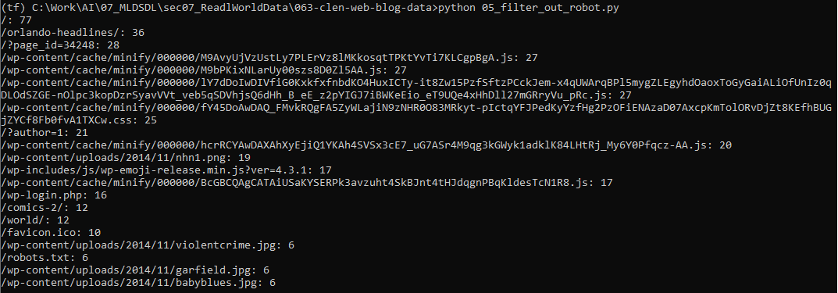
63.5 Filter Out Robot and Spider
https://www.udemy.com/course/data-science-and-machine-learning-with-python-hands-on/learn/lecture/4020720#overview
Filter Robot, Spider, and “W3 Total Cache”, and etc.

Slide 23
63.6 Pick up “GET”

Slide 24
63.6 Pick up “GET”
https://www.udemy.com/course/data-science-and-machine-learning-with-python-hands-on/learn/lecture/4020720#overview
Pick up “
Now, our new problem is that we're getting a bunch of hits on things that aren't web pages.
We are not interested in those, so let's filter out any URL that doesn't end in / (all of the pages on my site are accessed in that manner - again this is applying knowledge about my data to the analysis!)
We need the action is “GET” as well.

Slide 25
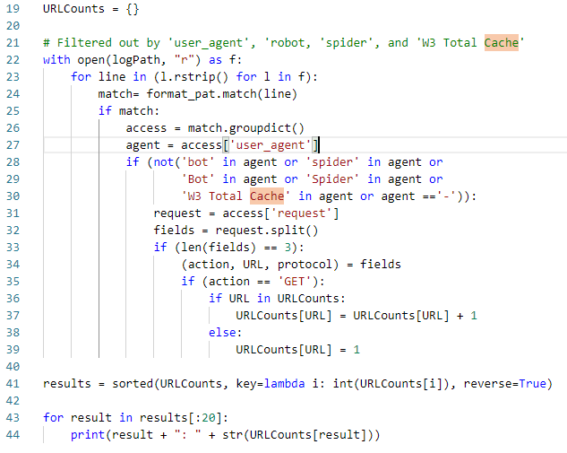
63.6 Pick up “GET”
https://www.udemy.com/course/data-science-and-machine-learning-with-python-hands-on/learn/lecture/4020720#overview
Pick up “GET”

Slide 26
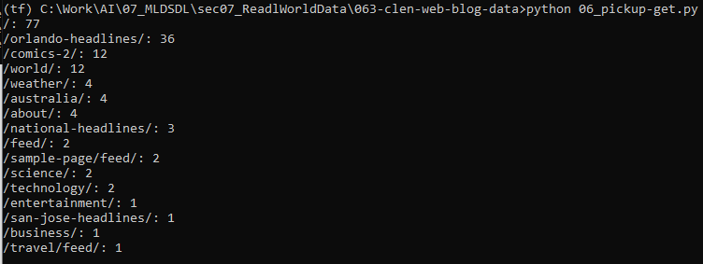
63.6 Pick up “GET”
https://www.udemy.com/course/data-science-and-machine-learning-with-python-hands-on/learn/lecture/4020720#overview
Pick up “GET”

Slide 27
63.6 Pick up “GET”
https://www.udemy.com/course/data-science-and-machine-learning-with-python-hands-on/learn/lecture/4020720#overview
Pick up “GET”
This is starting to look more sense now!
But if you were to dig even deeper, you'd find that the /feed/ pages are suspect, and some robots are still slipping through. However, it is accurate to say that Orlando news, world news, and comics are the most popular pages accessed by a real human on this day.
The moral of the story is - know your data!
And always question and scrutinize your results before making decisions based on them. If your business makes a bad decision because you provided an analysis of bad source data, you could get into real trouble.
Be sure the decisions you make while cleaning your data are justifiable too - don't strip out data just because it doesn't support the results you want!

Slide 28
63.7 Exercise

Slide 29
63.7 Exercise
https://www.udemy.com/course/data-science-and-machine-learning-with-python-hands-on/learn/lecture/4020720#overview
Exercise
These results still aren't perfect; URL's that include "feed" aren't actually pages viewed by humans.
Modify this code further to strip out URL's that include "/feed".
Even better, extract some log entries for these pages and understand where these views are coming from.

Slide 30
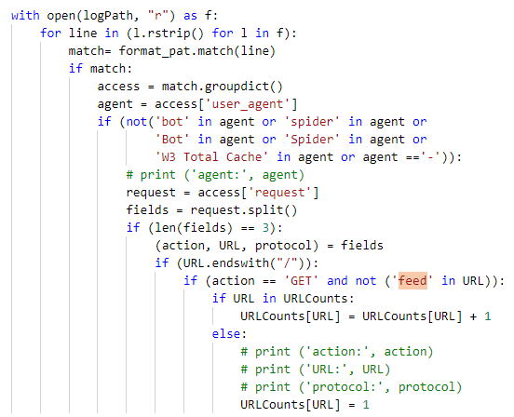
63.7 Exercise
https://www.udemy.com/course/data-science-and-machine-learning-with-python-hands-on/learn/lecture/4020720#overview
Exercise
Answer
Filter out URLw ith “feed”

Slide 31
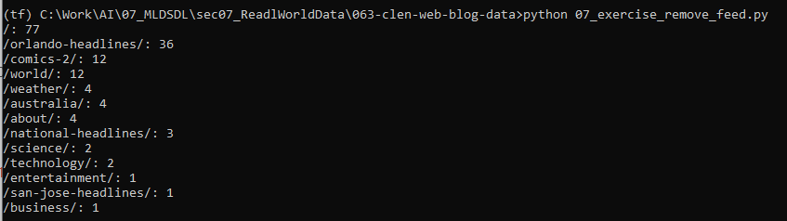
63.7 Exercise
https://www.udemy.com/course/data-science-and-machine-learning-with-python-hands-on/learn/lecture/4020720#overview
Exercise
Result

Slide 32
End of Chapter

