Slide 1

42 XGBoost
Peter H. Chen

Slide 2
42 XGBoost
https://www.udemy.com/course/data-science-and-machine-learning-with-python-hands-on/learn/lecture/4020582#overview
XGBoost
In this discussion, we discuss the boosting and decision tree.
Let’s put these concepts together.
XGBoost is arguably the most powerful machine learning algorithm out there today.

Slide 3
42 XGBoost
https://www.udemy.com/course/data-science-and-machine-learning-with-python-hands-on/learn/lecture/4020582#overview
XGBoost
eXtreme Gradient Boosted Trees
Remember boosting is an ensemble method
Each tree boosts attributes that lead to mis-classification of previous tree.
It is AMAZING
Routinely wins Kahhle compeitions
Easy to use
Fast
A good choice for an algorithm to start with

Slide 4
42 XGBoost
https://www.udemy.com/course/data-science-and-machine-learning-with-python-hands-on/learn/lecture/4020582#overview
XGBoost Explanation:
This is very important discussion here.
XGBoost stands for eXtreme Gradient Boosted Trees.
Remember boosting is an ensemble method.
The idea is that take a model and we have multiple versions of that model chain together.
So what happens is every tree within our boosting scheme here is going to boost the attributes that led to misclassification from the previous tree.
So basically we have multiple trees are just building on top of each other to correct the errors of the previous tree before it and it turns out this rather simple idea is really amazing.
XGBoost is routinely winning Kaggle competitions. It is very easy to use. It is very computationally efficient.
So, it makes for a really good choice for an algorithm to start from.
Whatever your problem. Whether it is classification or regression.

Slide 5
42.1 Features of XGBoost

Slide 6

42.1 Features of XGBoost
https://www.udemy.com/course/data-science-and-machine-learning-with-python-hands-on/learn/lecture/4020582#overview
Features of XGBoost
Regularized boosting (Prevents overfitting)
Can handle missing values automatically
Parallel processing
Can cross-validate at each iteration
Enables early stopping, finding optimal number of iteration
Incremental training
Can plug in your own optimization objectives
Tree pruning
Generally, results in deeper, but optimized trees

Slide 7
42.1 Features of XGBoost
https://www.udemy.com/course/data-science-and-machine-learning-with-python-hands-on/learn/lecture/4020582#overview
Features of XGBoost Explanation
XGBoost is so good. It uses something called regularized boosting. So this is what sets it apart from other boost of tree methods out there.
Regularization is something that prevents overfitting. It ensures that the model we end up with is generalized and it is not really overfitted to the set of data that you trained it on.
We will discuss regularization in more detail later.
But under the hood, it uses L1 and L2 regularization which we will talk later.
Another really cool feature is that XGBoost can handle missing values automatically.

Slide 8
42.1 Features of XGBoost
https://www.udemy.com/course/data-science-and-machine-learning-with-python-hands-on/learn/lecture/4020582#overview
Features of XGBoost Explanation
So, XGBoost will automatically figure out the best way to handle the missing values in your data. You do not need to think about it too much.
This is really cool feature because you know dealing with missing values and input those missing values can be a hug part of your job as a data scientist.
But XGBoost just kind of make it happen.
XGBoost also cane be run in parallel. That is the key of efficiency.
You can actually take advantage of all the cores on your GPU or even take advantage of a cluster of computers.
It can be run in parallel across multiple treads and this also means you can use it for a big data for large data sets that will not necessarily fit on my machine.

Slide 9
42.1 Features of XGBoost
https://www.udemy.com/course/data-science-and-machine-learning-with-python-hands-on/learn/lecture/4020582#overview
Features of XGBoost Explanation
So, not only a XGBoost are really powerful, it us also very accurate algorithm for small data sets. It also scales well.
That is why XGBoost is loved by many people.
Another nice feature of XGBoost is that you can do cross-validation at each iteration.
We will discuss Cross-validation later.
The idea of cross-validation is that you can evaluate the performance of this algorithm of XGBoost at each step of its training.

Slide 10
42.1 Features of XGBoost
https://www.udemy.com/course/data-science-and-machine-learning-with-python-hands-on/learn/lecture/4020582#overview
Features of XGBoost Explanation
This feature allows you to stop the iteration early if you already find the optimal number of iteration as you monitoring the accuracy of my model as it iterate and figure out when I should stop.
XGBoost can be stopped at the optimal point earlier and easier.
XGBoost also support incremental training.
What is incremental training? You can actually stop the training of an XGBoost model and then save it and then come back and pick up it later again.
So, if you want to actually split up the training over a period o time or across multiple batch jobs. That is possible as well with XGBoost.

Slide 11
42.1 Features of XGBoost
https://www.udemy.com/course/data-science-and-machine-learning-with-python-hands-on/learn/lecture/4020582#overview
Features of XGBoost Explanation
XGBoost also allows you to plug in your own optimization objectives. This is very flexible in nature.
So, whatever the problem you have if you can describe it in terms of something that you want to optimize, you can probably get XGBoost to work on it.
Finally, use a feature called Tree Pruning.
Unlike normal decision trees where it stop branching, XGBoost stop branching and result deeper, prune tree, and optimized trees.

Slide 12
42.2 Using XGBoost

Slide 13
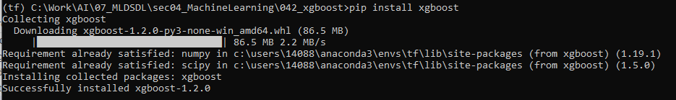
42.2 Using XGBoost
https://www.udemy.com/course/data-science-and-machine-learning-with-python-hands-on/learn/lecture/4020582#overview
Using XGBoost
> pip install xgboot

Slide 14
42.2 Using XGBoost
https://www.udemy.com/course/data-science-and-machine-learning-with-python-hands-on/learn/lecture/4020582#overview
Using XGBoost
Also CLI, C++, R, Julia, JVM Interface
XGBoost not only made for scikit_learn, but also has its own interface
Use DMatrix structure to hold feature and labels
Can create this easily from a numpy array though
All parameters passed in via a dictionary
Call train, then predict. it is easy.

Slide 15
42.2 Using XGBoost
https://www.udemy.com/course/data-science-and-machine-learning-with-python-hands-on/learn/lecture/4020582#overview
Using XGBoost Explanation:
XGBoost installation is easy. Just “conda install xgboost” (or “pip install xgboost”) from Anaconda prompt.
Once you installed XGBoost, you can use it.
XGBoost is written by C++ also offers interfaces on the CLI (Command Line Interface) for C++. XGBoost can be also used in R language Julia. XGBoost also have an JVM interface.
XGBoost can be used efficiently in program Java, Scala, and Spark using Scala.
XGBoost is not just made for scikit_learn, Python, Jupyter notebooks, it is more general than that.
When you use Jupyter Notebook and scikit_learn, it has its interface and it uses DMatrix data structure to hold the features and for numpy array.
You can pass all parameter for XGBoost from a dictionary.
When you do that, you can call the train mode and then call predict on the train model to make the prediction.

Slide 16
42.3 XGBoost Hyperparameters

Slide 17

42.3 XGBoost Hyperparameters
https://www.udemy.com/course/data-science-and-machine-learning-with-python-hands-on/learn/lecture/4020582#overview
XGBoost Hyperparameters
Booster
gbtree or gblinear
Objective (i.e., multi:softmax, multi:softprob)
Eta (Learning rate – adjust weights on each step)
Max_depth (depth of the tree)
Min_child_weight
Can control overfitting, but too high will underfit
…and many others

Slide 18
42.3 XGBoost Hyperparameters
https://www.udemy.com/course/data-science-and-machine-learning-with-python-hands-on/learn/lecture/4020582#overview
XGBoost Hyperparameters Explanation
The hard part in XGBoost is tuning all those hyperparameter.
There is a bunch of knobs and dials of XGBoost, to get the best results, you need to choose the right setup.
These setup is often done through the experimentation. These setup is very easy.
In the Booster, you can choose gbtree (gradient boost tree) for a classification problem or gblinear (gradient boost linear) for linear regression problem.
Then, you need to choose your type of objective function, for example, softmax for one of many classification and choose softprob for probability for each classification.

Slide 19
42.3 XGBoost Hyperparameters
https://www.udemy.com/course/data-science-and-machine-learning-with-python-hands-on/learn/lecture/4020582#overview
XGBoost Hyperparameters Explanation
After that, everything is through the experimentation.
For example, Eta (the learning rate) is the primary parameter, the biggest knob for XGBoost. It is going to adjust the weights on each step of training and the default value of that is 0.3. You can adjust to 0.2 or etc.
Other important parameters max_depth for depth of the tree. Too small tree cannot create accurate model, too large will be overfitting. So tuning that can be a very important thing. Try to get it right.
There is min_child_weight, this also used to control the overfitting. If you set to high you end up with underfit. Make sure you get the right value.

Slide 20
42.3 XGBoost Hyperparameters
https://www.udemy.com/course/data-science-and-machine-learning-with-python-hands-on/learn/lecture/4020582#overview
XGBoost Hyperparameters Explanation
There are some parameters but these are the major parameters that you want to experiment with.
Sometimes, you need to experiment which combination is the best.
The Jupyter Notebook is the best tool to experiment with.
The large system, such as, AWS Sage maker also have automatic hyperparameter.

Slide 21
42.4 XGBoost

Slide 22

42.4 XGBoost
https://www.udemy.com/course/data-science-and-machine-learning-with-python-hands-on/learn/lecture/4020582#overview
XGBoost
It is almost all that you need to know for machine learning gin practical terms, at least for simple classification or regression problems.
We will use XGBoost for Iris data set.
This data set has a bunch of flowers and measure the length and width of both the pedals and the sepal. The sepal is a specific kind of pedal.
Based on the measurement of pedal, we are not to try to predict the sybspecies of virus that flower actually belongs to.
We will see XGBoost is extremely good at this.

Slide 23
42.4 XGBoost

Slide 24
42.4 XGBoost
https://www.udemy.com/course/data-science-and-machine-learning-with-python-hands-on/learn/lecture/4020582#overview
XGBoost
It is almost all that you need to know for machine learning gin practical terms, at least for simple classification or regression problems.
We will use XGBoost for Iris data set.

Slide 25
42.5 Practice XGBoost

Slide 26
42.5 Practice XGBoost
https://www.udemy.com/course/data-science-and-machine-learning-with-python-hands-on/learn/lecture/4020582#overview
Practice XGBoost
Using XGBoost is easy.
Considering it's generally considered the best ML algorithm around right now.
To install it, just:
> pip install xgboost
Let's experiment using the Iris data set.
This data set includes the width and length of the petals and sepals of many Iris flowers, and the specific species of Iris the flower belongs to.
Our challenge is to predict the species of a flower sample just based on the sizes of its petals. We'll revisit this data set later when we talk about principal component analysis too.

Slide 27
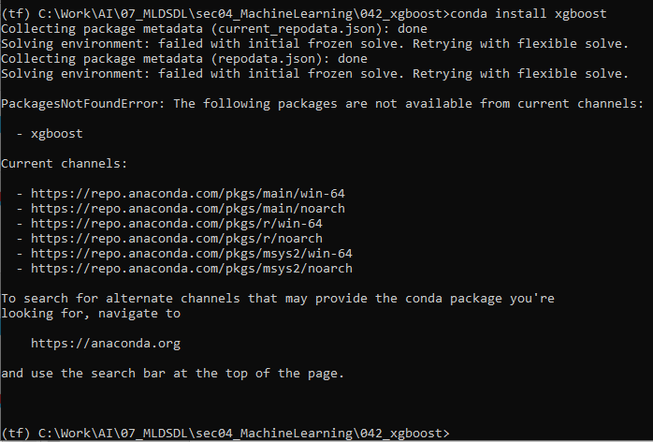
42.5 Practice XGBoost
https://www.udemy.com/course/data-science-and-machine-learning-with-python-hands-on/learn/lecture/4020582#overview
Practice XGBoost Explanation
Start the anaconda prompt.
> conda install xgboost

Slide 28
42.6 Load iris Data Set

Slide 29
42.6 Load iris Data Set
https://www.udemy.com/course/data-science-and-machine-learning-with-python-hands-on/learn/lecture/4020582#overview
Load Iris Data Set
https://scikit-learn.org/stable/modules/generated/sklearn.datasets.load_iris.html
The load_iris() function automatically load the iris.csv into the following folder:
C:\User\<user-name>\C:\Users\14088\anaconda3\Lib\site-packages\sklearn\datasets\data
In my case, iris.csv is located
C:\Users\14088\anaconda3\Lib\site-packages\sklearn\datasets\data
The sklearn.datasets packages have class load_iris and function load_iris()

Slide 30
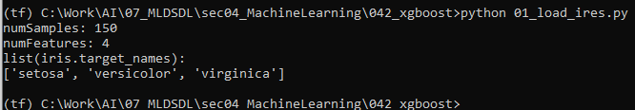
42.6 Load iris Data Set
https://www.udemy.com/course/data-science-and-machine-learning-with-python-hands-on/learn/lecture/4020582#overview
Load Iris Data Set

Slide 31
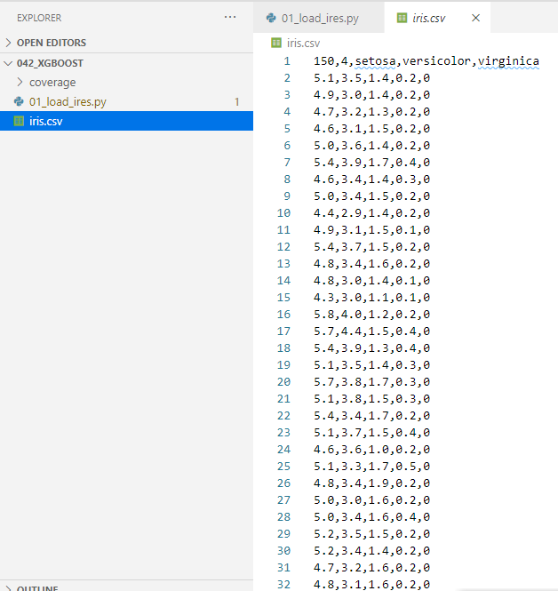
42.6 Load iris Data Set
https://www.udemy.com/course/data-science-and-machine-learning-with-python-hands-on/learn/lecture/4020582#overview
Load Iris Data Set
Copy the iris.csv to our local working folder. It is easier to browse.
We can see the first line is 150, 4, setosa (seta or hairy), versicolor (various colors),virginica (Virginia Iris).
The last columns is target:
0: setoa
1: versicolor
2: virginica

Slide 32
42.7 Split Data to Train and Test

Slide 33
42.7 Split Data to Train and Test
https://www.udemy.com/course/data-science-and-machine-learning-with-python-hands-on/learn/lecture/4020582#overview
Split Data to Train and Test
Let's divide our data into 20% reserved for testing our model, and the remaining 80% to train it with.
By withholding our test data, we can make sure we're evaluating its results based on new flowers it hasn't seen before.
Typically we refer to our features (in this case, the petal sizes) as X, and the labels (in this case, the species) as y.

Slide 34
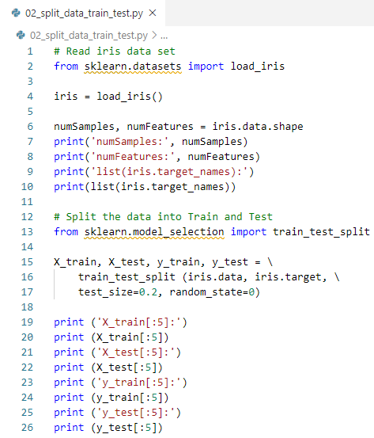
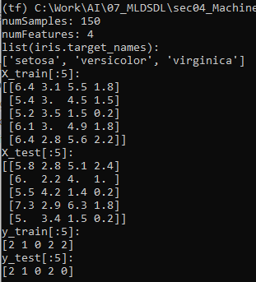
42.7 Split Data to Train and Test
https://www.udemy.com/course/data-science-and-machine-learning-with-python-hands-on/learn/lecture/4020582#overview
Split Data to Train and Test
Code and result:

Slide 35
42.8 Load XGBoost

Slide 36
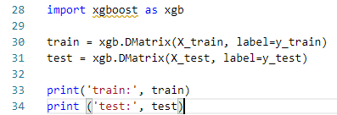
42.8 Load XGBoost
https://www.udemy.com/course/data-science-and-machine-learning-with-python-hands-on/learn/lecture/4020582#overview
Load XGBoost
Now, load up XGBoost, and convert our data into the DMatrix format it expects.
One for the training data, and one for the test data.

Slide 37
42.9 Define Hyperparameter

Slide 38
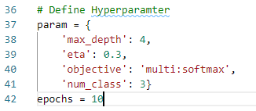
42.9 Define Hyperparameter
https://www.udemy.com/course/data-science-and-machine-learning-with-python-hands-on/learn/lecture/4020582#overview
Define Hyperparameter
Now, define our hyperparameters.
We're choosing softmax since this is a multiple classification problem, but the other parameters should ideally be tuned through experimentation.

Slide 39
42.10 Train Model

Slide 40

42.10 Train Model
https://www.udemy.com/course/data-science-and-machine-learning-with-python-hands-on/learn/lecture/4020582#overview
Train Model
Let's go ahead and train our model using these parameters as a first guess.

Slide 41
42.11 Model Prediction

Slide 42

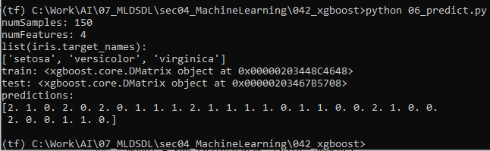
42.11 Model Prediction
https://www.udemy.com/course/data-science-and-machine-learning-with-python-hands-on/learn/lecture/4020582#overview
Model Prediction
Now, use the trained model to predict classifications for the data.
We set aside for testing.
Each classification number we get back corresponds to a specific species of Iris.

Slide 43
42.12 Measure Accuracy

Slide 44
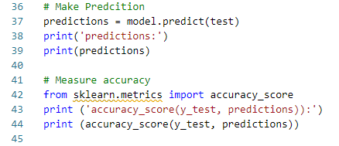
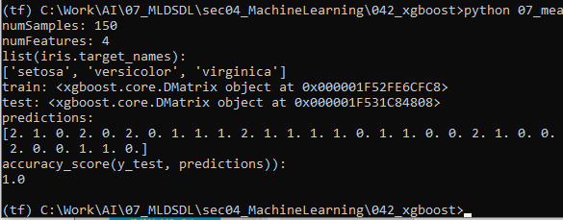
42.12 Measure Accuracy
https://www.udemy.com/course/data-science-and-machine-learning-with-python-hands-on/learn/lecture/4020582#overview
Measure Accuracy
Let's measure the accuracy on the test data.

Slide 45
42.12 Measure Accuracy
https://www.udemy.com/course/data-science-and-machine-learning-with-python-hands-on/learn/lecture/4020582#overview
Measure Accuracy
Oh! It's perfect, and that's just with us guessing as to the best hyperparameters!
Normally I'd have you experiment to find better hyperparameters as an activity, but you can't improve on those results.
Instead, see what it takes to make the results worse!
How few epochs (iterations) can I get away with?
How low can I set the max_depth?
Basically try to optimize the simplicity and performance of the model, now that you already have perfect accuracy.

Slide 46
42.13 Exercise

Slide 47
42.13 Exercise
https://www.udemy.com/course/data-science-and-machine-learning-with-python-hands-on/learn/lecture/4020582#overview
Exercise
Change max_depth = 2
Change the from epochs = 10 into Epochs = 5
Eta (Learning rate – adjust weights on each step) = 0.5

Slide 48
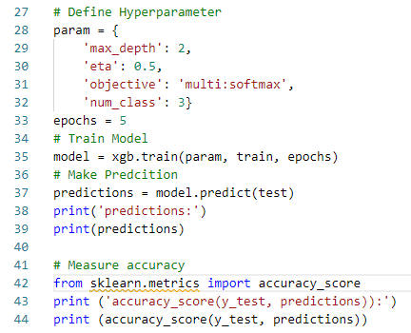
42.13 Exercise
https://www.udemy.com/course/data-science-and-machine-learning-with-python-hands-on/learn/lecture/4020582#overview
Exercise
Code

Slide 49
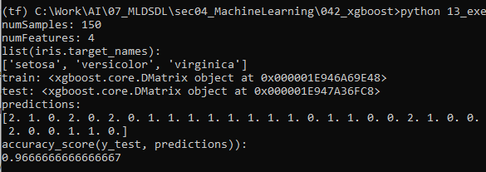
42.13 Exercise
https://www.udemy.com/course/data-science-and-machine-learning-with-python-hands-on/learn/lecture/4020582#overview
Exercise
Result

Slide 50
End of Chapter

