Slide 1

103 Tune Neural Network
Peter H. Chen

Slide 2
103 Tune Neural Network
https://github.com/peterhchen/930_Python_ML_DS_DL
Tune Neural Network
We discuss tuning our neural networks.

Slide 3
103.1 Learning Rate

Slide 4
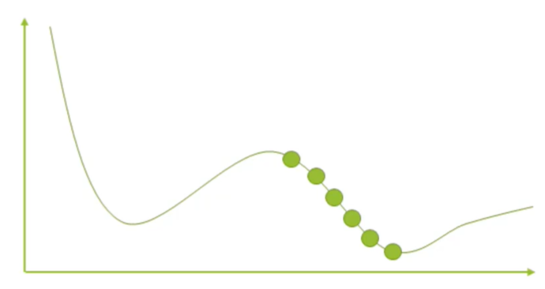
103.1 Learning Rate
https://github.com/peterhchen/930_Python_ML_DS_DL
Learning Rate
Neural Network are trained by gradient descent
We start at some random point of weights in our neural network, we sample different solutions of different sets of weights, and then trying to minimize some cost function that we define over several epochs.
We have many epochs iterations over which we train. At each epoch we try different set of weights on our neural network, trying to minimize some cost function which might be the overall accuracy of how well it makes predictions on our validation set.
How far apart of these samples are called the learning rate.
Start with some random set f weights

Slide 5
103.1 Learning Rate
https://github.com/peterhchen/930_Python_ML_DS_DL
Learning Rate (Explanation)
First of all, what do we mean by learning rate?
We need to understand how these neural networks are trained.
We use a technique called gradient descent.
The basic idea of gradient descent: We start at some random point of weights in our neural network, we sample different solutions of different sets of weights, and then trying to minimize some cost function that we define over several epochs.
Those are the key words: We have many epochs iterations over which we train. At each epoch we try different set of weights on our neural network, trying to minimize some cost function which might be the overall accuracy of how well it makes predictions on our validation set.

Slide 6
103.1 Learning Rate
https://github.com/peterhchen/930_Python_ML_DS_DL
Learning Rate (Explanation)
We need to have some way to make those samples for different solutions, (weights).
If we were to bring this into a two dimensional graph, maybe it would look something like this, where we sample different points here along a curve of solutions, and we are trying to find the one that minimizes the cost function.
The cost function is the y axis here.

Slide 7
103.1 Learning Rate
https://github.com/peterhchen/930_Python_ML_DS_DL
Learning Rate (Explanation)
What we are trying to find is the lowest point on this graph, and we are trying to get there by sampling it at different points and learning from each previous sample.
That's what gradient descent is all about.
The learning rate is all about how far apart those samples are.

Slide 8
103.1 Learning Rate
https://github.com/peterhchen/930_Python_ML_DS_DL
Learning Rate (Explanation)
We might have started up here and our learning rates said, okay I'm going to try another point here and I'll try again here so on and so forth until I finally find the lowest point along this curve and called out my best solution.
This is not too hard to understand the effective learning rate on your training.

Slide 9
103.2 Effect of Learning Rate

Slide 10
103.2 Effect of Learning Rate
https://github.com/peterhchen/930_Python_ML_DS_DL
Effect of Learning Rate
Learning rate too high means you might overshoot the optimal solution.
Learning Rate too small will take too long to find the optimal solution
Learning rate is an example of a hyperparameter.
Learning Rate

Slide 11
103.2 Effect of Learning Rate
https://github.com/peterhchen/930_Python_ML_DS_DL
Effect of Learning Rate (Explanation)
If we have a high learning rate we might overshoot that solution entirely.
If my learning rate was huge, and I went straight from here to here, I might miss that bottom point there entirely if my learning rate were too high.
If my learning rate is too small I am going to sampling a whole lot of different points here, and it is going to take a lot of epochs, a lot of steps to actually find that optimal solution.
Learning Rate

Slide 12
103.2 Effect of Learning Rate
https://github.com/peterhchen/930_Python_ML_DS_DL
Effect of Learning Rate (Explanation)
So too high learning rate might mean that I overshoot the correct solution entirely, but too small of a learning rate will mean that my training might take longer than it needs to.
Now learning rate is an example of what we call hyperparameters.
The learning rate one of the control parameters that you use while training your deep learning model that can affect the final result.
Learning Rate

Slide 13
103.2 Effect of Learning Rate
https://github.com/peterhchen/930_Python_ML_DS_DL
Effect of Learning Rate (Explanation)
And oftentimes these hyper parameters can have just as much influence on the quality of your model as the topology of the model, the feature engineering you've done and everything else.
So Learning rate is just another piece of the puzzle here that you need to arrive at experimentally.
Learning Rate

Slide 14
103.3 Batch Size

Slide 15
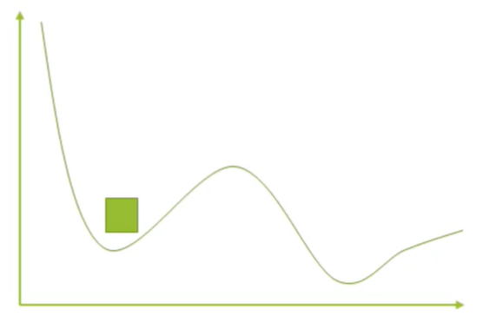
103.3 Batch Size
https://github.com/peterhchen/930_Python_ML_DS_DL
Batch Size
How many training samples are used within each epoch?
Somewhat counter-intuitively:
Smaller batch size can work their way out of “local minima” more easily.
Batch sizes that are too large can end up getting stuck in the wrong solution.
Radom shuffling at each epoch can make this look like very inconsistent results from run to run.

Slide 16
103.3 Batch Size
https://github.com/peterhchen/930_Python_ML_DS_DL
Batch Size (Explanation)
In addition to learning rate, another important hyperparameter is the batch size.
The batch size how many training samples are used within each epoch.
Batch size is a counter-intuitive, you may be think that a large batch size would be a good choice. But no, that is not how it ends up working.
If you have a small batch size, it has a better ability to work its way to jump out of local minima.

Slide 17
103.3 Batch Size
https://github.com/peterhchen/930_Python_ML_DS_DL
Batch Size (Explanation)
In this example below, we have a minimum here.
It is a dip in the local minima of graph, where we have a pretty good, you know, a nice low loss function value here.
What we're trying to optimize for is pretty good here, but there's a risk during gradient descent that we get stuck in that local minimum, when in fact the better solution is over here (the global minima).
So we want to make sure that during the process of gradient descent we have some ability to jump our way out of the local minima and find that better solution.
Local minima
Global minima

Slide 18
103.3 Batch Size
https://github.com/peterhchen/930_Python_ML_DS_DL
Batch Size (Explanation)
The smaller batch sizes can jump out of local minima effectively than larger batch sizes.
A small batch size can jump out of these local minima easily, but a large bad size might getting stuck in the local minima.
So batch sizes that are too large can end up getting stuck in the wrong solution.
And what's even weirder is that because you will usually randomly shuffle your data at the beginning of each training epoch, this can end up manifesting itself is getting very inconsistent results from run to run.
Local minima
Global minima

Slide 19
103.3 Batch Size
https://github.com/peterhchen/930_Python_ML_DS_DL
Batch Size (Explanation)
If my batch size is just a little bit too big, maybe sometimes, I'll get stuck in this minimum, and sometimes it won’t.
And I'll see that in the end results of seeing that, from run to run, sometimes I'll get that answer and sometimes I'll get that answer.
Local minima
Global minima

Slide 20
103.4 Recap

Slide 21
103.4 Recap
https://github.com/peterhchen/930_Python_ML_DS_DL
Recap
Remember these. Write them down:
Smaller batch sizes tend to not get stuck in local minima, but large batch sizes can converge on the wrong solution at random.
A large learning rate can end up overshooting the correct solution, but small learning rates can increase the training time.

Slide 22
103.5 Summary

Slide 23
103.5 Summary
https://github.com/peterhchen/930_Python_ML_DS_DL
Summary
We discussed the hyperparameter of learning rate and batch size:
1. Learning Rate: Large learning rate causes overshoot. Smaller learning rate cause slow step.
2. Batch Size: Large batch size may be trapped into local minima. Small batch size can jump out of local minima.

Slide 24
End of Chapter

