Slide 1

11 Pandas
Peter H. Chen

Slide 2
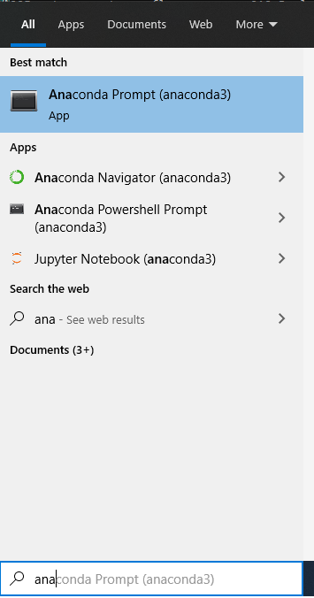
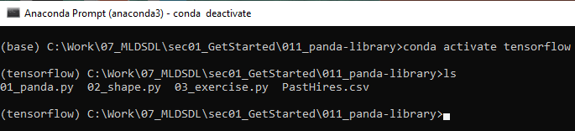
11 Pandas
https://github.com/peterhchen/900_Python_ML_DS_DL
Introduction of Pandas
We have gone through to the Python programming language.
Let us take a look about the Pandas Library.
Pandas library is used a lot in data science.
Bring up “Anaconda Prompt”.
> conda activate tensorflow
> cd [Work-folder]

Slide 3
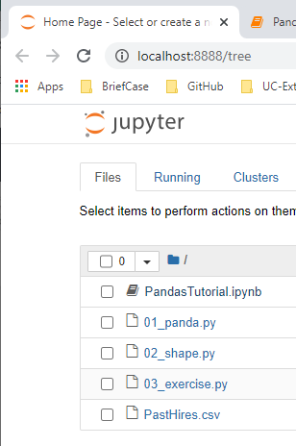
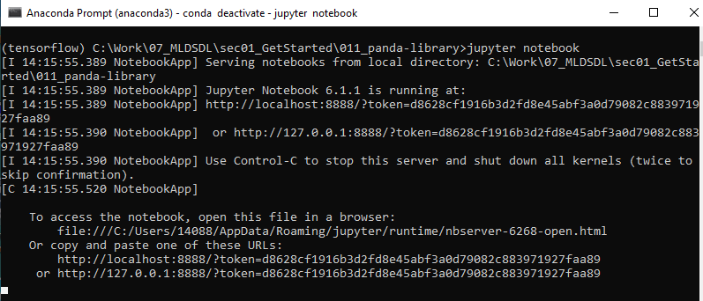
11 Pandas
https://github.com/peterhchen/900_Python_ML_DS_DL
Introduction of Pandas
Open Chrome
1. > jupyter notebook
2. Double click “PandasTutorial.ipynb”
1
2

Slide 4
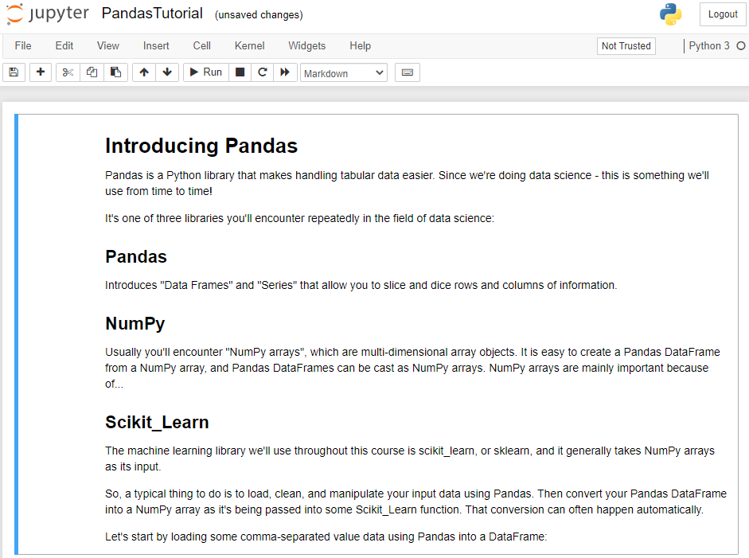
11 Pandas
https://github.com/peterhchen/900_Python_ML_DS_DL
Introduction of Pandas

Slide 5
11.1 What is Panda Library?
Peter H. Chen

Slide 6
11.1 What is Panda Library?
https://github.com/peterhchen/900_Python_ML_DS_DL
What is Panda Library?

Slide 7
11.1 What is Panda Library?
https://github.com/peterhchen/900_Python_ML_DS_DL
What is Pandas (Panel Data) Library?
Pandas is a Python library that handles tabular data.
What is tabular data?
In data science, almost all of the information are stored in columns and rows format.
Since we're doing data science, we use Pandas Library all the time.
Pandas is one of three libraries [Panda, Numpy, scikit-learn (or SciPy)] we will encounter repeatedly in the field of data science and machine learning.
Pandas
Introduces "Data Frames" and "Series" that allow you to slice and dice rows and columns of information.

Slide 8
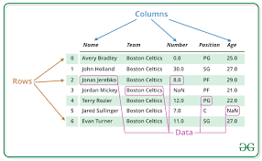
11.1 What is Panda Library?
https://github.com/peterhchen/900_Python_ML_DS_DL
Questions:
What is Pandas Data Frame?
Ans:
Two-dimensional, size-mutable, potentially heterogeneous tabular data.
Data structure also contains labeled axes (rows and columns).
Arithmetic operations align on both row and column labels.
Can be thought of as a dictionary-like container for Series objects.
The primary pandas data structure.

Slide 9
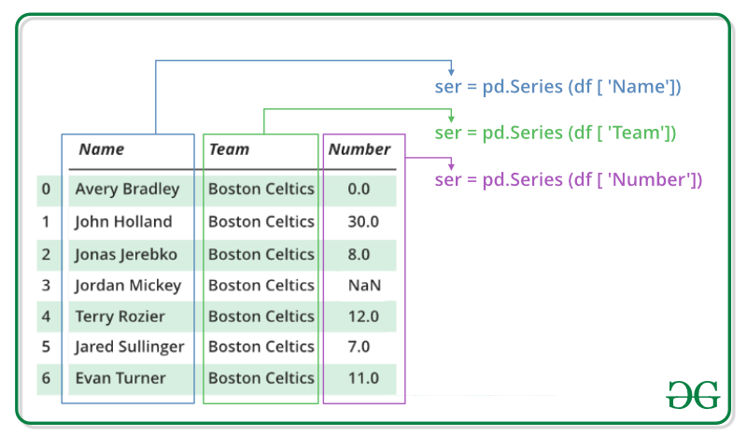
11.1 What is Panda Library?
https://github.com/peterhchen/900_Python_ML_DS_DL
Questions:
What is Pandas Series?
Ans:
Pandas Series is a one-dimensional column array capable of holding data of any type (integer, string, float, python objects, etc.).
The axis labels are collectively called index.
Pandas Series is nothing but a column in an excel sheet.

Slide 10
11.1 What is Panda Library?
https://github.com/peterhchen/900_Python_ML_DS_DL
NumPy
Usually we will encounter "NumPy arrays", which are multi-dimensional array objects.
It is easy to create a Pandas DataFrame from a NumPy array, and Pandas DataFrames can be cast as NumPy arrays.
NumPy arrays are very important because of scikit_learn library for machine learning.
scikit_learn
The machine learning library we'll use throughout this course is scikit_learn, or sklearn, and it generally takes NumPy arrays as its input.
A typical thing to do is to load, clean, and manipulate your input data using Pandas.
Then convert your Pandas DataFrame into a NumPy array as it's being passed into some scikit_learn function. That conversion can often happen automatically.

Slide 11
11.2 Panda Read and Data Frame

Slide 12
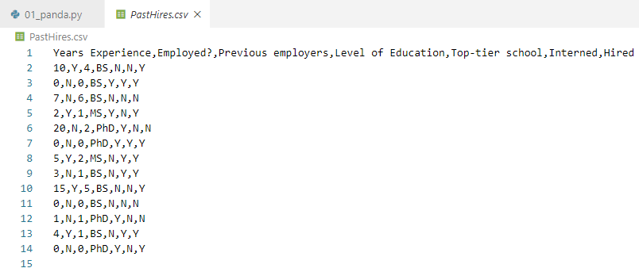
11.2 Panda Read and Data Frame
https://github.com/peterhchen/900_Python_ML_DS_DL
Read PastHires.csv
csv stands for “Coma Separate Value” which means every line of token is separated by coma (,).
First row is one line of column name.

Slide 13
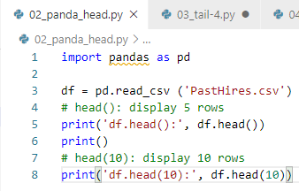
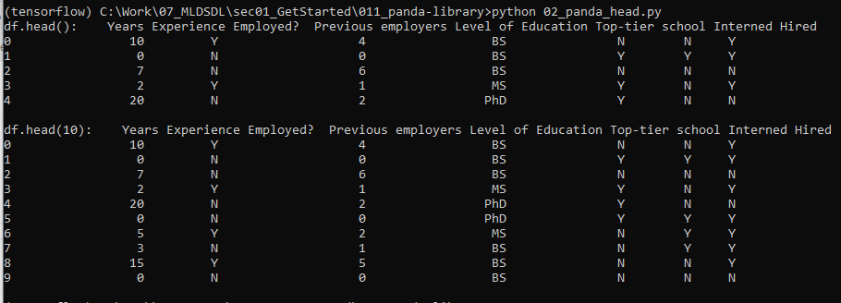
11.2 Panda Read and Data Frame
https://github.com/peterhchen/900_Python_ML_DS_DL
Read PastHires.csv
Import pandas library
pd is shorthand of pandas.
df is shorthand of Dataframe.
Data Frame Operations:
df.head(): Display 5 rows.
df.head(10): Display 10 rows.

Slide 14
11.3 df.tail()

Slide 15
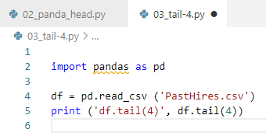
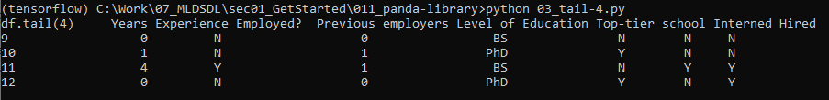
11.3 df.tail()
https://github.com/peterhchen/900_Python_ML_DS_DL
Read PastHires.csv
Import pandas library
Data Frame Operations:
> df.tail(4) # Display the last 4 rows

Slide 16
11.4 df.shape

Slide 17
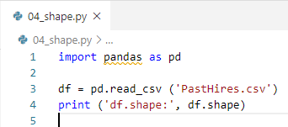
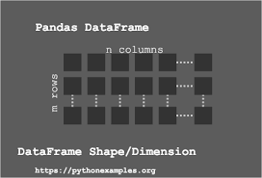
11.4 df.shape
https://github.com/peterhchen/900_Python_ML_DS_DL
df.shape
We use "shape" often of your DataFrame.
Shape is dimensions.
This CSV file has 13 rows with 7 columns per row:
columns
Rows

Slide 18
11.5 df.size

Slide 19
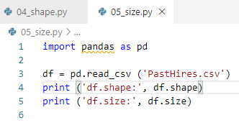

11.5 df.size
https://github.com/peterhchen/900_Python_ML_DS_DL
df.size
The total size of the data frame is the rows * columns = 13 * 7 = 91
columns
Rows

Slide 20
11.6 len(df)

Slide 21
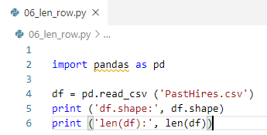

11.6 len(df)
https://github.com/peterhchen/900_Python_ML_DS_DL
len(df)
The len() function gives you the number of rows in a DataFrame:
columns
Rows
len (df)

Slide 22
11.7 df.columns

Slide 23
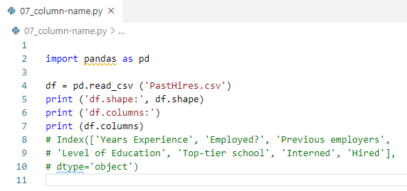

11.7 df.columns
https://github.com/peterhchen/900_Python_ML_DS_DL
df.columns
If your DataFrame has named columns (in our case, extracted automatically from the first row of a .csv file,) you can get an array of them back.
columns
Rows

Slide 24
11.8 df[‘Hired’]

Slide 25
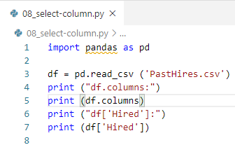
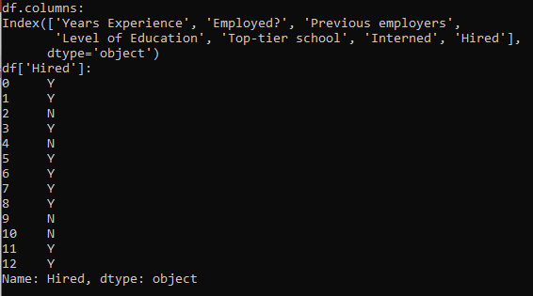
11.8 df[‘Hired’]
https://github.com/peterhchen/900_Python_ML_DS_DL
Df[‘Hired’]
Extracting a single column from your DataFrame looks like this.
This gives you back a "Series" in Pandas:
Remember: Pandas Series is a one-dimensional labeled array.

Slide 26
11.9 df[‘Hired’][:5]

Slide 27
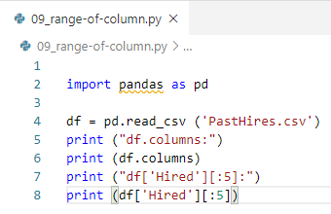
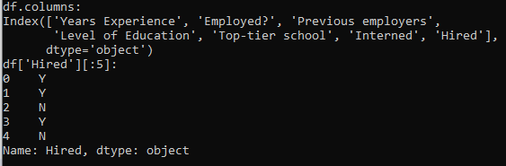
11.9 df[‘Hired’][:5]
https://github.com/peterhchen/900_Python_ML_DS_DL
Df[‘Hired’][:5]
You can also extract a given range of rows from a named column:

Slide 28
11.10 df[‘Hired’][5]

Slide 29
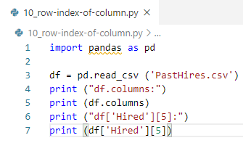
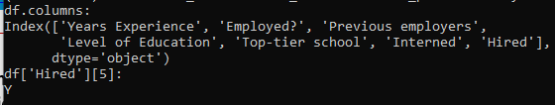
11.10 df[‘Hired’][5]
https://github.com/peterhchen/900_Python_ML_DS_DL
df[‘Hired’][5]
Or even extract a single value from a specified column / row combination:

Slide 30
11.11 df[‘Years Experience’, ‘Hired’]

Slide 31
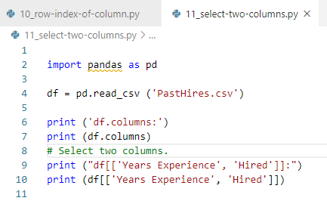
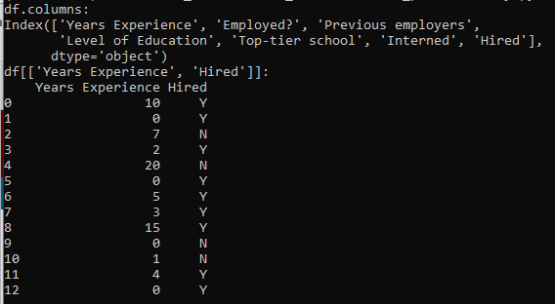
11.11 df[‘Years Experience’, ‘Hired’]
https://github.com/peterhchen/900_Python_ML_DS_DL
Df[‘Years Experience’][‘Hired’]
Select two columns: pass in two column names:

Slide 32
11.12 df[‘Years Experience’, ‘Hired’][:5]

Slide 33
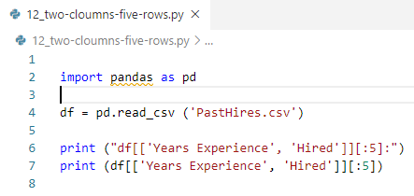
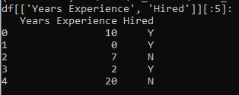
11.12 df[‘Years Experience’, ‘Hired’][:5]
https://github.com/peterhchen/900_Python_ML_DS_DL
df[‘Years Experience’, ‘Hired’][:5]
Select 2 columns and 5 rows

Slide 34
11.13 Sort Selected Column

Slide 35
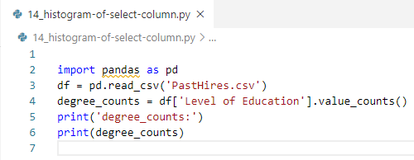

11.14 Histogram of Selected Column
https://github.com/peterhchen/900_Python_ML_DS_DL
Histogram of Selected Columns
You can break down the number of unique values in a given column into a Series using value_counts()

Slide 36
11.14 Histogram of Selected Column

Slide 37
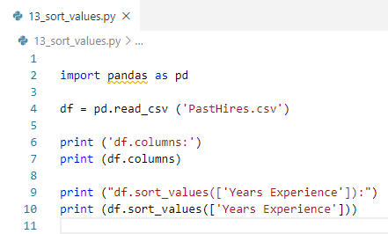
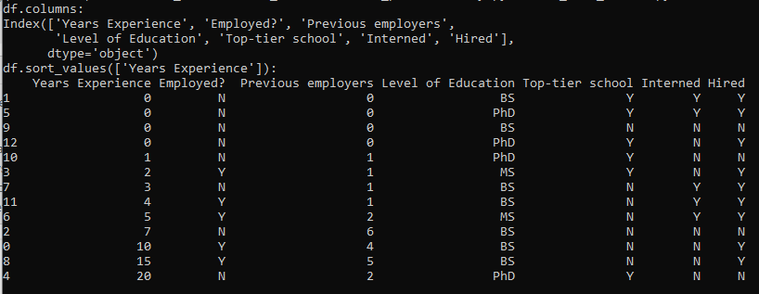
11.13 Sort Selected Column
https://github.com/peterhchen/900_Python_ML_DS_DL
df.sort_values([‘Years Experience’])
Sort selected column.

Slide 38
11.15 Histogram Plot

Slide 39
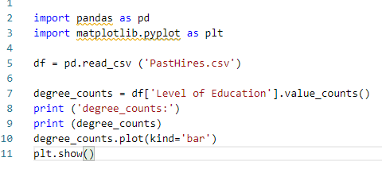

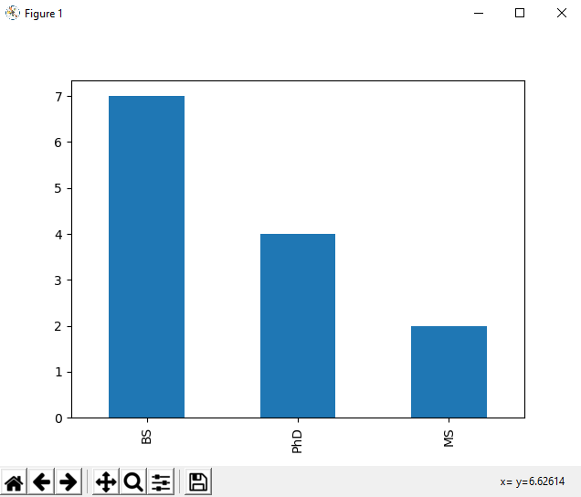
11.15 Histogram Plot
https://github.com/peterhchen/900_Python_ML_DS_DL
Histogram Plot
Pandas make Series (one dimensional column) of DataFrame for plot():

Slide 40
11.6 Exercise

Slide 41
11.16 Exercise
https://github.com/peterhchen/900_Python_ML_DS_DL
Exercise
1. Extract rows 5-10 of DataFrame of “previous employers” and “Hire” columns.
2. Assign to a new DatFrame called hist.
3. Create a histogram plotting the distribution of previous employers.

Slide 42
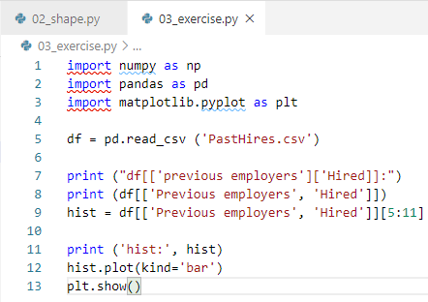
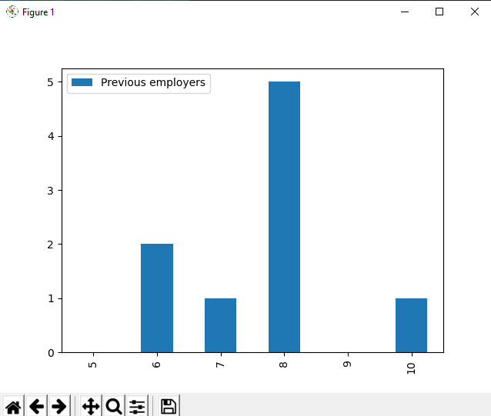
11.16 Exercise Answer
https://github.com/peterhchen/900_Python_ML_DS_DL
Exercise
1. Extract rows 5-10 of DataFrame of “previous employers” and “Hire” columns.
2. Assign to a new DatFrame called hist.
3. Create a histogram plotting the distribution of previous employers.
Answer:

Slide 43
End of Chapter

