Slide 1

58 Confusion Matrix
Peter H. Chen

Slide 2

58 Confusion Matrix
https://www.udemy.com/course/data-science-and-machine-learning-with-python-hands-on/learn/lecture/16656244#overview
What is Confusion Matrix for?
Well, the thing is, sometimes “Accuracy does not tell the Whole Story”, and a Confusion Matrix can help you.
A test for a disease can be 99.9% accurate by just guessing “no” all the time, saying that you do not have it. A model based on data can predict high accuracy but in reality it is useless. It does not tell you everything you need to know about the model.
Confusion tell you what is true positive and true negative, as well as false positive and false negative.
In order to measure how good of your model is. A confusion matrix tell you how accuracy of your model.

Slide 3
58.1 Binary Confusion Matrix

Slide 4
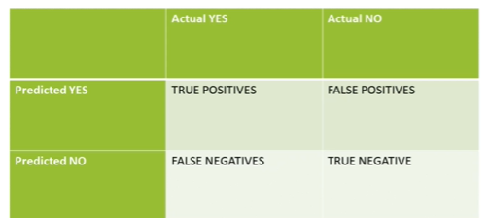
58.1 Binary Confusion Matrix
https://www.udemy.com/course/data-science-and-machine-learning-with-python-hands-on/learn/lecture/16656244#overview
Binary Confusion Matrix
Confusion Matrix has the general format looks as below:
Image we have a binary situation where we predict Yes or No.
I have test positive for this drug or I do not have test positive for this drug.
We can see the rows, we have predicted values.
In the columns, we have the actual values.

Slide 5
58.1 Binary Confusion Matrix
https://www.udemy.com/course/data-science-and-machine-learning-with-python-hands-on/learn/lecture/16656244#overview
Binary Confusion Matrix
If we predict something that is Yes and it really is, then that is a true positive.
If we predict something that is Yes and it is actually no, actually negative, that is false negative.
If we predict No, but it is actually Yes, and that is a False Negative.
If we predict No, when it is actually No, and that is True Negative.
It gets very confusing, therefore, we called it “Confusing Matrix”.

Slide 6
58.1 Binary Confusion Matrix
https://www.udemy.com/course/data-science-and-machine-learning-with-python-hands-on/learn/lecture/16656244#overview
Binary Confusion Matrix
In real world prediction of testing dataset. It gives you actually number of True Positive, False Positive, False Negative, and True Negative.
Keep in mind, we have to pay attention to the labels. There is no convention of the order of these labels.
The diagonals (True Positive and True Negative) are the result should be.
The accurate model would have high number along the diagonal.

Slide 7
58.2 Cat Prediction Example

Slide 8
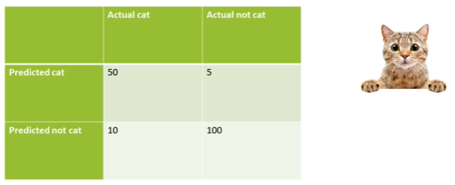
58.2 Cat Prediction Example
https://www.udemy.com/course/data-science-and-machine-learning-with-python-hands-on/learn/lecture/16656244#overview
Cat Prediction
For example, we have a machine learning model trying to predict an image is a Cat or not
If we predicted that is a cat, and it really is. It is a 50 times True Positive in our test set.
Sometimes, we predict that is a cat, and it is not. It is 5 times False Positive.
If we predicted that is not a cat, and it is a cat. It is a 10 times False Negative.
If we predicted that is not a cat, and it is really no. It is a 100 times True Negative.

Slide 9
58.2 Cat Prediction Example
https://www.udemy.com/course/data-science-and-machine-learning-with-python-hands-on/learn/lecture/16656244#overview
Cat Prediction
That is how you interpret a Confusion Matrix.
We will discuss how to make the confusion matrix.

Slide 10
58.3 Another Format

Slide 11
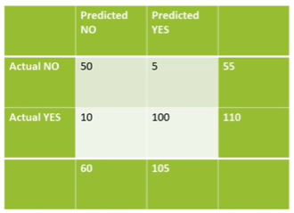
58.3 Another Format
https://www.udemy.com/course/data-science-and-machine-learning-with-python-hands-on/learn/lecture/16656244#overview
Another Format of Confusion Matrix
Sometimes, we have prediction on the columns and actual results on the rows. Predicted and Actual values No and Yes in different orders.
Below, we have sum of predicted No and Sum of predicted Yes. Sum of Actual No and Sum of Actual Yes.
No matter the orders, make sure you pay attention the labels on confusion matrix.

Slide 12
58.4 Multi-Class Confusion Matrix

Slide 13
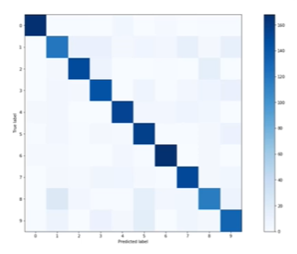
58.4 Multi-Class Confusion Matrix
https://www.udemy.com/course/data-science-and-machine-learning-with-python-hands-on/learn/lecture/16656244#overview
Multi-Class Confusion Matrix: Heat Map
We can have a heat map to predict different hand-writing for digits (0 to 9) and actual values. We can have multi-class confusion matrix.
Image we have a hand-writing recognition systems that try to identify somebody writing a digit from 0 to 9. It is a multi-class hand-writing recognition system.
We can put the predicted label on horizontal axis and actual value on the vertical axis. The color represent how high of the prediction number is.
We can see the dark on the diagonal, representing a good accuracy on the on True Positive and True Negative.

Slide 14
58.5 Summary

Slide 15
58.5 Summary
https://www.udemy.com/course/data-science-and-machine-learning-with-python-hands-on/learn/lecture/16656244#overview
Summary
When we make prediction with True or False, it does not tell how good of the Model prediction.
We use Confusion Matrix to measure the model with True Positive and True Negative, False Positive and False Negative.
For multi-class confusion matrix, we can have prediction value on the horizontal axis and actual value on the vertical axis.
We have darker color for high number in True Positive and True Negative which mean the model is very accuracy.

Slide 16
End of Chapter

