Slide 1

32 Spam Classifier
Peter H. Chen

Slide 2
32 Spam Classifier
https://www.udemy.com/course/data-science-and-machine-learning-with-python-hands-on/learn/lecture/4020548#overview
Spam Classifier
We classify the Spam with Naïve Bayes, the easy way.
We'll cheat by using sklearn.naive_bayes to train a spam classifier.

Slide 3
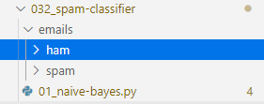
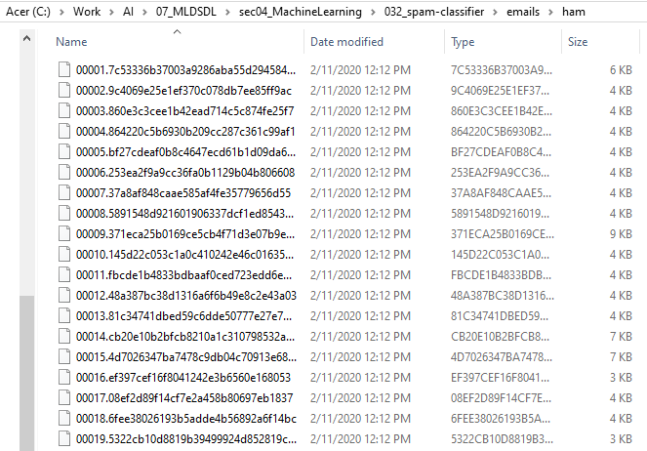
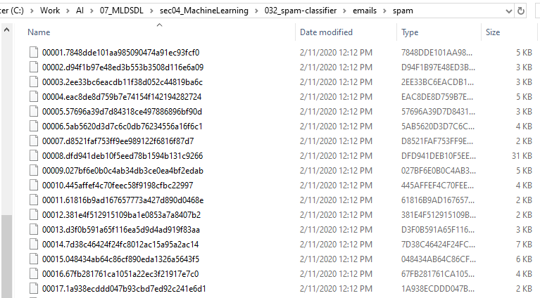
32 Spam Classifier
https://www.udemy.com/course/data-science-and-machine-learning-with-python-hands-on/learn/lecture/4020548#overview
Spam Classifier
We have emails folder.
The emails folder contains folder ham and folder spam

Slide 4
32.1 Read Spam and Ham Emails

Slide 5
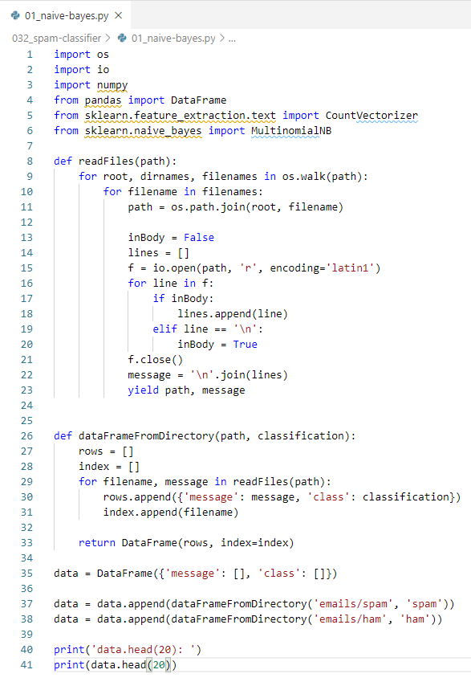
32.1 Read Spam and Ham Emails
https://www.udemy.com/course/data-science-and-machine-learning-with-python-hands-on/learn/lecture/4020548#overview
Spam Classifier
Most of the code is just loading our training data into a pandas DataFrame that we can play with:\.
From package import CountVectorizer class
From package Import MultinomialNB class
Read Spam and hams files.
Transform emails (Spam/Ham) into path, message, class (Spam/Ham) format ans store in Panda DataFrame.

Slide 6
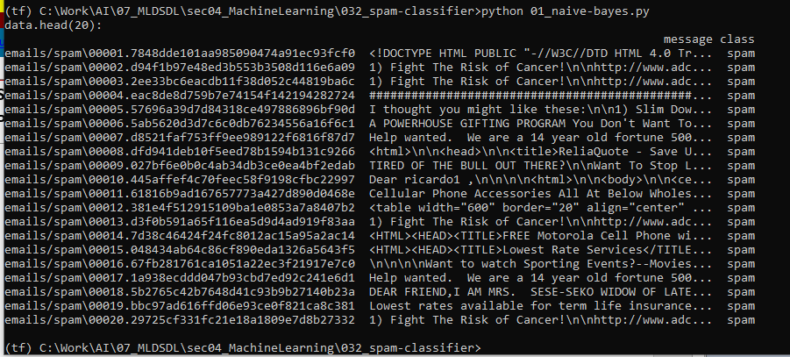
32.1 Read Spam and Ham Emails
https://www.udemy.com/course/data-science-and-machine-learning-with-python-hands-on/learn/lecture/4020548#overview
Spam Classifier
> print DatFrame.head (20)

Slide 7
32.2 Vectorization and Model Fit

Slide 8
32.2 Vectorization and Model Fit
https://www.udemy.com/course/data-science-and-machine-learning-with-python-hands-on/learn/lecture/4020548#overview
Vectorization and Model Fit:
Because data fit (linear regression) can only recognize integer values, we need to split the text message into words and then translate every words into integer values. This process call Vectorization, i.e., transform the text into integer vector.
We will use a CountVectorizer to split up each message into its list of words, and throw that into a MultinomialNB classifier.
Call fit() and we've got a trained spam filter ready to go! It's just that easy.

Slide 9
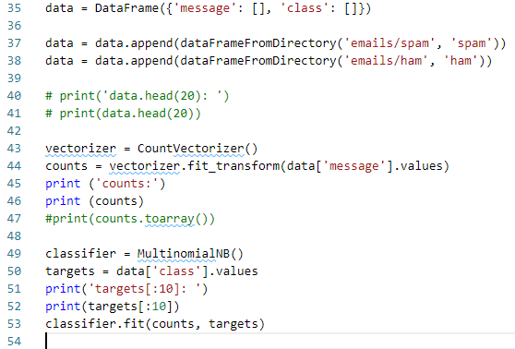
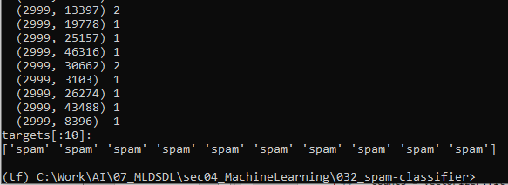
32.2 Vectorization and Model Fit
https://www.udemy.com/course/data-science-and-machine-learning-with-python-hands-on/learn/lecture/4020548#overview
Vectorization and Model Fit:

Slide 10
32.3 Message Classifier

Slide 11
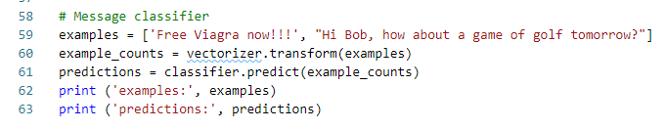
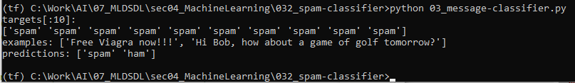
32.3 Message Classifier
https://www.udemy.com/course/data-science-and-machine-learning-with-python-hands-on/learn/lecture/4020548#overview
Message Classifier

Slide 12
32.4 Exercise

Slide 13
32.4 Exercise
https://www.udemy.com/course/data-science-and-machine-learning-with-python-hands-on/learn/lecture/4020548#overview
Exercise
https://blog.hubspot.com/blog/tabid/6307/bid/30684/the-ultimate-list-of-email-spam-trigger-words.aspx
Write some Spam and Ham message and make prediction.

Slide 14
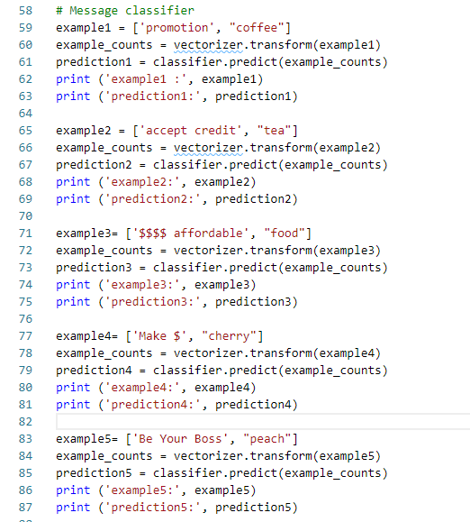
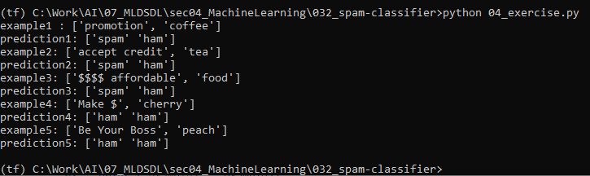
32.4 Exercise
https://www.udemy.com/course/data-science-and-machine-learning-with-python-hands-on/learn/lecture/4020548#overview
Exercise
Code example for wrong prediction.
Wrong Prediction

Slide 15
32.5 Summary

Slide 16
32.5 Summary
https://www.udemy.com/course/data-science-and-machine-learning-with-python-hands-on/learn/lecture/4020548#overview
Summary
Our dataset is very small. It is easy to make wrong prediction.
You can find bigger data set and example from Kaggle web site.
https://www.kaggle.com/balakishan77/spam-or-ham-email-classification

Slide 17
End of Chapter

