Slide 1

33 K-Mean Cluster
Peter H. Chen

Slide 2
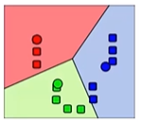
33 K-Mean Cluster
https://www.udemy.com/course/data-science-and-machine-learning-with-python-hands-on/learn/lecture/4020558#overview
K-Mean Clustering
K-Mean Clustering is very common in Machine Learning.
K-Mean Clustering attempts to split data into K-groups that are closest to K centroids (Red, green, and blue colors).
K-Means Clustering is a Unsupervised learning: It uses only the positions of each data point
Can uncover interesting groupings of people, things, behavior, and etc.
Example:
Where do millionaires live?
What genres (types) of music (songs), movies, and etc., classification?
Create your own stereotypes (classification) from demographic data, Spanish, Asian, and etc.

Slide 3
33 K-Mean Cluster
https://www.udemy.com/course/data-science-and-machine-learning-with-python-hands-on/learn/lecture/4020558#overview
K-Mean Clustering
Unsupervised Learning Cluster K.
How is works?
Randomly pick K centroids (K-Means), for example, we have k = 3.
Assign each data point to the centroid that pick up data closest to. We can plot the scatter plot to verify the assignment.
Recompute the centroid based on the average position of each centroid’s point. The centroid point start moving.
Iterate until stop changing assignment to centroids
If you want to predict the cluster for new point, just find the centroid they are closest to.

Slide 4
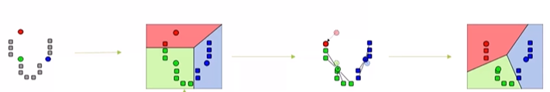
33 K-Mean Cluster
https://www.udemy.com/course/data-science-and-machine-learning-with-python-hands-on/learn/lecture/4020558#overview
Graphical Example
We have a scatter plot on the left with gray colors. We want to find the relations in between.
We pick up the red color, green, and blue as the centroids.
Pick up any point and compare to centroid. Group the pickup point.
Adjust the group the groups and centroids.

Slide 5
33 K-Mean Cluster
https://www.udemy.com/course/data-science-and-machine-learning-with-python-hands-on/learn/lecture/4020558#overview
K-Mans Clustering Gotchas (Tricky Trap)
Choosing K
You start the lower K value and try increasing K values until you stop getting large reduction in squared error (distances from each point to their centroids)
Avoid local minima
The random choice of initial centroids can yield different results. Try to random choose the centroid points for global minima.
Run it a few times just to make sure your initial results are not trap into local minima.
Labeling the clusters
K-Means does not attempt to assign any meaning to the clusters you find
It is up to you to dig into the data and try to determine the labeling meaning

Slide 6
33 K-Mean Cluster
https://www.udemy.com/course/data-science-and-machine-learning-with-python-hands-on/learn/lecture/4020558#overview
Scikit-learn makes K-Mean Cluster easy.

Slide 7
End of Chapter

