Slide 1
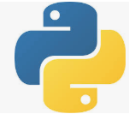
34 K-Mean: Income and Age Data
Peter H. Chen

Slide 2
34 K-Mean: Income and Age Data
https://www.udemy.com/course/data-science-and-machine-learning-with-python-hands-on/learn/lecture/4020558#overview
K-Mean Clustering Example
Make data for people clustered by income and age, randomly and then plot the data with cluster.

Slide 3
34.1 Generate Income and Age Data

Slide 4
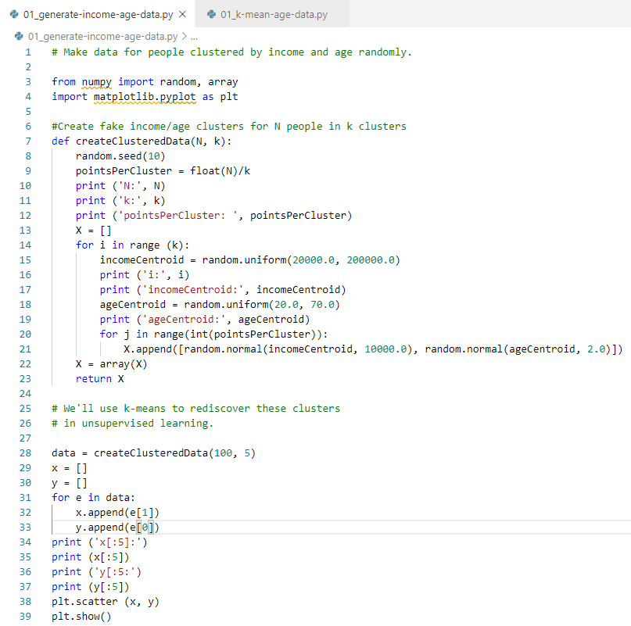
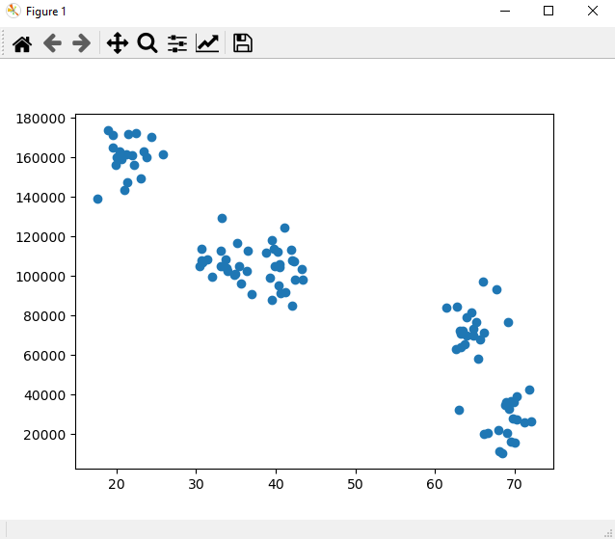
34 Generate Income and Age Data
https://www.udemy.com/course/data-science-and-machine-learning-with-python-hands-on/learn/lecture/4020558#overview
K-Mean Clustering Example
Make data for people clustered by income and age, randomly.
Plot data

Slide 5
34.2 K-Mean fit for Income vs Age

Slide 6
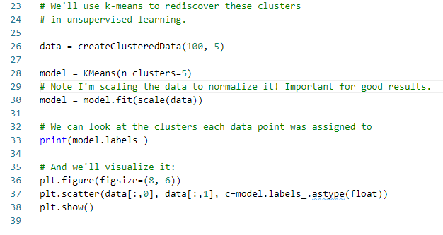
34.2 K-Mean fit for Income vs Age
https://www.udemy.com/course/data-science-and-machine-learning-with-python-hands-on/learn/lecture/4020558#overview
K-Mean: Income and Age
We scale the array [[x0, y0], [x1, y0], …]
Use sklearn’s KMean.fit (scale(data)) to model data.
Plot the orginal data

Slide 7
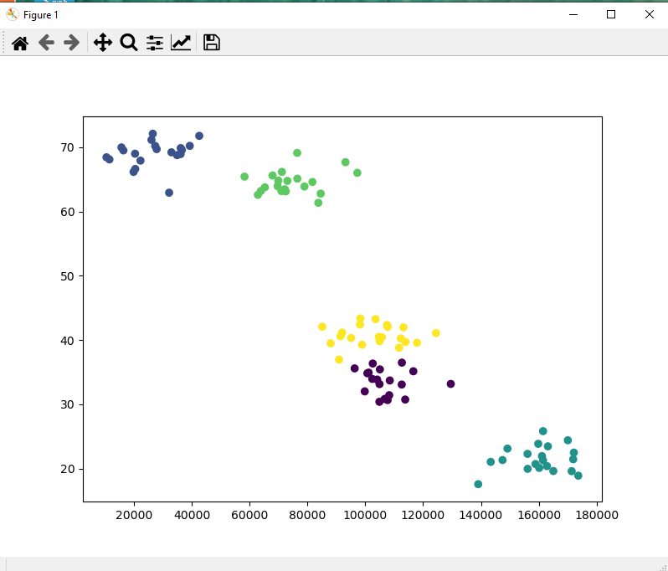
34.2 K-Mean fit for Income vs Age
https://www.udemy.com/course/data-science-and-machine-learning-with-python-hands-on/learn/lecture/4020558#overview
K-Mean: Income and Age
We scale the array [[x0, y0], [x1, y0], …]
Use sklearn’s KMean.fit (scale(data)) to model data.
Plot the original data

Slide 8
34.3 Swap Display Data: Income vs Age
Peter H. Chen

Slide 9
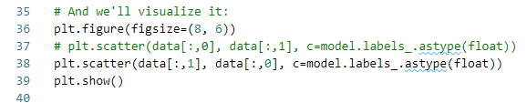
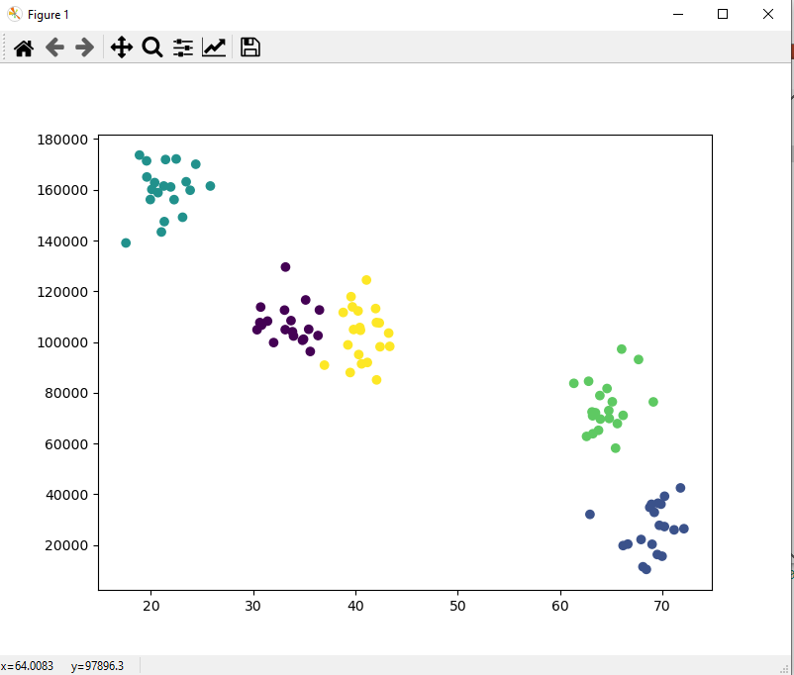
34.3 Swap Display Data: Income vs Age
https://www.udemy.com/course/data-science-and-machine-learning-with-python-hands-on/learn/lecture/4020558#overview
Swap Display Data:

Slide 10
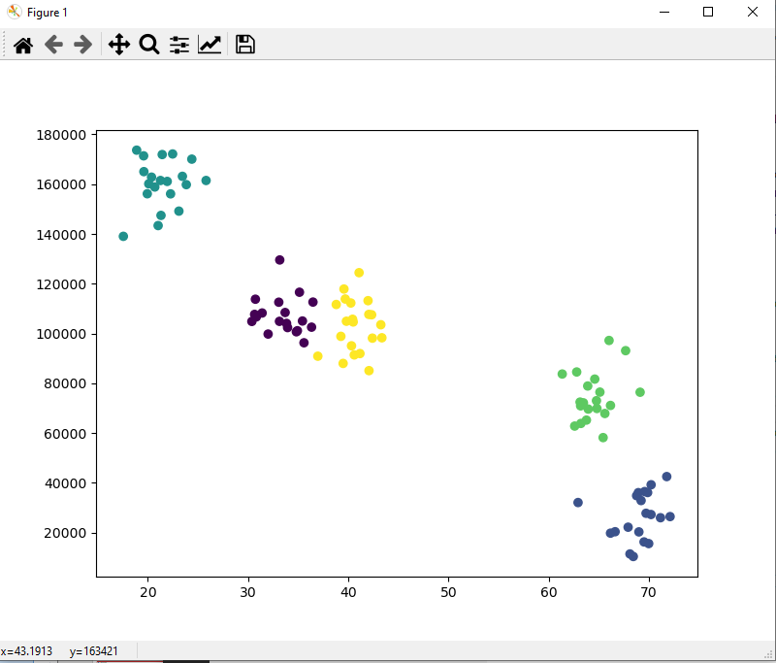
34.3 Swap Display Data: Income vs Age
https://www.udemy.com/course/data-science-and-machine-learning-with-python-hands-on/learn/lecture/4020558#overview
Result

Slide 11
34.4 Exercise
Peter H. Chen

Slide 12
34.4 Exercise
https://www.udemy.com/course/data-science-and-machine-learning-with-python-hands-on/learn/lecture/4020558#overview
Exercise
What happens if we don't scale the data?
What happens if we choose different values of K? In the real world, we will not know the "right" value of K to start with. We will need to converge on it yourself.

Slide 13

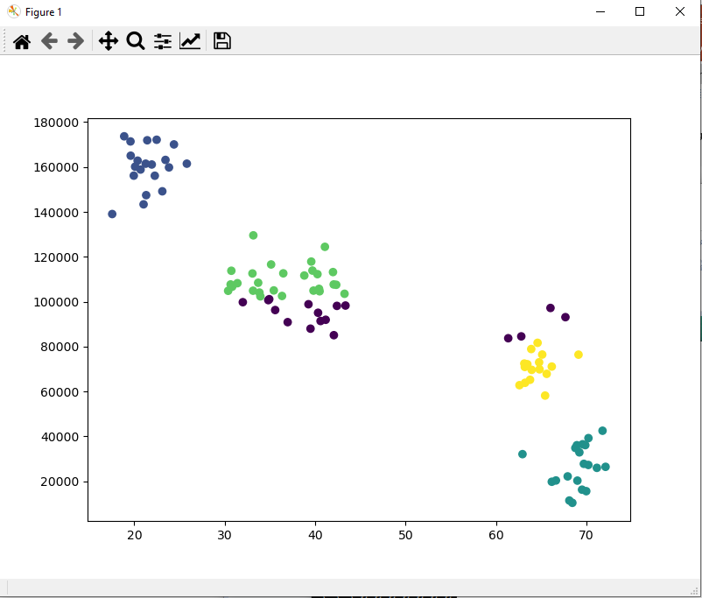
34.4 Exercise
https://www.udemy.com/course/data-science-and-machine-learning-with-python-hands-on/learn/lecture/4020558#overview
Exercise
What happens if we don't scale the data?
Ans:
The data point moves without scaling. Sci-learn K-mean algorithm required scale data.
With Scale
Without Scale

Slide 14

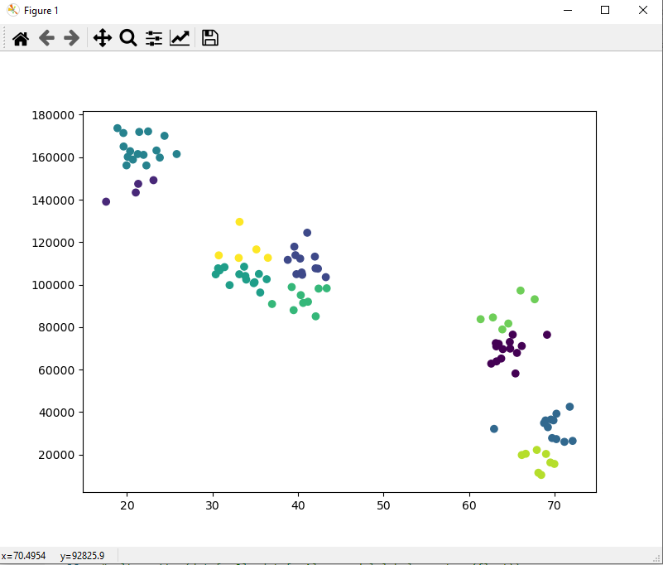
34.4 Exercise
https://www.udemy.com/course/data-science-and-machine-learning-with-python-hands-on/learn/lecture/4020558#overview
Exercise
What happens if we don't scale the data?
What happens if we choose different values of K? In the real world, we will not know the "right" value of K to start with. We will need to converge on it yourself.
K = 5
K = 10

Slide 15
34.5 Summary
Peter H. Chen

Slide 16
34.5 Summary
https://www.udemy.com/course/data-science-and-machine-learning-with-python-hands-on/learn/lecture/4020558#overview
Summary
We generate the age vs income data
1. Perform the scale
2. Perform K-Mean fit by sck-learn
3. Plot Scatter diagram.

Slide 17
End of Chapter

