Slide 1

1 Flask API: Part 1
Peter H. Chen

Slide 2
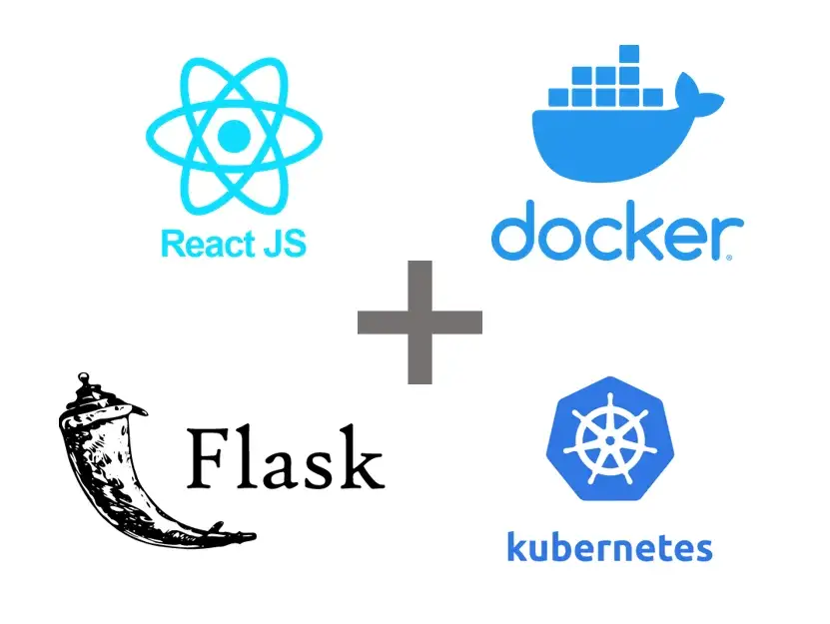
1 Flask API
https://www.youtube.com/watch?v=5aDfgcI8MHM&list=PLEt8Tae2spYkfEYQnKxQ4vrOULAnMI1iF
Flask API
We develop the Flask API under Linux/Ubuntu 22.04.
We use MS-Code under Ubuntu 22.04 as the editor.
We start from backend and move to frontend.

Slide 3
1.1 Install Dependencies

Slide 4
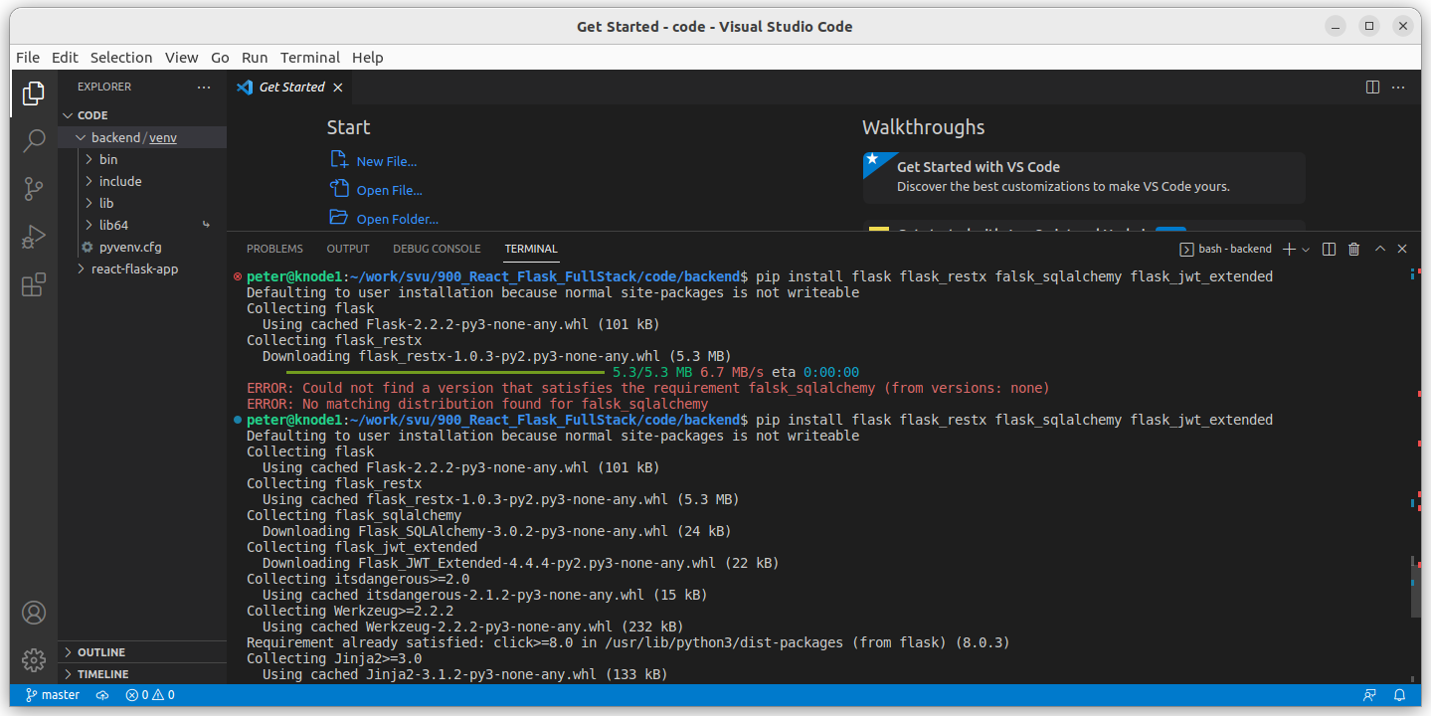
1.1 Install Dependencies
https://www.youtube.com/watch?v=5aDfgcI8MHM&list=PLEt8Tae2spYkfEYQnKxQ4vrOULAnMI1iF
Create Backend Folder and Install Dependencies
Create “backend” folder and install the following dependencies (flask, flask_sqlalchemy, flask_jwt_extended):
> md backend
> cd backend
> python3 -m venv venv
> pip install flask flask_sqlalchemy flask_jwt_extended
Note: JWT (JSON Web Token) for security of document communication.

Slide 5
1.2 Define Environment Variable

Slide 6
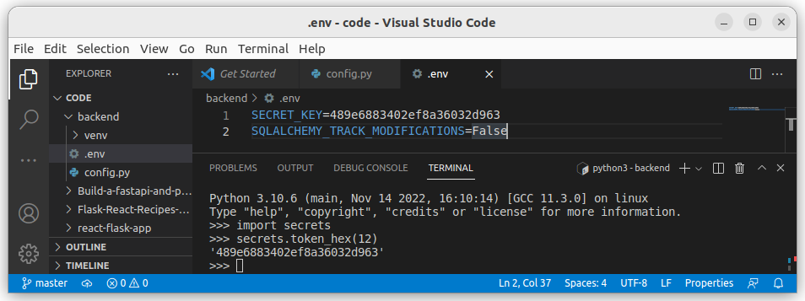
1.2 Define Environment Variable
https://www.youtube.com/watch?v=5aDfgcI8MHM&list=PLEt8Tae2spYkfEYQnKxQ4vrOULAnMI1iF
Define Environment Variable
Python decouple put the environment variable into the file ini and file env.
> pip install python-decouple python-dotenv
Now, we create a file “.env” and we create a file “.env”
We create .env file and define variable SECRET_KEY=’some secrete token’
We define another variable SQLALCHEMY_TRACK_MODIFICATIONS=False
We generate some secret token, e.g., token_hex(12) as below.
> python3
> import secrets
> secrets.token_hex(12)

Slide 7
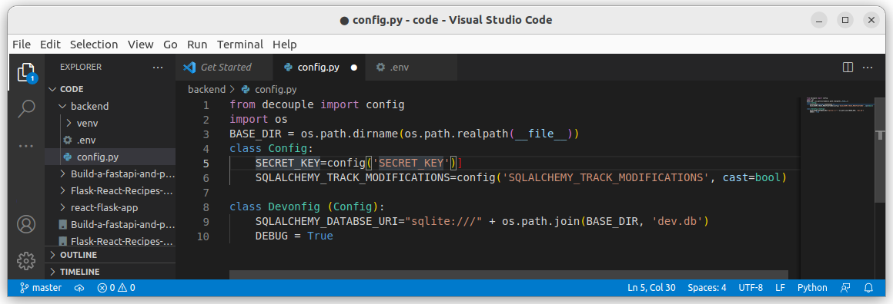
1.2 Define Environment Variable
https://www.youtube.com/watch?v=5aDfgcI8MHM&list=PLEt8Tae2spYkfEYQnKxQ4vrOULAnMI1iF
Define Environment Variable
Now, we create config.py
> from decouple import config
> class Config:
> SECRETE_KEY = config(‘SECRET_KEY’)
> SQLALCHEMY_TRACK_MODIFICATIONS = config(‘SQLALCHEMY_TRACK_MODIFICATIONS’, cast=bool)

Slide 8
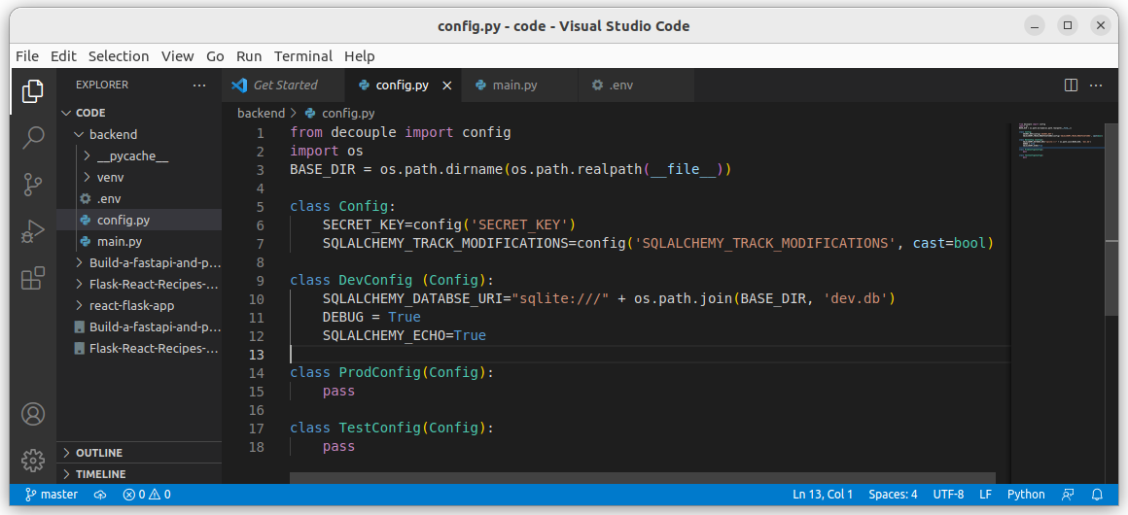
1.2 Define Environment VariableI
https://www.youtube.com/watch?v=5aDfgcI8MHM&list=PLEt8Tae2spYkfEYQnKxQ4vrOULAnMI1iF
Define Environment Variable
Define SQLALCHEM_DATABASE_URL
We define a new class DevConfig and inherited all definition from class Config
>from decuple import config
> import os
# We define the base directory as below.
> BASE_DIR = os.path.dirname(os.path.realpath(__file__))
> class Config:
# We define a new class DevConfig and inherit class Config
> class DevConfig (Config):
> SQLALCHEM__DATABASE_URI = “sqlite:///”+os.path.join(BASE_DIR, ‘dev.db’)

Slide 9
1.2 Define Environment Variable
https://www.youtube.com/watch?v=5aDfgcI8MHM&list=PLEt8Tae2spYkfEYQnKxQ4vrOULAnMI1iF
Define Environment Variable
We define class ProdConfig(Config) and TestConfig(Config).
We do not have new environment variables and pass both of them.
Now, we have finished all the environment configuration for the backend.

Slide 10
1.3 main.py

Slide 11
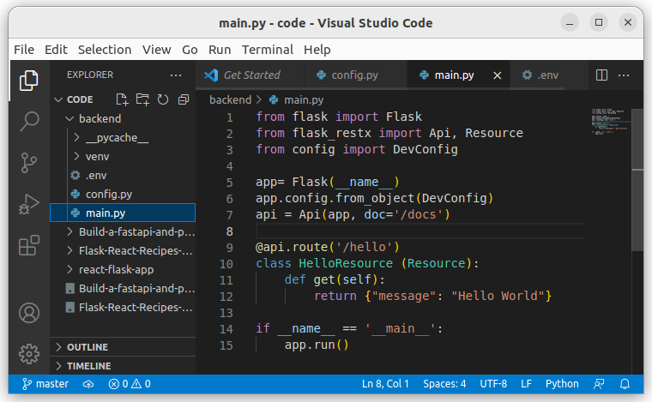
1.3 main.py
https://www.youtube.com/watch?v=5aDfgcI8MHM&list=PLEt8Tae2spYkfEYQnKxQ4vrOULAnMI1iF
main.py
1. Import class Flask from framework flask.
2. Import class Api and Resource from framework flask_restx
3. import class DevConfig from config

Slide 12
1.3 main.py
https://www.youtube.com/watch?v=5aDfgcI8MHM&list=PLEt8Tae2spYkfEYQnKxQ4vrOULAnMI1iF
main.py
5. Create application by class Flask (__name__).
6. Get Configuration variable for application.
7. Specify API document directory.

Slide 13
1.3 main.py
https://www.youtube.com/watch?v=5aDfgcI8MHM&list=PLEt8Tae2spYkfEYQnKxQ4vrOULAnMI1iF
main.py
9. @api.route(‘/hello’): We use decorator for Flask router.
10. class HelloResource () inherit base Resource and return the message “Hello World”.

Slide 14
1.3 main.py
https://www.youtube.com/watch?v=5aDfgcI8MHM&list=PLEt8Tae2spYkfEYQnKxQ4vrOULAnMI1iF
main.py
14. if __name__ ==’__main__’
15. start run by app.run()

Slide 15
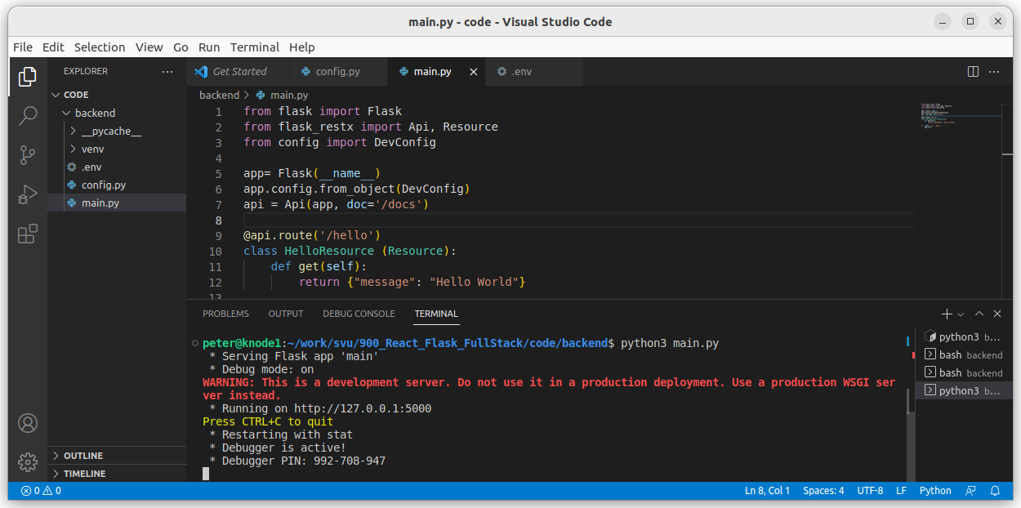
1.3 main.py
https://www.youtube.com/watch?v=5aDfgcI8MHM&list=PLEt8Tae2spYkfEYQnKxQ4vrOULAnMI1iF
main.py (15:10/1:09:18)
> python3 main.py

Slide 16
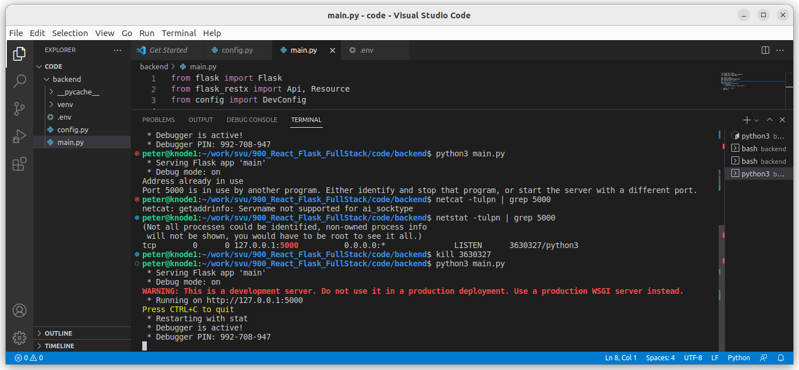
1.3 main.py
https://www.youtube.com/watch?v=5aDfgcI8MHM&list=PLEt8Tae2spYkfEYQnKxQ4vrOULAnMI1iF
main.py (15:10/1:09:18)
> python3 main.py
If you see “address is already in use”
> netcat -tulpn | grep 5000
> kill <PID>
Then restart “python3 main.py”

Slide 17
End

