Slide 1

1 Basic REST API
Peter H. Chen

Slide 2
1 Basic REST API
https://www.youtube.com/watch?v=Uyei2iDA4Hs&list=PLillGF-RfqbbRA-CIUxlxkUpbq0IFkX60
Basic REST API
We will build up React, Redux, and Django.
Django API uses Django REST Framework which is very high level. We do not have to write a lot of code to implement the functionality.
We create REST API and implement the React and Redux, and then we add token called Django REST Knox.
The application is a simple user management system. We can add lead manager, name, email, and message. We have authentication login and each user will have their own lead. If I create a lead as one user then then login as another user, I will not be able to see or manage the other person’s lead.

Slide 3
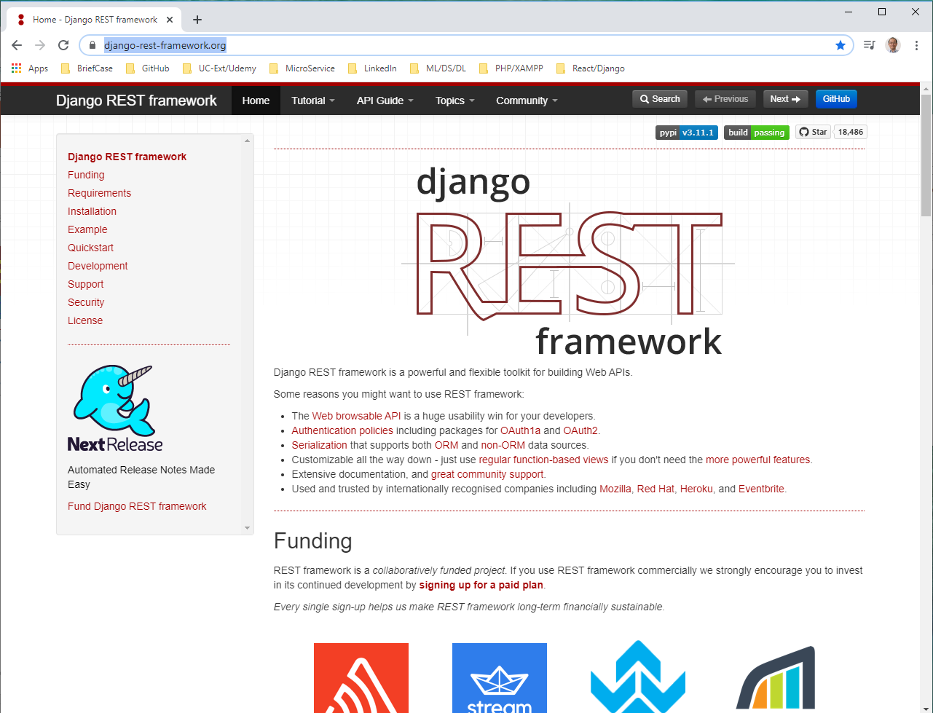
1 Basic REST API
https://www.youtube.com/watch?v=Uyei2iDA4Hs&list=PLillGF-RfqbbRA-CIUxlxkUpbq0IFkX60
Django REST framework
https://www.django-rest-framework.org/
This is the Django REST Framework.

Slide 4
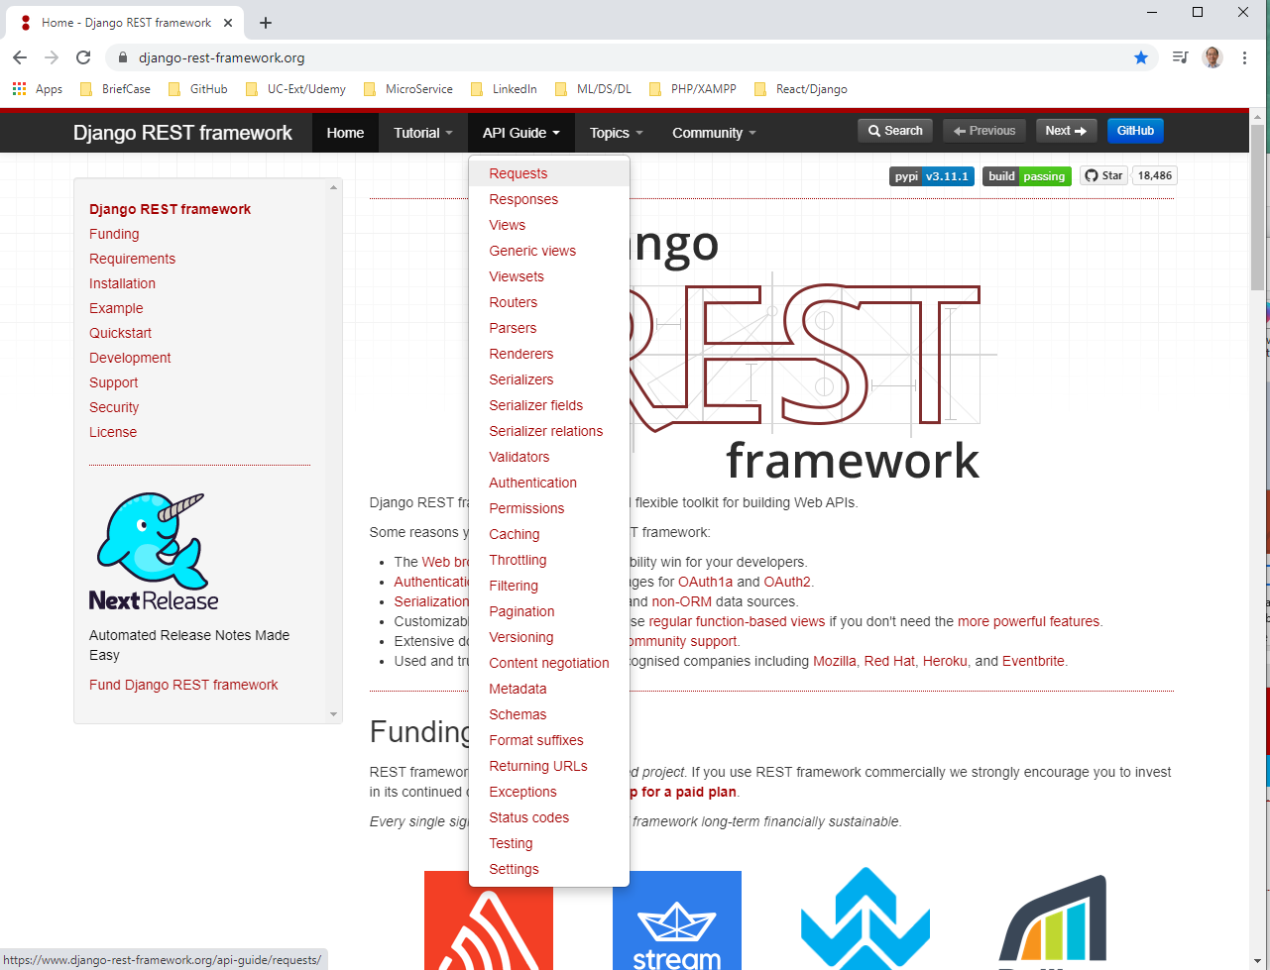
1 Basic REST API
https://www.youtube.com/watch?v=Uyei2iDA4Hs&list=PLillGF-RfqbbRA-CIUxlxkUpbq0IFkX60
Django REST framework
https://www.django-rest-framework.org/
The API Guide includes in-depth concepts are here.
It includes the views, serializers, and etc.

Slide 5
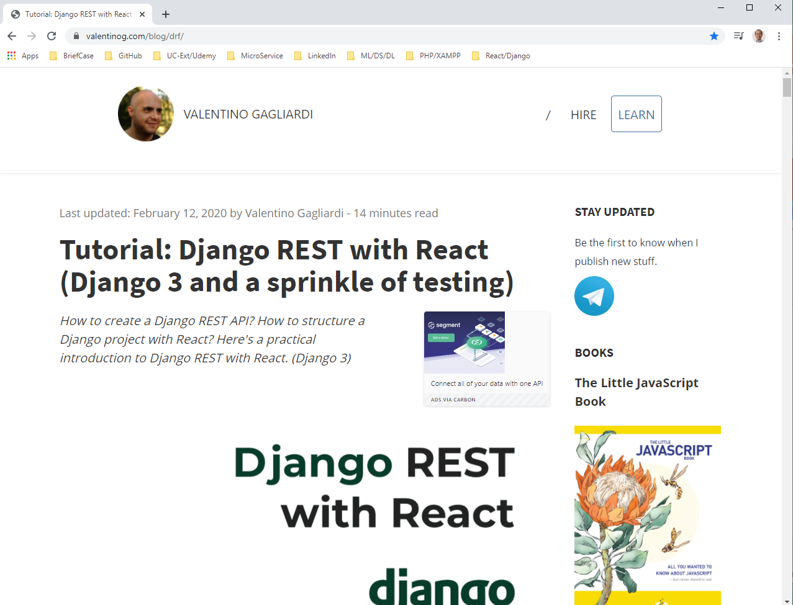
1 Basic REST API
https://www.youtube.com/watch?v=Uyei2iDA4Hs&list=PLillGF-RfqbbRA-CIUxlxkUpbq0IFkX60
Tutorial of Django REST framework
https://www.valentinog.com/blog/drf/
This is the tutorial of Django REST with React.

Slide 6
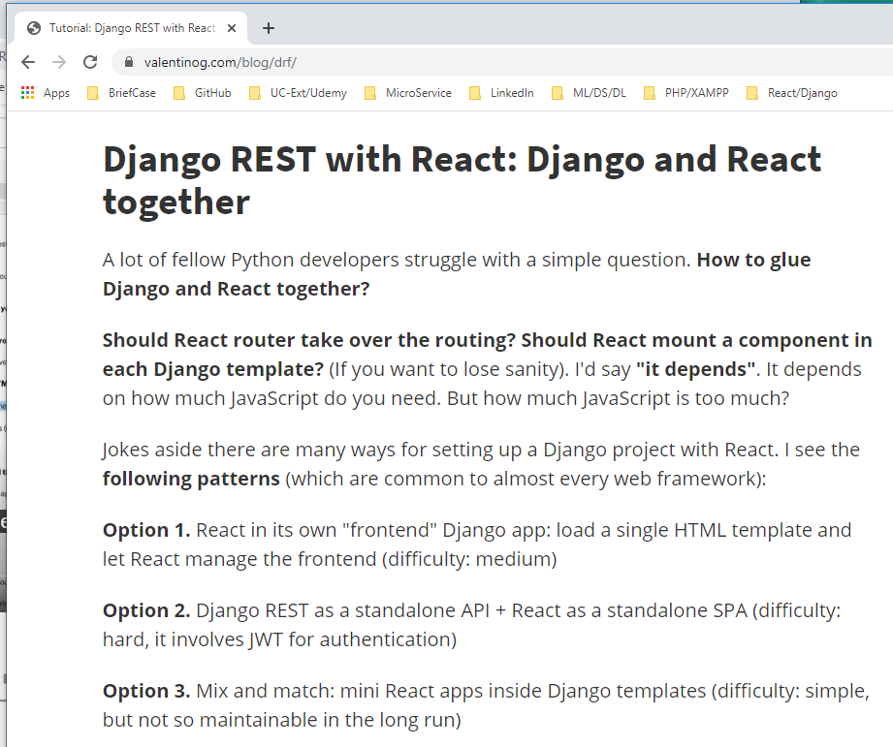
1 Basic REST API
https://www.youtube.com/watch?v=Uyei2iDA4Hs&list=PLillGF-RfqbbRA-CIUxlxkUpbq0IFkX60
Tutorial of Django REST framework
https://www.valentinog.com/blog/drf/
The way I did before is option 2: stand alone API and stand alone React Single Page Application.
We will here is option 1: React own Django app. Load HTML template and left React manage the frontend.

Slide 7
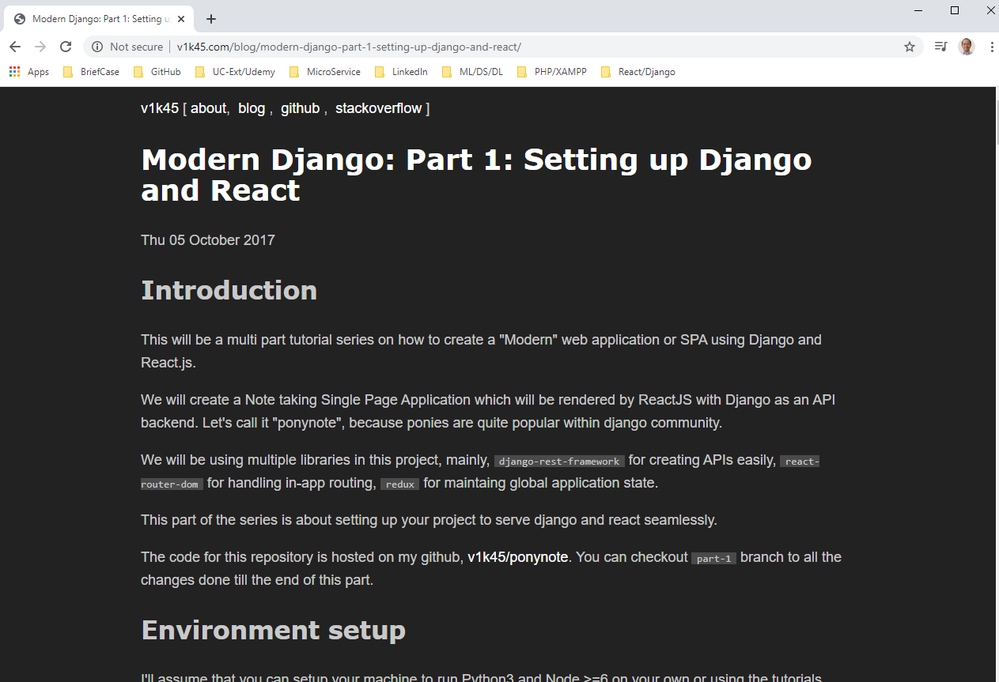
1 Basic REST API
https://www.youtube.com/watch?v=Uyei2iDA4Hs&list=PLillGF-RfqbbRA-CIUxlxkUpbq0IFkX60
Tutorial of Django REST framework
http://v1k45.com/blog/modern-django-part-1-setting-up-django-and-react/
This is a five parts tutorials for Django and React.
This provide lots of ideas about authentication.

Slide 8
1.1 Environment Setup

Slide 9
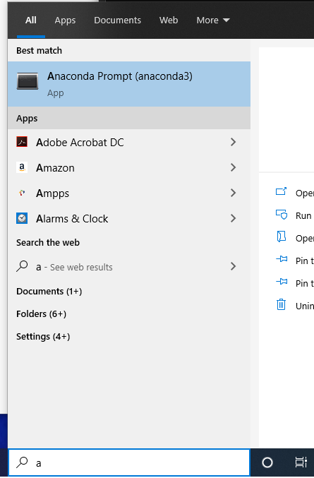
1.1 Environment Setup
https://www.youtube.com/watch?v=Uyei2iDA4Hs&list=PLillGF-RfqbbRA-CIUxlxkUpbq0IFkX60
Environment Setup
Make sure you have anaconda 3 install
Start the anaconda:
(base) ..>
(base) ..> conda activate tf
(tf) ..>

Slide 10
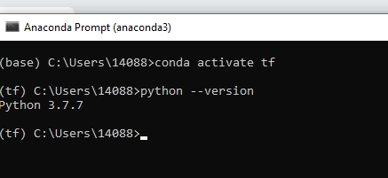
1.1 Environment Setup
https://www.youtube.com/watch?v=Uyei2iDA4Hs&list=PLillGF-RfqbbRA-CIUxlxkUpbq0IFkX60
Environment Setup
Make sure you have Python 3 installed
> python --version
> python 3.7.7

Slide 11
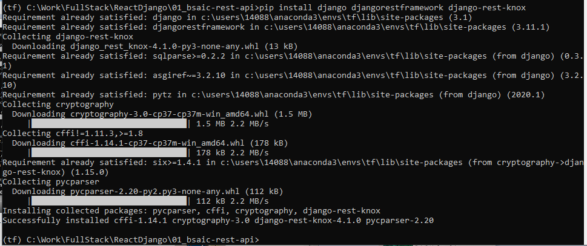
1.1 Environment Setup
https://www.youtube.com/watch?v=Uyei2iDA4Hs&list=PLillGF-RfqbbRA-CIUxlxkUpbq0IFkX60
Environment Setup
> pip install django djangorestframework django-rest-knox

Slide 12
1.2 Create Django Project

Slide 13
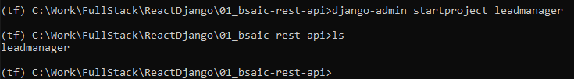
1.2 Create Django Project
https://www.youtube.com/watch?v=Uyei2iDA4Hs&list=PLillGF-RfqbbRA-CIUxlxkUpbq0IFkX60
Create Django Project
> django-admin startproject leadmanager

Slide 14
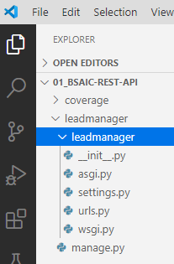
1.2 Create Django Project
https://www.youtube.com/watch?v=Uyei2iDA4Hs&list=PLillGF-RfqbbRA-CIUxlxkUpbq0IFkX60
Create Django Project
Django-admin create leadmanager with manage.py.
The manage.py is like the CLI for Django.
We can crate migration run the server all that stuff.

Slide 15
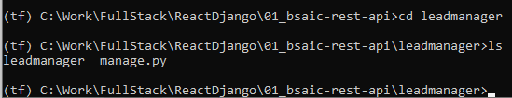
1.2 Create Django Project
https://www.youtube.com/watch?v=Uyei2iDA4Hs&list=PLillGF-RfqbbRA-CIUxlxkUpbq0IFkX60
Create Django Project
> cd leadmanager
> ls

Slide 16

1.2 Create Django Project
https://www.youtube.com/watch?v=Uyei2iDA4Hs&list=PLillGF-RfqbbRA-CIUxlxkUpbq0IFkX60
Create Django Project
> python manage.py startapp leads
> ls
Whatever you create a new app, you want to go into your core file.

Slide 17
1.3 Setting.py

Slide 18
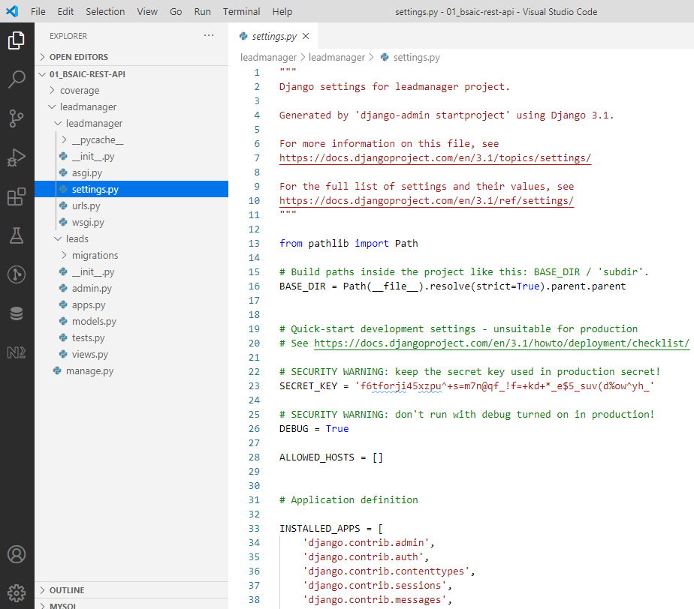
1.3 Setting.py
https://www.youtube.com/watch?v=Uyei2iDA4Hs&list=PLillGF-RfqbbRA-CIUxlxkUpbq0IFkX60
Setting.py
Check the setting.py file.

Slide 19
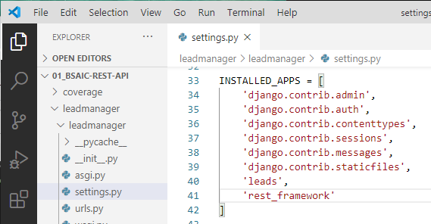
1.3 Setting.py
https://www.youtube.com/watch?v=Uyei2iDA4Hs&list=PLillGF-RfqbbRA-CIUxlxkUpbq0IFkX60
Setting.py
INSTALLED_APPS = [ …., ‘leads’, ‘rest_framework’]

Slide 20
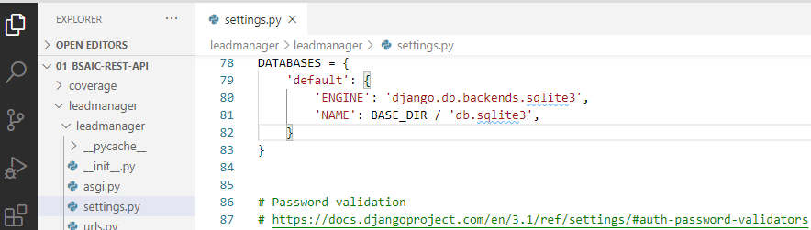
1.3 Setting.py
https://www.youtube.com/watch?v=Uyei2iDA4Hs&list=PLillGF-RfqbbRA-CIUxlxkUpbq0IFkX60
Setting.py
DATABASE = { ‘ENGINE’: ‘django.db.backends.sqlite3’, …}

Slide 21
1.4 Models.py

Slide 22
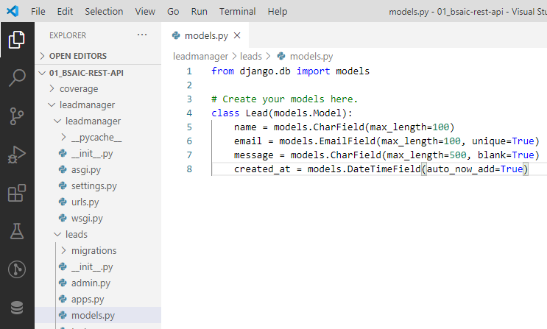
1.4 Models.py
https://www.youtube.com/watch?v=Uyei2iDA4Hs&list=PLillGF-RfqbbRA-CIUxlxkUpbq0IFkX60
Models.py

Slide 23
1.5 Migration

Slide 24
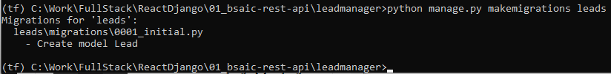
1.5 Migration
https://www.youtube.com/watch?v=Uyei2iDA4Hs&list=PLillGF-RfqbbRA-CIUxlxkUpbq0IFkX60
Migration
> python manage.py makemigrayion leads

Slide 25
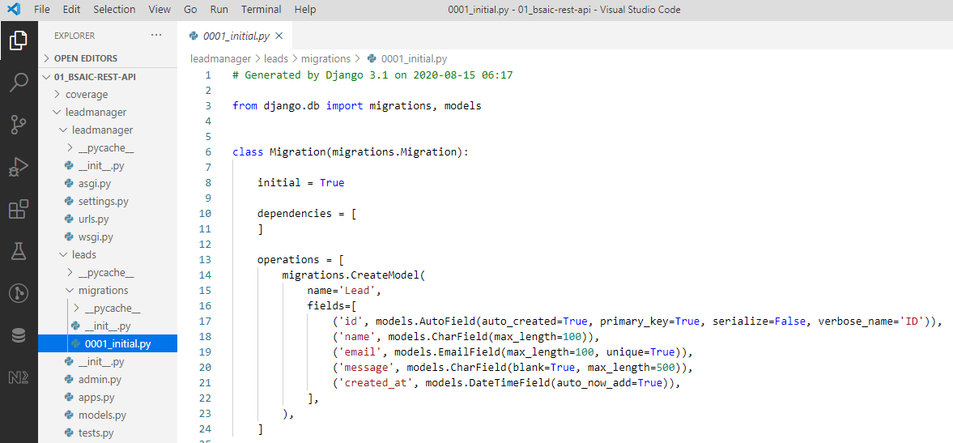
1.5 Migration
https://www.youtube.com/watch?v=Uyei2iDA4Hs&list=PLillGF-RfqbbRA-CIUxlxkUpbq0IFkX60
Migration
> leads\migration\0001_initial.py

Slide 26
1.6 Migrate

Slide 27
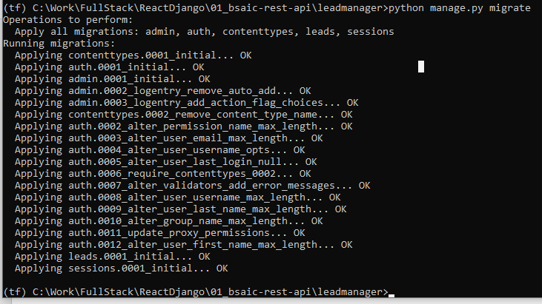
1.6 Migrate
https://www.youtube.com/watch?v=Uyei2iDA4Hs&list=PLillGF-RfqbbRA-CIUxlxkUpbq0IFkX60
Migrate
Create default tables, such as, users, permissions, and etc.
> python manage.py migrate

Slide 28
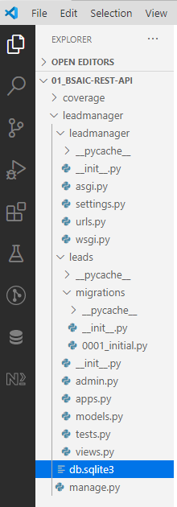
1.6 Migrate
https://www.youtube.com/watch?v=Uyei2iDA4Hs&list=PLillGF-RfqbbRA-CIUxlxkUpbq0IFkX60
Migrate
Now, we have generated the database.

Slide 29
1.7 REST API

Slide 30
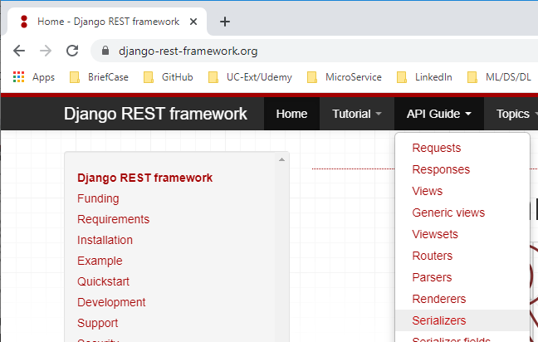
1.7 REST API
https://www.youtube.com/watch?v=Uyei2iDA4Hs&list=PLillGF-RfqbbRA-CIUxlxkUpbq0IFkX60
REST API
https://www.django-rest-framework.org/api-guide/serializers/
> API Guide > Serializers

Slide 31
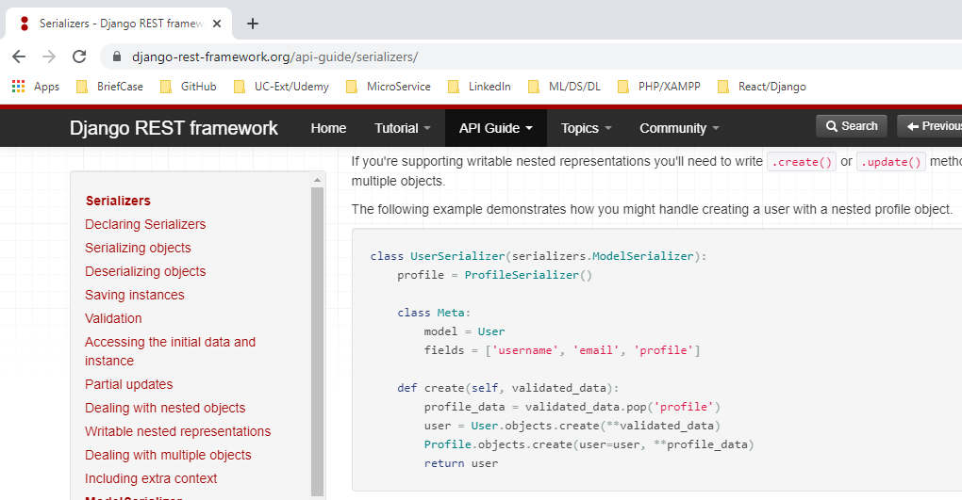
1.7 REST API
https://www.youtube.com/watch?v=Uyei2iDA4Hs&list=PLillGF-RfqbbRA-CIUxlxkUpbq0IFkX60
REST API
https://www.django-rest-framework.org/api-guide/serializers/
> class UserSerializer (serializers.ModelSerializre):

Slide 32
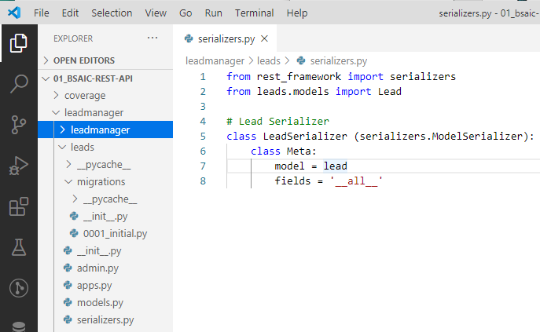
1.7 REST API
https://www.youtube.com/watch?v=Uyei2iDA4Hs&list=PLillGF-RfqbbRA-CIUxlxkUpbq0IFkX60
REST API
https://www.django-rest-framework.org/api-guide/serializers/
>seralizers.py

Slide 33
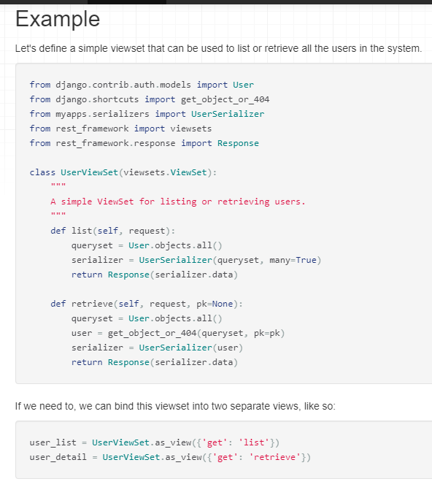
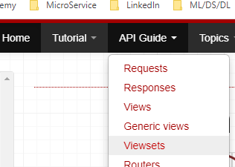
1.7 REST API
https://www.youtube.com/watch?v=Uyei2iDA4Hs&list=PLillGF-RfqbbRA-CIUxlxkUpbq0IFkX60
REST API
https://www.django-rest-framework.org/api-guide/serializers/
> API Guide > Viewsets

Slide 34
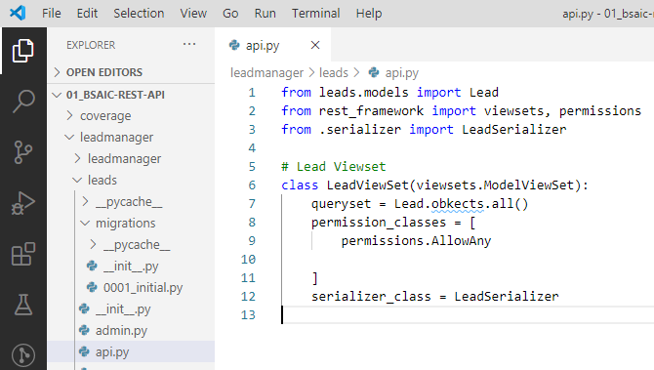
1.7 REST API
https://www.youtube.com/watch?v=Uyei2iDA4Hs&list=PLillGF-RfqbbRA-CIUxlxkUpbq0IFkX60
REST API
https://www.django-rest-framework.org/api-guide/serializers/
> API Guide > Viewsets

Slide 35
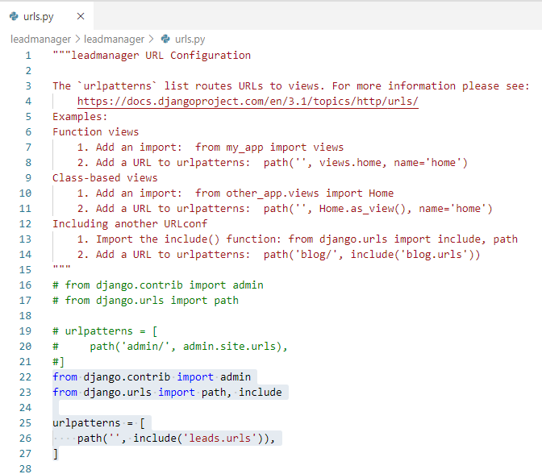
1.7 REST API
https://www.youtube.com/watch?v=Uyei2iDA4Hs&list=PLillGF-RfqbbRA-CIUxlxkUpbq0IFkX60
REST API
https://www.django-rest-framework.org/api-guide/serializers/
> /leadmanager/urls.py

Slide 36
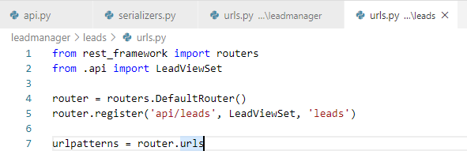
1.7 REST API
https://www.youtube.com/watch?v=Uyei2iDA4Hs&list=PLillGF-RfqbbRA-CIUxlxkUpbq0IFkX60
REST API
https://www.django-rest-framework.org/api-guide/serializers/
> /leadmanager/leads/urls.py

Slide 37
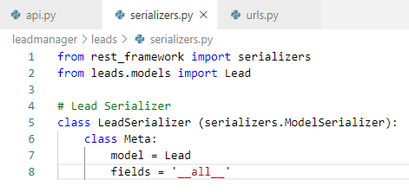
1.7 REST API
https://www.youtube.com/watch?v=Uyei2iDA4Hs&list=PLillGF-RfqbbRA-CIUxlxkUpbq0IFkX60
REST API
https://www.django-rest-framework.org/api-guide/serializers/
> serializers.py

Slide 38
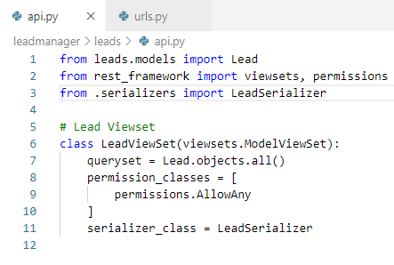
1.7 REST API
https://www.youtube.com/watch?v=Uyei2iDA4Hs&list=PLillGF-RfqbbRA-CIUxlxkUpbq0IFkX60
REST API
https://www.django-rest-framework.org/api-guide/serializers/
> api.py

Slide 39
1.8 Run Server

Slide 40
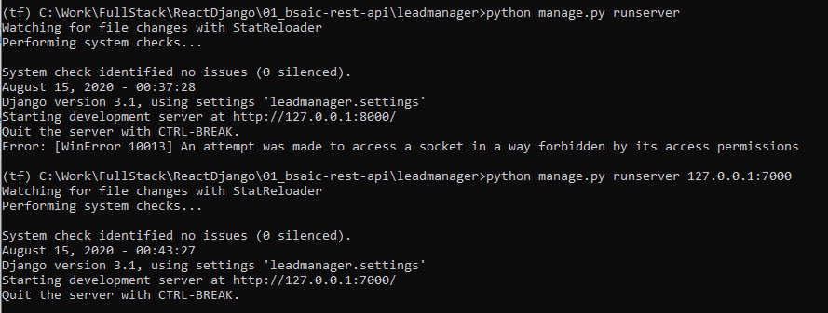
1.8 Run Server
https://www.youtube.com/watch?v=Uyei2iDA4Hs&list=PLillGF-RfqbbRA-CIUxlxkUpbq0IFkX60
Run Server
> python manage.py runserver 127.0.0.1:7000

Slide 41
1.9 Postman Setup

Slide 42
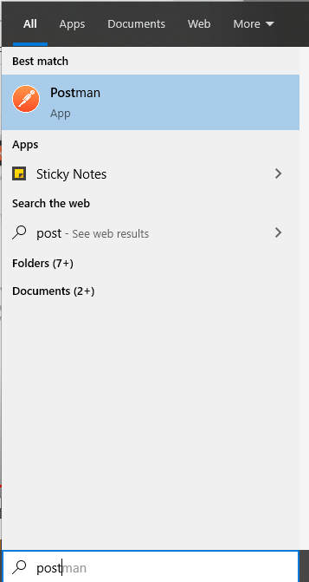
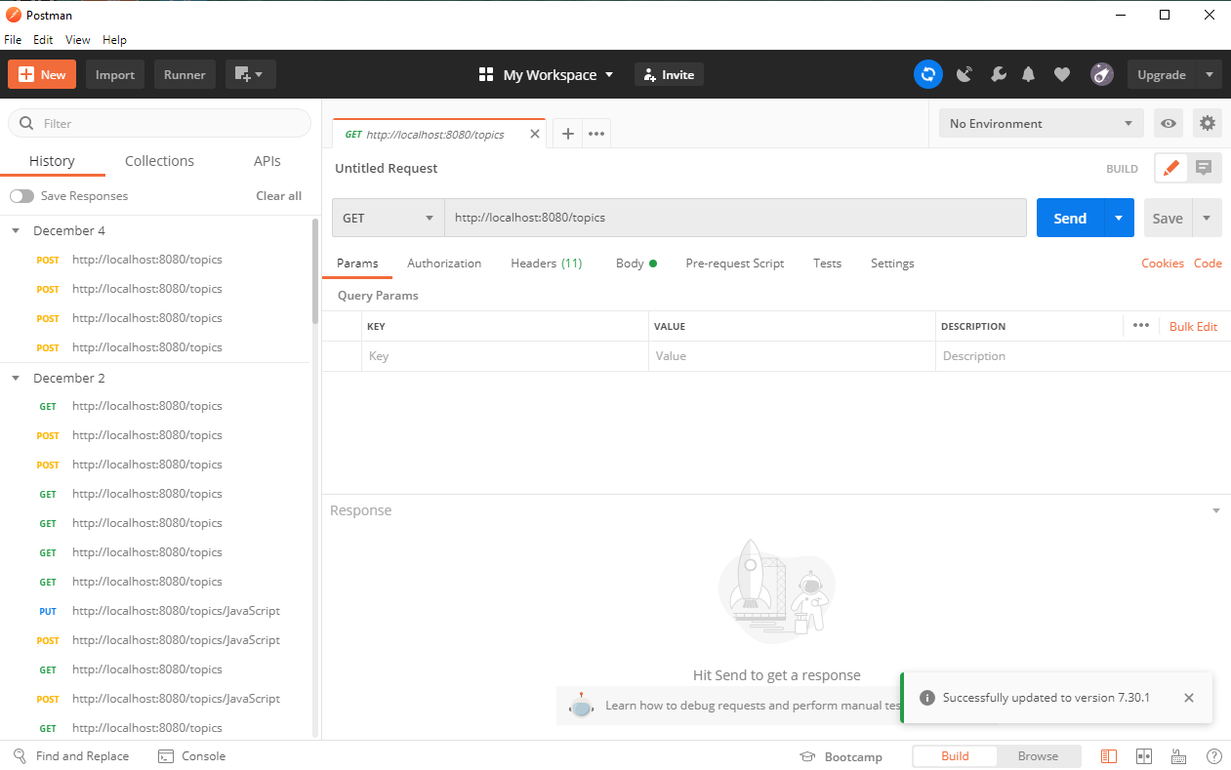
1.9 Postman Setup
https://www.youtube.com/watch?v=Uyei2iDA4Hs&list=PLillGF-RfqbbRA-CIUxlxkUpbq0IFkX60
Postman Setup
Start Postman

Slide 43
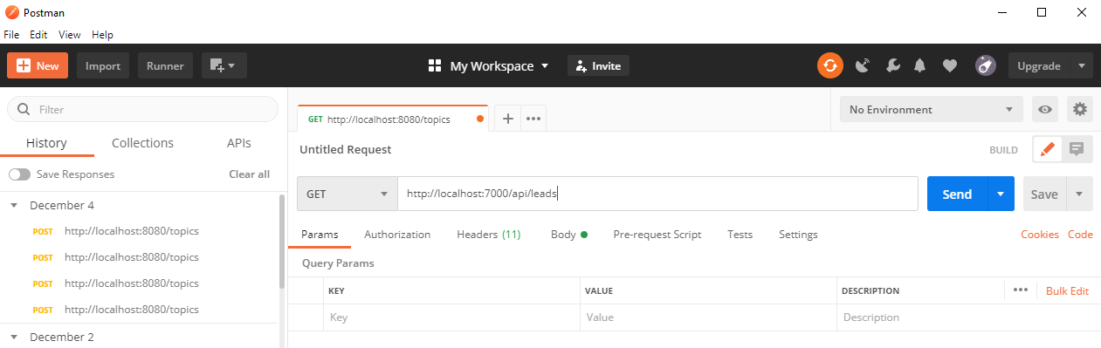
1.9 Postman Setup
https://www.youtube.com/watch?v=Uyei2iDA4Hs&list=PLillGF-RfqbbRA-CIUxlxkUpbq0IFkX60
Postman Setup
Select “GET” and “http://localhost:7000/api/leads

Slide 44
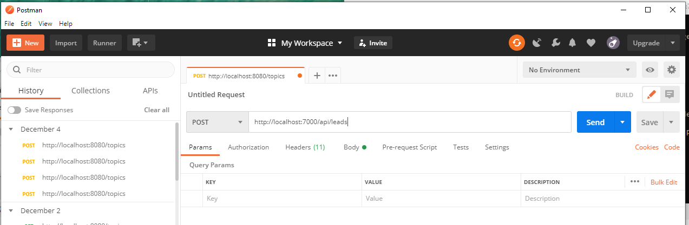
1.9 Postman Setup
https://www.youtube.com/watch?v=Uyei2iDA4Hs&list=PLillGF-RfqbbRA-CIUxlxkUpbq0IFkX60
Run Server
Select “POST” and “http://localhost:7000/api/leads

Slide 45
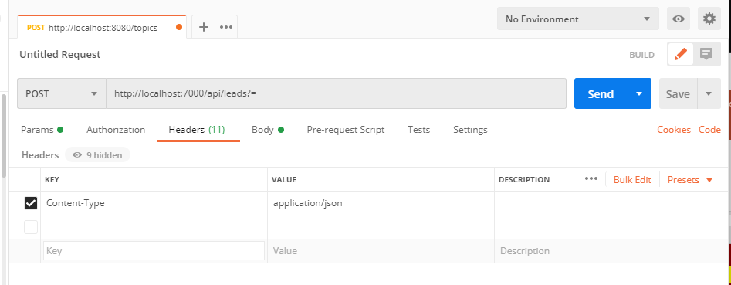
1.9 Postman Setup
https://www.youtube.com/watch?v=Uyei2iDA4Hs&list=PLillGF-RfqbbRA-CIUxlxkUpbq0IFkX60
Run Server
Select “Headers”, KEY: content-Type, VALUE: application/json

Slide 46
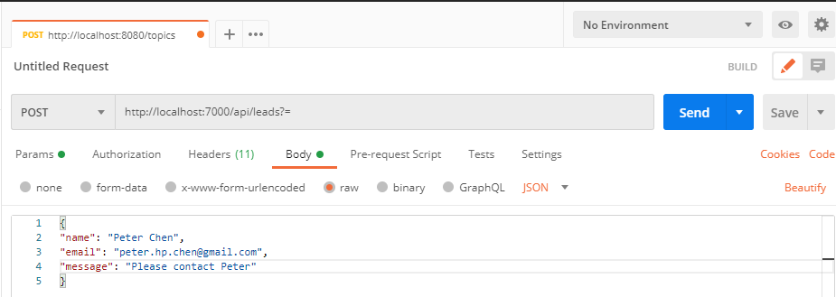
1.9 Postman Setup
https://www.youtube.com/watch?v=Uyei2iDA4Hs&list=PLillGF-RfqbbRA-CIUxlxkUpbq0IFkX60
Run Server
Select “Body”,
{ “name”: “Peter Chen”,
“email”: “peter.hp.chen@gmail.com”
“message”: “Please contact Peter”
}

Slide 47
1.10 Send POST

Slide 48
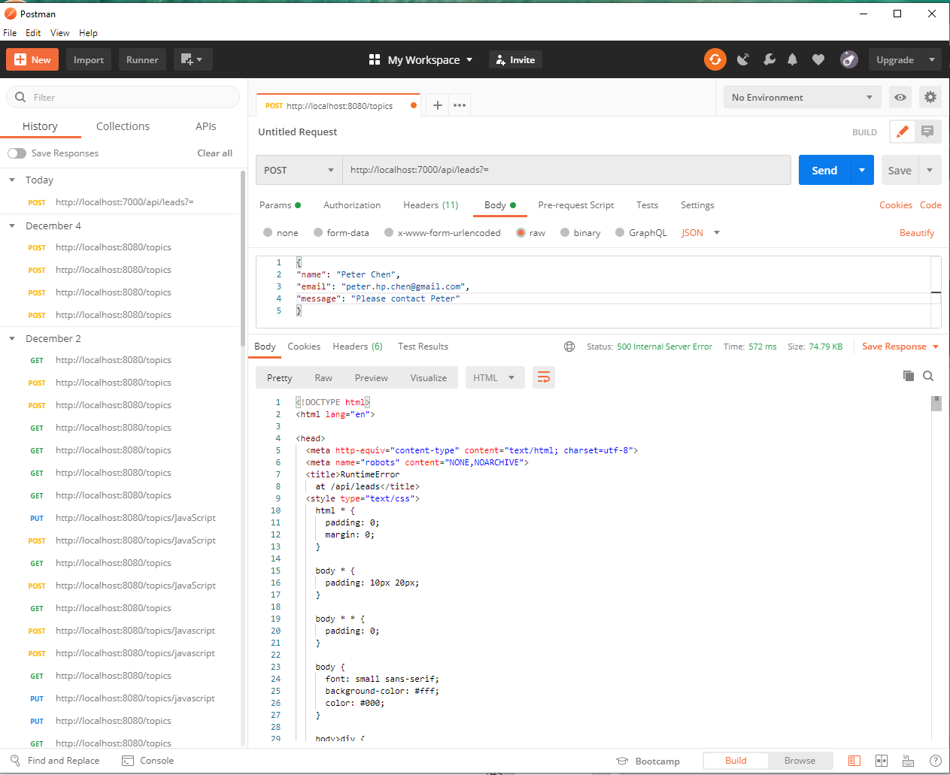
1.10 Send POST
https://www.youtube.com/watch?v=Uyei2iDA4Hs&list=PLillGF-RfqbbRA-CIUxlxkUpbq0IFkX60
Send POST
Click “Send”.
We have 500 Error back

Slide 49
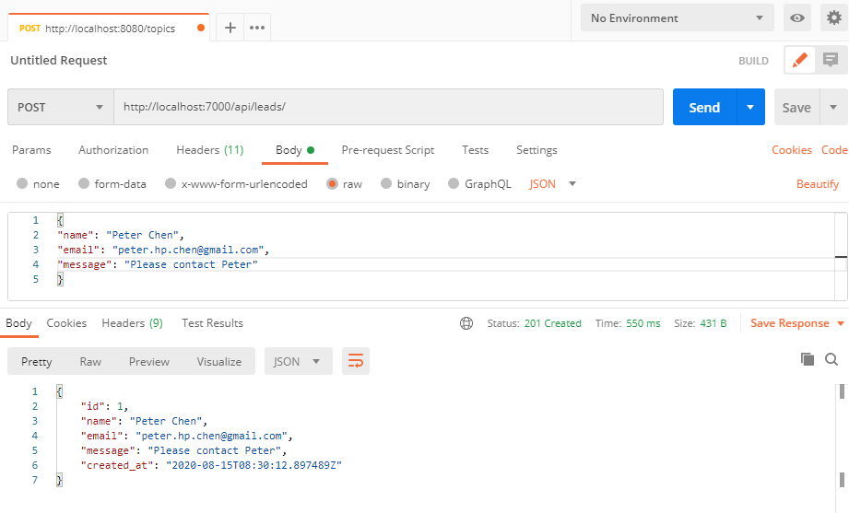
1.10 Send POST
https://www.youtube.com/watch?v=Uyei2iDA4Hs&list=PLillGF-RfqbbRA-CIUxlxkUpbq0IFkX60
Send POST
POST, http//localhost:7000/api/leads/
Add “/” after “leads”. Click “Send” and get the “201” Created.

Slide 50
1.10 Send POST
https://www.youtube.com/watch?v=Uyei2iDA4Hs&list=PLillGF-RfqbbRA-CIUxlxkUpbq0IFkX60
Send POST
We have “created_at”: “…” in send out.

Slide 51
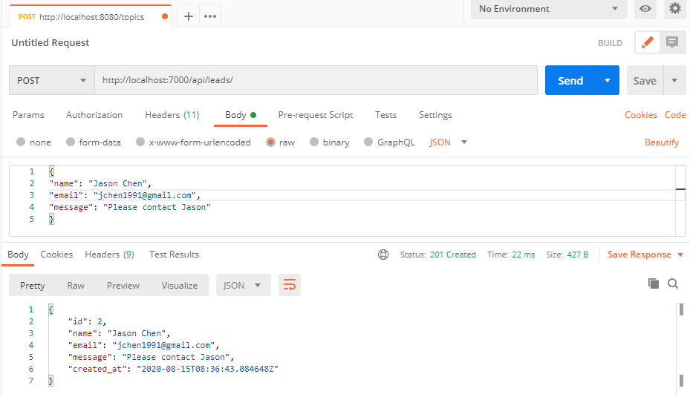
1.10 Send POST
https://www.youtube.com/watch?v=Uyei2iDA4Hs&list=PLillGF-RfqbbRA-CIUxlxkUpbq0IFkX60
Run Server
We add another name, email, and message and click “Send”

Slide 52
1.11 Send GET

Slide 53
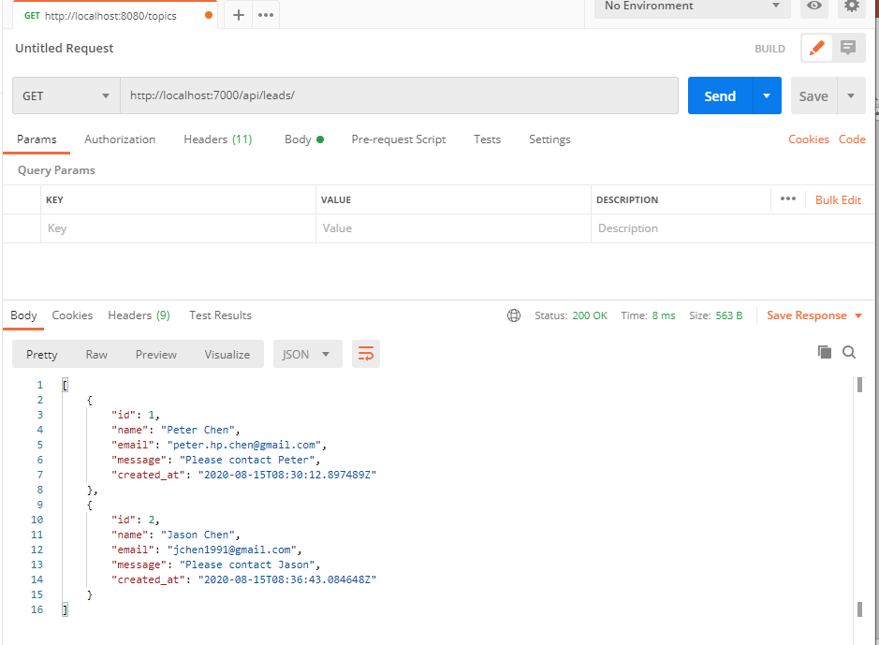
1.11 Send GET
https://www.youtube.com/watch?v=Uyei2iDA4Hs&list=PLillGF-RfqbbRA-CIUxlxkUpbq0IFkX60
Send GET
Select “GET” and “http://localhost:7000/api/leads/” and click “Send”.

Slide 54
1.11 Send GET
https://www.youtube.com/watch?v=Uyei2iDA4Hs&list=PLillGF-RfqbbRA-CIUxlxkUpbq0IFkX60
Send GET
The ids are automatically assigned.

Slide 55
1.12 Send GET with id

Slide 56
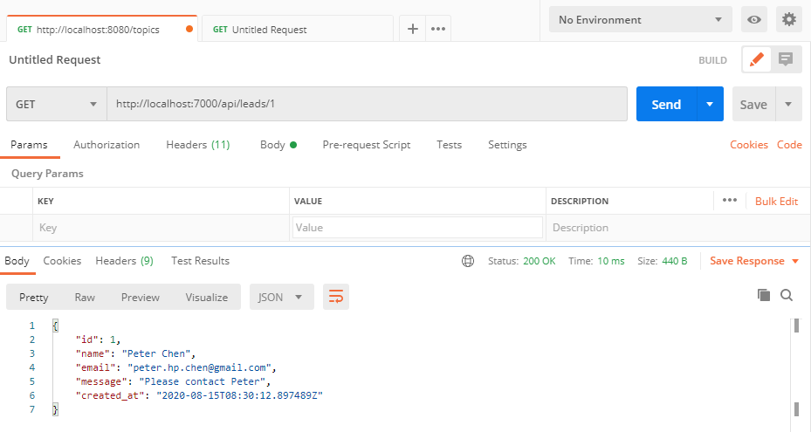
1.12 Send GET with id
https://www.youtube.com/watch?v=Uyei2iDA4Hs&list=PLillGF-RfqbbRA-CIUxlxkUpbq0IFkX60
Send GET with id
GET and “http/localhost:7000/api/leads/1”

Slide 57
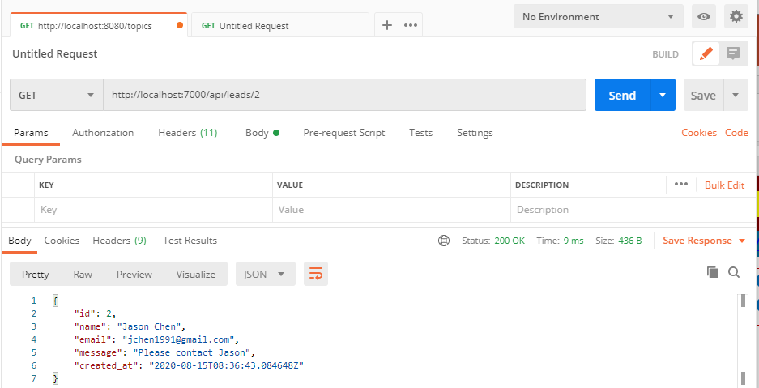
1.12 Send GET with id
https://www.youtube.com/watch?v=Uyei2iDA4Hs&list=PLillGF-RfqbbRA-CIUxlxkUpbq0IFkX60
Send GET with id
GET and “http/localhost:7000/api/leads/2”

Slide 58
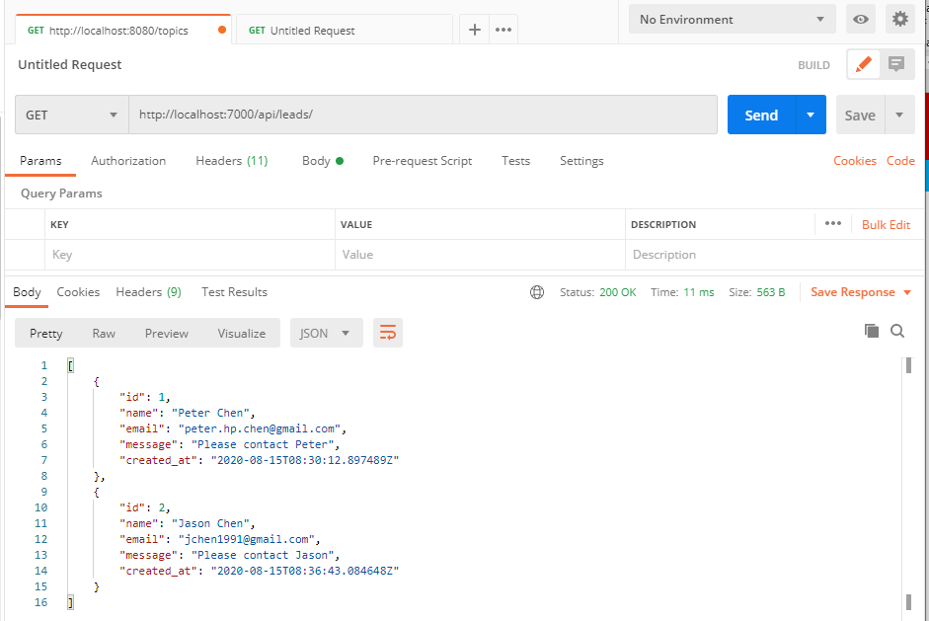
1.12 Send GET with id
https://www.youtube.com/watch?v=Uyei2iDA4Hs&list=PLillGF-RfqbbRA-CIUxlxkUpbq0IFkX60
Send GET with id
GET and “http/localhost:7000/api/leads/” (without IDs)

Slide 59
1.13 DELETE with IDs

Slide 60
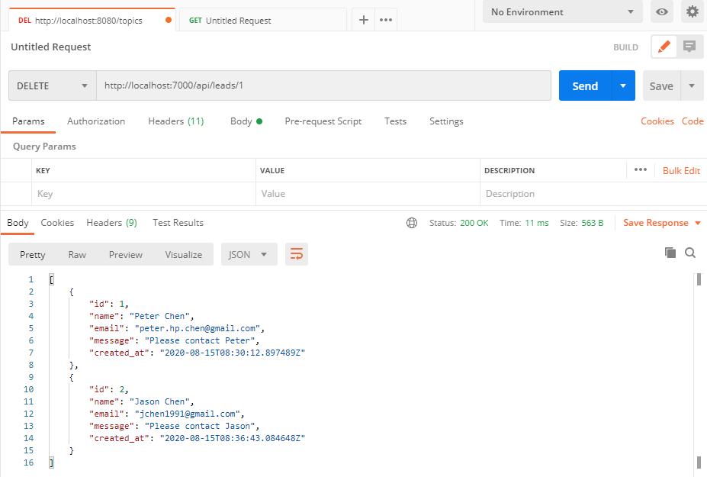
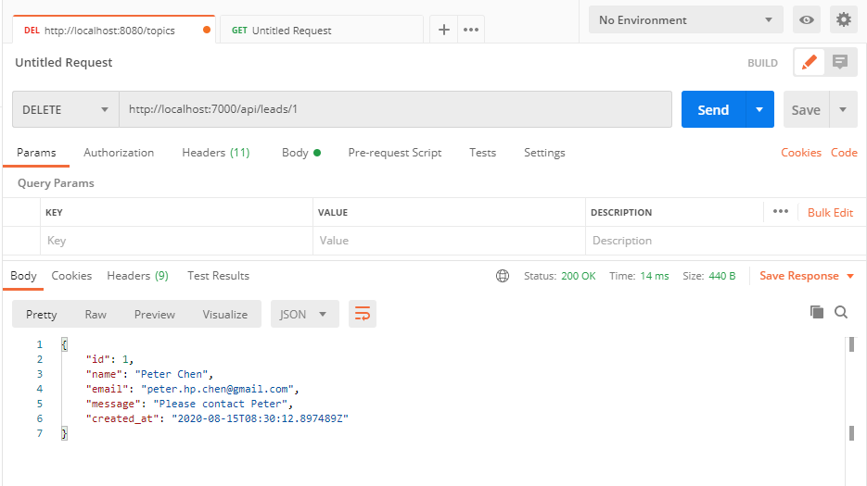
1.13 DELETE with IDs
https://www.youtube.com/watch?v=Uyei2iDA4Hs&list=PLillGF-RfqbbRA-CIUxlxkUpbq0IFkX60
Send DELETE with id
Select DELETE and “http/localhost:7000/api/leads/1” (with ID)

Slide 61
1.13 DELETE with IDs
https://www.youtube.com/watch?v=Uyei2iDA4Hs&list=PLillGF-RfqbbRA-CIUxlxkUpbq0IFkX60
Working Folder
C:\Work\FullStack\ReactDjango\01_bsaic-rest-api\leadmanager>python manage.py runserver 127.0.0.1:7000

Slide 62
End of Chapter

