Slide 1

2 Implement React
Peter H. Chen

Slide 2
2 Implement React
https://www.youtube.com/watch?v=GieYIzvdt2U&list=PLillGF-RfqbbRA-CIUxlxkUpbq0IFkX60&index=2
Implement React
We implement Django in the last discussion, now, we want to implement React.
We will create manually. We will not use command create-react-app.
Because we are integrating React into Django, we are going to create a frontend app. Django has the concept of app. Inside the Django, we are going to have the index.html.
We will have the index.html as a template and that is the entry point for React.
We have an index.js which will ne the entry point for the JavaScript and then index.js will point to a main app component that will get loaded.
We need to install webpack and babel. Babel take care of transpiling of our code.
So anything that you know newer features of JavaScript that React uses and then we also install a react preset as well.
So there is quite a bit there.

Slide 3
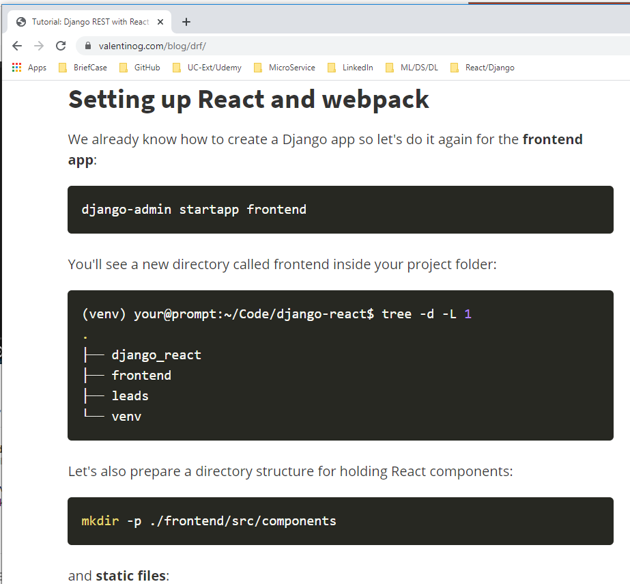
2 Implement React
https://www.youtube.com/watch?v=GieYIzvdt2U&list=PLillGF-RfqbbRA-CIUxlxkUpbq0IFkX60&index=2
Django REST with React
https://www.valentinog.com/blog/drf/

Slide 4
2.1 Create App

Slide 5
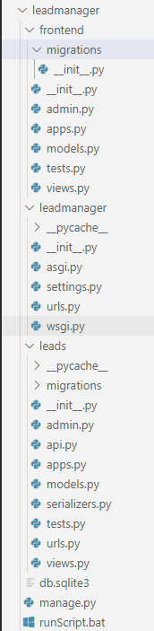
2.1 Create App
https://www.youtube.com/watch?v=GieYIzvdt2U&list=PLillGF-RfqbbRA-CIUxlxkUpbq0IFkX60&index=2
Create App
(tf) …\leadmanagere> python manage.py startapp frontend

Slide 6

2.1 Create App
https://www.youtube.com/watch?v=GieYIzvdt2U&list=PLillGF-RfqbbRA-CIUxlxkUpbq0IFkX60&index=2
Create App
We will create several directories for React.
> mkdir -p .\frontend\src\components
> mkdir -p .\frontend\static\frontend
> mkdir -p .\frontend\templates\frontend

Slide 7
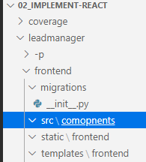
2.1 Create App
https://www.youtube.com/watch?v=GieYIzvdt2U&list=PLillGF-RfqbbRA-CIUxlxkUpbq0IFkX60&index=2
Create App
View the frontend folder with
> src/components: The frontend source code put in src/components
> static/frontend and templates/frontend: The source is where all the components of redux put here
> templates/frontend: The React index.html file. This is for SPA (Single Page Application).
> static/frontend: The static are compiled JavaScript.
We will have webpack take our React application from src/components. We will have index.js as an entry point. It is going to compile down to a file called main.js inside the static folder. If you use create-react-app, you can put all files put in the static folder.
We will install webpack.

Slide 8
2.2 Install Webpack

Slide 9
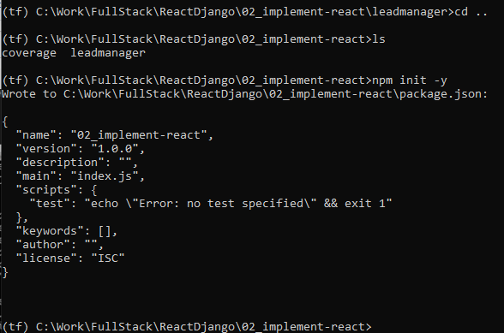
2.2 Install Webpack
https://www.youtube.com/watch?v=GieYIzvdt2U&list=PLillGF-RfqbbRA-CIUxlxkUpbq0IFkX60&index=2
Install Webpack
> cd ..
> ls
We are in the top of the loadmanager project.
> npm init -y

Slide 10
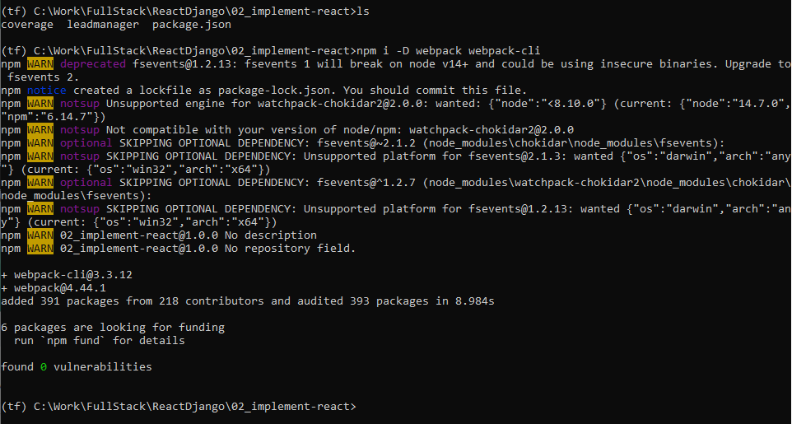
2.2 Install Webpack
https://www.youtube.com/watch?v=GieYIzvdt2U&list=PLillGF-RfqbbRA-CIUxlxkUpbq0IFkX60&index=2
Install Webpack
> ls
> npm i –D webpack webpack-cli
Note:
i:Install, -D: Developer dependencies

Slide 11
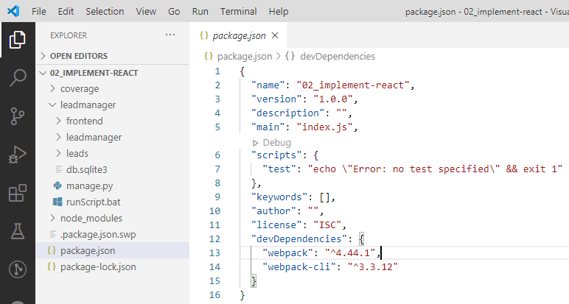
2.2 Install Webpack
https://www.youtube.com/watch?v=GieYIzvdt2U&list=PLillGF-RfqbbRA-CIUxlxkUpbq0IFkX60&index=2
Install Webpack
Check dependencies in package.json

Slide 12
2.3 Install Babel

Slide 13
2.3 Install Babel
https://www.youtube.com/watch?v=GieYIzvdt2U&list=PLillGF-RfqbbRA-CIUxlxkUpbq0IFkX60&index=2
Install Babel
Next, we want ot install Babel.
Babel is used to transpile the ES7 into JavaScript.
We also are going to install React preset.
We want to install
1. Babel/core package
2. We install babel loader for webpack and transpiler from ES7 to JavaScript.
3. We install preset for preset-env, present-react, and plugin-transform-class-properties

Slide 14
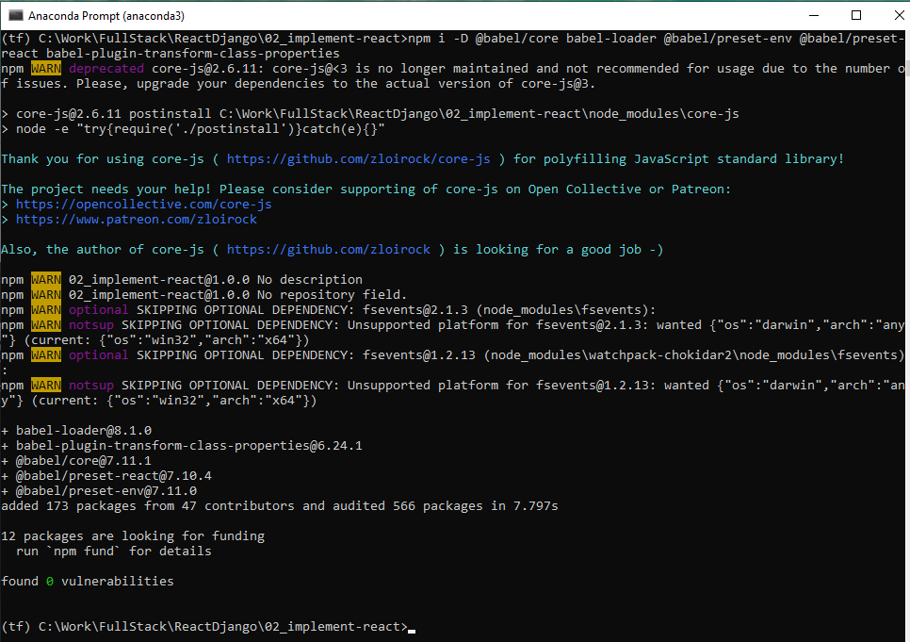
2.3 Install Babel
https://www.youtube.com/watch?v=GieYIzvdt2U&list=PLillGF-RfqbbRA-CIUxlxkUpbq0IFkX60&index=2
Install Babel
> npm i –D @babel/core babel-loader \
@babel/preset-env @babel/preset-react @babel/preset-react \
babel-plugin-transform-class-properties
D: Developer Dependencies.

Slide 15
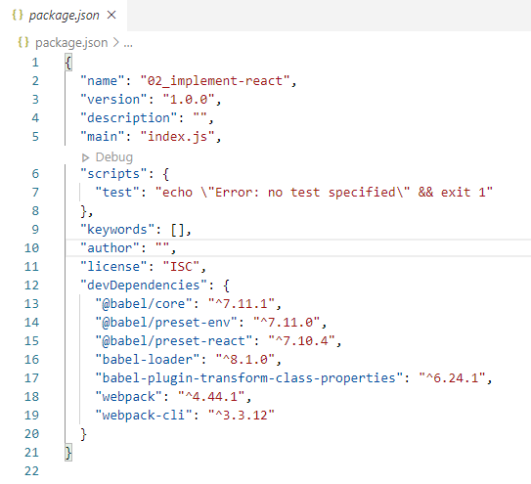
2.3 Install Babel
https://www.youtube.com/watch?v=GieYIzvdt2U&list=PLillGF-RfqbbRA-CIUxlxkUpbq0IFkX60&index=2
Install Babel
Babel: core, preset, loader, plugin-transform-class-properties

Slide 16
2.4 Install React/React-dom

Slide 17
2.4 Install React/React-dom
https://www.youtube.com/watch?v=GieYIzvdt2U&list=PLillGF-RfqbbRA-CIUxlxkUpbq0IFkX60&index=2
Install React/React-dom
We need to install react.
Note:
React: GUI component
react-dom: Libraries to display application in browser and DOM (Document Object Model)
prop-types: property types.

Slide 18
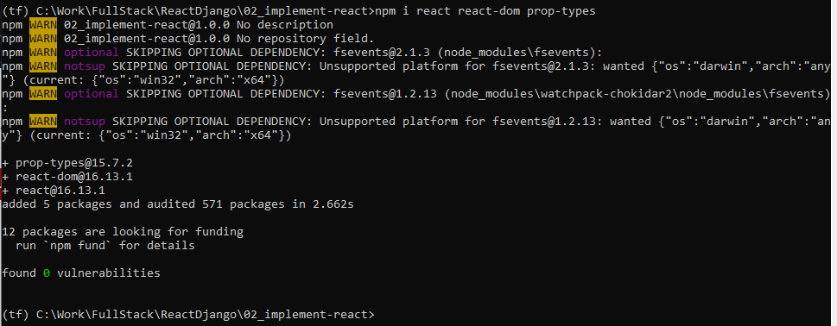
2.4 Install React/React-dom
https://www.youtube.com/watch?v=GieYIzvdt2U&list=PLillGF-RfqbbRA-CIUxlxkUpbq0IFkX60&index=2
Install React/React-dom
> npm i react react-dom prop-types

Slide 19
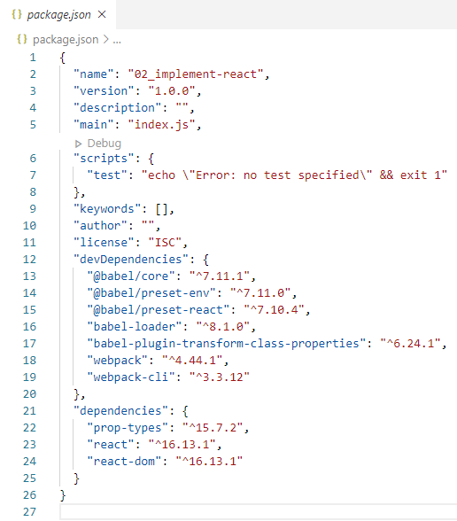
2.4 Install React/React-dom
https://www.youtube.com/watch?v=GieYIzvdt2U&list=PLillGF-RfqbbRA-CIUxlxkUpbq0IFkX60&index=2
Preset:
Plugin are used to create a file in the root. Here we called .babel-plugin-transform-class-properties.
Install React/React-dom
Check the react, react-dom, and prop-types in package.json.

Slide 20
2.5 Create .babelrc

Slide 21
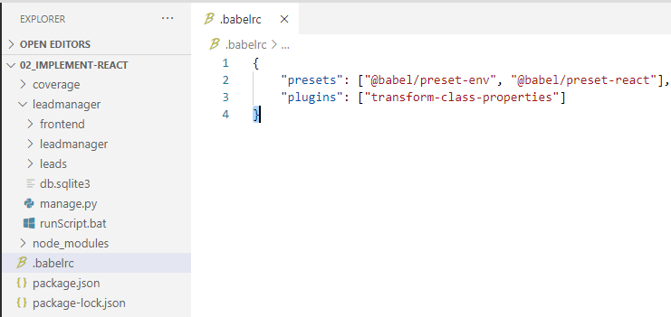
2.5 Create .babelrc
https://www.youtube.com/watch?v=GieYIzvdt2U&list=PLillGF-RfqbbRA-CIUxlxkUpbq0IFkX60&index=2
We create the .babelrc in the root.

Slide 22
2.6 Create .webpack.config.js

Slide 23
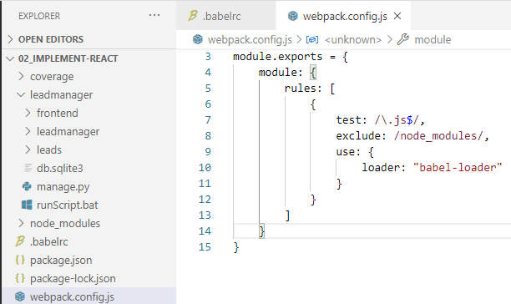
2.6 Create .webpack.config.js
https://www.youtube.com/watch?v=GieYIzvdt2U&list=PLillGF-RfqbbRA-CIUxlxkUpbq0IFkX60&index=2
We create the webpack.config.js in the root.
We want to load the babel loader.
test: Look at all the JavaSctipt .js files.
exclude: Take out the files in node_modules folder.
use:load the “babel-loader”

Slide 24
2.7 Transpile for Dev and Build

Slide 25
2.7 Transpile for Dev and Build
https://www.youtube.com/watch?v=GieYIzvdt2U&list=PLillGF-RfqbbRA-CIUxlxkUpbq0IFkX60&index=2
The babel will transpile the code. will compile the react application that lives in the frontend app.
Inside package.json, we want to have a couple scripts because we need to compile our react application that lives in front end app.

Slide 26
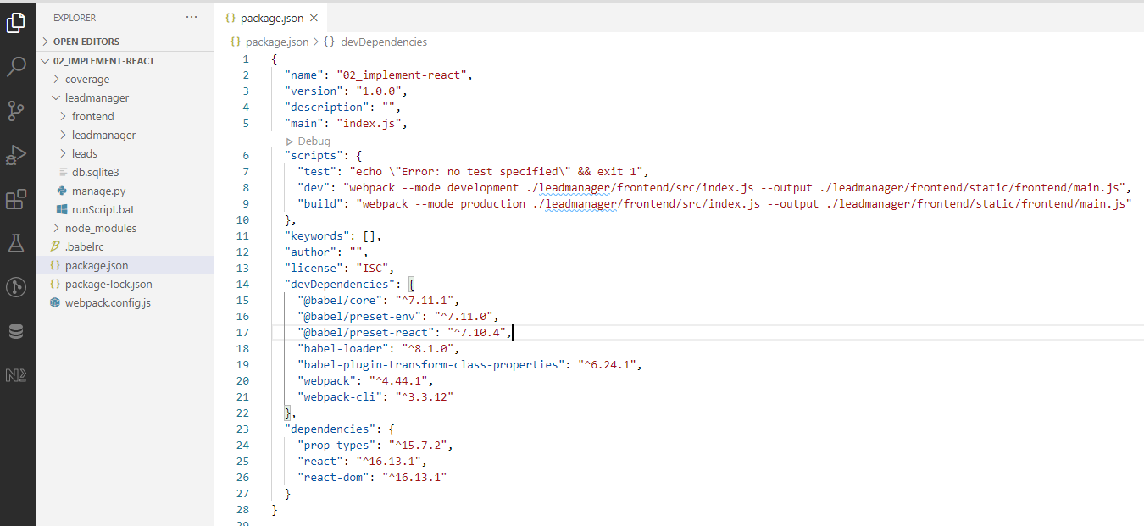
2.7 Transpile for Dev and Build
https://www.youtube.com/watch?v=GieYIzvdt2U&list=PLillGF-RfqbbRA-CIUxlxkUpbq0IFkX60&index=2
In our package.json, let’s replace the test script with
> “scripts”: {
> “dev”: “webpack --mode development ./leadmanager/frontend/src/index.js --output ./leadmanager/frontend/static/frontend/main.js“
> },
This will transpile the ES7 script and compile output into static folder.

Slide 27
2.7 Transpile for Dev and Build
https://www.youtube.com/watch?v=GieYIzvdt2U&list=PLillGF-RfqbbRA-CIUxlxkUpbq0IFkX60&index=2
In the “scripts” section inside the package.json, we need to have “dev” for development transpile and “build” for production transpile, respectively.
We can do “npm run build” just like we use crete-react-app.

Slide 28
2.8 Create index.js

Slide 29
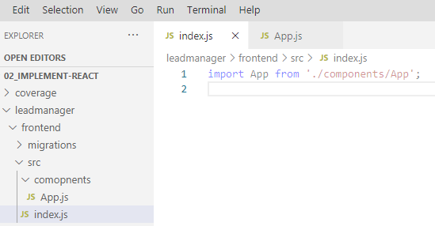
2.8 Create index.js
https://www.youtube.com/watch?v=GieYIzvdt2U&list=PLillGF-RfqbbRA-CIUxlxkUpbq0IFkX60&index=2
We need to create the index.js in the leadmanager/src folder.
The index.js is load the app component.
> import App from ‘./components/App’

Slide 30
2.9 Create App.js

Slide 31
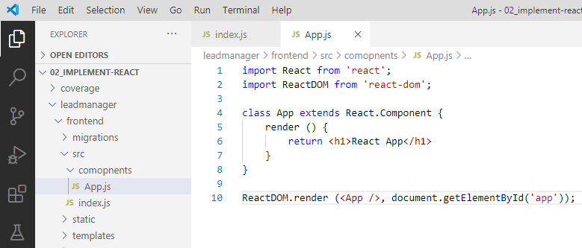
2.9 Create App.js
https://www.youtube.com/watch?v=GieYIzvdt2U&list=PLillGF-RfqbbRA-CIUxlxkUpbq0IFkX60&index=2
We need to create App.js in the components folder.
We need to get ‘app’ from templates folder.

Slide 32
2.10 Create index.html

Slide 33
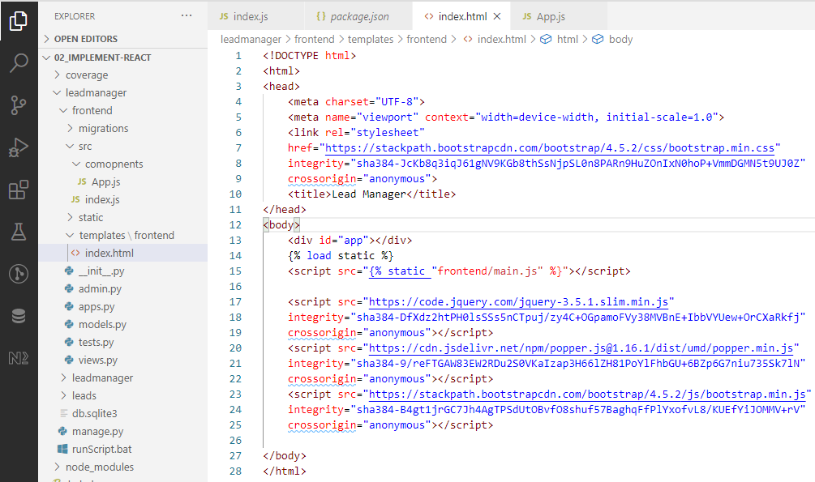
2.10 Create index.html
https://www.youtube.com/watch?v=GieYIzvdt2U&list=PLillGF-RfqbbRA-CIUxlxkUpbq0IFkX60&index=2
We need to create index.html in the templates/frontend/index.html
Add id=“app” and {% load static %} from transpile JavaScript.

Slide 34
2.11 Get Load index.html

Slide 35
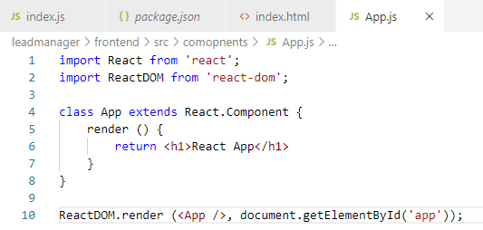
2.11 Get Load index.html
https://www.youtube.com/watch?v=GieYIzvdt2U&list=PLillGF-RfqbbRA-CIUxlxkUpbq0IFkX60&index=2
How do this actually get loaded?
We need to go to frontend/App.js

Slide 36
2.12 froentend/setting.py and urls.py

Slide 37
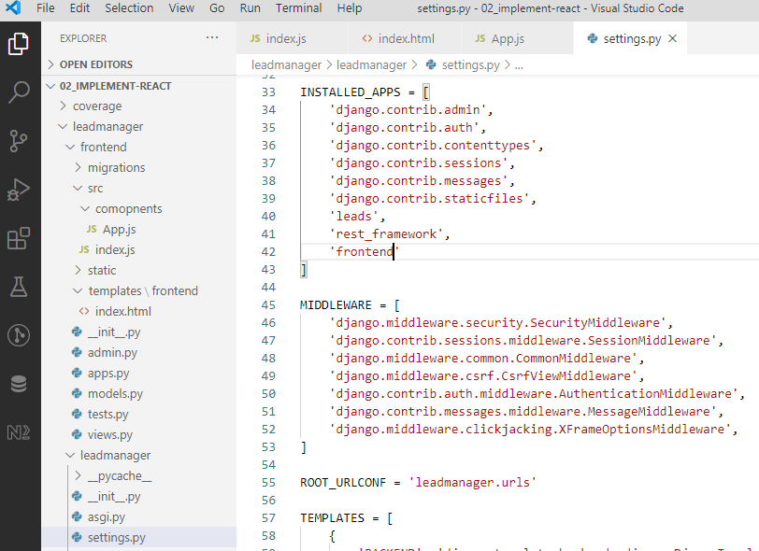
2.12 froentend/setting.py and urls.py
https://www.youtube.com/watch?v=GieYIzvdt2U&list=PLillGF-RfqbbRA-CIUxlxkUpbq0IFkX60&index=2
We need to add “frontend” for Django first.

Slide 38
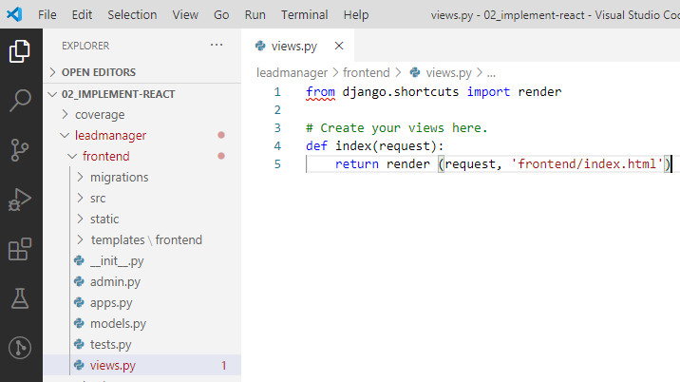
2.12 froentend/setting.py and urls.py
https://www.youtube.com/watch?v=GieYIzvdt2U&list=PLillGF-RfqbbRA-CIUxlxkUpbq0IFkX60&index=2
In the frontend/Views.py

Slide 39
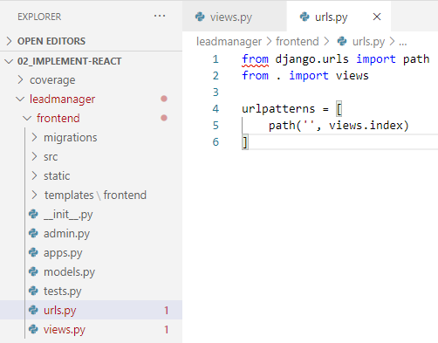
2.12 froentend/setting.py and urls.py
https://www.youtube.com/watch?v=GieYIzvdt2U&list=PLillGF-RfqbbRA-CIUxlxkUpbq0IFkX60&index=2
In the frontend/urls.py

Slide 40
2.13 leadmanager/setting.py and urls.py

Slide 41
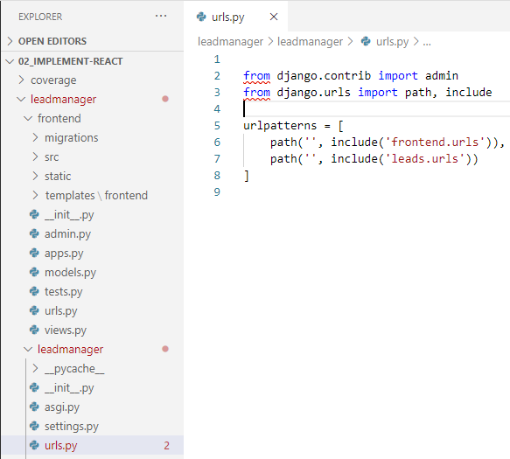
2.13 leadmanager/setting.py and urls.py
https://www.youtube.com/watch?v=GieYIzvdt2U&list=PLillGF-RfqbbRA-CIUxlxkUpbq0IFkX60&index=2
In the leadmanager/views.py and urls.py
We need to include frontend/views.py and urls.py into the main URLs file.
In the leadmanager/urls.py and views.py,

Slide 42
2.14 Compile

Slide 43

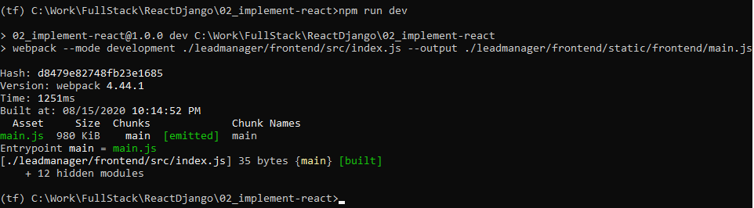
2.14 Compile
https://www.youtube.com/watch?v=GieYIzvdt2U&list=PLillGF-RfqbbRA-CIUxlxkUpbq0IFkX60&index=2
Compile
> ls
> npm run dev

Slide 44
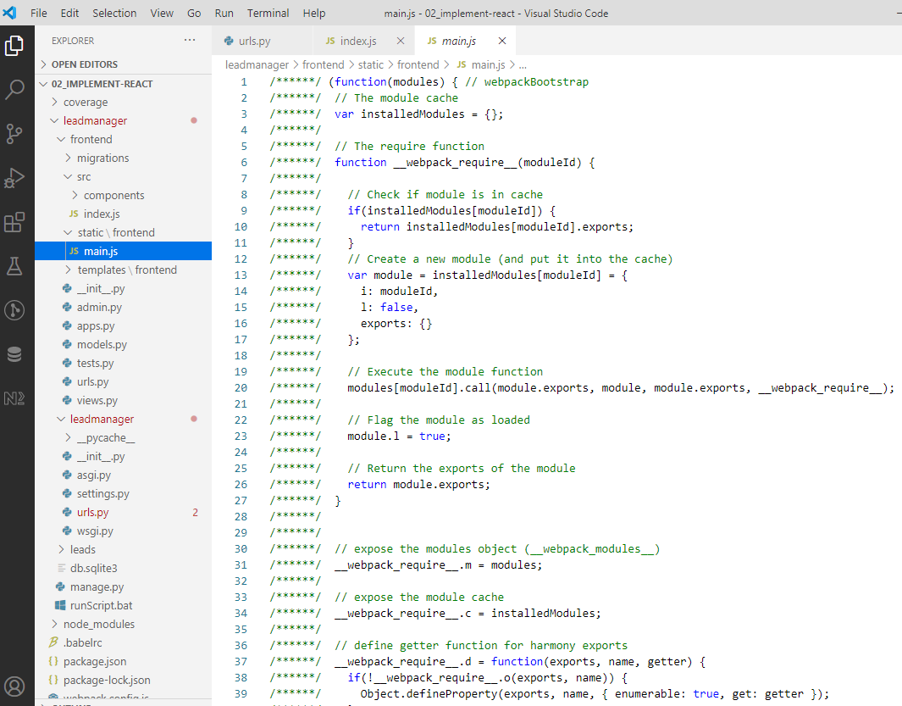
2.14 Compile
https://www.youtube.com/watch?v=GieYIzvdt2U&list=PLillGF-RfqbbRA-CIUxlxkUpbq0IFkX60&index=2
Now, we go to the frontend\static\frontend\main.js, we can find the compiled JavaScript file main.js.
The main.js is compiled from the templates\index.html.

Slide 45
2.15 Run Server and Open Client Chrome

Slide 46
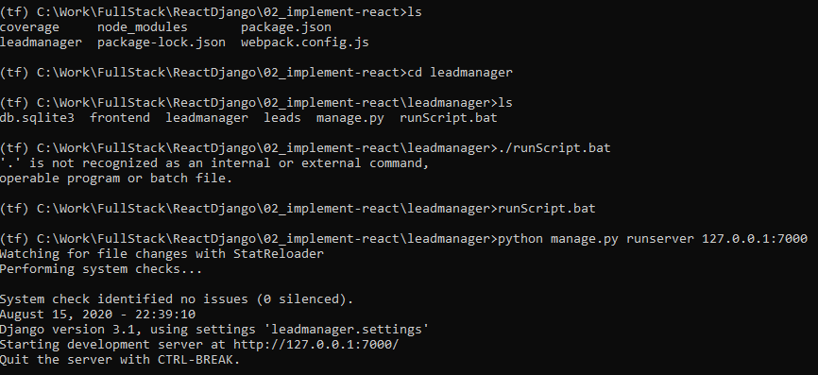
2.15 Run Server and Open Client Chrome
https://www.youtube.com/watch?v=GieYIzvdt2U&list=PLillGF-RfqbbRA-CIUxlxkUpbq0IFkX60&index=2
Run Server
> python rmanage.py run server

Slide 47
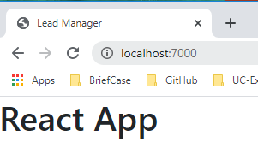
2.15 Run Server and Open Client Chrome
https://www.youtube.com/watch?v=GieYIzvdt2U&list=PLillGF-RfqbbRA-CIUxlxkUpbq0IFkX60&index=2
Open Chrome
> http://localhost:7000

Slide 48
2.16 Layout

Slide 49
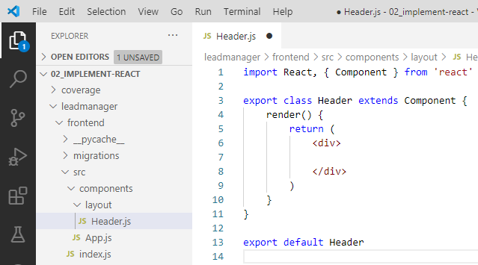
2.16 Layout
https://www.youtube.com/watch?v=GieYIzvdt2U&list=PLillGF-RfqbbRA-CIUxlxkUpbq0IFkX60&index=2
Layout
Now, the Django backend to React frontend are connected together.
We will do some enhancement before we do the complicated Redux.
In the frontend/src/components/layout/Header.js, type rce (React class ES7).

Slide 50
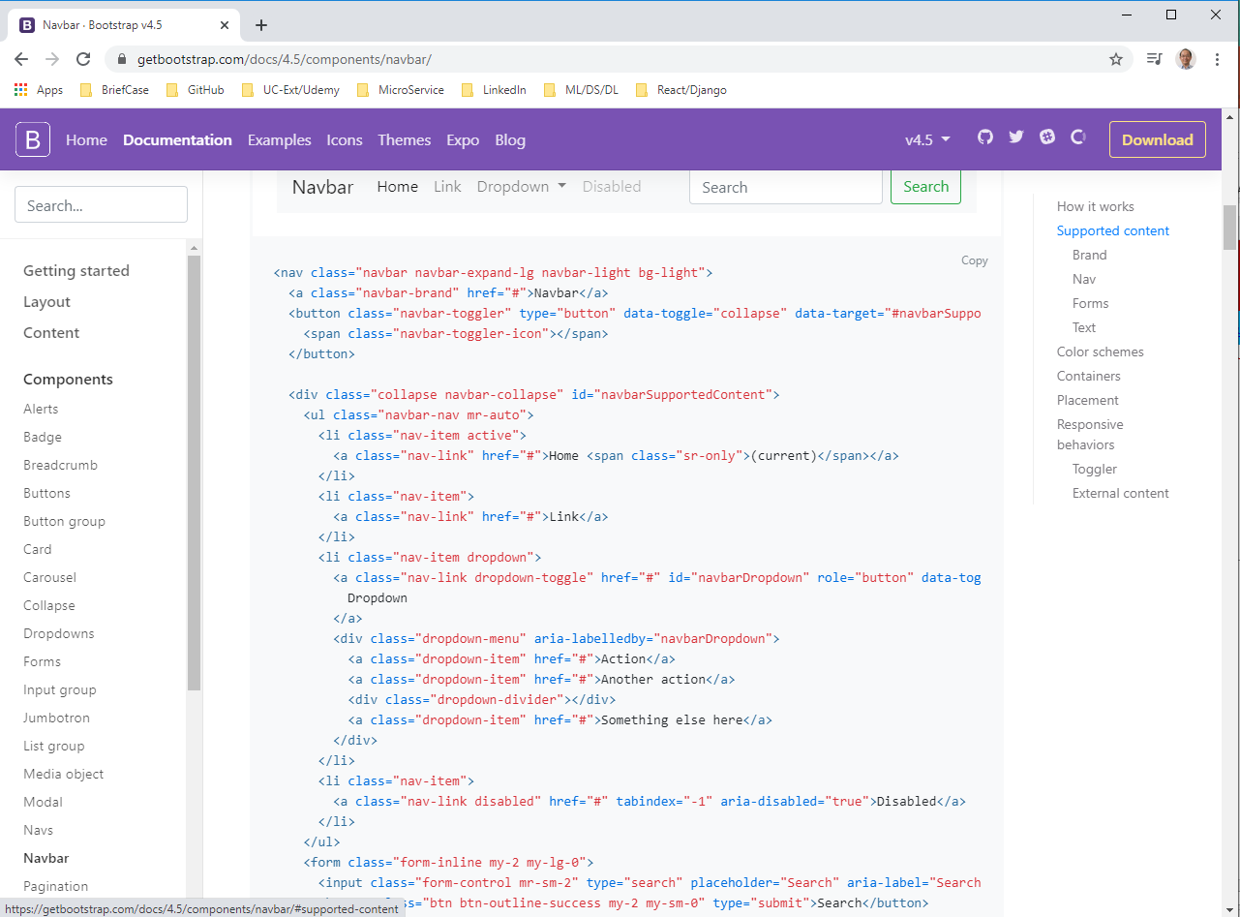
2.16 Layout
https://www.youtube.com/watch?v=GieYIzvdt2U&list=PLillGF-RfqbbRA-CIUxlxkUpbq0IFkX60&index=2
Layout
In the Header.js, add navbar.
In the bootstrap, search for “navbar”.
https://getbootstrap.com/docs/4.5/components/navbar/
Find Toggler Demo01 example. Copy <nav> … </nav> into <div>..</div> of the Header.js. Make sure no error.

Slide 51
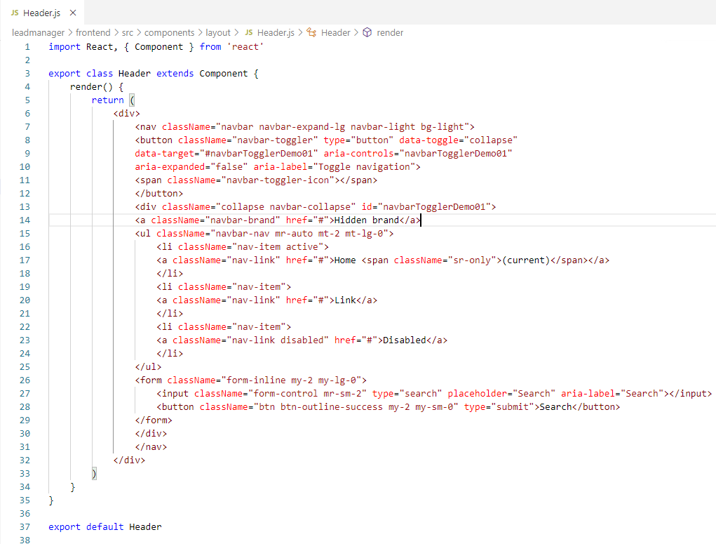
2.16 Layout
https://www.youtube.com/watch?v=GieYIzvdt2U&list=PLillGF-RfqbbRA-CIUxlxkUpbq0IFkX60&index=2
Layout
In React, we have to change the bootstrap <class> into <className>

Slide 52
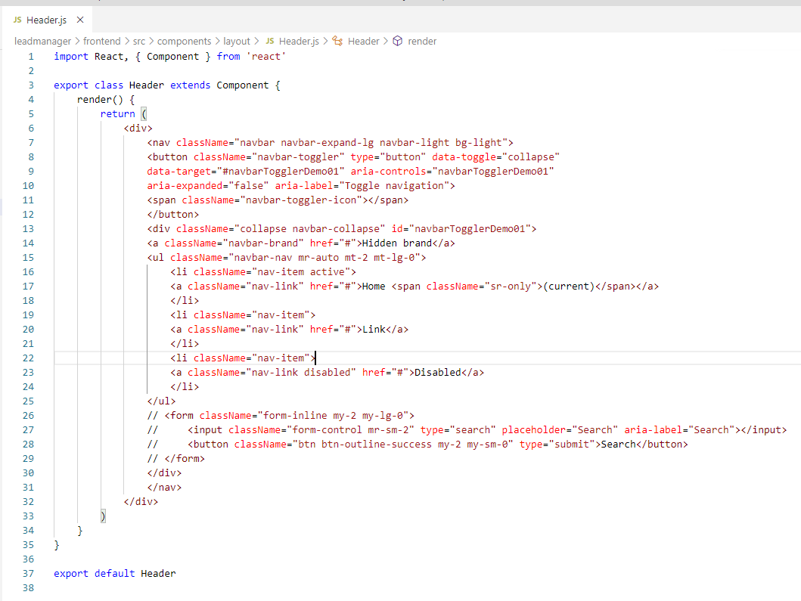
2.16 Layout
https://www.youtube.com/watch?v=GieYIzvdt2U&list=PLillGF-RfqbbRA-CIUxlxkUpbq0IFkX60&index=2
Layout
Remove the <form>…</form>

Slide 53
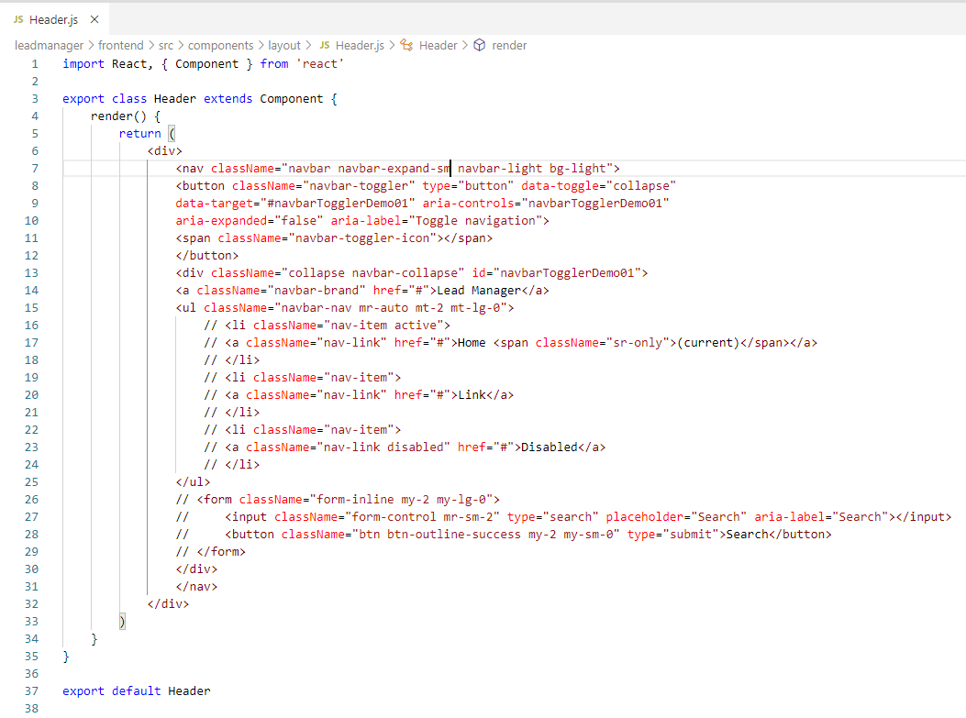
2.16 Layout
https://www.youtube.com/watch?v=GieYIzvdt2U&list=PLillGF-RfqbbRA-CIUxlxkUpbq0IFkX60&index=2
Layout
Change collapse brand to “Lead Manager”. Remove <li>…</li>. Change <lg> to <sm>.

Slide 54
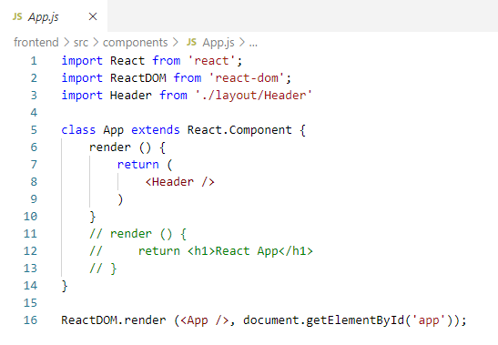
2.16 Layout
https://www.youtube.com/watch?v=GieYIzvdt2U&list=PLillGF-RfqbbRA-CIUxlxkUpbq0IFkX60&index=2
Layout
In App.js, import Header and render <Header />.

Slide 55
2.17 Compile and Run React

Slide 56
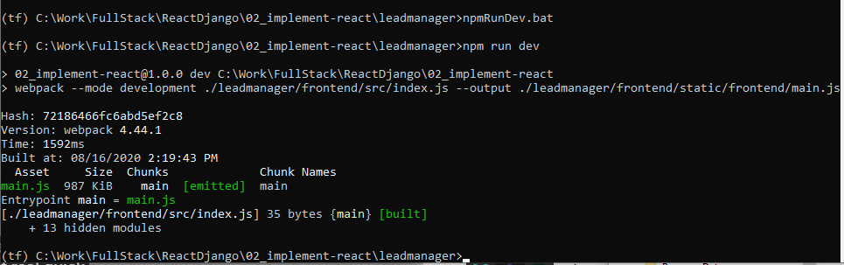
2.17 Compile and Run React
https://www.youtube.com/watch?v=GieYIzvdt2U&list=PLillGF-RfqbbRA-CIUxlxkUpbq0IFkX60&index=2
Compile and run react
> npm run dev

Slide 57
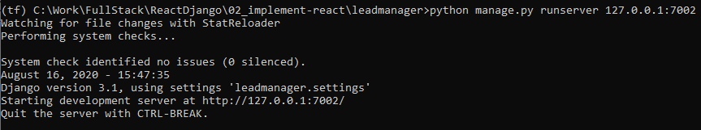
2.17 Compile and Run React
https://www.youtube.com/watch?v=GieYIzvdt2U&list=PLillGF-RfqbbRA-CIUxlxkUpbq0IFkX60&index=2
Compile and run react
> pyhton manage.py runserver 127.0.0.1:7002
Note:
port 7000 seems keep the previous result and not able to clean.
If you have the same problem, reboot the computer to clear the port.

Slide 58
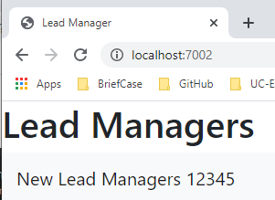
2.17 Compile and Run React
https://www.youtube.com/watch?v=GieYIzvdt2U&list=PLillGF-RfqbbRA-CIUxlxkUpbq0IFkX60&index=2
Compile and run react
Open chrome
> localhost:7002

Slide 59
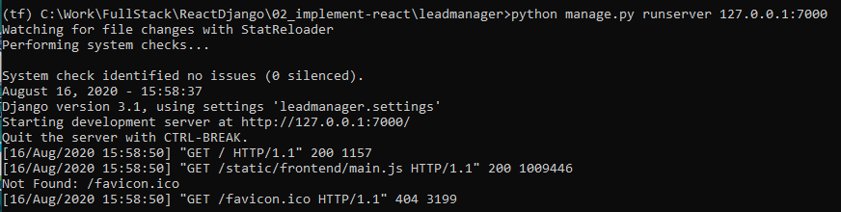
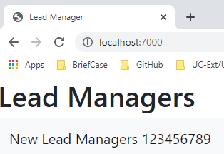
2.17 Compile and Run React
https://www.youtube.com/watch?v=GieYIzvdt2U&list=PLillGF-RfqbbRA-CIUxlxkUpbq0IFkX60&index=2
Compile and run react
After reboot the computer, I can use port 7000
> python manage.py runserver 127.0.0.1:7000

Slide 60
2.18 Dashboard

Slide 61
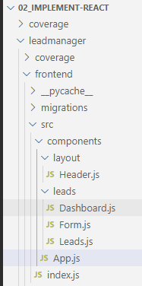
2.18 Dashboard
https://www.youtube.com/watch?v=GieYIzvdt2U&list=PLillGF-RfqbbRA-CIUxlxkUpbq0IFkX60&index=2
Dashboard
We will add dashboard.
Create leads/Dashboard.js
Create leads/Form.js
Create leads/Leads.js

Slide 62
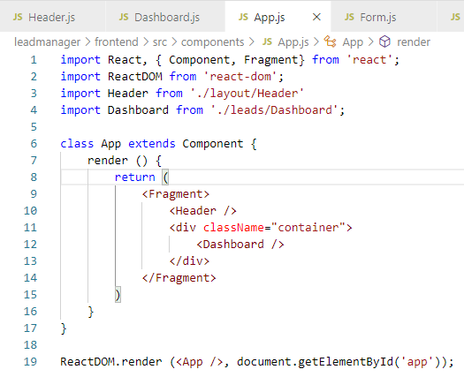
2.18 Dashboard
https://www.youtube.com/watch?v=GieYIzvdt2U&list=PLillGF-RfqbbRA-CIUxlxkUpbq0IFkX60&index=2
Dashboard
In App.js, add <Dashboard />

Slide 63
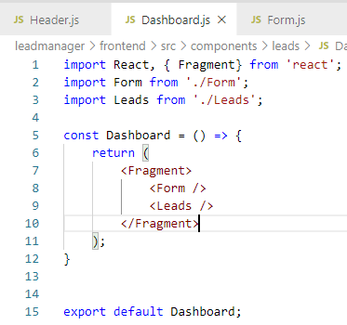
2.18 Dashboard
https://www.youtube.com/watch?v=GieYIzvdt2U&list=PLillGF-RfqbbRA-CIUxlxkUpbq0IFkX60&index=2
Dashboard
In Dashboard.js, add <Form /> and <Leads>

Slide 64
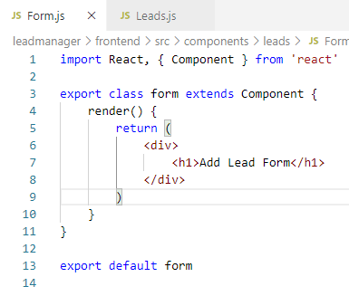
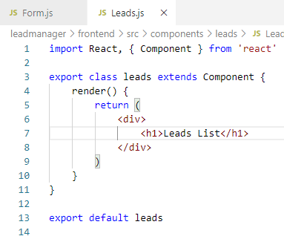
2.18 Dashboard
https://www.youtube.com/watch?v=GieYIzvdt2U&list=PLillGF-RfqbbRA-CIUxlxkUpbq0IFkX60&index=2
Dashboard
Form.js and Leads.js are as below:

Slide 65
2.19 Verify Dashboard

Slide 66
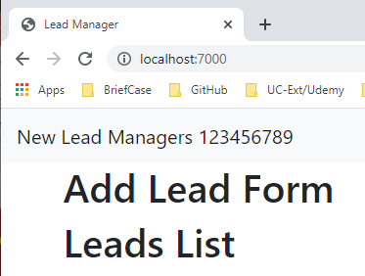
2.19 Verify Dashboard
https://www.youtube.com/watch?v=GieYIzvdt2U&list=PLillGF-RfqbbRA-CIUxlxkUpbq0IFkX60&index=2
Verify Dashboard
Compile the frontend (src and src/components) and templates into JavaScript and Django static/main.js.
> npm run dev
Start Django server
> python manage.py runserver 127.0.0.1:7000
Open Chorme:
> localhost:7000

Slide 67
End of Chapter

