Slide 1
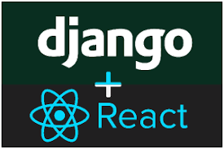
5 Django and Django REST
Peter H. Chen

Slide 2
5 Django and Django REST
https://www.udemy.com/course/full-stack-development-with-django-react/learn/lecture/21391160#overview
Django and Django REST:
Model: name, description, updated_at, created_at
Model: user (fk), product_names, transaction_id, total_amount, created_at, updated_at
category
Views: get all categories - serialized
Views: Validate user session, add
order
URLs: Add id/token, default
Views Get all products - serialized
Views: Validate user-session, generate token, process payment
API-D
Products
Model: category (fk), is_active, price, name, description, image, created_at, updated_at
Payment Brain tree
Model: session token, phone, name, email, gender, created_at, updated_at
URLs: Gettoken/id/token, process id/token
Serializers: created_at, updated_at
user
Views: generate session token, signin, sign out
Note: login/logout will come from Django authorization
Legend:
fk: foreign-key
URLs: login with id, logout with id, default routing

Slide 3
5 Django and Django REST
https://www.udemy.com/course/full-stack-development-with-django-react/learn/lecture/21391160#overview
Django and Django REST:
Django is a framework and why do we need Django REST framework?
As you know, we use ReactJS in the front end and Django in the backend.
We are using the JavaScript inn the front end and python in the backend.
Both languages do not understand that often.
We need to find the middleware where they can shake their hands together.
If this is a project, I would use some of the templating using the Django. The full fledged project can be achieved just with the Django.
But that is not how everybody wants to write the code right now.
They want to have a separate modular architecture on the front end as well as on the backend.
So, come to the point, what is the Django. How is helps us?
What is the stylization?

Slide 4
5.1 Django Framework

Slide 5
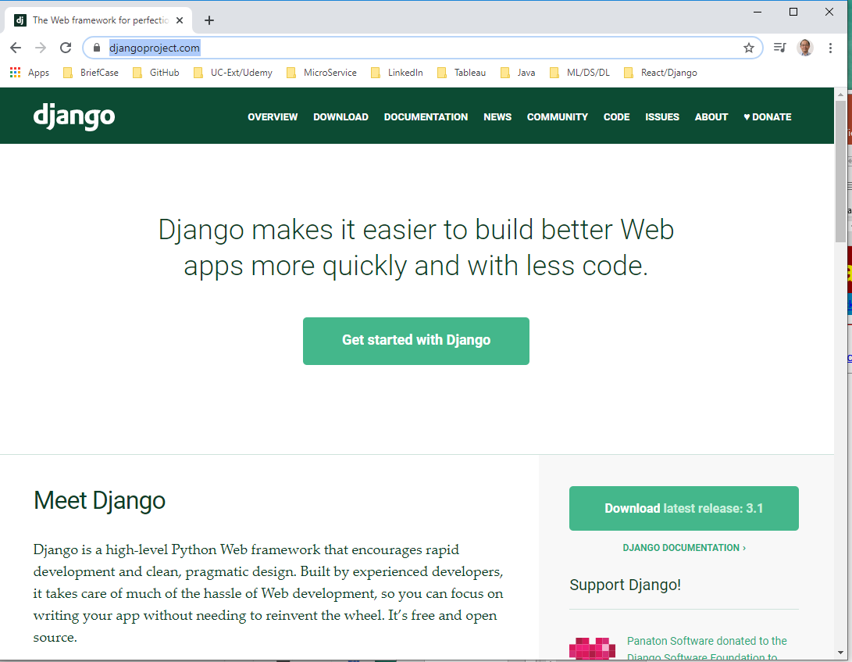
5.1 Django Framework
https://www.udemy.com/course/full-stack-development-with-django-react/learn/lecture/21391160#overview
Django Framework
https://www.djangoproject.com/
This is the Django framework. Django is very easy to build web apps and SQL database, and very popular for the startup.

Slide 6
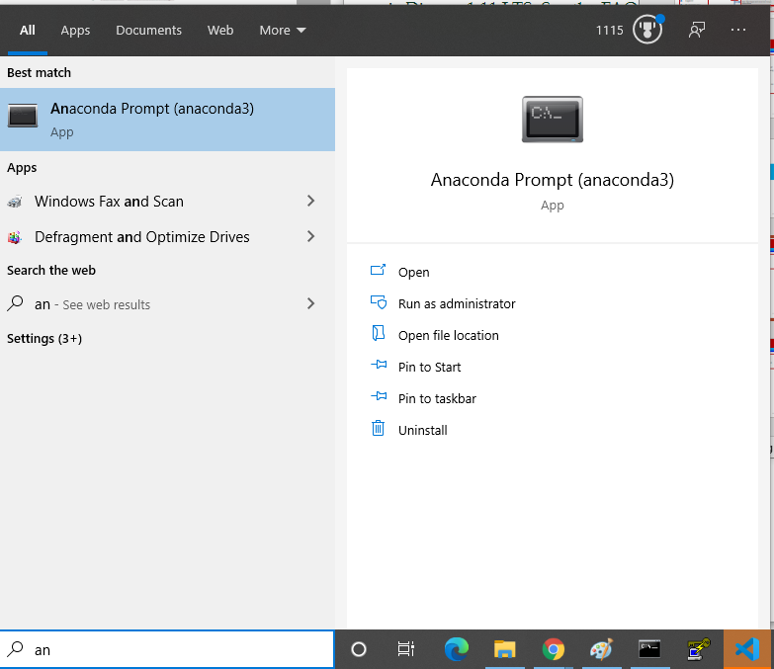
5.1 Django Framework
https://www.udemy.com/course/full-stack-development-with-django-react/learn/lecture/21391160#overview
Django Framework
https://www.djangoproject.com/
Under the window, search for “anaconda”

Slide 7
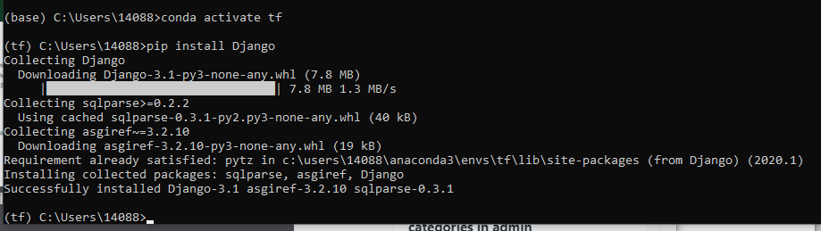
5.1 Django Framework
https://www.udemy.com/course/full-stack-development-with-django-react/learn/lecture/21391160#overview
Django Framework
https://www.djangoproject.com/
We will use the anaconda environment for project.
Create the anaconda environment tf (tensorflow). Switch the anaconda tf
> conda activate tf
(tf) > pip install Django

Slide 8
5.2 Django REST Framework

Slide 9
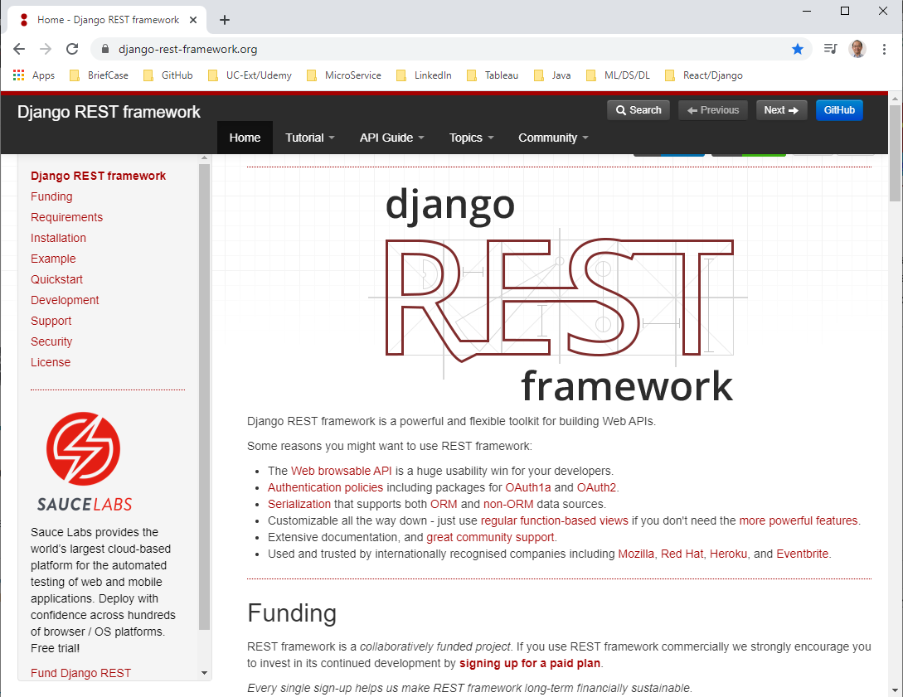
5.2 Django REST Framework
https://www.udemy.com/course/full-stack-development-with-django-react/learn/lecture/21391160#overview
Django REST Framework
https://www.django-rest-framework.org/
Why do we need the Django REST framework?
Because we will use the ReactJS at the frontend, the ReactJS , Angular, and Vue can only understand the JSON format.
That is the reason we need the Django REST framework: To convert into JSON format from backend to the frontend can understand.

Slide 10
5.2 Django REST Framework
https://www.udemy.com/course/full-stack-development-with-django-react/learn/lecture/21391160#overview
Django REST Framework
Django REST Framework provides the following:
Web Browsable API: Developer can write API.
Authentication Policies
Serialization: ORM and non-ORM data source.

Slide 11
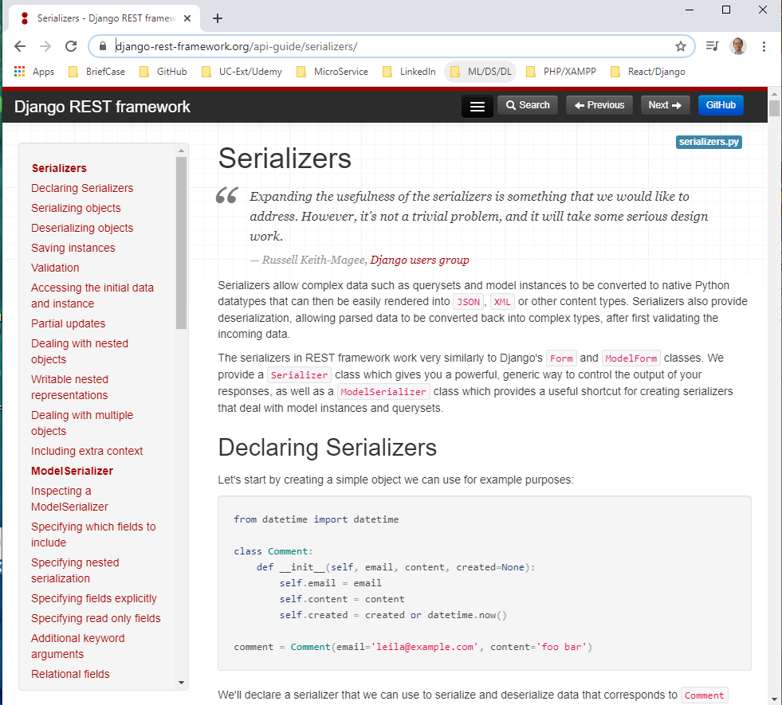
5.2 Django REST Framework
https://www.udemy.com/course/full-stack-development-with-django-react/learn/lecture/21391160#overview
Django REST Framework
What is Serialization?
https://www.django-rest-framework.org/api-guide/serializers/
Serialization convert the database into JSON Format.
Serializers allow complex data such as querysets and model instances to be converted to native Python datatypes that can then be easily rendered into JSON, XML or other content types.
Serializers also provide deserialization, allowing parsed data to be converted back into complex types, after first validating the incoming data.

Slide 12
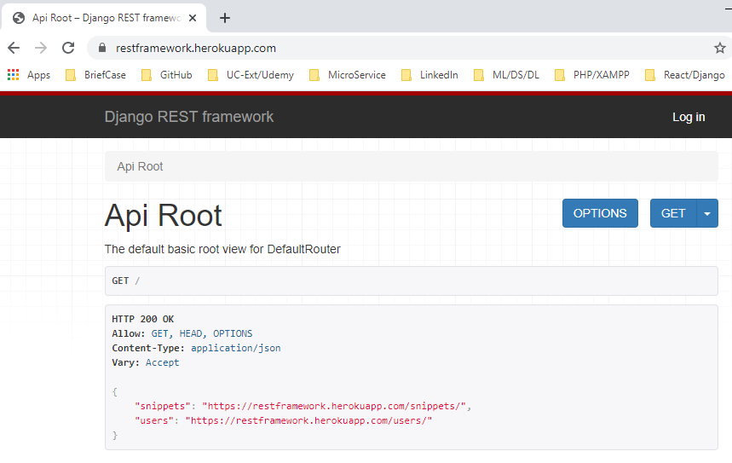
5.2 Django REST Framework
https://www.udemy.com/course/full-stack-development-with-django-react/learn/lecture/21391160#overview
Django REST Framework
What is Browser API Looks like?
https://restframework.herokuapp.com/
Serialization convert the database into JSON Format.

Slide 13
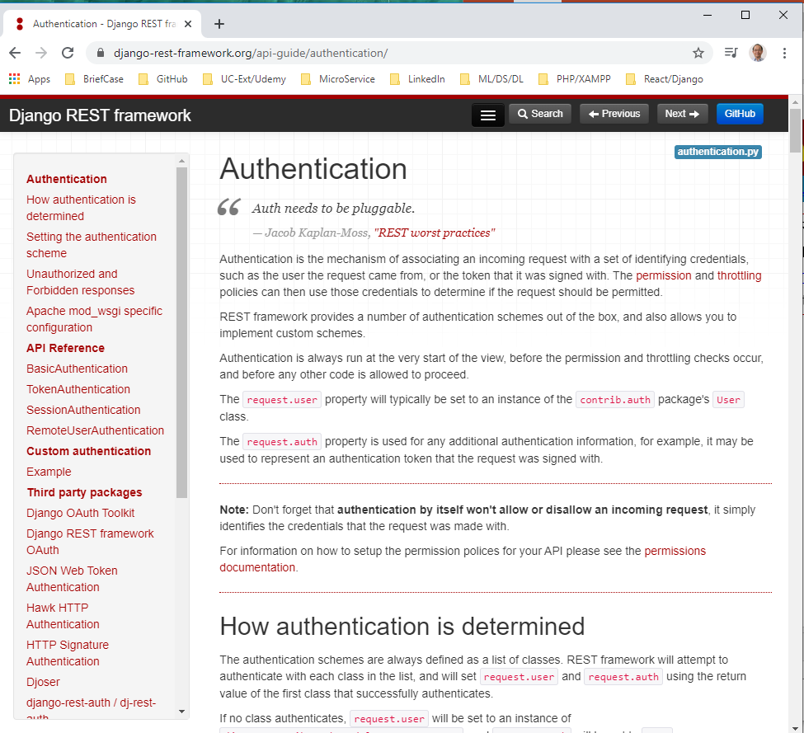
5.2 Django REST Framework
https://www.udemy.com/course/full-stack-development-with-django-react/learn/lecture/21391160#overview
Django REST Framework
What is Authentication?
https://www.django-rest-framework.org/api-guide/authentication/
Authentication is for login user verification.
Authentication is the mechanism of associating an incoming request with a set of identifying credentials, such as the user the request came from, or the token that it was signed with.
The permission and throttling policies can then use those credentials to determine if the request should be permitted.

Slide 14
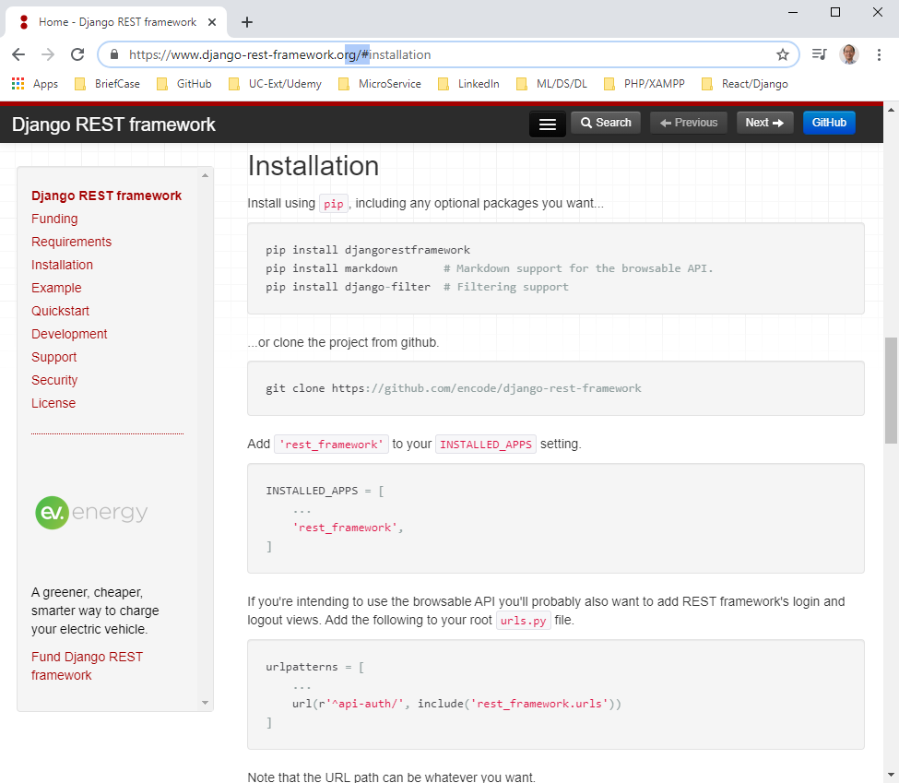
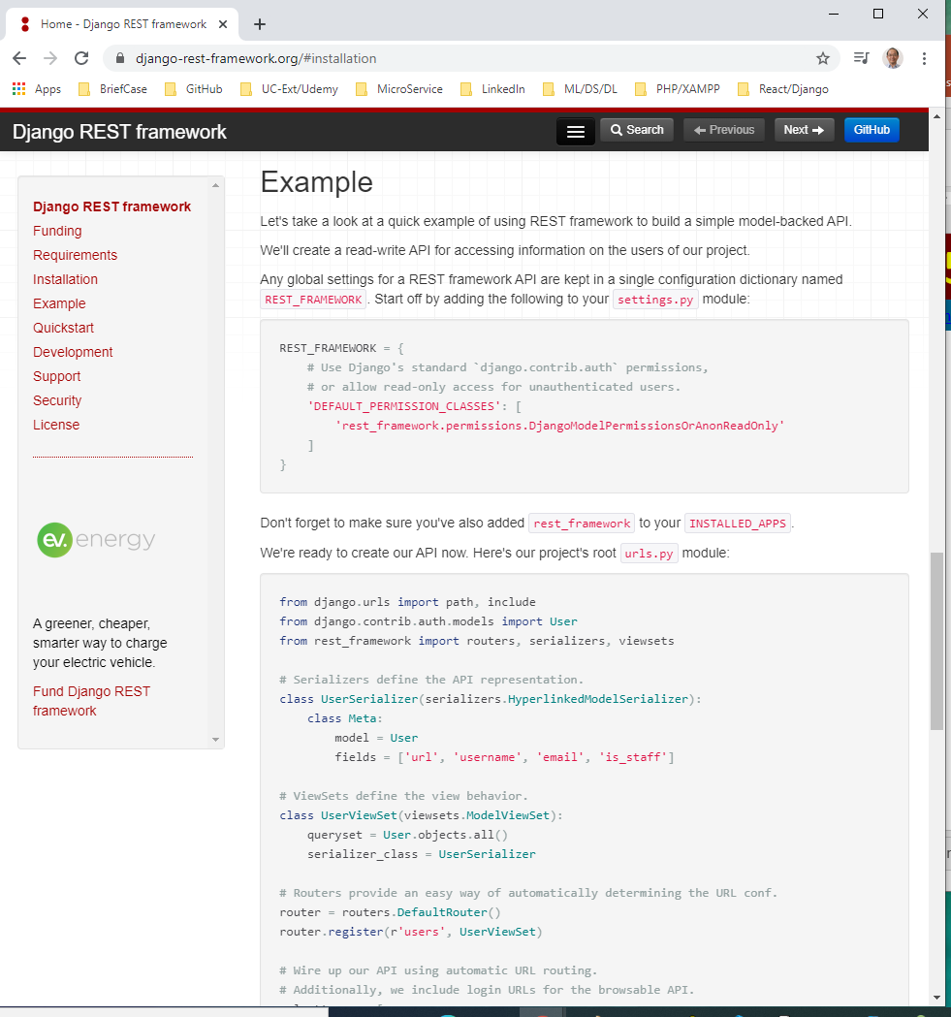
5.2 Django REST Framework
https://www.udemy.com/course/full-stack-development-with-django-react/learn/lecture/21391160#overview
Django REST Framework
Installation
https://www.django-rest-framework.org/#installation

Slide 15
End of Chapter

