Slide 1
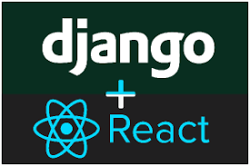
1 React/Django Introduction
Peter H. Chen

Slide 2
1 React/Django Introduction
https://www.udemy.com/course/full-stack-development-with-django-react/learn/lecture/21389170#overview
Introduction
We discussed ReactJS, REST API, and Django Framework.

Slide 3
End of Chapter

