Slide 1
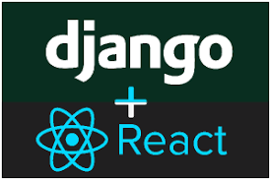
2 Goal
Peter H. Chen

Slide 2
2 Goal
https://www.udemy.com/course/full-stack-development-with-django-react/learn/lecture/21391100#overview
Introduction
We discussed the goal of Full Stack with frontend ReactJS UI Library and backend Django Framework.
Goals:
Backend with Django
REST API: Mobile, web application, Angular framework, and ReactJS Library.
Customization of Django: You can go 100% without customization of Django and with some option in customization of Django for existing of framework.
Frontend with React: React is top most library in the frontend.
Stay away from Myths: Do not argue and stay away of the existing technologies, such as, MySQL is more secure than MongoDB, Django is faster than Node, and etc.

Slide 3
End of Chapter

