Slide 1

3 Project Structure
Peter H. Chen

Slide 2
3 Project Structure
https://www.udemy.com/course/full-stack-development-with-django-react/learn/lecture/21391132#overview
Create Project Structure from Client Requirement
Assume there is a client is asking for a project and we will be working with the client directly.
Requirements: I want to sell T-shirts online. I got T-shirts for winter and Summer.
The client wants to sell the T-shirt product and want to display the T-short product. The client has winter and summer products.
There is a separate product team to handle to the client requirement for programmer. Like the big scale companies: Amazon, Google, Facebook, and etc.
From the product team requirement, we have chosen “Django for backend and ReactJS at the frontend.”
There is another requirement, “Separate login for admin and customer.”

Slide 3
3 Project Structure
https://www.udemy.com/course/full-stack-development-with-django-react/learn/lecture/21391132#overview
Create Project Structure from Client Requirement
Requirements Summary:
I want to sell T-shirts online. I got T-shirts for winter and Summer.
Django for backend and ReactJS at the frontend.
Separate login for admin and customer.

Slide 4
3 Project Structure
https://www.udemy.com/course/full-stack-development-with-django-react/learn/lecture/21391132#overview
Create Project Structure from Client Requirement
In Django, a default admin panel or login panel is given to you.
We will have separate login panel for admin and for regular customer.
We will start the backend first and architecture the projects.

Slide 5
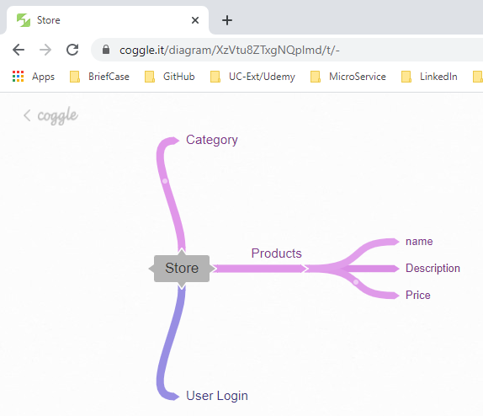
3 Project Structure
https://www.udemy.com/course/full-stack-development-with-django-react/learn/lecture/21391132#overview
Create Concept Diagram:
You can go to “coggle.it” to create it.

Slide 6
3 Project Structure
https://www.udemy.com/course/full-stack-development-with-django-react/learn/lecture/21391132#overview
Create Concept Diagram:
You can go to “coggle.it” to create it.
Category
Description
Product
Store
name
price
Login

Slide 7
End of Chapter

