Slide 1

220 Introduction
Peter H. Chen

Slide 2
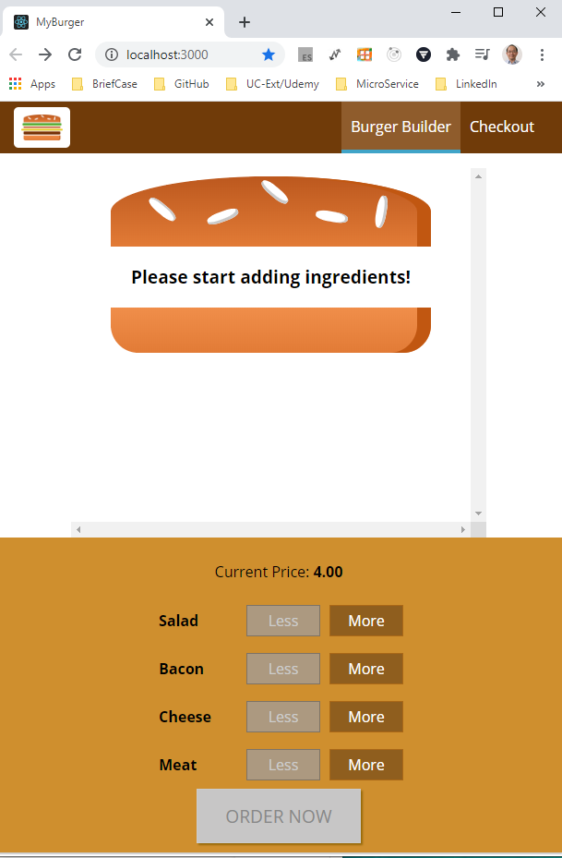
220 Introduction
https://www.udemy.com/course/react-the-complete-guide-incl-redux/learn/lecture/8145908#notes
Introduction
Back to our Burger Project.
We will add some routing to our Real React Project.

Slide 3
End of Chapter

