Slide 1

70 Style Radium
Peter H. Chen

Slide 2
70 Style Radium
https://www.udemy.com/course/react-the-complete-guide-incl-redux/learn/lecture/8211788#overview
Style Radium
Radium is a set of tools to manage inline styles on React elements.
Radium gives you powerful styling capabilities without CSS.
In CSS class, we can use @Media to change background color when screen size changed.
@media only screen and (max-width: 600px) {
body {
background-color: lightblue;
}
}
We can do this in Radium as well.

Slide 3
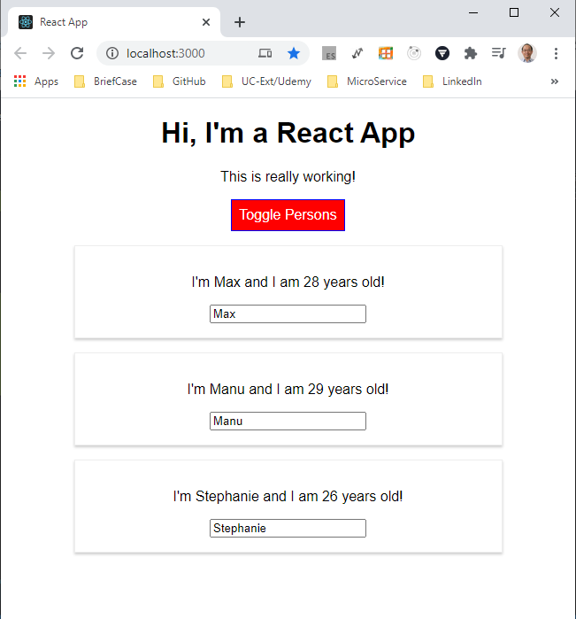
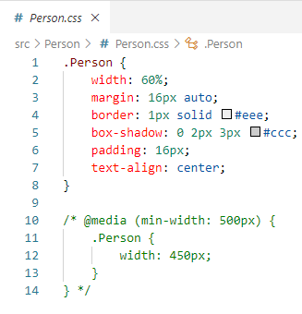
70 Style Radium
https://www.udemy.com/course/react-the-complete-guide-incl-redux/learn/lecture/8211788#overview
Style Radium
Comment out the /* @media … */. We will use inline style radium instead.
This rule say: When screen size has minimum width = 500px, then set the Person Widget (Display Person record) size to 450px.
Screen size bigger than min-width 500 px
450 px

Slide 4
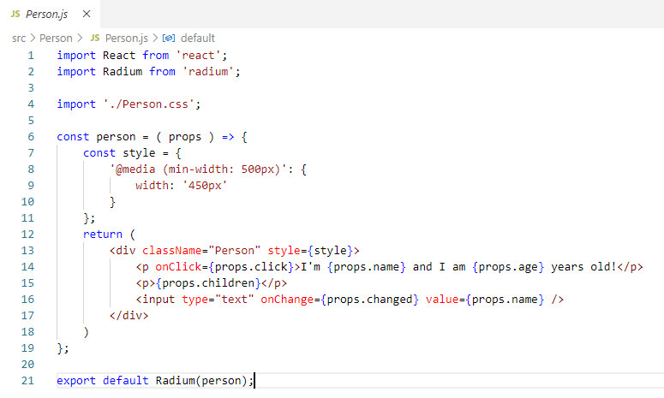
70 Style Radium
https://www.udemy.com/course/react-the-complete-guide-incl-redux/learn/lecture/8211788#overview
Style Radium
Change to inline Radium instead of specified in file Person.CSS.
Inline Radium Style for @media

Slide 5
End of Chapter

