Slide 1

75 Style Component
Peter H. Chen

Slide 2
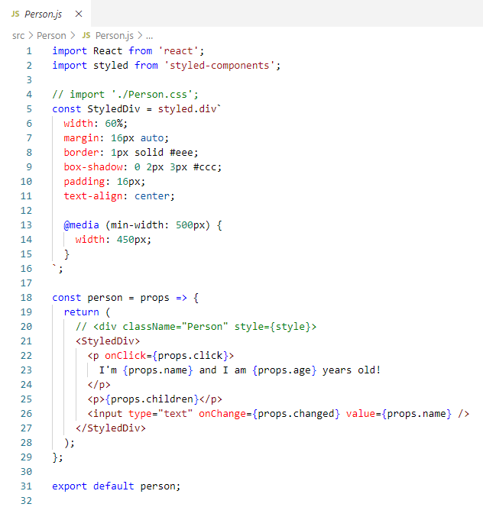
75 Style Component
https://www.udemy.com/course/react-the-complete-guide-incl-redux/learn/lecture/8211788#overview
Style Component
We can style the a group of CSS component.

Slide 3
End of Chapter

