Slide 1

34 Component and JSX
Peter H. Chen

Slide 2
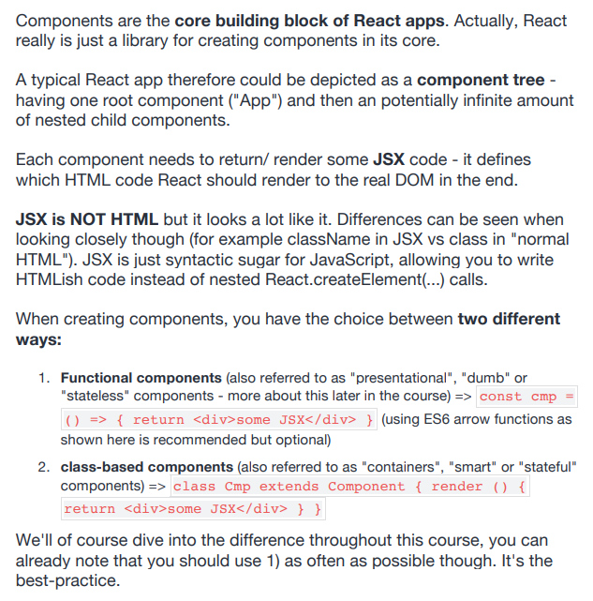
34 Component and JSX
https://www.udemy.com/course/react-the-complete-guide-incl-redux/learn/lecture/8211788#overview
Component and JSX

Slide 3
End of Chapter

