Slide 1

37 Props
Peter H. Chen

Slide 2
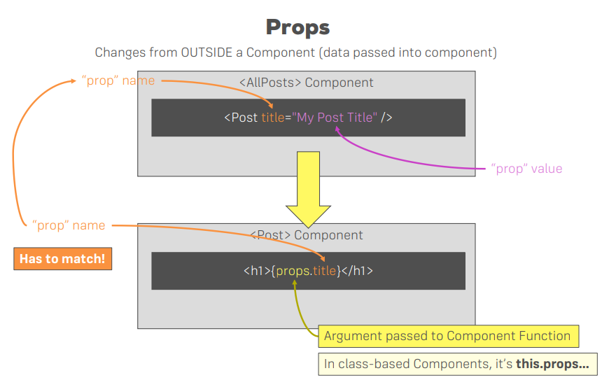
37 Props
https://www.udemy.com/course/react-the-complete-guide-incl-redux/learn/lecture/8211788#overview
Props

Slide 3
End of Chapter

