Slide 1

40 Props and State
Peter H. Chen

Slide 2
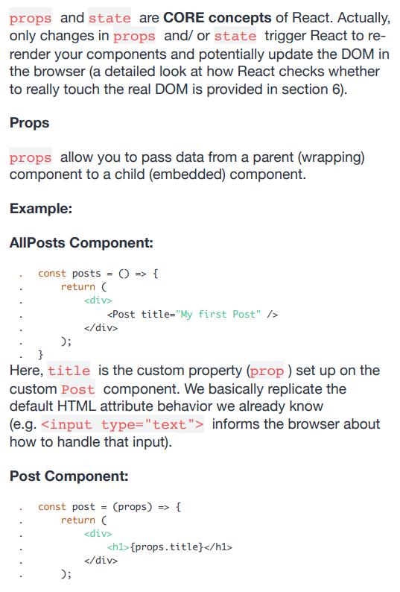
40 Props and State
https://www.udemy.com/course/react-the-complete-guide-incl-redux/learn/lecture/8211788#overview
Props and State

Slide 3
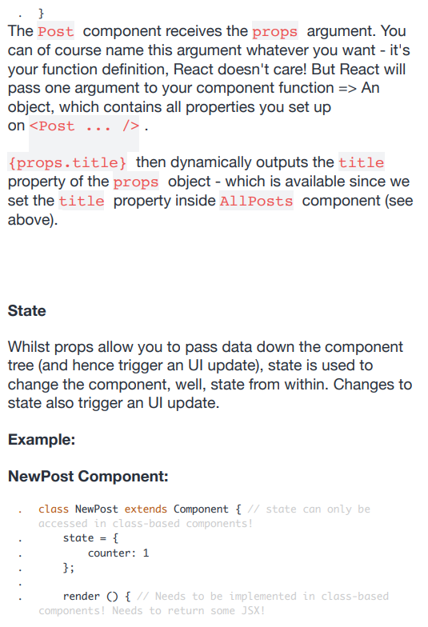
40 Props and State
https://www.udemy.com/course/react-the-complete-guide-incl-redux/learn/lecture/8211788#overview
Props and State

Slide 4
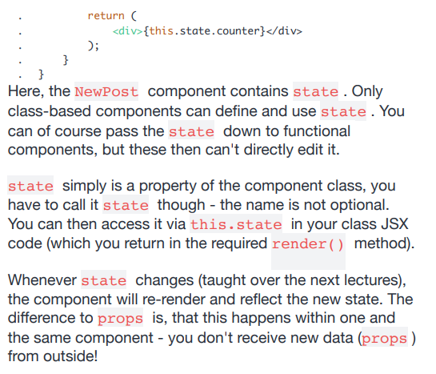
40 Props and State
https://www.udemy.com/course/react-the-complete-guide-incl-redux/learn/lecture/8211788#overview
Props and State

Slide 5
End of Chapter

