Slide 1

43 State
Peter H. Chen

Slide 2
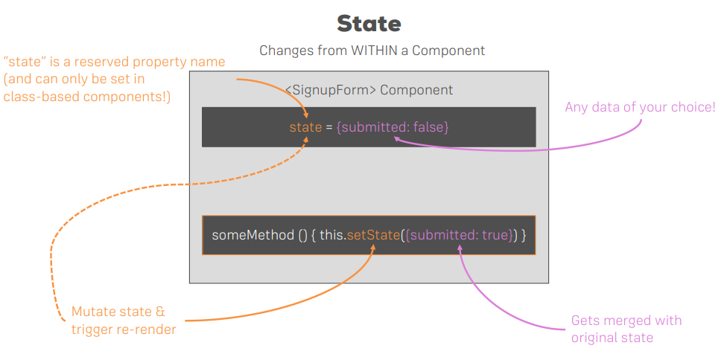
43 State
https://www.udemy.com/course/react-the-complete-guide-incl-redux/learn/lecture/8211788#overview
State

Slide 3
End of Chapter

