Slide 1

45 useState
Peter H. Chen

Slide 2
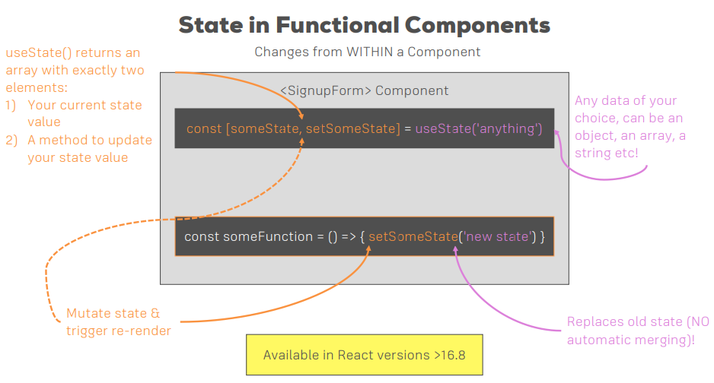
45 useState
https://www.udemy.com/course/react-the-complete-guide-incl-redux/learn/lecture/8211788#overview
useState

Slide 3
End of Chapter

