Slide 1

1 Project 1: Component
Peter H. Chen

Slide 2
1 Project 1: Component
https://www.udemy.com/course/react-the-complete-guide-incl-redux/learn/lecture/12982500#overview
React Complete: Programming Assignment 1
Create TWO new components: UserInput and UserOutput
UserInput should hold an input element, UserOutput two paragraphs
Output multiple UserOutput components in the App component (any paragraph texts of your choice)
Pass a username (of your choice) to UserOutput via props and display it there
Add state to the App component (=> the username) and pass the username to the UserOutput component
Add a method to manipulate the state (=> an event-handler method)
Pass the event-handler method reference to the UserInput component and bind it to the input-change event
Ensure that the new input entered by the user overwrites the old username passed to UserOutput
Add two-way-binding to your input (in UserInput) to also display the starting username
Add styling of your choice to your components/elements in the components - both with inline styles and stylesheets

Slide 3
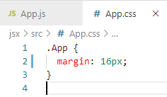
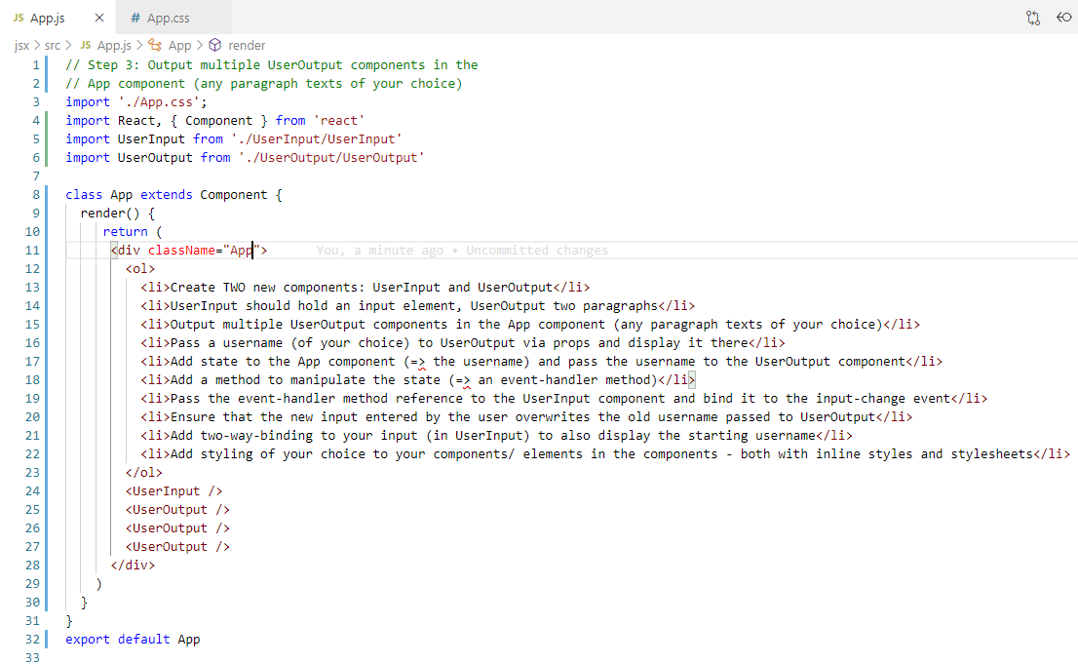
1 Project 1: Component
https://www.udemy.com/course/react-the-complete-guide-incl-redux/learn/lecture/12982500#overview
React Complete: Programming Assignment 1
We have App.js and App.css given as follow:

Slide 4
1.1 Create Two Component

Slide 5
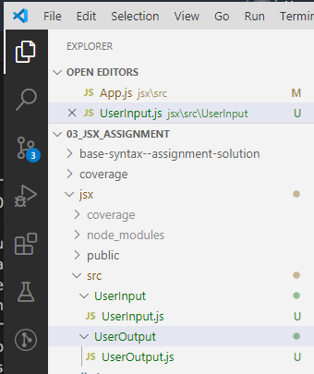
1.1 Create Two Component
https://www.udemy.com/course/react-the-complete-guide-incl-redux/learn/lecture/12982500#overview
Create TWO new components: UserInput and UserOutput

Slide 6
1.2 UserInput and UserOutput

Slide 7
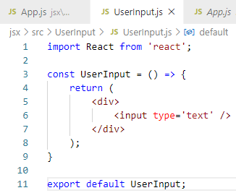
1.2 UserInput and UserOutput
https://www.udemy.com/course/react-the-complete-guide-incl-redux/learn/lecture/12982500#overview
UserInput should hold an input element, UserOutput two paragraphs.
In the source folder, we create two folders, UserInput and UserOutput
In the UserInput.js, we can create the class component or functional component.
We want to create stateless functional component as much as possible for representation only component.
In VS Code, Type ‘rfce’ (React Functional Component for ES7) to generate functional component template.
We wan to create state in UserInput component, it is a Class Component.
Type ‘rfc’ (React Functional Component for ES7).
We need to hold an input element.

Slide 8
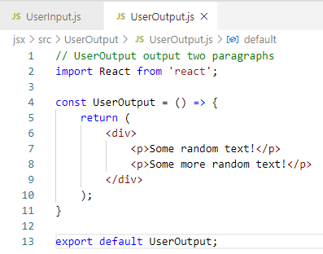
1.2 UserInput and UserOutput
https://www.udemy.com/course/react-the-complete-guide-incl-redux/learn/lecture/12982500#overview
UserInput should hold an input element, UserOutput two paragraphs.
We output two “random text”

Slide 9
1.3 Add UserInput and UserOutput

Slide 10
1.3 Add UserInput and UserOutput
https://www.udemy.com/course/react-the-complete-guide-incl-redux/learn/lecture/12982500#overview
Output multiple UserOutput components in the App component (any paragraph texts of your choice)
Now, in the App.js, we need to add
Import UserInput andUserOutput
Add component <UserInput /> <UserOuptut />.

Slide 11
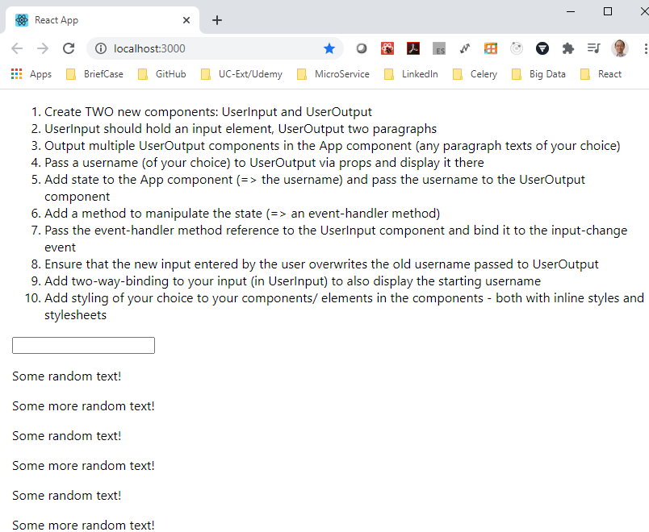
1.3 Add UserInput and UserOutput
https://www.udemy.com/course/react-the-complete-guide-incl-redux/learn/lecture/12982500#overview
Output multiple UserOutput components in the App component (any paragraph texts of your choice)
Verify it work or not.
> npm start

Slide 12
1.4 Pass User Name to UserOutput

Slide 13
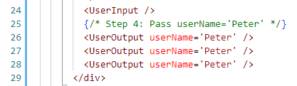
1.4 Pass User Name to UserOutput
https://www.udemy.com/course/react-the-complete-guide-incl-redux/learn/lecture/12982500#overview
Pass a username (of your choice) to UserOutput via props and display it there.
In the App.js:
Pass a username props. You can use ‘username’, ‘username’, or ‘usrName’.
We pass same userName=‘Peter’. These will be overwrite, anyway.

Slide 14
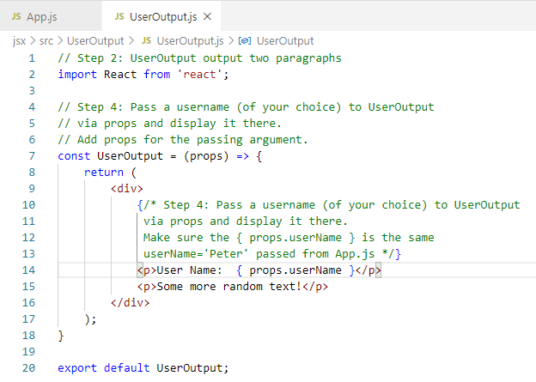
1.4 Pass User Name to UserOutput
https://www.udemy.com/course/react-the-complete-guide-incl-redux/learn/lecture/12982500#overview
Pass a username (of your choice) to UserOutput via props and display it there.
In the UserOutput.js, we add the passing argument in the arrow function, and then display the props.userName.

Slide 15
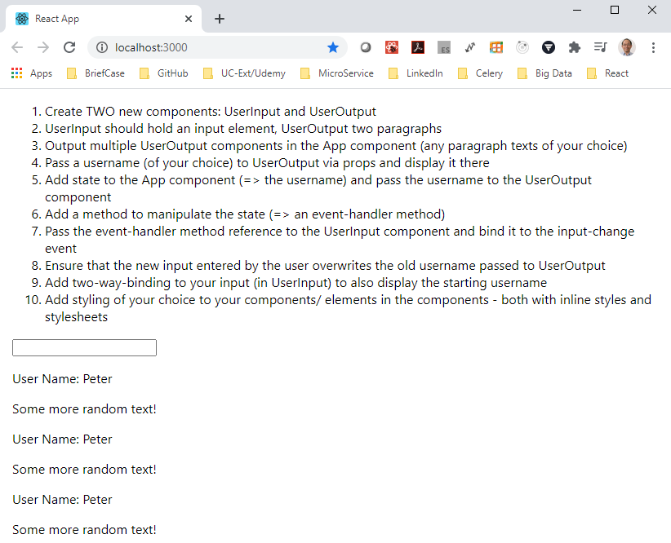
1.4 Pass User Name to UserOutput
https://www.udemy.com/course/react-the-complete-guide-incl-redux/learn/lecture/12982500#overview
Pass a username (of your choice) to UserOutput via props and display it there.
Verify it work or not.
> npm start

Slide 16
1.5 Assign State to Props and Pass

Slide 17
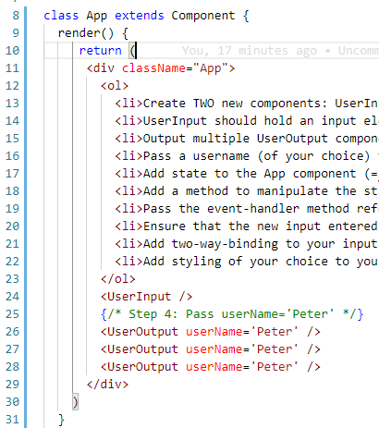
1.5 Assign State to Props and Pass
https://www.udemy.com/course/react-the-complete-guide-incl-redux/learn/lecture/12982500#overview
Add state to the App component (=> the username) and pass the username to the UserOutput component
The App component is the container that hold the state.
The App container extends the Component.
We need to add the state management inside the App component.

Slide 18
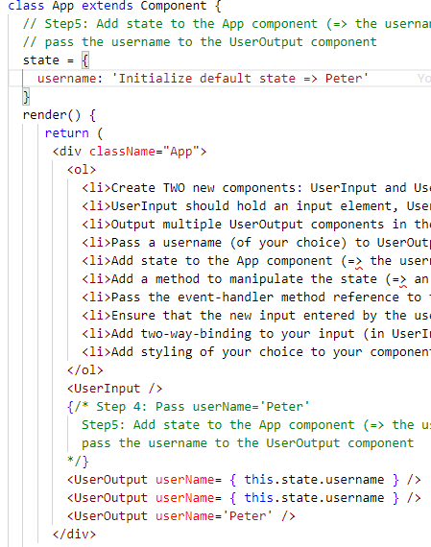
1.5 Assign State to Props and Pass
https://www.udemy.com/course/react-the-complete-guide-incl-redux/learn/lecture/12982500#overview
Add state to the App component (=> the username) and pass the username to the UserOutput component
In the class component App, add state
> state = {
> username: ‘default-Peter’
> }
Pass state into the UserOutput component:
<UserOutput username = { this.satte.username }
Note:
The state username (this.state.username) is assigned to props (username = {}).

Slide 19
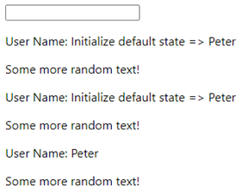
1.5 Assign State to Props and Pass
https://www.udemy.com/course/react-the-complete-guide-incl-redux/learn/lecture/12982500#overview
Add state to the App component (=> the username) and pass the username to the UserOutput component
Verify the result
> npm start
We are successfully pass the state from parent to children.

Slide 20
1.6 State Event Handler

Slide 21
1.6 State Event Handler
https://www.udemy.com/course/react-the-complete-guide-incl-redux/learn/lecture/12982500#overview
Add a method to manipulate the state (=> an event-handler method)
Now, We want to update the state.
Add arrow function:
> usernameChangedHandler = (event) => {
> this.setState ()
> }
Note:
We cannot manipulate the state directly. We have to use setState() to change the state.
setState() method is extended from the ‘Component’.
We will use setState({ }) to overwrite the state = { … } and React will update to DOM.
> usernameChangeHandler = (event) => {
> this.setState ({ username: event.target.value } )
> }

Slide 22
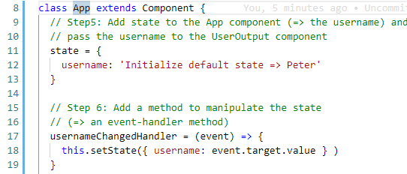
1.6 State Event Handler
https://www.udemy.com/course/react-the-complete-guide-incl-redux/learn/lecture/12982500#overview
Add a method to manipulate the state (=> an event-handler method)
When user enter the username, the event.target.value will get the username and update the state (username).
The UserOuptut component will get and display the new change.
Because we have not implement the UserInput yet, we can not see the change yet.

Slide 23
1.7 Pass Event Handler and onChange

Slide 24
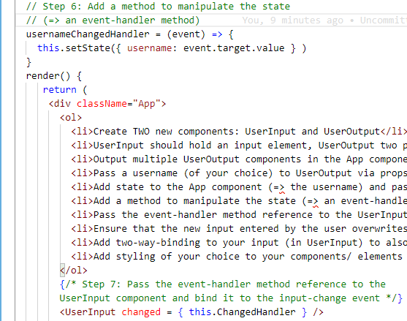
1.7 State Event Handler
https://www.udemy.com/course/react-the-complete-guide-incl-redux/learn/lecture/12982500#overview
Pass the event-handler method reference to the UserInput component and bind it to the input-change event
Pass Event handler reference from parent (App) component to child (UserInput) component
Add onChange for Event Handler.
In the App component, we add
<UserInput changed = { this.usernameChangedHandler } />
We add the props “changed” and pass to child component <UserInput>.
The child can use the props as the reference.

Slide 25
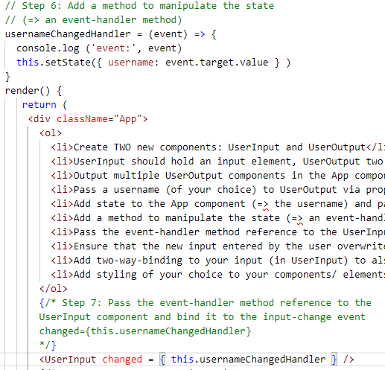
1.7 State Event Handler
https://www.udemy.com/course/react-the-complete-guide-incl-redux/learn/lecture/12982500#overview
Pass the event-handler method reference to the UserInput component and bind it to the input-change event
Pass Event handler reference from parent (App) component to child (UserInput) component
Add onChange for Event Handler.
Note:
We cannot use () for arrow function, such as, this.usreNameChangedHandler ().
It will execute the code immediately.
We just use the reference this.usernameChangedHandler to reference this method.

Slide 26
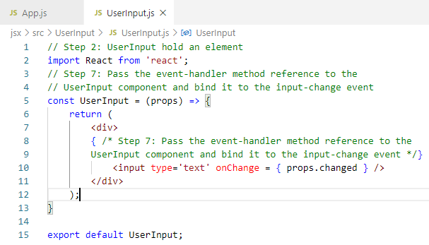
1.7 State Event Handler
https://www.udemy.com/course/react-the-complete-guide-incl-redux/learn/lecture/12982500#overview
Pass the event-handler method reference to the UserInput component and bind it to the input-change event
Pass Event handler reference from parent (App) component to child (UserInput) component
Add onChange for Event Handler.
In the UserInput () method, we now have the props as the accessible argument.
> const UserInput = (props) => {
> return <input type=‘text’ onChange = { props.changed } />
> }

Slide 27
1.7 State Event Handler
https://www.udemy.com/course/react-the-complete-guide-incl-redux/learn/lecture/12982500#overview
Pass the event-handler method reference to the UserInput component and bind it to the input-change event
Pass Event handler reference from parent (App) component to child (UserInput) component
Add onChange for Event Handler.
Note:
We use onChange event provided by React.
We pass the event-handler method reference from App to UserInput and bind the event
At the point of time, this event occurs, it will automatically pass the event object to our event handler. The props.changed will automatically updated whenever user make the change.

Slide 28
1.7 State Event Handler
https://www.udemy.com/course/react-the-complete-guide-incl-redux/learn/lecture/12982500#overview
Pass the event-handler method reference to the UserInput component and bind it to the input-change event
Pass Event handler reference from parent (App) component to child (UserInput) component
Add onChange for Event Handler.
Note:
Do not add parenthesis () to the EventHandler. We do not want it as the function.
We just want the event hander register as the reference only.

Slide 29
1.7 State Event Handler
https://www.udemy.com/course/react-the-complete-guide-incl-redux/learn/lecture/12982500#overview
Pass the event-handler method reference to the UserInput component and bind it to the input-change event
Pass Event handler reference from parent (App) component to child (UserInput) component
Add onChange for Event Handler.
The props.changed is passed from parent App and the changed refers to Event handler.
So the event were executed whenever the onChange event occurs.

Slide 30
1.8 Verify Test

Slide 31
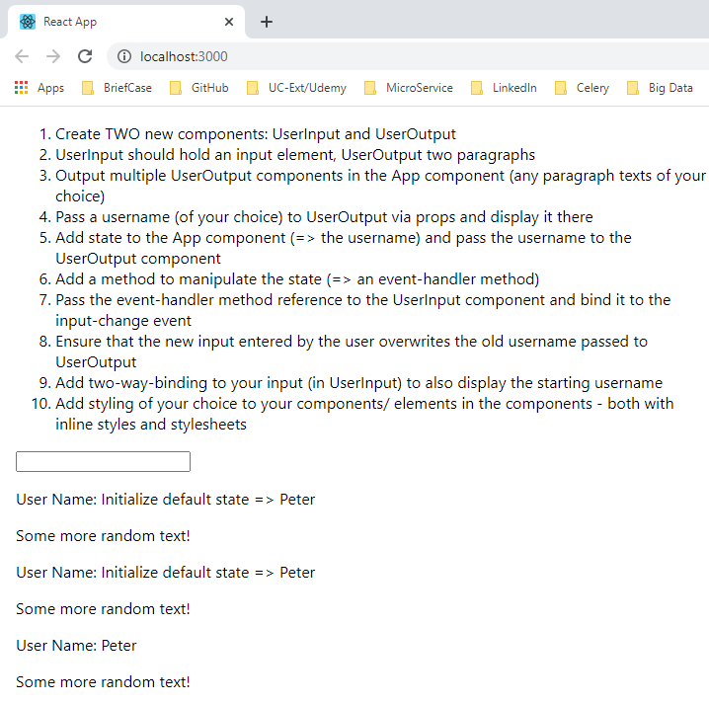
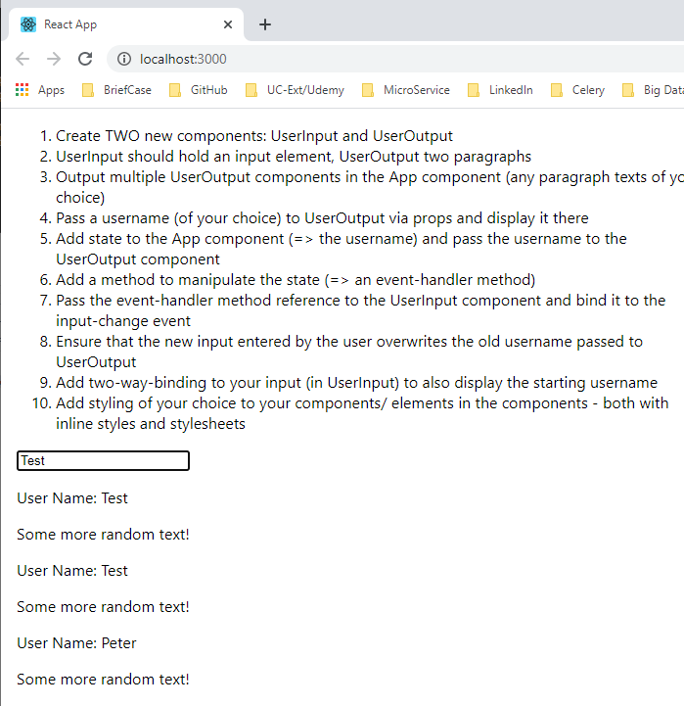
1.8 Verify Test
https://www.udemy.com/course/react-the-complete-guide-incl-redux/learn/lecture/12982500#overview
Ensure that the new input entered by the user overwrites the old username passed to UserOutput
Verify it work or not.
> npm start
Type “Test” to verify the UserOutput user name display “Test” when you type in User input.

Slide 32
1.8 Verify Test
https://www.udemy.com/course/react-the-complete-guide-incl-redux/learn/lecture/12982500#overview
Ensure that the new input entered by the user overwrites the old username passed to UserOutput
We entering “test” and we will see that all the components pass the state username and it will overwrite the user name. We can compare with hardcoded ‘Peter’ without overwrite.

Slide 33
1.9 Two Ways Binding

Slide 34
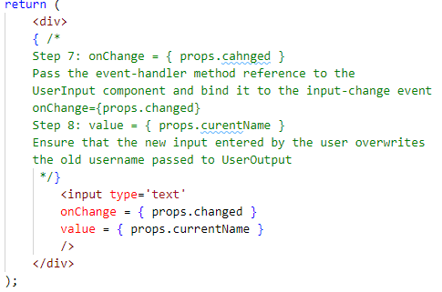
1.9 Two Ways Binding
https://www.udemy.com/course/react-the-complete-guide-incl-redux/learn/lecture/12982500#overview
Add two-way-binding to your input (in UserInput) to also display the starting username
In UserInput.js.

Slide 35
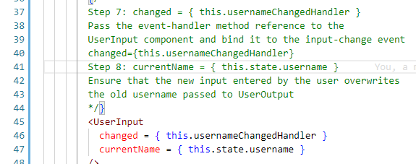
1.9 Two Ways Binding
https://www.udemy.com/course/react-the-complete-guide-incl-redux/learn/lecture/12982500#overview
Add two-way-binding to your input (in UserInput) to also display the starting username
In App.js.

Slide 36
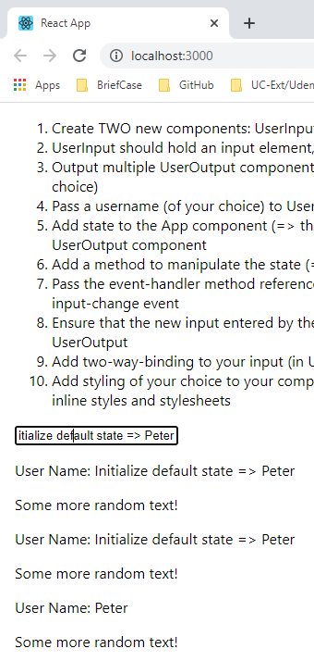
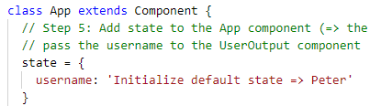
1.9 Two Ways Binding
https://www.udemy.com/course/react-the-complete-guide-incl-redux/learn/lecture/12982500#overview
Add two-way-binding to your input (in UserInput) to also display the starting username
Verify the initial Display.
We almost done now.

Slide 37
1.10 Setup Style

Slide 38
1.10 Setup Style
https://www.udemy.com/course/react-the-complete-guide-incl-redux/learn/lecture/12982500#overview
Add styling of your choice to your components/elements in the components - both with inline styles and stylesheets
We will add the style for our component.
We will two different approaches for styling.
For the user input, where we do not have a wrapping element. We will use inline style and make sure the styling get applied to this input and not any other input in our application.

Slide 39
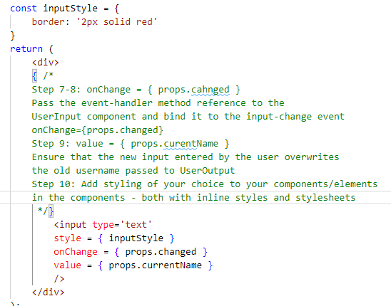
1.10 Setup Style
https://www.udemy.com/course/react-the-complete-guide-incl-redux/learn/lecture/12982500#overview
Add styling of your choice to your components/elements in the components - both with inline styles and stylesheets
Add inputStyle for UserInput.js:

Slide 40
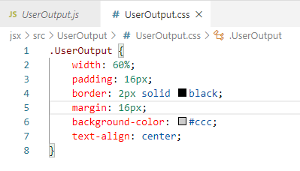
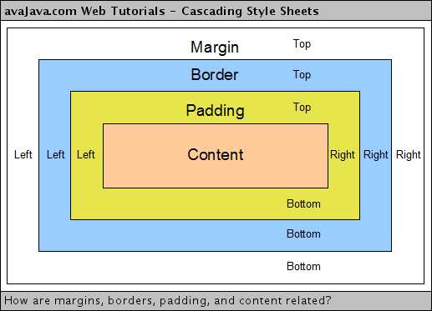
1.10 Setup Style
https://www.udemy.com/course/react-the-complete-guide-incl-redux/learn/lecture/12982500#overview
Add styling of your choice to your components/elements in the components - both with inline styles and stylesheets
Add outputStyle for UserOutput.js:
Use ‘.’ as the selector for UserOutput Class (or Component).

Slide 41
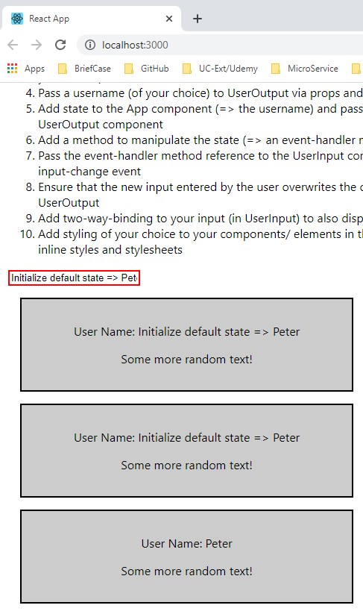
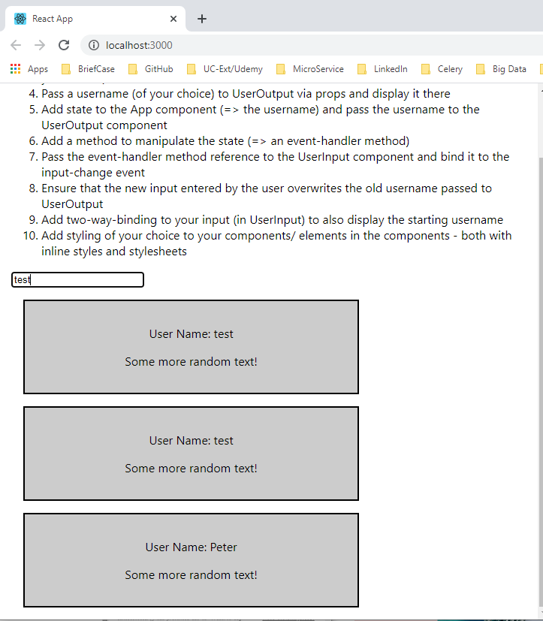
1.10 Setup Style
https://www.udemy.com/course/react-the-complete-guide-incl-redux/learn/lecture/12982500#overview
Add styling of your choice to your components/elements in the components - both with inline styles and stylesheets
Verify the result.
The styles are changed.
Type “test” to verify.

Slide 42
End of Chapter

