Slide 1

177 Introduction
Peter H. Chen

Slide 2
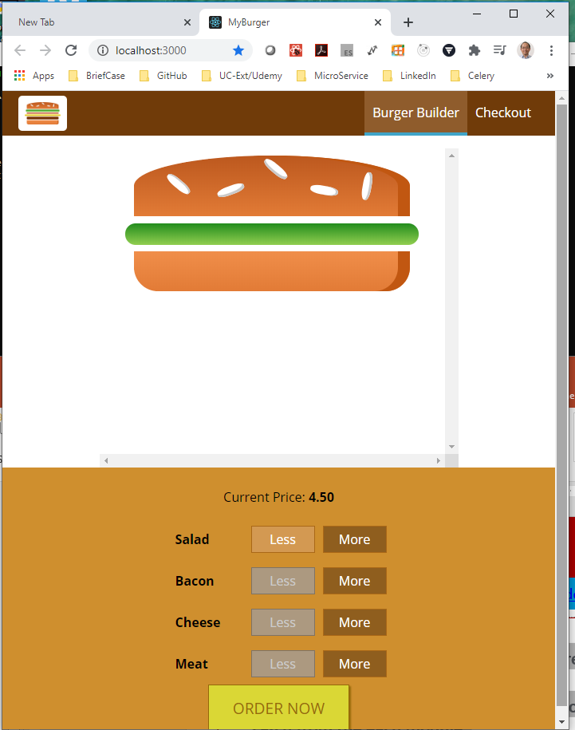
177 Introduction
https://www.udemy.com/course/react-the-complete-guide-incl-redux/learn/lecture/8138510#notes
Introduction
In the GUI project, we cannot store the data to the server.
We will implement the backend to store the order.
For the backend, we are going to use Firebase.

Slide 3
177.1 Firebase

Slide 4
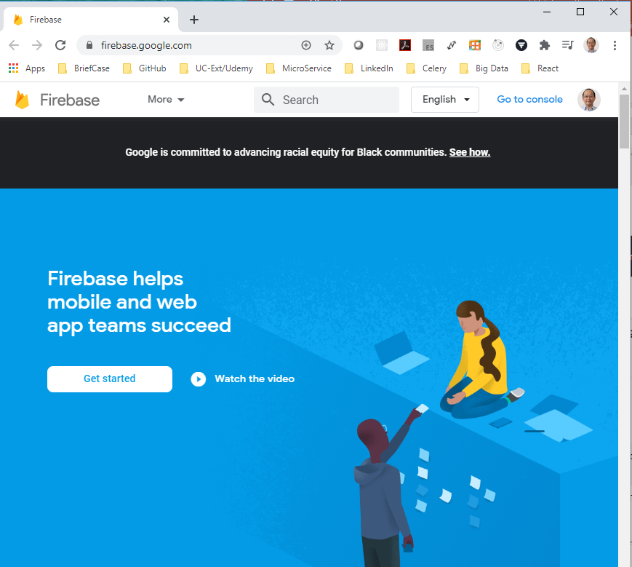
177.1 Firebase
https://www.udemy.com/course/react-the-complete-guide-incl-redux/learn/lecture/8138510#notes
Firebase is a service offered by Google.
Firebase is a out of box working backend which includes a database.
Firebase is free. We will use it for our discussion.

Slide 5
End of Chapter

